Slide 1
Steps 2 & 3
<Insert Date>
Presenter: <Insert Presenter’s Name>
<Insert Presentation Time>

Slide 2
Training Overview
Introduction
Walk Through Steps 2 & 3
Username & passwords
Team Requirements
Scheduled FET Trainings & Completion Dates for FET Step(s)
Question(s) & Answer(s)

Slide 3
Orientation Objectives
Provide an overview of Steps 2 and 3 of the Family Engagement Tool web based system for the School Improvement Team to utilize.
2. Demonstrate how the tool is used on the website.
3. Answer any questions at the end of the session.

Slide 4
Access FET:
Native Star Userid & Password (Process Manager & Principal) LIMITED ACCESS
ELO will submit request to Family Engagement Coordinator at DPA to have the “icon” turned on
Select Icon “Family Engagement Tool”
Email: valerie.todacheene@bie.edu if you have problems.

Slide 7
Walk Through the Step 2

Slide 8
Main Menu
Quality resources for the school and the team

Slide 9
The team leader completes the Enter/Edit School Information with principal. Team will review responses.
Series of questions on the various building blocks that is the current practice of the school in current Parent Involvement Practices
Shared Leadership
Goals and Roles
School-Home Communication
Education
Step 2

Slide 10
The principal completes the About Your School Form and gather needed documents for review.
Step 2
Shared Leadership - Teams, Committee & Councils at your school.
Goals and Roles – Policies, Guidelines, Classroom visits, School improvement plans
School Home Communication – communication practices to parents
Education – Training practices to staff and parents
Connection – School practices on connection with parents and communty

Slide 11
Walk Through the Step 3

Slide 12
Tools for the Team
The principal/team leader prints out worksheets for Step 3
School Parent Involvement Policy
Compact Evaluation
Homework Guidelines Evaluation
Student Report Card Evaluation
Classroom Visit Procedures Evaluation
Homeless Policy (new)
*Disregard District Parent Involvement Policy

Slide 13
Schedule Meeting
Schedule minimum of 90 minute meeting to complete Step 3 of tool with FET team
All FET team members are required to attend

Slide 14
Gather Documents & Complete Analysis
Step 3
Gather Key Documents: The team leader gathers the key documents with the principal which will be analyzed by the team.
School Parent Involvement Policy*
Compact*
Homework Guidelines
Student Report Card
Classroom Visit Procedures
Homeless/McKinney Vento Policy*
*Title I documents/McKinney Vento Requirements

Slide 15
Analyze Documents: The team leader distributes the key documents to the team, and the members will evaluate each document with the rubric provided in this step.

Slide 16
The school team scores the key documents with the rubrics
School Parent Involvement Policy*
Compact*
Homework Guidelines
Student Report Card
Classroom Visit Procedures
Homeless/McKinney Vento Policy*
*Title I documents

Slide 17
STEP 3

Slide 18
STEP 3
Use the rubric to score each of your documents. If there isn’t a document in place, you will indicate that on the web-entry form.
See the “Score Guide” for your scoring key. This will be different, depending on the document. Add the scores for each item in the policy analysis to get your “Total Score” for that document.
The McKinney Vento Rubric can be found on the BIE website or on your Native Star Dashboard. At this point it has not been integrated into FET.

Slide 19
STEP 3
Score Guide School Parent Involvement Policy :
0 = no evidence of criterion being met
1 = evidence that criterion 1 is met
2 = evidence that criteria 1 and 2 are met
Score Guide for all other documents:
0 = no evidence of criterion being met
1 = evidence that criterion 1 is met
2 = evidence that criteria 1 and 2 are met

Slide 20
Analyze Homeless Policy: (refer to PDF)
Creating an overall Goal or Statement
Creating a definition of homelessness
Stating the rights of the students and families
Distributing information on the school’s homeless policy
Creating enrollment policy and procedures
Creating and collecting student records
Maintaining and transfer of records
Providing Information for student and family
Coordinating services with BIE, prior school, liaison, and support services
Providing a liaison
Explaining rights of Student and Family to a liaison
Providing professional development on homelessness
Handling of disputes

Slide 21
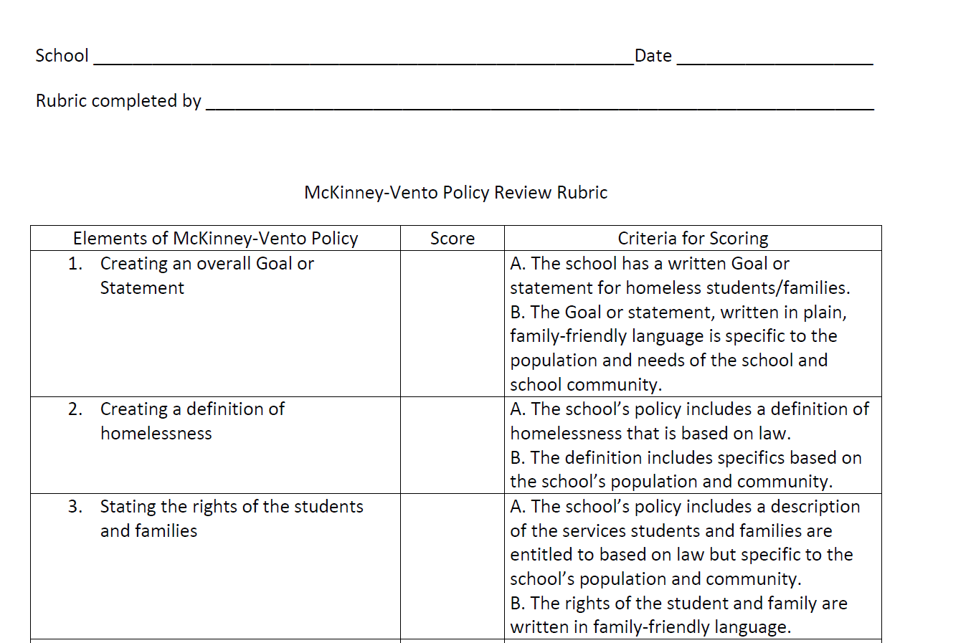
Homeless Policy Rubric: (PDF)
Uploaded to the BIE Website
Native Star “Docs & Links” tab

Slide 22
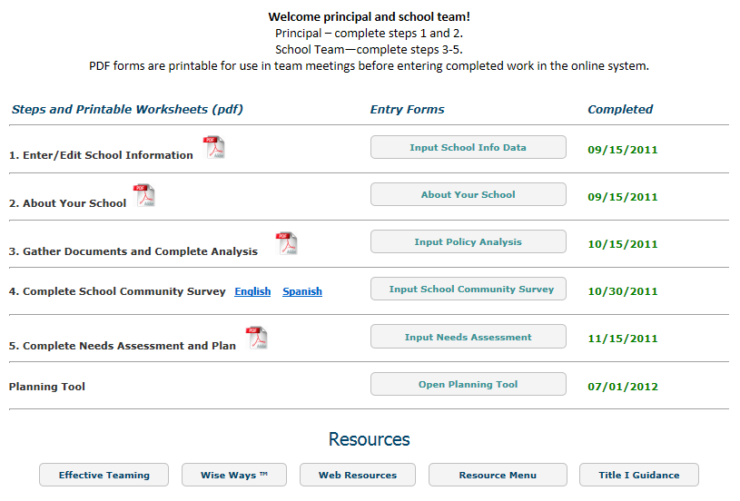
STEP 3
Once all of the key documents have been scored by the school team, click the “Input Policy Analysis” button to open the online form.

Slide 23
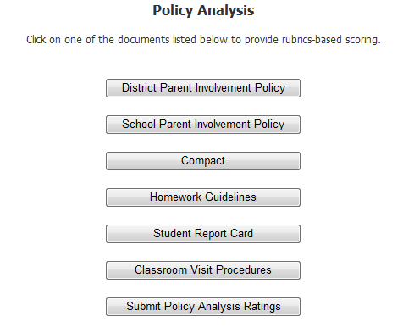
STEP 3

Slide 24
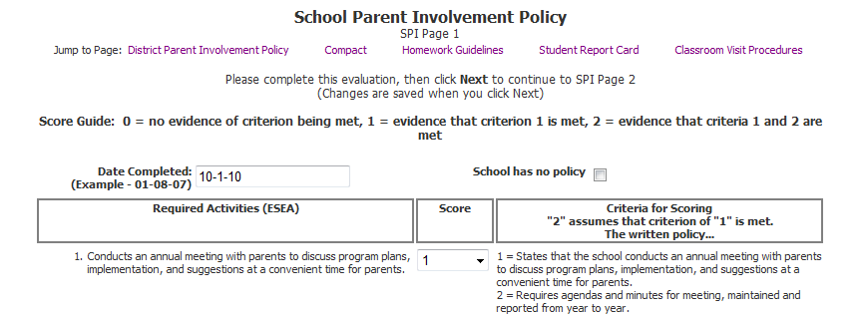
STEP 3

Slide 25
STEP 3
When you’ve entered all of the scores for a document, you may click the “Calculate Total” button to view the total score.
Don’t forget to click the “Next” button to save your data and move to the next web-entry page.

Slide 26
STEP 3
Once you’ve entered all of the document scores in the web-entry pages, either of the links shown below (at the bottom of the policy analysis web-entry pages or on the Policy Analysis main page) will take you to the page to review and submit your report.

Slide 27
STEP 3

Slide 28
STEP 3

Slide 29
STEP 3

Slide 30
STEP 3
Indicate date completed

Slide 31
STEP 3
Reminder…if you’ve previously submitted your Policy Analysis report, when you click the “Input Policy Analysis” button you will have access to your pdf report, but you will no longer have access to the entry forms. If you determine that you need to edit the data you’ve submitted, just email solidfoundation@adi.org and ask us to reopen your Policy Analysis form for you.

Slide 32
Quality resources are provided
to help schools implement their plan.

Slide 33
The School Team
The team may be an existing team (school improvement team) or a team formed especially to conduct the analysis.
A typical team should include the principal, school staff, and parents.
A least half of the members of the team should be parents of currently enrolled students and not employed by the school or district.

Slide 34
Trainings for FET Steps 1-5
<Enter Date> Step 1
<Enter Date> Steps 2 & 3
<Enter Date> Step 4
<Enter Date> Step 5
<Enter Date> Debriefing

Slide 35
Completion of FET Steps 1-5
<Enter Date>, Complete Step 1
<Enter Date>, Complete Steps 2 & 3
<Enter Date>, Complete Step 4
<Enter Date>, Complete Step 5

Slide 36
We can help you to build strong school communities
within the schools you serve.
Presenter’s Name
Title
Email
Phone Number

