Slide 1
NDMile to Native Star
Technical Assistance webinar
SEP-dpa-4/27/2018 & 5/9/2018

Slide 2

Why Native star?
Native Star is a planning tool that supports the school’s work to develop, implement and evaluate their school improvement plan.

Slide 3

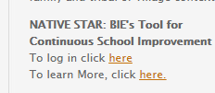
How to access Native STar

Slide 4

How to access Native STar
Enter Login & Password

Slide 5
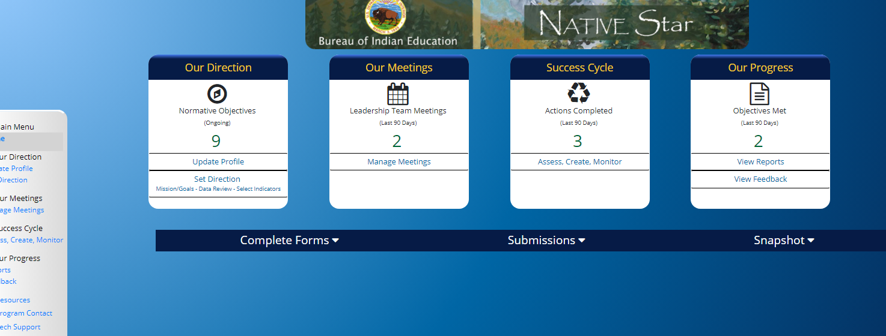
Native Star Dashboard

Slide 6
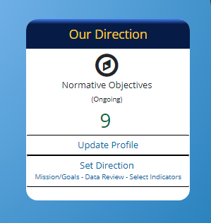
Our direction: Update Profile

Slide 7
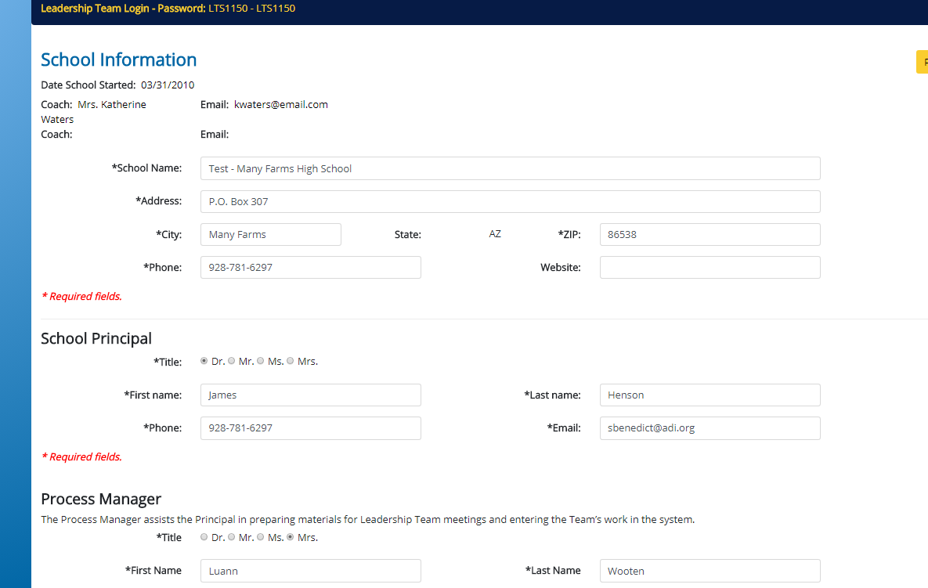
Our direction: Update Profile
1.

Slide 8
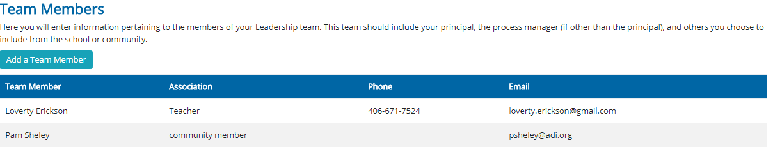
Our direction: Update Profile
  Team Members:
  Team Members could include the administrator(s), the Leadership Team, the business technician(s), business manager, other school leaders and community stakeholders, like parents.

Slide 9

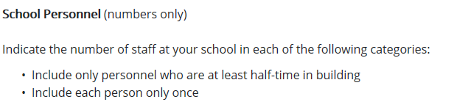
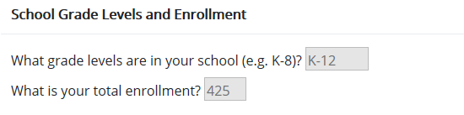
Our direction: Update Profile
  School Demographics- Student and school personnel: demographics

Slide 10
Our direction: set direction

Slide 11
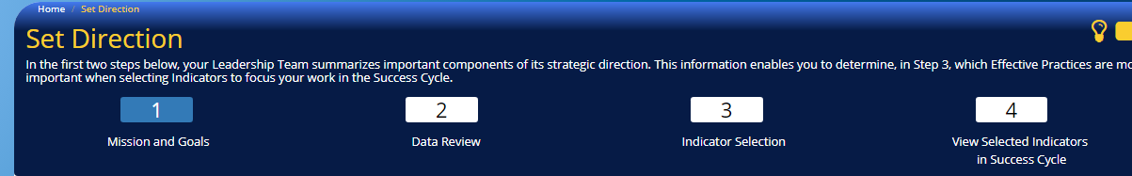
Our direction: set direction
4 components in Set Direction:

Slide 12
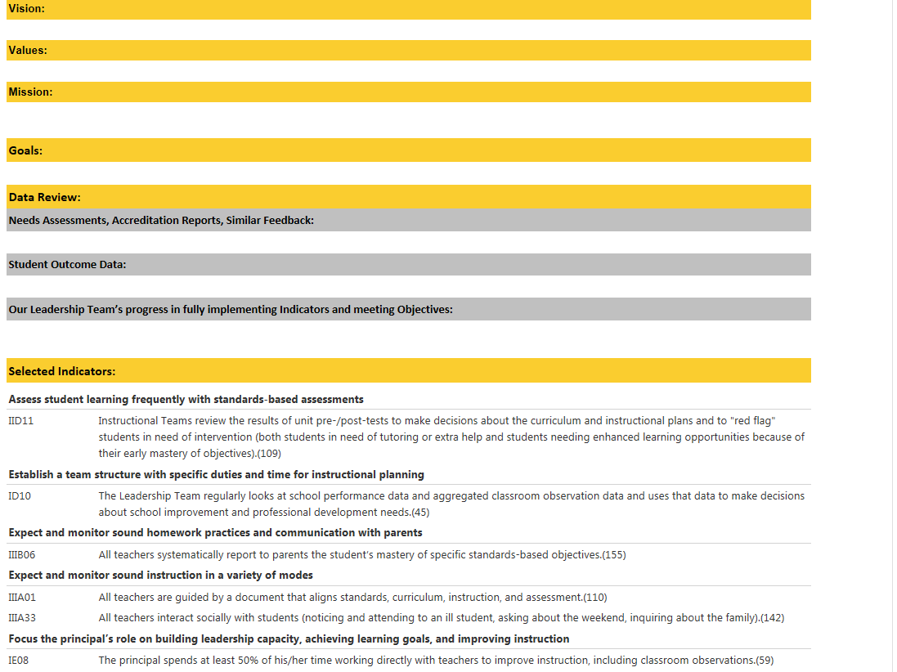
Our direction: set direction
2. Set Direction:
Review school Mission/ Goals (Required by 25 CFR)
  The Data Review drives what Indicators will be selected.

Slide 13
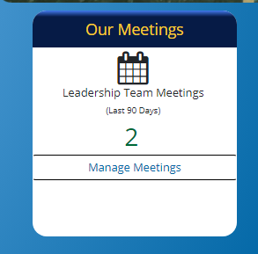
Our meetings

Slide 14
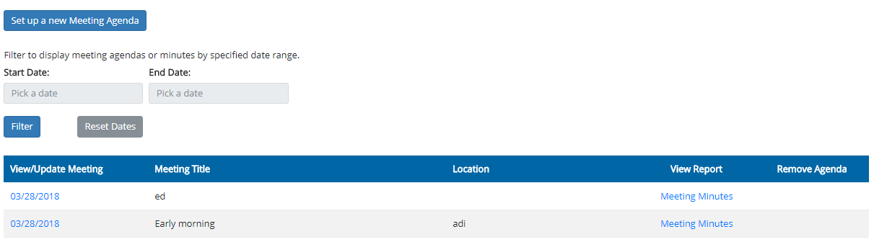
Our meetings: Manage Meetings
Documenting your Leadership Team Meetings:
This space helps you manage your meetings and the documentation is all in one place.

Slide 15
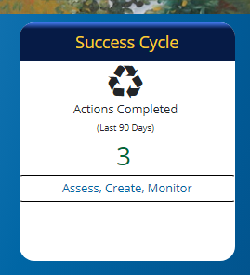
Success cycle: assess, create, monitor

Slide 16
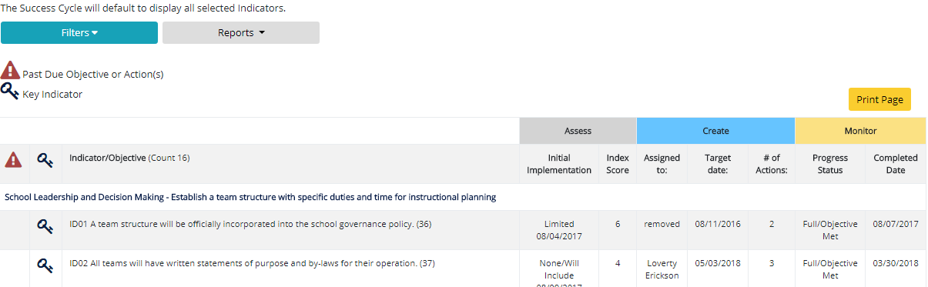
Success cycle: assess, create, monitor
Success Cycle: Access, create and monitor
  Select the Indicators that align with the SMART Goals you will be working on. Be sure to include them in your Schoolwide Program Plan. The Indicators of Effective Practices are imbedded into the Schoolwide Program to guide in the process to improve student outcomes.

Slide 17
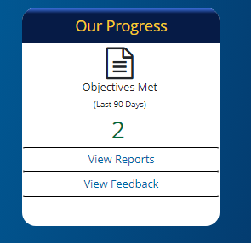
Our progress: View Reports & View feedback

Slide 18
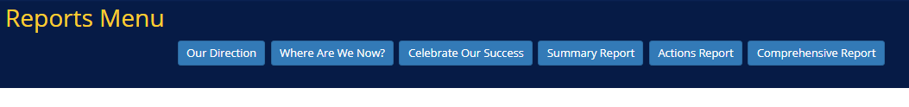
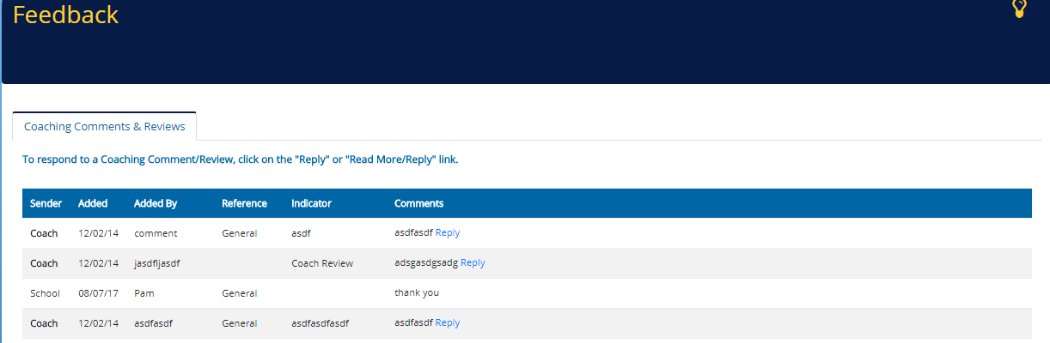
Our progess: View Reports & View feedback
5. Our Progress:
View Reports and View Feedback

Slide 19

Native Star Resources

Slide 20
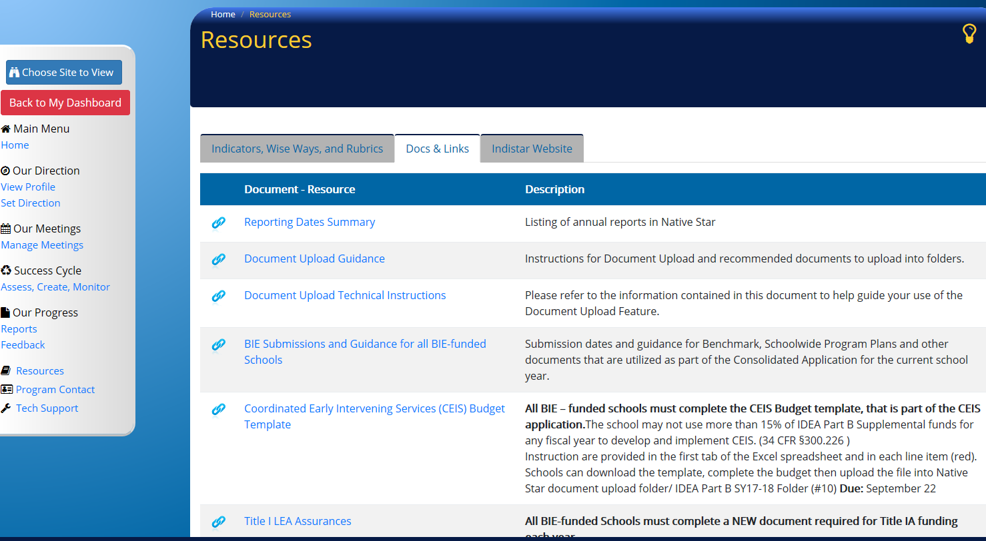
Native Star Resources

Slide 21
ALL BIE-Funded Schools Operate Schoolwide Programs
The schoolwide program consists of:
  The Base Program (ISEP) activities which is coordinated with all supplemental program activities. The Base program is funded with ISEP formula funds.
  The 15% Special Education Set-aside.
  Additional programs funded through the Department of the Interior (DOI) Education Enhancements.
  The ISEP supplemental funding for Gifted and Talented and Language Development ELL/NLL.
  The supplemental programs funded through the Department of Education (ED) include the Elementary and Secondary Education Act (ESSA) programs and the Individuals with Disabilities Education Act (IDEA) programs.

Slide 22
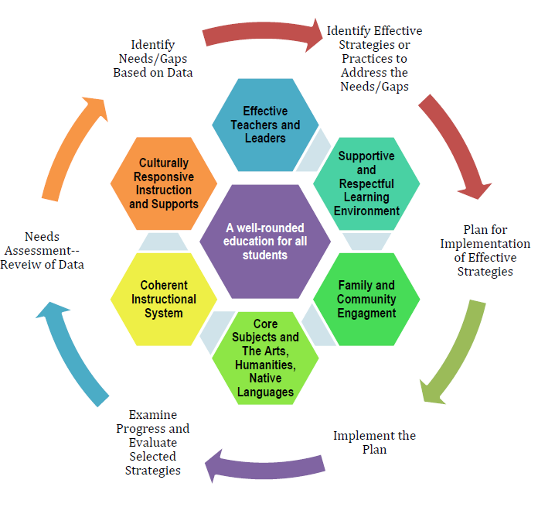
Example of School Process

Slide 23
Organizing a Schoolwide program Plan for school improvement
Planning and Budget Development

Slide 24
Organizing a Plan for School Improvement
Identify Gaps/Needs through the Comprehensive Needs Assessment (CNA)
Develop SMART Goals in to Address the Identified Needs/Gaps
The Schoolwide Program Plan in NS helps Organize and Summarize LEA Schoolwide Improvement Strategies to address the SMART Goals
Develop the Schoolwide Budget to Support the Schoolwide Improvement Strategies and Provide Clear, Succinct Justification
Indicators of Effective Practice Progress and Evaluation

Slide 25
The Local Education Agency (LEA)
School Plan [ESSA Section 1112(a) & (b)]
Needs Assessment and SMART Goals [ESSA Section 1008(b)]
Benchmark Reporting Period [ESSSA Section 1008(b)(7)(A)(ii)]
Title I Schoolwide Plan Report [ESSA Section 1008(b)]
Notes:
Rather than create a separate application, we used the reports in NS to develop an application.
It would have been duplicative since the information in Native Star Reports would be the same as for a separate application.

Slide 26
The Schoolwide Budget
The initial Schoolwide Budget submission should:
  Demonstrate allowable financial support of all activities described in the LEA Plan including specific schoolwide initiatives that address ESSA Title I, Part A Section 1114
  Include school improvement activities that address ESSA Title I, Part A Section 1116
  Align to the Needs Assessment/SMART Goals & Schoolwide Program Plan
  The SY 17-18 Schoolwide Budget Template can be downloaded from the Docs & Links tab.
Notes:
Again, the LEA Plan is actually:
the SMART Goals,
the Schoolwide Supplemental Report,
the appropriate School Improvement Supplemental Report,
and the indicators of effective practice.

Slide 27
LEA Assurances
The LEA Assurances and the Schoolwide Budget should be presented to the School Board at the same time to better inform the board.
The signed assurances verify that that the funds will be expended as budgeted for the intent of the program.
Upload the signed Title I LEA Assurances document into the Schoolwide Budget and Assurances folder in Native Star
LEA/School should notify the ERC if the Title I LEA Assurances will be uploaded after May 31st due to school board scheduling
Download the LEA Assurances document from the link under the Docs & Links tab
Notes:
LEA/School agrees to the assurances and ensures the School Board is aware that the assurance are directly related to the items in the schoolwide budget

Slide 28
Coordinating Funds to Support the Schoolwide Program Plan
ISEP Funds: The Base Academic Program
•15% ISEP Set-Aside for the Base Special Education Program
•Base ELL/NLL Program(s)
•Base G&T Program
Supplemental Program Funds
ESSA
•Title I-A
•Title II-A
IDEA
Part B Program Funds
Other Interior Funds: IT, Transportation, Facilities, Enhancement, etc.
(4) ESSA Discretionary Funds
•Title IV-B: 21st CCLC
•Title IX: MV Homeless

Slide 29
Key Programs That Provide Funds to BIE Schools
Indian School Equalization Act (ISEP) Program
ISEP Supplemental Gifted and Talented
ISEP Supplemental Language Development (ELL/NLL)
ESEA/ESSA Title I, II, IV, V, VI, & IX
IDEA Part B, CEIS,
IT, Facilities Maintenance and Operations, etc.
ISEP Special Education 15% Set Aside
Notes:
All programs should be coordinated in a schoolwide effort to provide students with quality instruction and services that lead to increased student achievement in order to meet the mission of the BIE

Slide 30
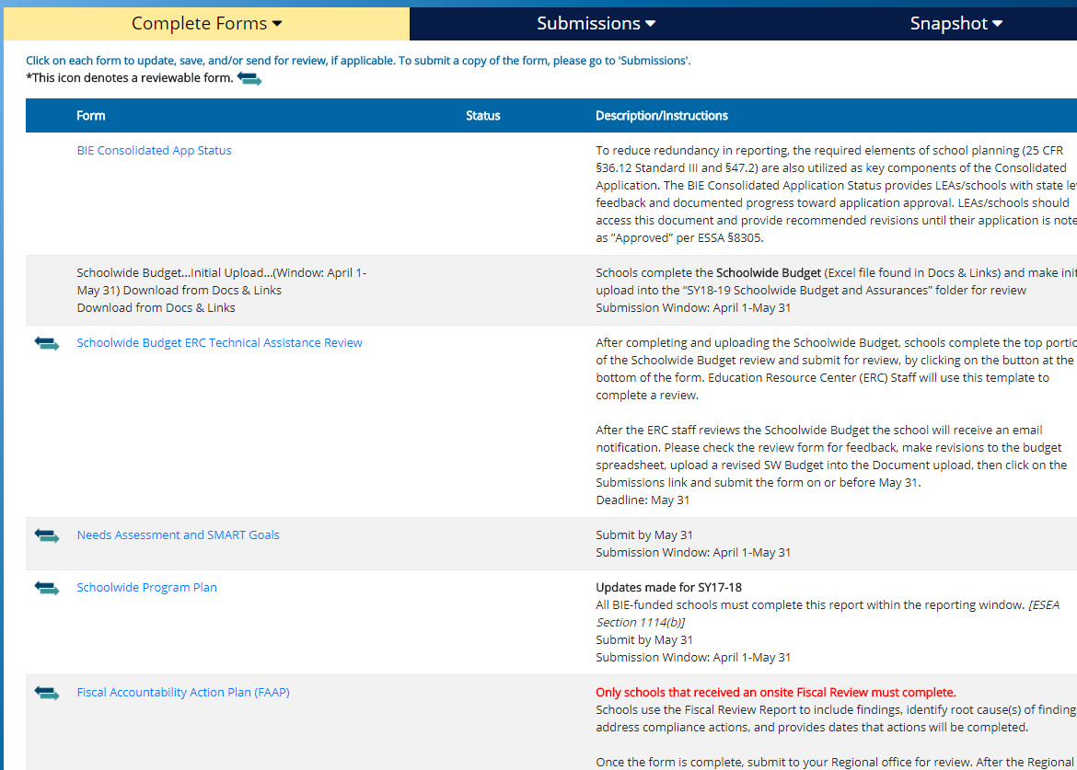
Complete forms

Slide 31
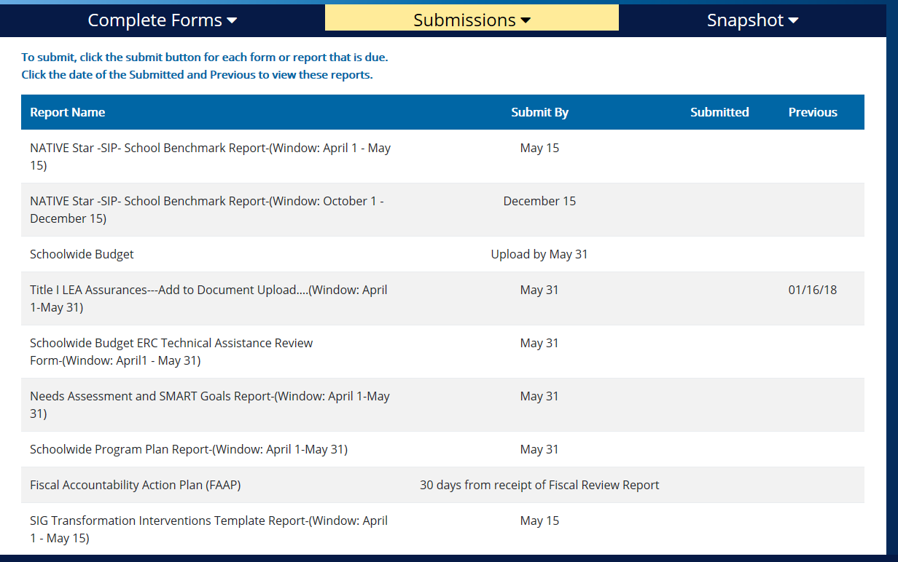
Submitted forms

Slide 32

Native Star Document Upload

Slide 33
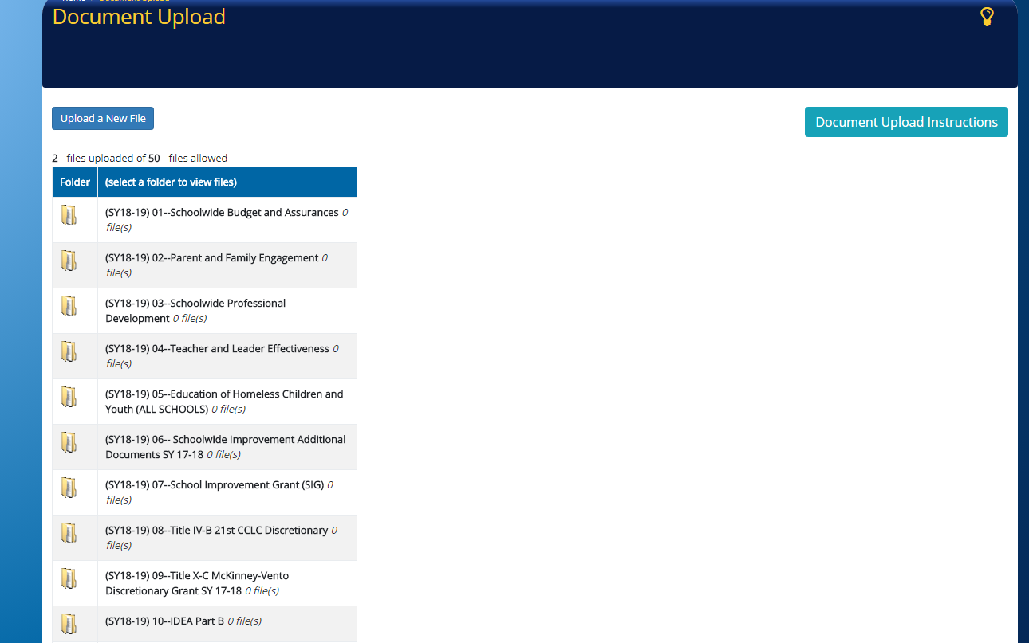
Native Star Document Upload

Slide 34
Education Program Specialists
Division of Performance and Accountability
(ESSA Programs)
Albuquerque and Nashville ERCs (Tribally Controlled)
VACANT POSITION
Albuquerque ERC (Bureau Operated)
North Dakota (Tribally Controlled)
Valerie Todacheene
505-563-5269
valerie.todacheene@bie.edu
Seattle and Minneapolis ERCs
(Tribally Controlled)
Margo DeLaune
206-220-7978
margo.delaune@bie.edu
Phoenix ERC (Bureau Operated)
South Dakota (Tribally Controlled)
Jacqueline Wade
602-265-1592
jacqueline.wade@bie.edu
GayeLeia King, Supervisory Education Specialist
202-208-2535
gayeleia.king@bie.edu

Slide 35
Education Program Specialists
Division of Performance and Accountability
(ESSA Programs)
Crownpoint and Window Rock ERCs
Cheryl Quimayousie
505-786-6144
cheryl.quimayouise@bie.edu
Chinle and Window Rock ERCs
Marie Silverhatband
938-674-5137
marie.silverhatband@bie.edu
Shiprock ERC
Eleanor Jones
505-368-3403/3400
eleanor.jones@bie.edu
Tuba City ERC
Andrea Bia
928-283-2308
andrea.bia@bie.edu
GayeLeia King, Supervisory Education Specialist
202-208-2535
gayeleia.king@bie.edu

