Slide 1
Notes:
11:05

Slide 2
OPENING SESSION – DAY 2
Learning Loss: A focus on the impact on a student’s academic progress and social growth.
Notes:
11:05

Slide 3
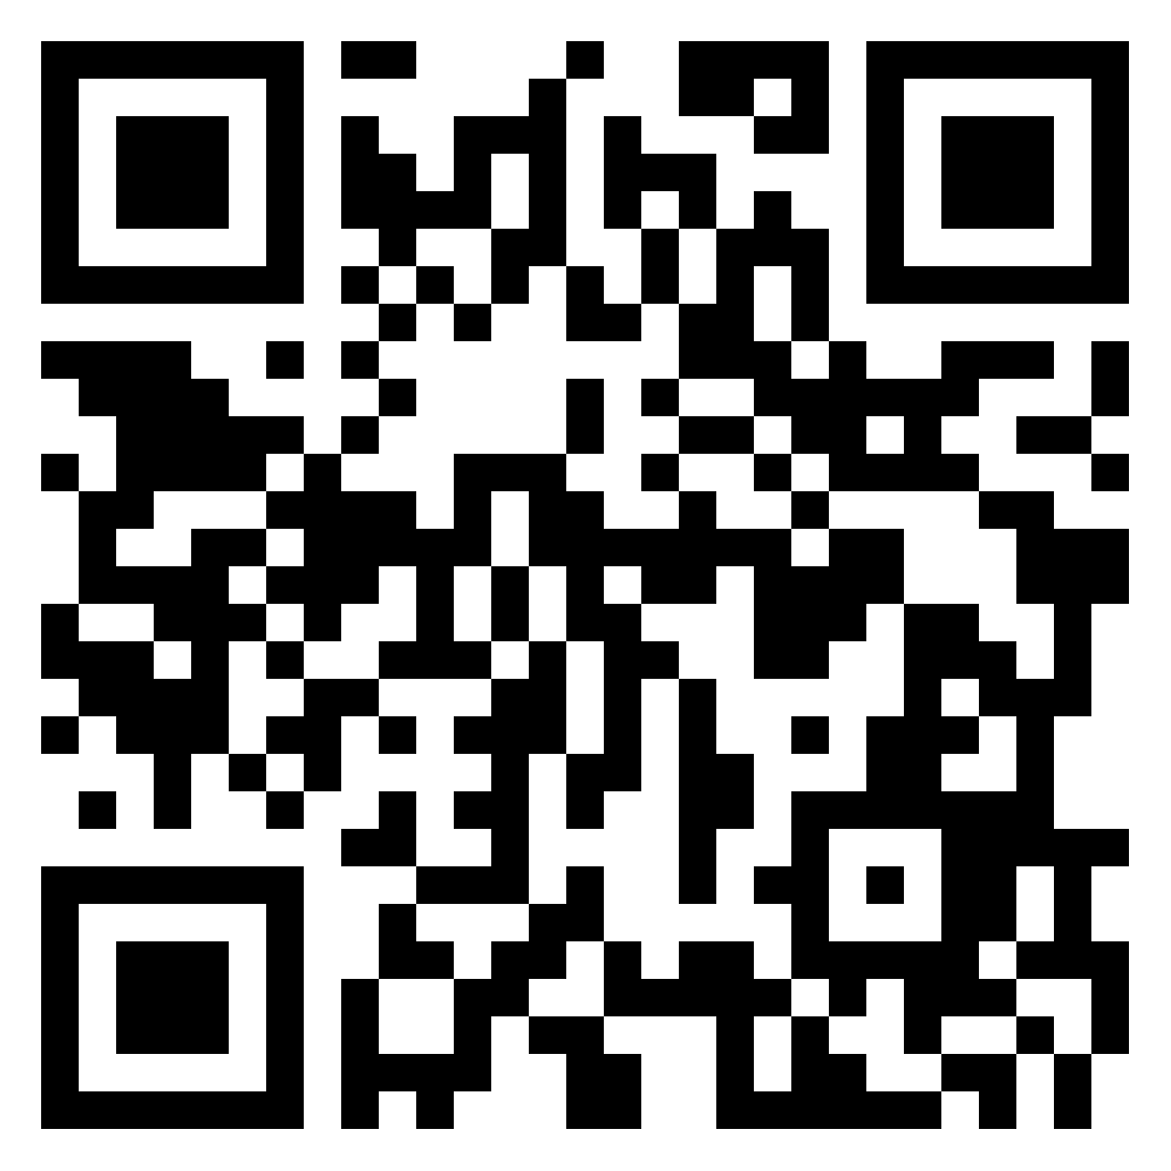


Padlet

Slide 4
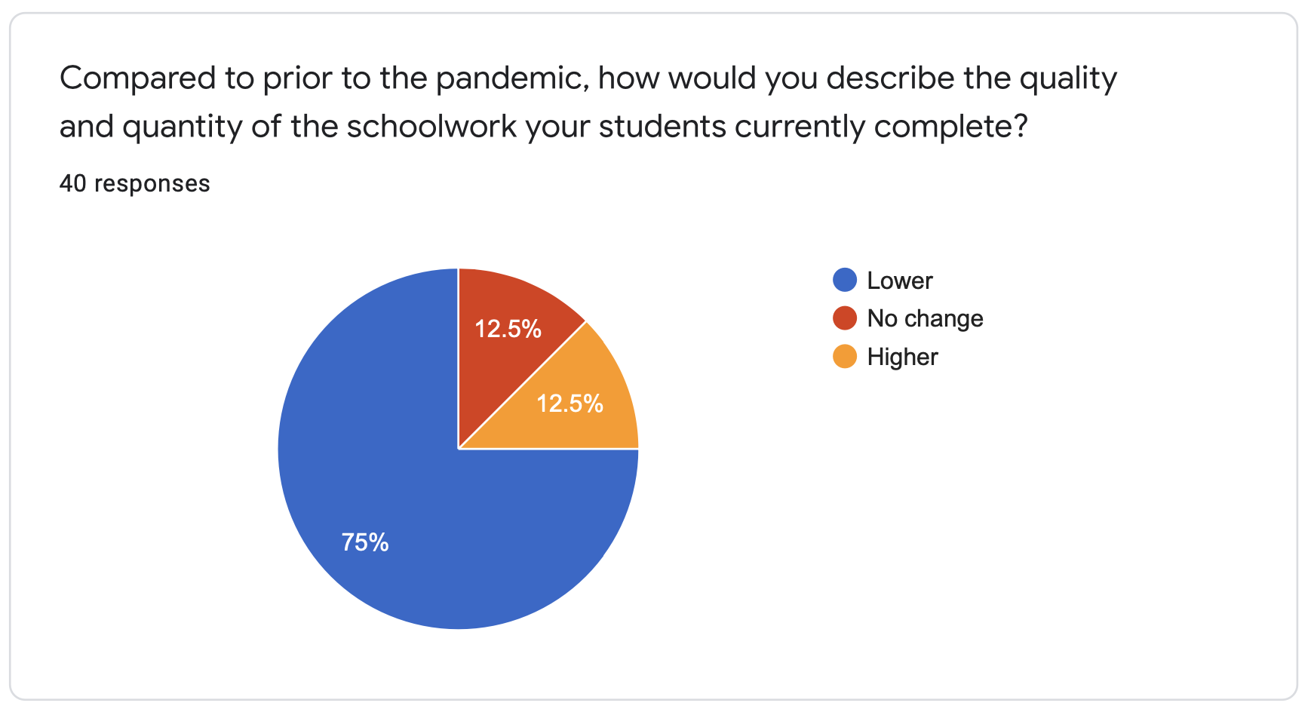
BIE PLA Session data March 2022
Notes:
11:12

Slide 5
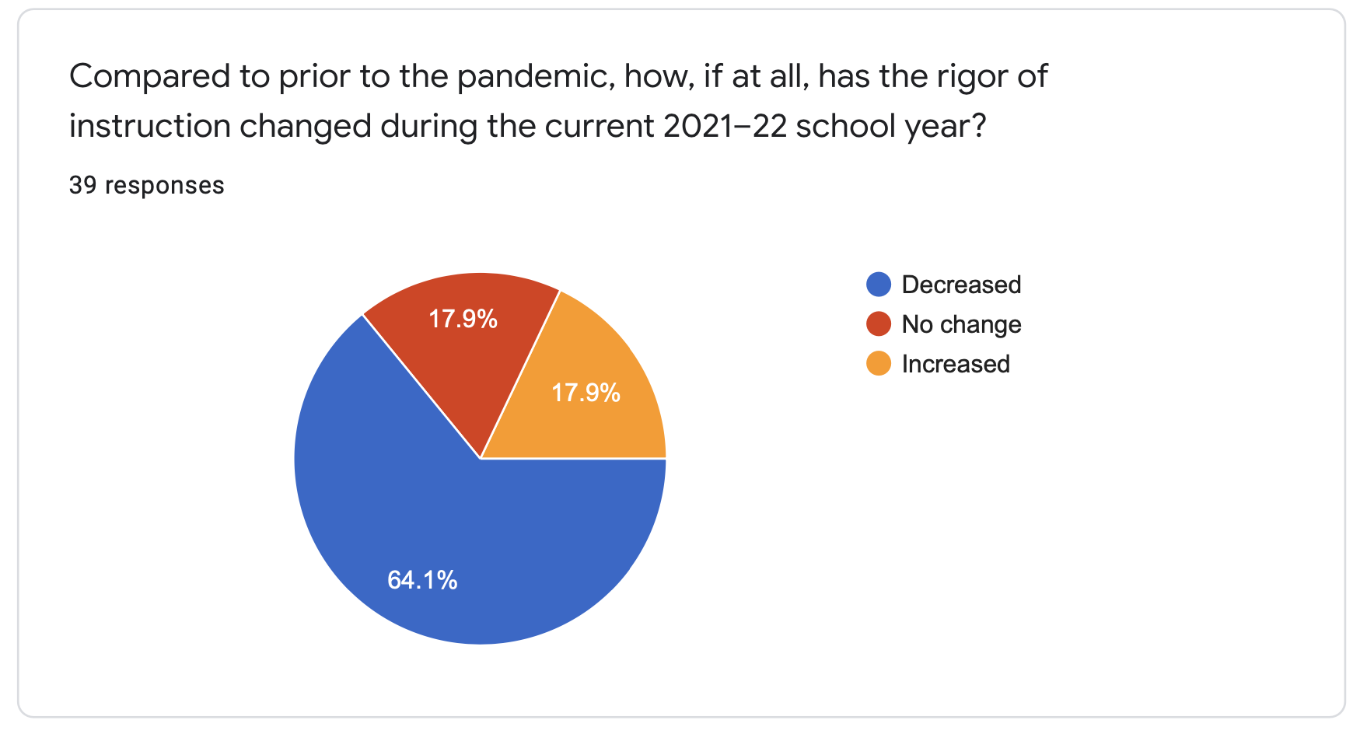
BIE PLA Session data March 2022
Notes:
11:12

Slide 6
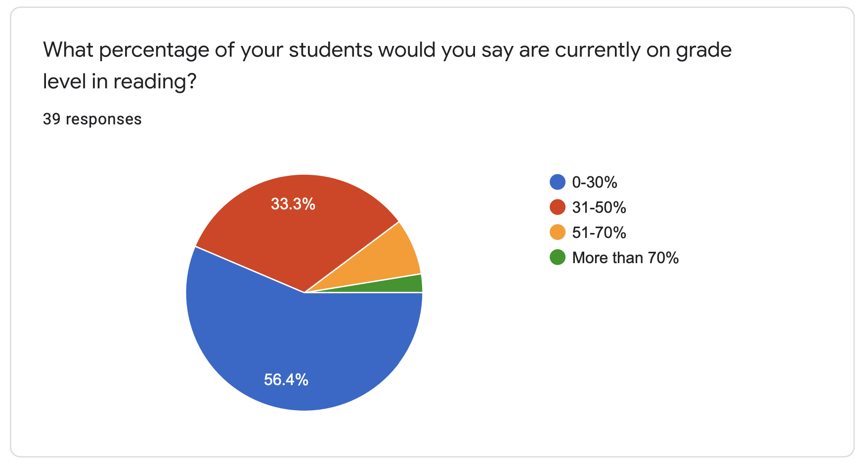
BIE PLA Session data March 2022
Notes:
11:12

Slide 7
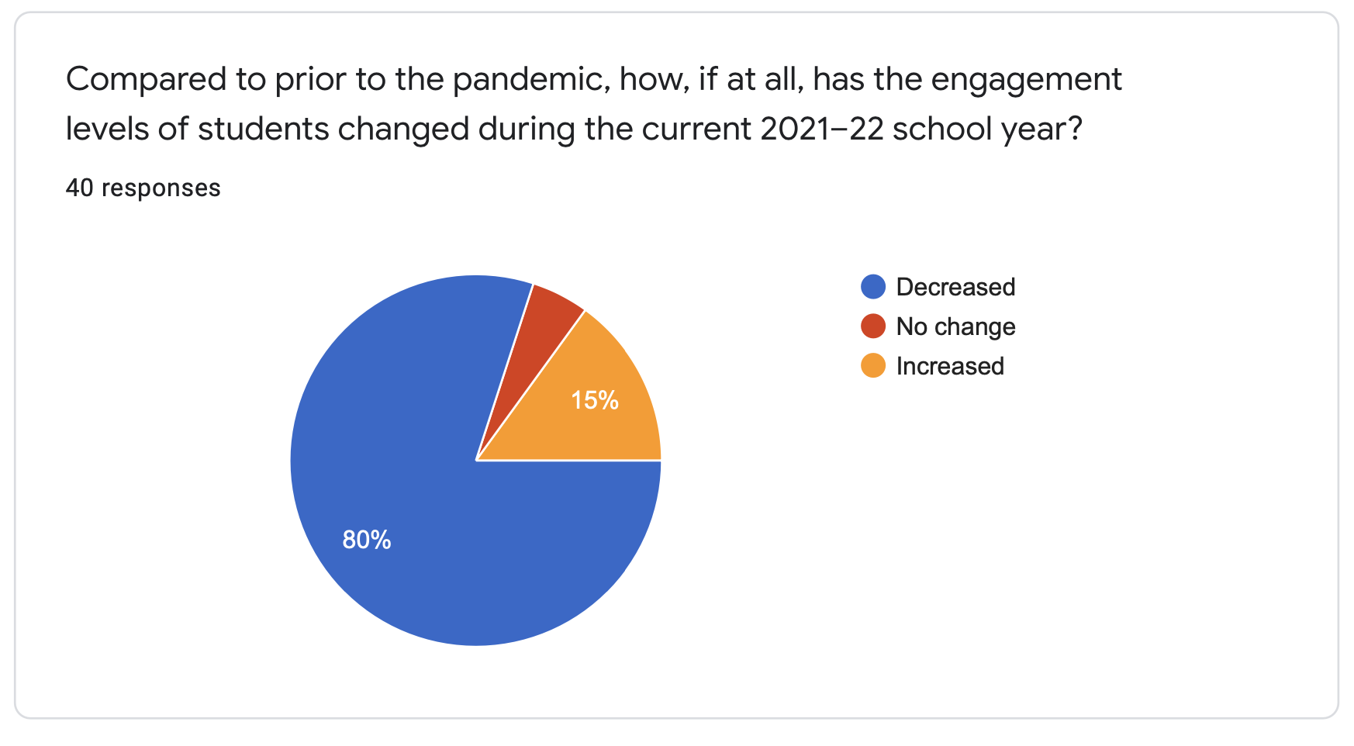
BIE PLA Session data March 2022
Notes:
11:12

Slide 8
A recent study found that teacher strikes in Argentina had a negative impact on the incomes of students, now in their 30's, who had lost 80 to 90 days of school as children. Those deficits extended to the children of those students, presenting a generational impact. That research also suggested that lost learning in early grades had the biggest impact.
Source: Jaume & Willén, 2017

Slide 9
Students came back on average more than two years below grade level, some much more. Losses were most dramatic in mathematics. The degree of learning loss couldn't be predicted by family income, prior school, student age, or pre-Katrina grade level.
Source: Paul Hill April 2020

Slide 10
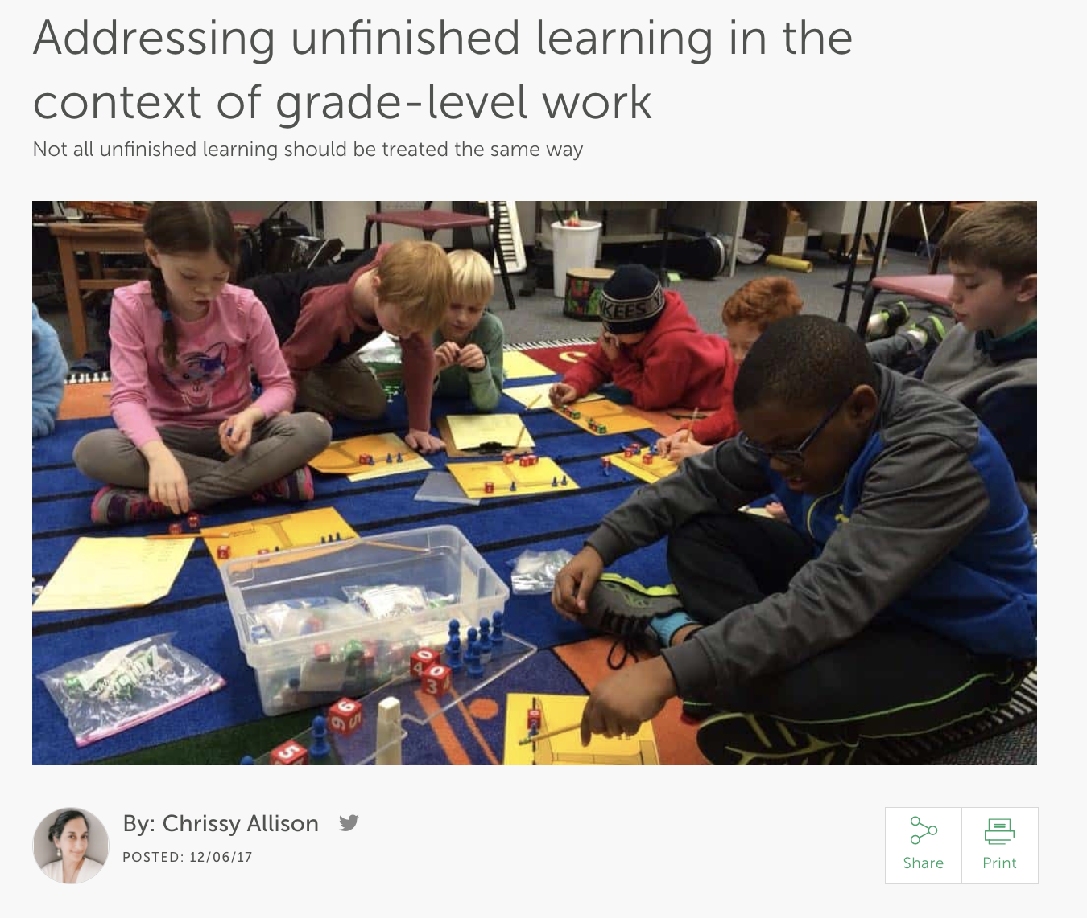
Unfinished learning refers to any prerequisite knowledge or skills that students need for future work that they don’t have yet.
Source: Chrissy Allison, Achieve The Core Blog, 2017

Slide 11

There is no one program or solution to catching kids up who are several years behind. Instead, it takes deep content knowledge, increased time, and strategic planning to meet students where they are and accelerate their path forward.
Source: Chrissy Allison, Achieve The Core Blog , 2017

Slide 12





Ever heard this?
“My class is too far behind for grade level work”
“My students can’t do that”
“That’s too rigorous for my students”
“My students are below grade level””
“My students give up too easily”
“My students don’t know their basic facts”
Notes:
11:12

Slide 13
When you're teaching students with unfinished learning it is very common to have thoughts that are along the lines of deficit thinking.
Notes:
11:12

Slide 14
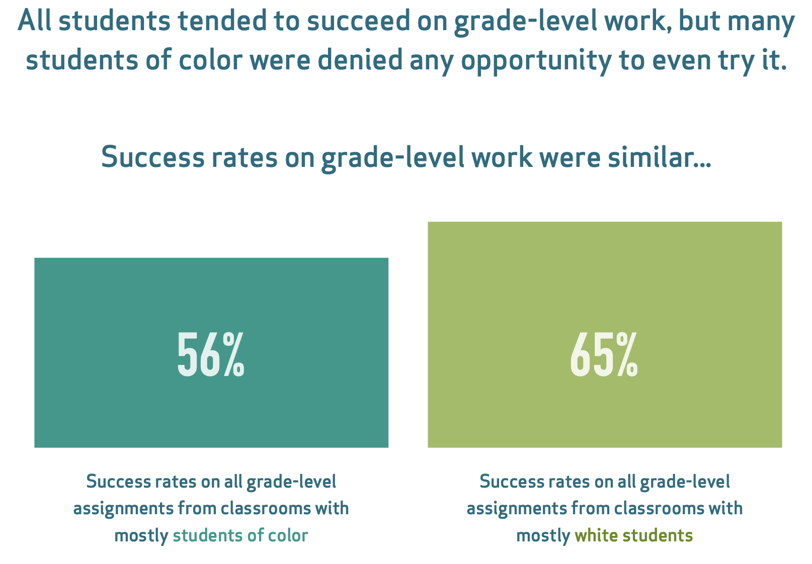
Source: TNTP’s The Opportunity Myth, 2018
Notes:
11:12

Slide 15
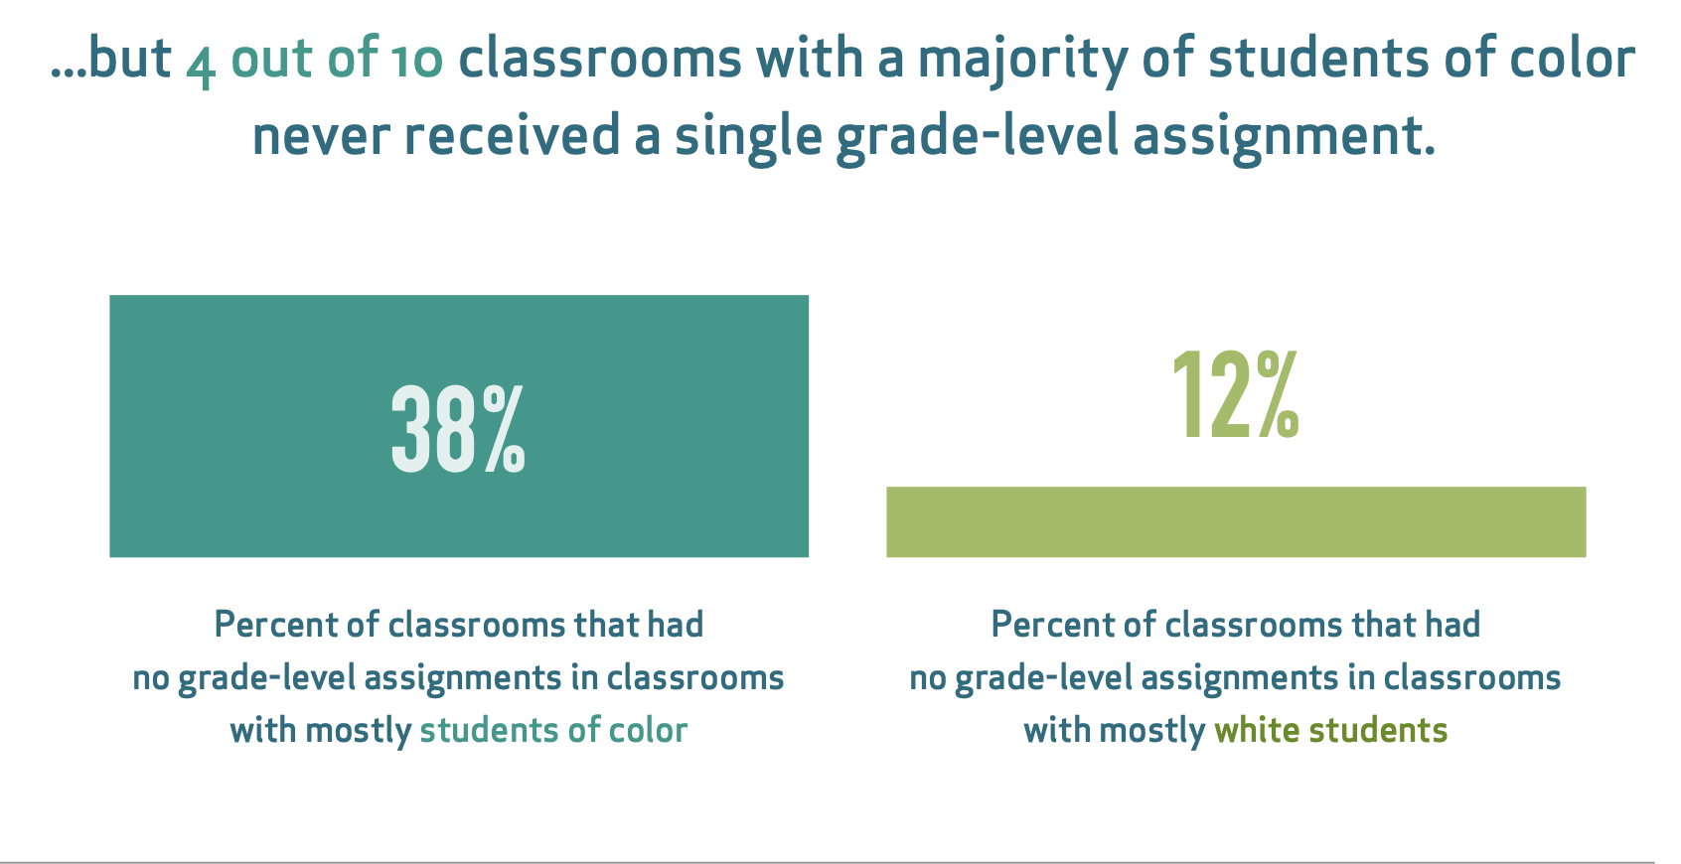
Source: TNTP’s The Opportunity Myth, 2018
Notes:
11:12

Slide 16
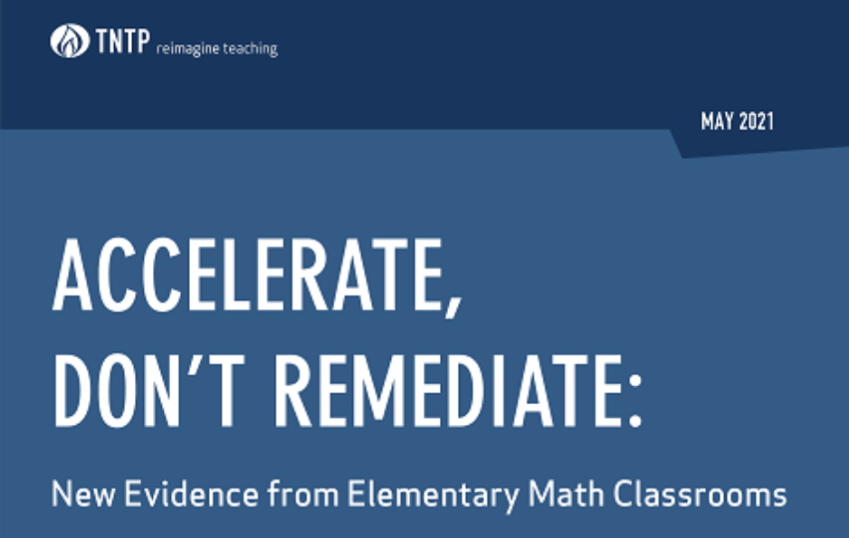
Evidence on acceleration vs. remediation
“Put simply, this data provides strong evidence that learning acceleration works, and that it could be key to unwinding generations-old academic inequities, the COVID-19 pandemic, has only exacerbated.”
Source: Accelerate, Don’t Remediate, 2021

Slide 17
Remediation is a common approach
Remediation = assigning work better suited for earlier grades
For example, at the beginning of third grade, a teacher would review all second-grade content the student missed before moving on to third-grade level work
It’s an intuitive strategy, and one that many teachers have been told to use throughout their careers.
However, our own pre-pandemic research showed that is can actually hurt students and compound unfinished learning
Source: Accelerate, Don’t Remediate, 2021

Slide 18
Learning acceleration is a better alternative
Acceleration = starting with grade level work and providing “just in time teaching” as necessary.
For example, the fourth-grade teacher starts with fourth-grade content, and strategically builds in key third-grade concepts when students might need them to master the grade-level content.
This ‘just-in-time” teaching ensures students spend more time on the work of their grade – the key to ultimately catching up
Source: Accelerate, Don’t Remediate, 2021

Slide 19
How do you increase access for your students with unfinished learning?
Notes:
11:12

Slide 20
What is access?
Consistent opportunities to engage in grade level content.
Ensure students have an entry point into the grade level task.
Notes:
11:12

Slide 21



Provide an accessibility bridge
Notes:
11:12

Slide 22
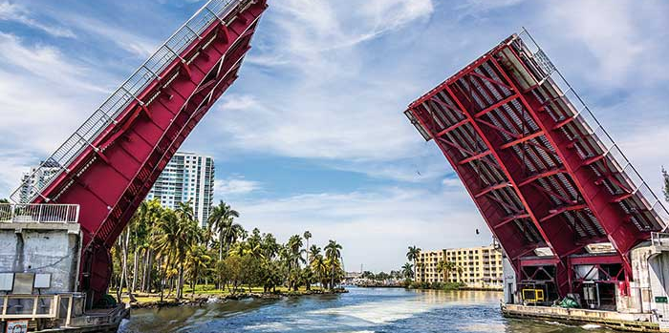
Yes? Provide just-in-time support
Source: Chrissy Allison, Achieve The Core Blog, 2017
Notes:
11:12

Slide 23

No? Create a “bridge” to increase access to the daily, grade-level lessons
Source: Chrissy Allison, Achieve The Core Blog, 2017
Notes:
11:12

Slide 24
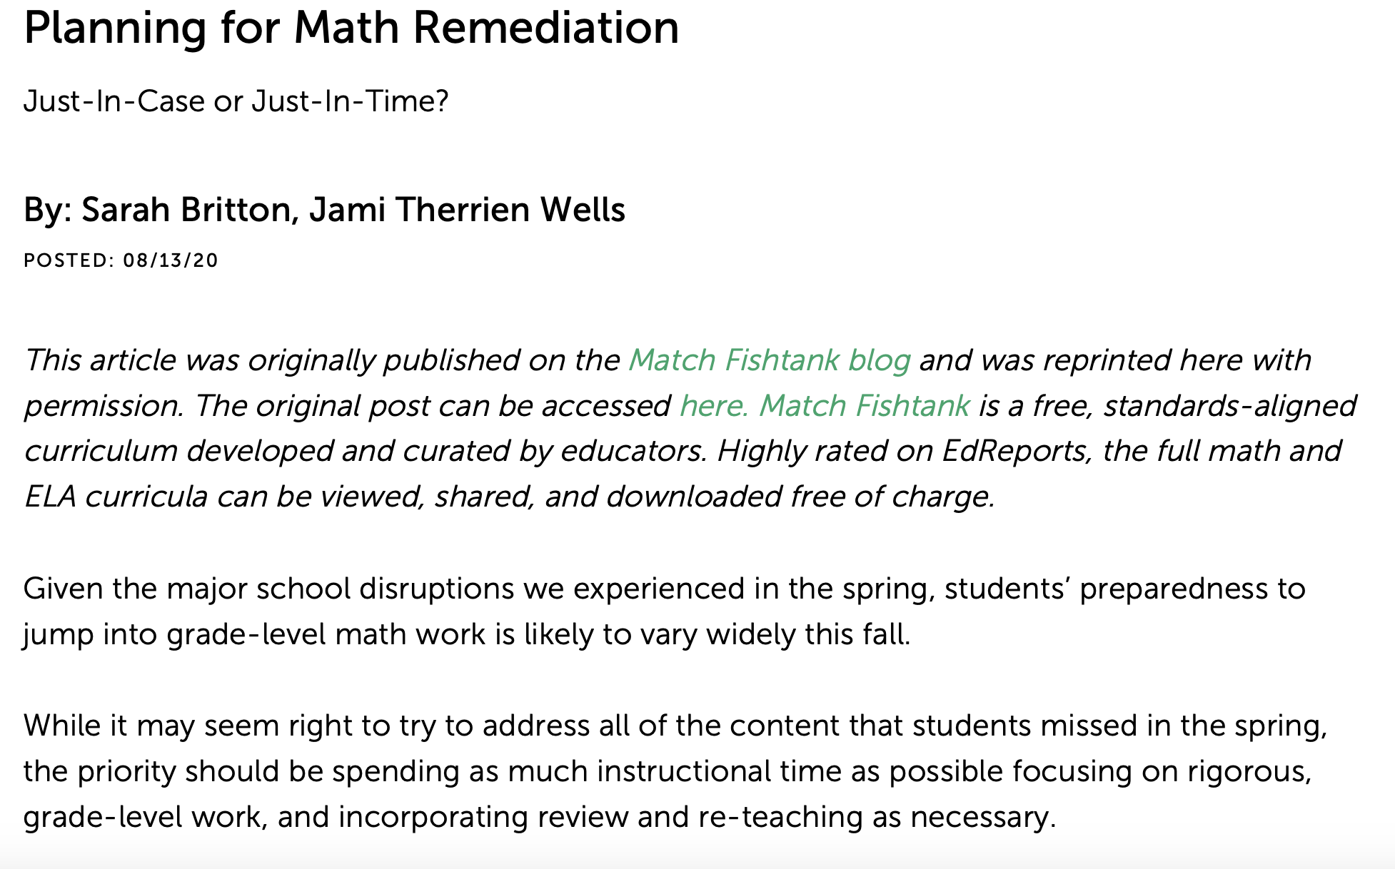
Just-In-Case vs. Just-In-Time
Source: Planning for Math Remediation: Achieve the Core 2021
Just-In-Case
Review
Unit 1
Unit 2
Unit 3
Just-In-Time
R
Unit 1
R
Unit 2
R
Unit 3

Slide 25
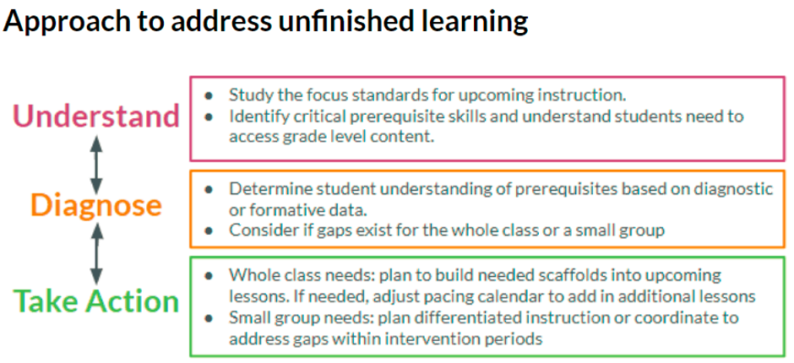
Source: Chrissy Allison, Achieve The Core Blog, 2017

Slide 26
Accelerating Unfinished Learning Unit 1
Accelerating Unfinished Learning Unit 1
Priority Instructional Content: 3.OA.D.8 (Addition and Subtraction)
Understand What are the critical prerequisite knowledge and skills students need to access the grade level content? | Diagnose What do your students currently know and understand? | Take Action What just in time interventions will support students in engaging with grade-level content?
 |  | Actions to select from, if necessary What does assessment and observation tell me students need in order to access the unit’s content? | Student & Teacher supports
2.OA.A.1 Use + and - within 100 to solve one-and two-step word problems involving . . . | 3rd grade NCBL Item 6a-b | Bridges Intervention Volume 4, Modules 7-9, selected activities | Student scaffolds: Word Problem Graphic Organizers change part-part-whole compare multi-step

Slide 27
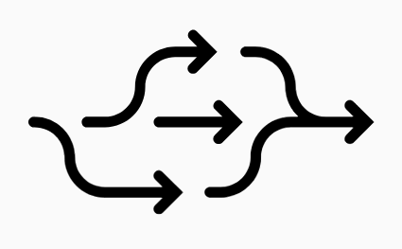



Principles for Instructional Design
Instruction and resources are designed to be flexibly implemented
Unfinished learning is addressed in “just in time” supports
Focus on high priority content
Cut low priority content
Moving forward with rigorous grade level content
Move forward with rigorous grade level content
Focus teaching and learning on high priority content and cut lowest priority topics
Unfinished learning will be addressed through “just in time” support, as it relates to essential learning goals, rather than reteaching or remediating previous grade level content
Instruction and resources will be designed so that they can be flexibly implemented in a variety of contexts (face-to-face, distance learning, blended hybrids, etc.)
Source: San Diego UFSD Enhanced Mathmatics

Slide 28
Ways to Address Unfinished Learning
IDENTIFY & PRIORITIZE the most critical prerequisite skills that prevent access to grade level content
STRENGTHEN & EMBED prerequisites students need for upcoming instruction
PROVIDE additional support with grade-level content

Slide 29
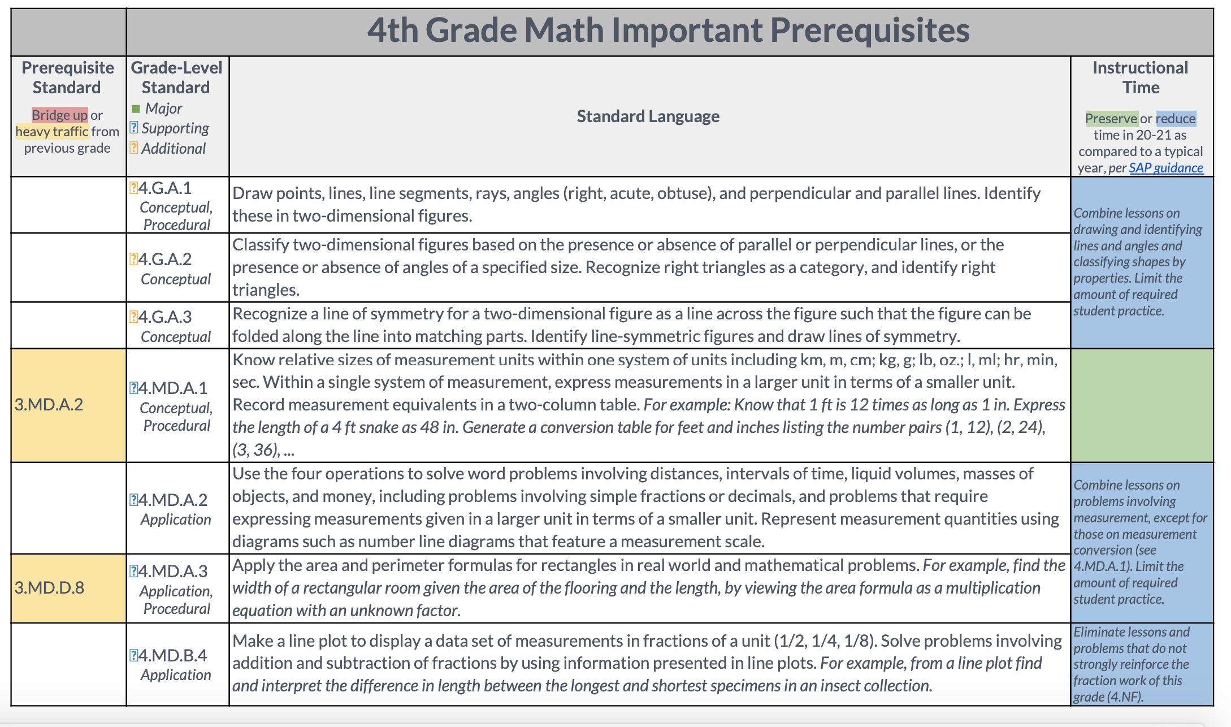
IDENTIFY critical prerequisites

Slide 30
PRIORITIZE critical prerequisites
Critical prerequisite = a skill or understanding that is necessary for students to be able to engage with the on-grade level lesson, task, or problem in a meaningful way. (ie. Is the bridge truly 'up’?)
Think: "What knowledge and skills do students need to be able to ENTER the task?" rather than, "What are ALL of the things students need to COMPLETE the problem independently with 100% accuracy?"

Slide 31
STRENGTHEN & EMBED critical prerequisites
Embed Prerequisites – weave prerequisite skills and understandings into Bellwork / Do Now; focus on content students will need in the upcoming unit / standard; ensure students have a high success rate.
Small Group Support – identify students with unfinished learning on prerequisite content; use small group or intervention time to teach mini-lessons on these skills / concepts

Slide 32
PROVIDE support
Create flexible groups that change based on student needs. Use both homogeneous and heterogeneous groupings in your class.
Respond to data in real-time. For example, use yesterday's exit tickets to form a small group for today, or allow students to opt into a 'support group' during independent practice.
Focus on the most essential content such as critical prerequisites from the current or previous grades and skills/understandings students need more support with in the current unit.
Align instructional activities to the rigor of the standard. Ensure students have the opportunity to build conceptual understanding and engage in problem solving when the standard(s) call for it.

Slide 33
Instructional Routines to Increase Access
Notice & Wonder
engage students in this instructional routine before diving into difficult problems
What is it?
Put a problem, task, or image on the board.
Ask students to think of something they notice and something they wonder.
Share as a class or in pairs.
When to use it?
At the beginning of a lesson to spark engagement, activate prior knowledge, and create an on-ramp to the grade-level lesson content.
If you put a problem on the board and students give you the 'deer in headlights' look, ask them what they Notice & Wonder -- don't rescue them!

Slide 34
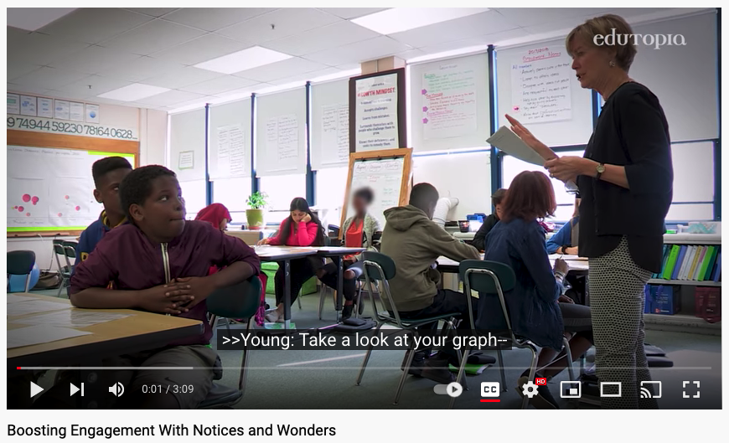
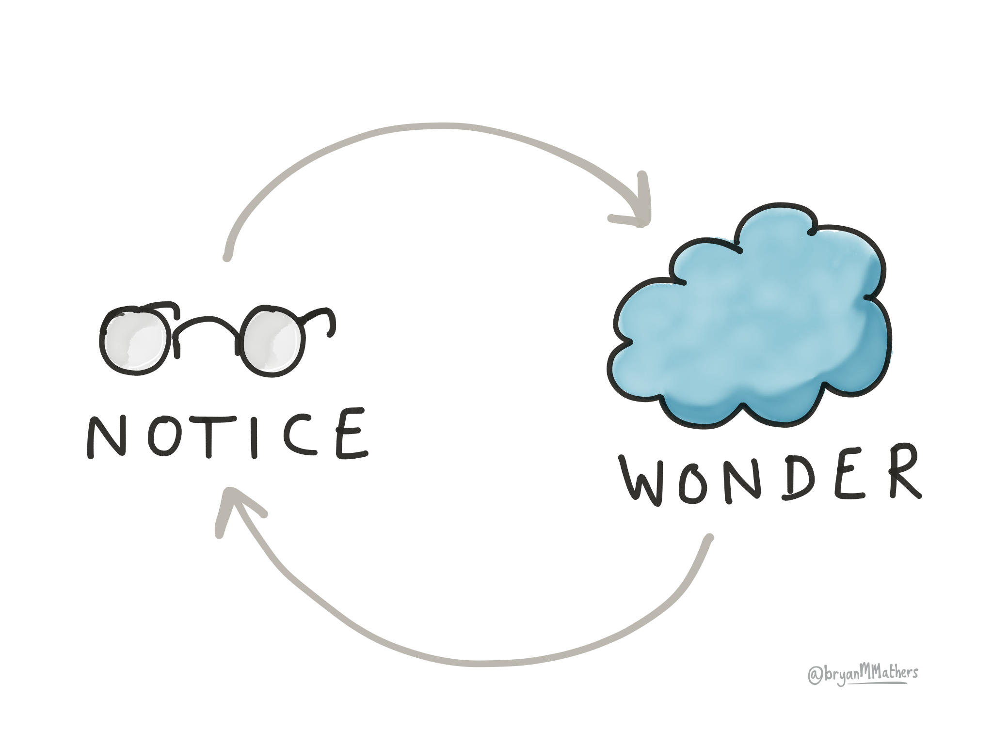
Share how the teacher uses notice and wonder to help student gain access to the content.

Slide 35
Instructional Routines to Increase Access
Math Talk
engage students in a math talk related to the current unit of study; goal is to increase conceptual understanding and fluency.
How to do a Math Talk
Write a problem on the board (horizontally).
Students solve the problem mentally. Give a signal when ready.
Call on students to share answers, and list them on the board. Do not indicate whether answers are correct or incorrect.
Ask for volunteers to explain their thinking. (what they are visualizing, how they found their answer, why they think it's right)
Record students' thinking for the entire class to see.
Prompt other students to engage with the previous explanation. (ask a question, build on, restate, make a connection to)

Slide 36
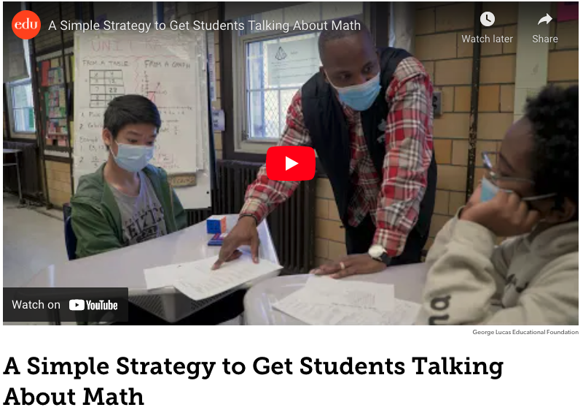

Share how the teacher Math Talk to help students increase access to the grade level content.

Slide 37
Instructional Routines to Increase Access
Which One Doesn’t Belong
Great as warm-ups, to activate prior knowledge.
What is it?
Students analyze four images, decide which one doesn't belong, and share their thinking.
Each and every student can contribute to the discussion, no matter their level of understanding coming into the lesson.
It's SO easy to implement!
How to find them
The Which One Doesn't Belong routine is embedded in the Illustrative Mathematics curriculum.
You can also google Which One Doesn't Belong to find websites such as this one.

Slide 38
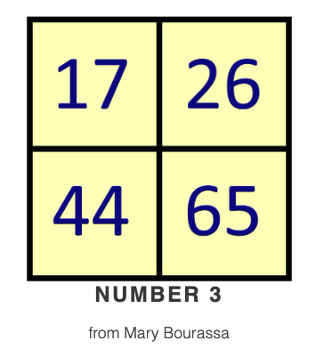
Find a reason why one doesn’t belong.
Which one Doesn’t Belong?
Discuss your reason why one doesn’t belong?

Slide 39
Planning Guide For Grade-Level Lessons
Prioritize grade-level learning with targeted support to attend to unfinished learning

Slide 40


Planning Guide For Grade-Level Lessons
Prioritize grade-level learning with targeted support to attend to unfinished learning
What is the learning goal of the lesson?
What problem or task will be the focus of the discussion?
Considerations:
● Aligns to grade-level content
● Matches the language and rigor of standard(s)
● Describes the cognitive understanding you want students to have (not SWBAT...)
Considerations:
● Aligns to grade-level content
● Matches the language and rigor of standard(s)
● Interesting and relevant to students
● Provides opportunities for reasoning, problem-solving, and/or explaining
● You believe discussion of this problem can lead to deeper understanding

Slide 41


Planning Guide For Grade-Level Lessons
Prioritize grade-level learning with targeted support to attend to unfinished learning
How will you increase access to the grade-level problem / task?
How will you launch the problem?
Ideas:
● Scaffold the task
● Introduce the task using an instructional routine
● Provide a concrete or visual model to illustrate the problem context
● Quick refresher on prerequisite skills during ‘Bell Work’
● Ensure the problem has multiple entry points and/or solution strategies that can be used to solve
● Check for understandings to ensure students are familiar with the problem context and vocabulary they will need to make sense of the problem
Considerations:
● Hook / Motivation (some ideas below)
○ Present the problem as a challenge
○ Accountability: “Be ready to ___ when we come back together in X minutes.”
○ Show an engaging video or visual that connects to the problem
● Clear directions
○ What ​exactly​ are you asking students to do? (state it simply)
○ Tell students they should work silently, by themselves for X number of minutes

Slide 42


Planning Guide For Grade-Level Lessons
Prioritize grade-level learning with targeted support to attend to unfinished learning
What strategies and solutions do you anticipate students using, and which of these will you highlight in the discussion?
What takeaway(s) do you want students to have at the end of the lesson?
Considerations:
● Correct and incorrect solutions
● Most common strategies
● Concrete strategy - share to increase accessibility for all students [example: picture, drawing, use of manipulative]
● Visual strategy - share as a bridge between concrete and abstract
● Abstract strategy - must include if required by the standard
● Incorrect solutions - share to address a common misconception
Plan the lesson summary:
● Main point(s) you want to reinforce, connected to the learning goal (write them out!)
● Student work you can highlight to illustrate the mathematics tied to the learning goal
● Decide how you will structure and facilitate the lesson summary

Slide 43



Accelerate Learning
Plan to Accelerate Learning
Readiness Pre-Assessment
Elicit Evidence Strategies
Prioritize grade-level learning with targeted support to attend to unfinished learning
A strategy that displays students’ incoming knowledge and in turn informs accelerated learning
The essential purpose of formative assessment is to move students’ learning forward while their learning is still in the process of developing. Margaret Heritage (2011)
Highlight the focus standards in your approaching instruction for each subject area and/or grade level unit.
Make student thinking visible through a few open response questions tied to important goals of the unit and pre-requisite knowledge and skills.
$2 Buck Summary – Ask students to write a summary of what they just learned. Each word is worth 5/10 cents adding up to 2 bucks.
Identify skills, language and content needed to master the focus standard(s) for each unit.
Seek to discover what students do know instead of seeking to confirm what they don’t know.
3-2-1 - At the end of a lesson, ask students to summarize what they just learned. 3 things that are new to you, 2 things that surprise you, and 1 thing you want to start doing with what you learned.
Align and map the essential prerequisite skills for each unit.
Give students multiple ways to show what they know.
Design lesson progressions to include practice with the prerequisite skills.
Determine if unfinished learning is present for the whole class or a small group.
What’s Muddy – At the end of learning, ask students to explain why something is confusing or difficult. Ask students to explain the muddiest point in the lesson.
Adjust the lesson sequence and pace to add in additional lessons for prerequisite skills.
Observe and analyze students’ academic discourse, allow for connections to be made through peer-to-peer activities which activates schema.
Misconception Check – Present students with a common misunderstanding and ask them to apply previous knowledge to correct the mistake or to decide if it contains any mistakes at all. Have them write and discuss their answers.
Use “just in time” scaffolds to allow students to engage in the most immediate work of the grade level.
Ask students questions that adequately address
the language, skills, and content you want them
to know.

Slide 44
Simple Ways to Address Unfinished Learning
Adapt the Lesson
Instructional Routines
Strengthen Prerequisites
Prioritize grade-level learning with targeted support to attend to unfinished learning
Develop instructional routines before diving into difficult grade level concepts
Identify essential prerequisite skills, language and content needed to master the grade level standard
Prioritize Time - Allow more time for discussion; ensure tasks align to grade-level standards and lesson’s goal.
Notice & Wonder – At the beginning of a lesson or transition to spark engagement activate prior knowledge before grade level content. Put a problem, task, or image on the board. Ask students to think of something they notice and something they wonder. Share as a class or in pairs.
Watch this short video of an 8th grade class. Boosting Engagement with Notices and Wonders
(Source: Edutopia)
Embed Prerequisites – weave prerequisites skills and understandings into Bell Work, lesson activities, and Do Now Work; focus on content student will need in the upcoming unit.
Scaffold the Task – Students complete an accessible task that leads into the grade level task.
Small Group Support – Identify students with unfinished learning on prerequisite content; use small group or intervention time to teach mini-lesson on these skills/concepts.
Visual Model – Include a visual model as part of instruction; students can us the model to help conceptualize the problem and/or solve.
In Daily Lessons –
1.Get clear on the lesson's learning goal.
2.Prioritize the problems and tasks that align most strongly with the learning goal.
3.Eliminate or limit class time spent on other tasks.
Math Talk - engage students in a math talk related to the current unit of study; goal is to increase conceptual understanding and fluency.
Watch this short video A Simple Strategy to Get Students talking About Math
(Source: Edutopia)
Misconception Check – Present students with a common misunderstanding and ask them to apply previous knowledge to correct the mistake or to decide if it contains any mistakes at all. Have them write and discuss their answers.
Two Solutions – in pairs, students discuss two solutions to a problem (teacher selects two correct, one correct / one incorrect, or two incorrect solutions); provide a discussion prompt

