Slide 1
Notes:
Context is everything. And your context will be important this morning. This morning, I invite you to process the presentation from your own perspective.
The Four Domains for Rapid School Improvement Framework was created by the Center on School Turnaround at WestEd, and first shared at the National ESEA Conference in 2018. Since its release, the Framework has supported school improvement planning and implementation efforts at the school, district, and state levels. Within the Four Domains, there are twelve practices that research and experience suggest are central to rapid and significant improvement. This session offers insight into the application of these practices by incorporating the voices of practitioners as they reflect on their own school improvement planning and implementation efforts. Based on the case studies and lessons learned, the presenter will offer considerations for launching new school improvement efforts or jumpstarting existing efforts that may have plateaued.

Slide 2
OPENING SESSION: APPLYING THE FOUR DOMAINS FOR RAPID SCHOOL IMPROVEMENT
Notes:
Context is everything. And your context will be important this morning. This morning, I invite you to process the presentation from your own perspective.
The Four Domains for Rapid School Improvement Framework was created by the Center on School Turnaround at WestEd, and first shared at the National ESEA Conference in 2018. Since its release, the Framework has supported school improvement planning and implementation efforts at the school, district, and state levels. Within the Four Domains, there are twelve practices that research and experience suggest are central to rapid and significant improvement. This session offers insight into the application of these practices by incorporating the voices of practitioners as they reflect on their own school improvement planning and implementation efforts. Based on the case studies and lessons learned, the presenter will offer considerations for launching new school improvement efforts or jumpstarting existing efforts that may have plateaued.

Slide 3
WestEd School Improvement Team
(Ashleigh, Contann, Giselle, Joe, Mario, Terry)
Notes:
Context is everything. And your context will be important this morning. This morning, I invite you to process the presentation from your own perspective.
The Four Domains for Rapid School Improvement Framework was created by the Center on School Turnaround at WestEd, and first shared at the National ESEA Conference in 2018. Since its release, the Framework has supported school improvement planning and implementation efforts at the school, district, and state levels. Within the Four Domains, there are twelve practices that research and experience suggest are central to rapid and significant improvement. This session offers insight into the application of these practices by incorporating the voices of practitioners as they reflect on their own school improvement planning and implementation efforts. Based on the case studies and lessons learned, the presenter will offer considerations for launching new school improvement efforts or jumpstarting existing efforts that may have plateaued.

Slide 4

csti.wested.org
Notes:
Tell Story – What is 🡺 What can be.

Slide 5
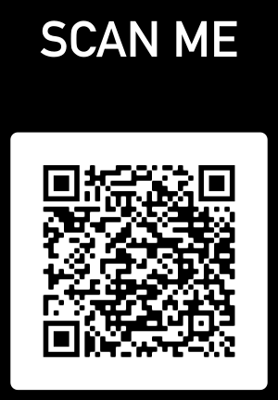
How familiar are you with the Four Domains for Rapid School Improvement?
The Four Domains of what now?
I have heard of it.
I have looked at it before today.
I could speak to another about main points.
I have applied it to school improvement efforts.
It is a central feature of my school improvement efforts
Notes:
I hope that you are at a 3 by the end of today’s session and a 4 by the end of the school, and you will at least have a few ideas on how it could become a feature of your school improvement efforts by the end of the session.

Slide 6



3 Ways to Get The Most From This Session
Think about your unique context, and especially a specific priority initiative. Jot it down!
Decide on one action you plan to complete for the upcoming school year.
If you have questions during or after today’s session, please reach out
Notes:
Context is everything. And your context will be important this morning. This morning, I invite you to process the presentation from your own perspective.

Slide 7
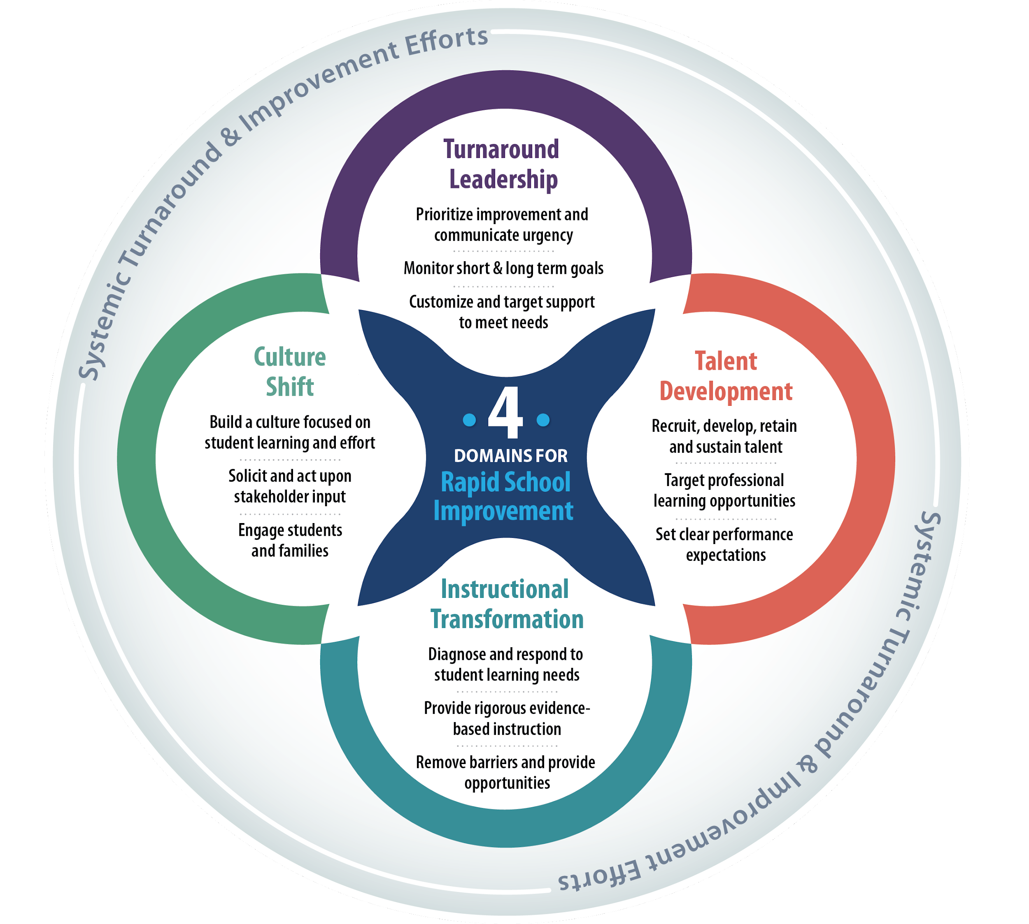

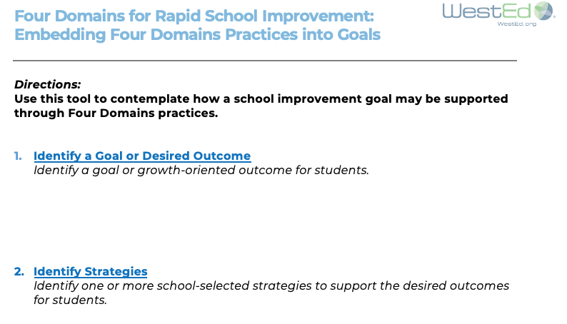
Identify a Goal and Corresponding Strategies
Notes:
Context is important… before we dive into the Four Domains, I invite you to identify a specific goal and supporting strategies. It might be a priority initiative that you are currently implementing or one that you have in mind for next year. If you are from a district or state and familiar with a school improvement goal, choose that… or choose a goal that is unique to your LEA or SEA.

Slide 8

REALITY This work is not easy. Turn & Talk: What barriers have you encountered when implementing priority initiatives?
Think
Notes:
Introduce yourself to your neighbor(s) and share your goal and any challenges…
The barriers you’ve seen are likely more common than you think. Often, when we meet with a new school and hear their story and learn their context, there is a sense that they are alone. The reality is that there are many commonalities among low performing schools, and the Four Domains for Rapid School Improvement were created to be responsive to those common barriers.

Slide 9

Acknowledgements
Development of this framework was a group effort in every way.
Contributing writers were Coby V. Meyers, Sam Redding, Dallas Hambrick Hitt, Carlas McCauley, Lenay Dunn, Katy Chapman, Eric Ambroso, and Min Chen-Gaddini.
Contributing reviewers included Lauren Morando Rhim, Kathleen Ryan Jackson, Dean Fixsen, Caryn Ward, William Robinson, and Julie Corbett.
The Center on School Turnaround leadership team also thanks WestEd’s Nikola Filby and John Rice for their thoughtful review and feedback.
Notes:
https://csti.wested.org/wp-content/uploads/2018/04/CST_Four-Domains-Framework-Final.pdf

Slide 10
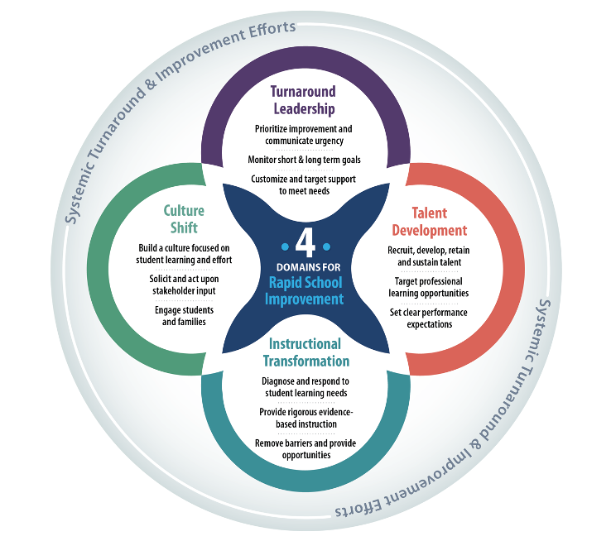


Notes:
Here is a graphic representation of the Four Domains. I know we live in a largely paperless world these days, but if nothing else comes out of this session, I encourage you to print this out and keep in nearby to inform your school improvement efforts – particularly when they may not be moving as quickly as you’d like.

Slide 11

Domain
1
Practices
1.1, 1.2, 1.3
Notes:
Talk about this slide from perspective of being responsive to common barriers to school improvement. The circumstances differ from school to school. Through conducting diagnostic reviews from the perspective of the Four Domains, we have seen things such as:
1.2 – Sometimes plans exist, they are done for compliance purposes, and folks don’t know they exist or what their role is in executing them.
2.2 – Target professional learning opportunities… sometimes there is an assumption, a hope, an expectation, that if training was provided everyone does it.
3.3. – Remove barriers and provide opportunities – there are often plans to do this, but they are not known or routinely used.
4.1 – Build a culture focused on student learning and effort – we often see a gap between the culture that administrators think exists, and the one that teachers experience.
The good news is… the Four Domains provide us a lens to contemplate these things – intentionally, and in the spirit of diagnosing what may be holding back the potential of a school.
https://csti.wested.org/wp-content/uploads/2018/04/CST_Four-Domains-Framework-Final.pdf

Slide 12
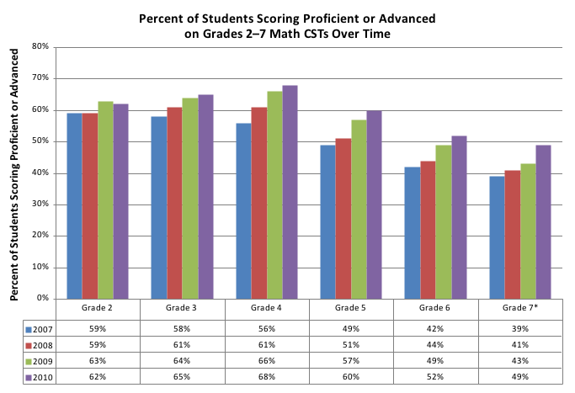
COMMON DATA IN NEEDS ASSESSMENTS
Math Summative and Benchmark Achievement Data
ELA Summative and Benchmark Achievement Data
Parent/Guardian Attendance at Conferences and Events
Graduation Data
Student Attendance
Student Discipline Data
Notes:
Assessments generally include data like this…lagging indicators that feature outcomes of students or parents. It is not a surprise that we routinely see root cause analyses that identify the students or the families as the root cause.

Slide 13
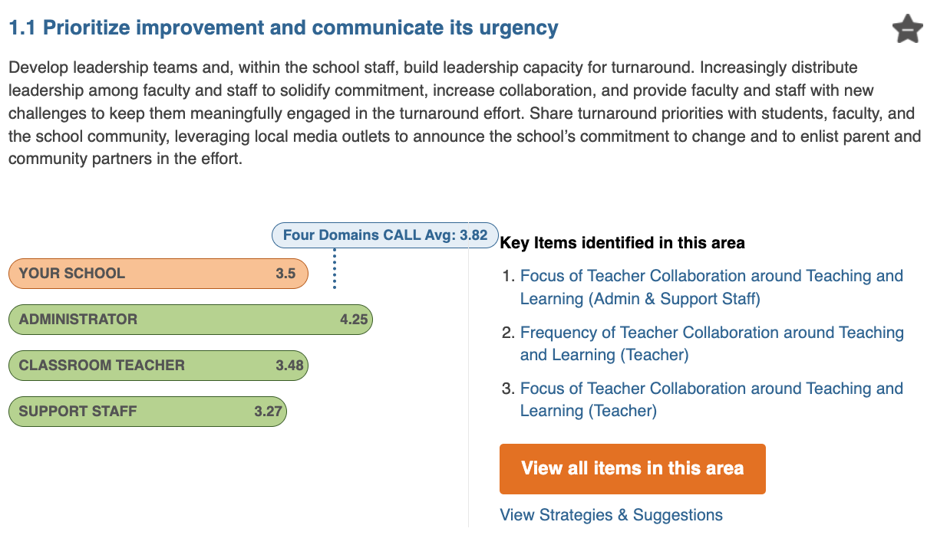


Slide 14

Change Efforts Fail When …
Not focused on a few high-leverage priorities
Insufficiently rigorous in expectations
Inadequately rooted in research-based practice
Not focused on implementation fidelity as well as program/intervention fidelity
Not monitored by a core team committed to its success
Too rigid, inflexible, and absent performance management procedures for making necessary changes in course
Notes:
Ask someone to share an answer to: Why is this important?
Then Say: because the work of school turnaround is about making shifts or changes. And, when we look at why change efforts fail, they rarely fail because of student or parents.

Slide 15
The Diagnostic Review process provides an opportunity for the school leader and his/her school team to utilize the data, reports, and emerging priorities to inform the school’s school improvement process-inclusive of needs to be targeted, schoolwide program planning, and school budgeting while rooted in the Four Domains for Rapid School Improvement framework.
Dr. Carmelia Becenti
Bureau of Indian Education
Division of Performance and Accountability

Slide 16

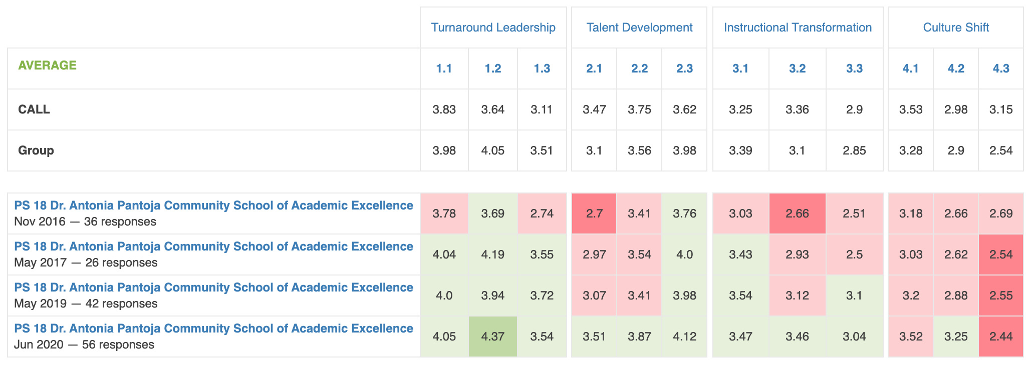
IMPACT
Notes:
The next year 5 of 12. Most recently, in June 2020, 10 of the 12 practices were above the national average. And, you took the same survey twice during this past school year.
Share background of the school and tell the story of the climate when Aakta took over… (Then click to the next slide…)

Slide 17
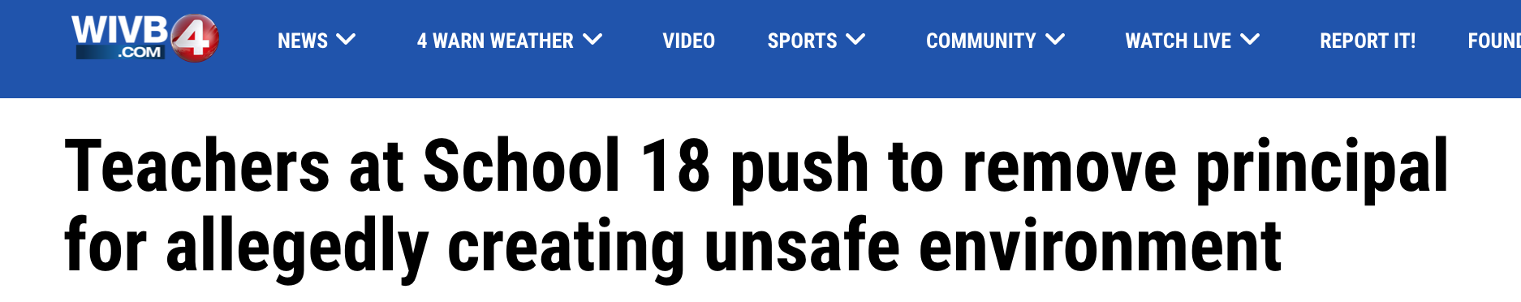
Notes:
Aakta: 0:29 to
First year I was new…
Most schools we work with are receivership, CSI or TSI.
I ask leaders to write down their story on day one… the current state… so they can remember is accurately when looking back.

Slide 18
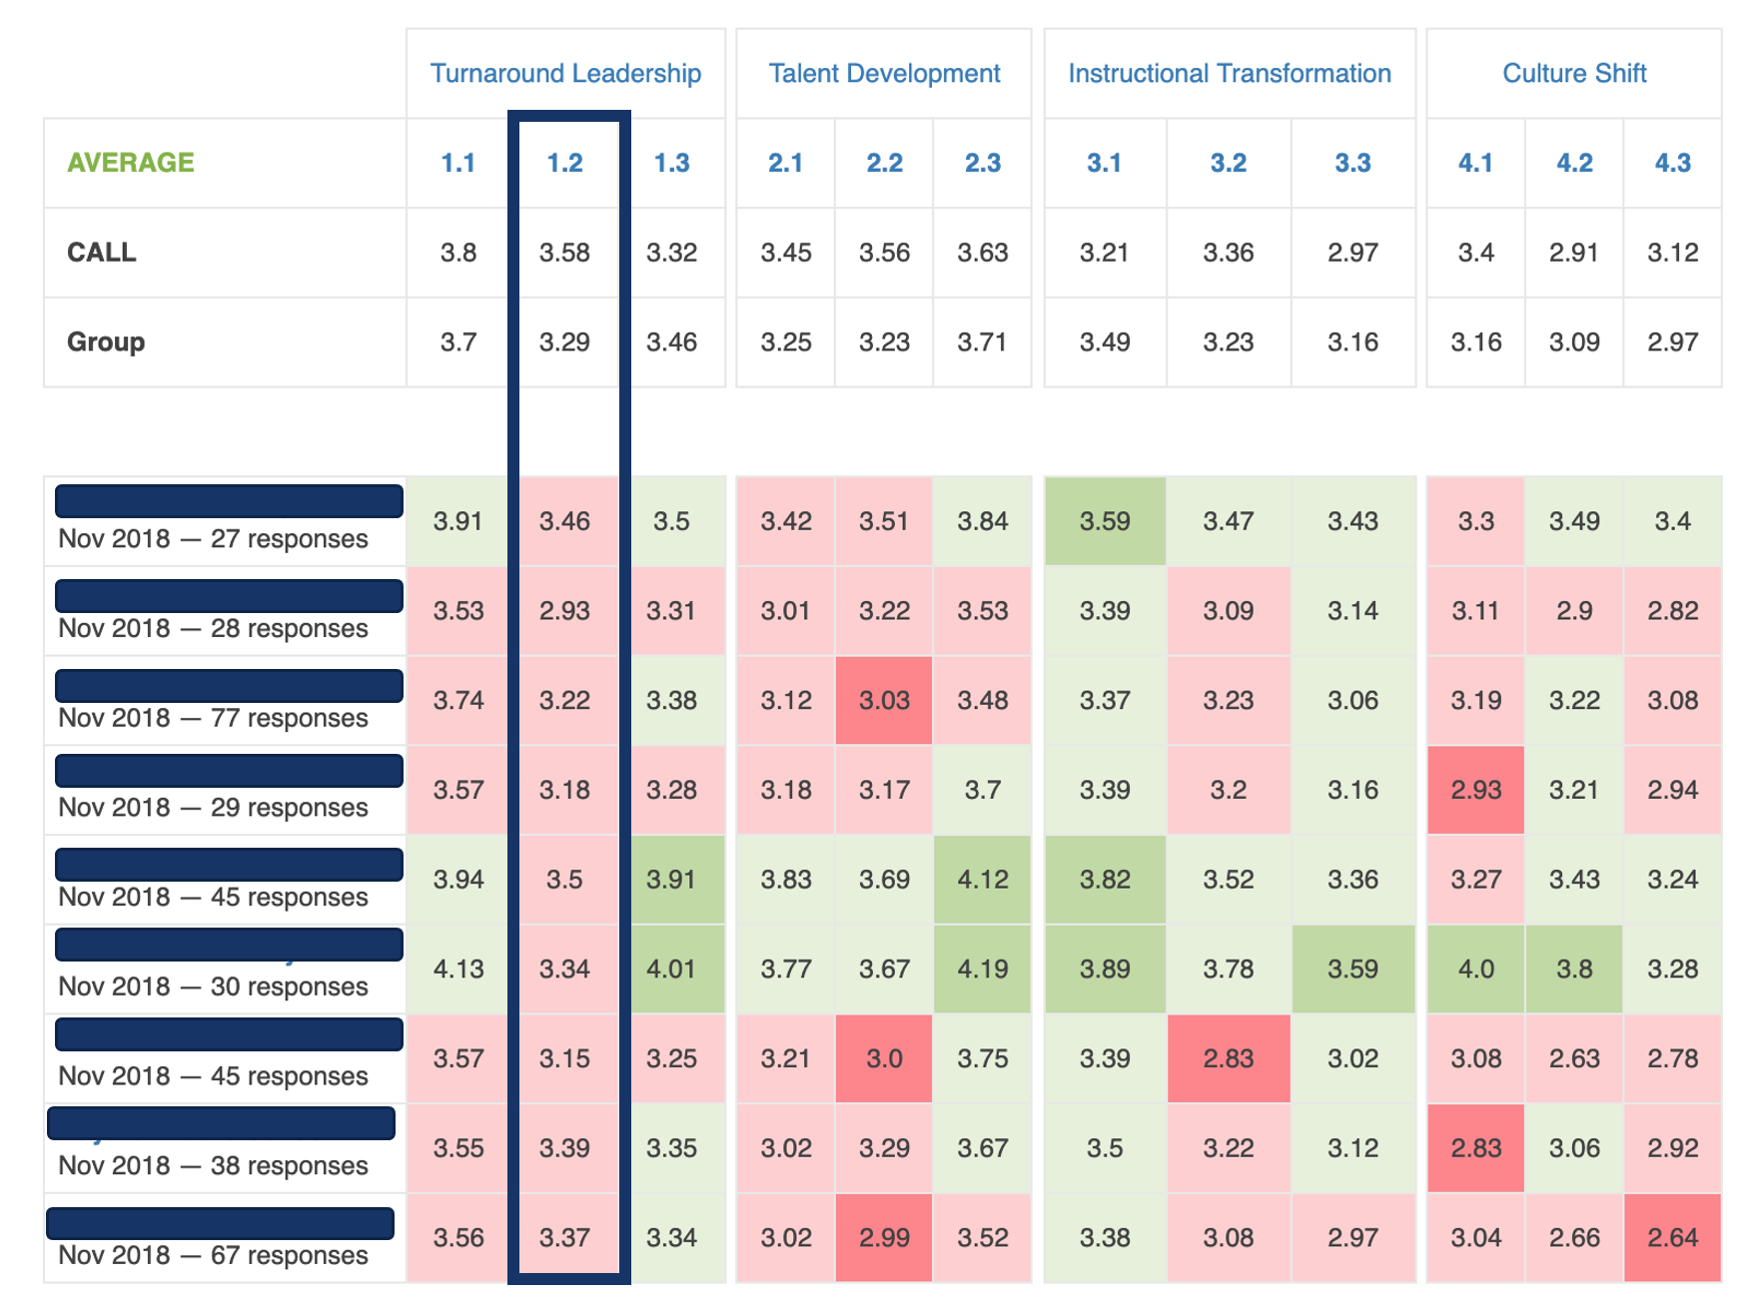
SAMPLE SCHOOLS
Notes:
The data can make shifts visible across a system.
The data can also draw attention to blind spots.

Slide 19
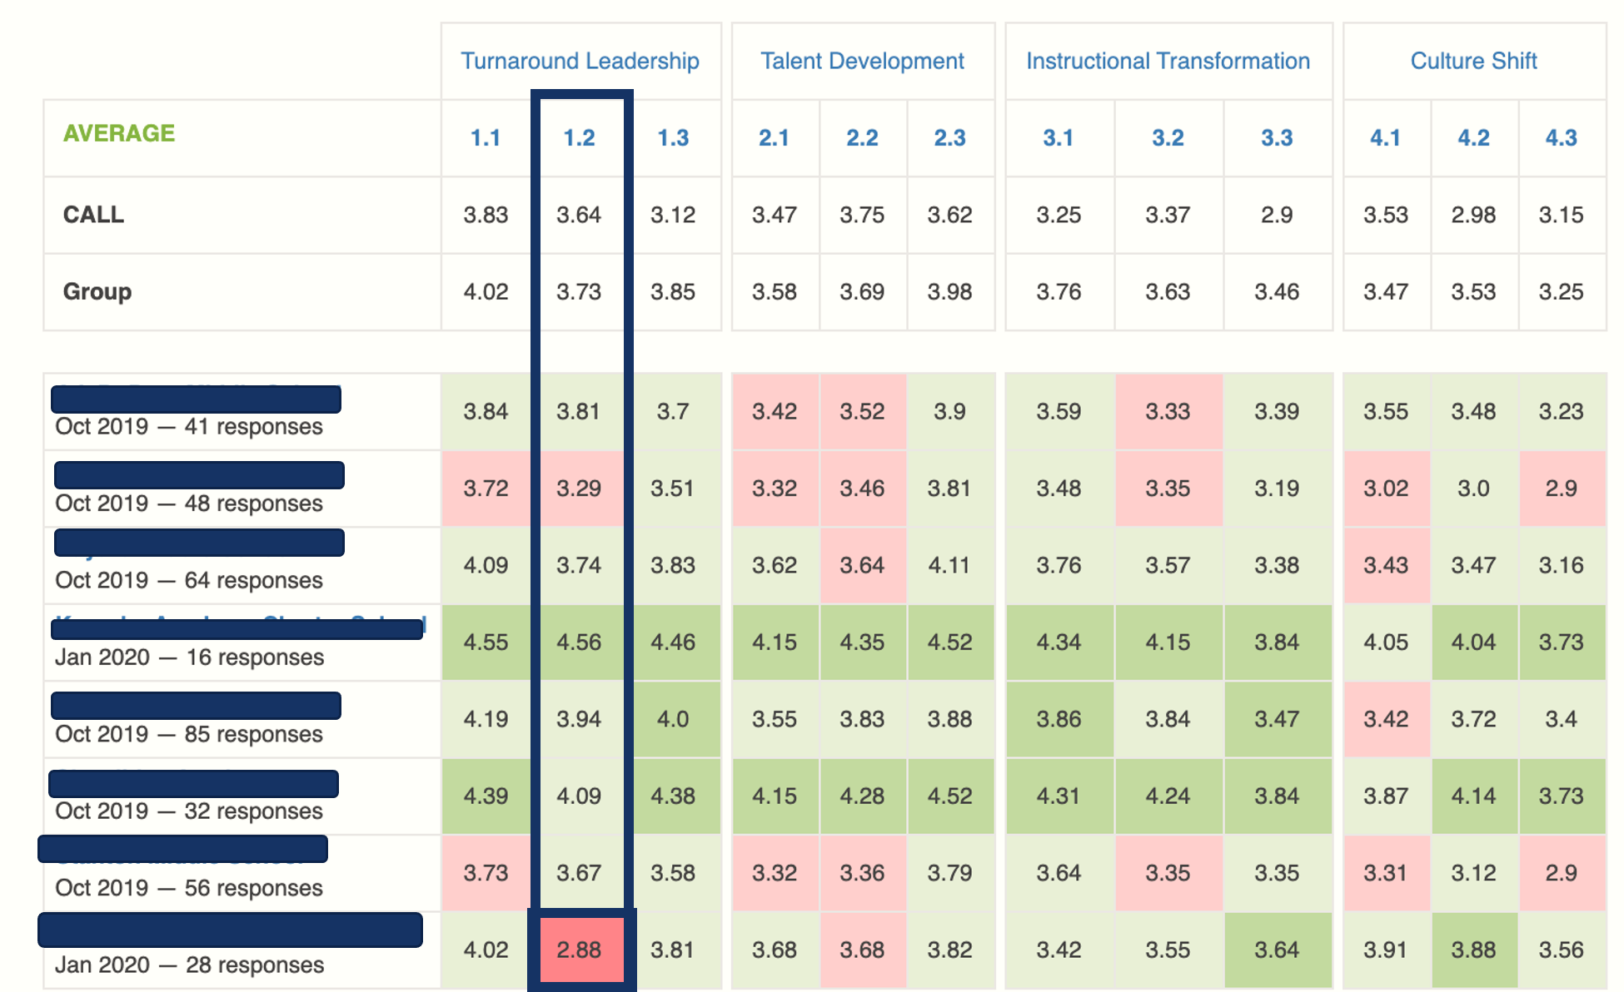
SAMPLE SCHOOLS
Notes:
Blind spots that can be addressed. Strategic Plan.

Slide 20







SCHOOL IMPROVEMENT: A TECHNICAL AND AN ADAPTIVE CHALLENGE
Technical Assistance
Adaptive Supports
EVIDENCE
EXPERTS
FRAMEWORKS
PLANS
MANUALS
TOOLS
PROTOCOLS
Notes:
Strategies…

Slide 21

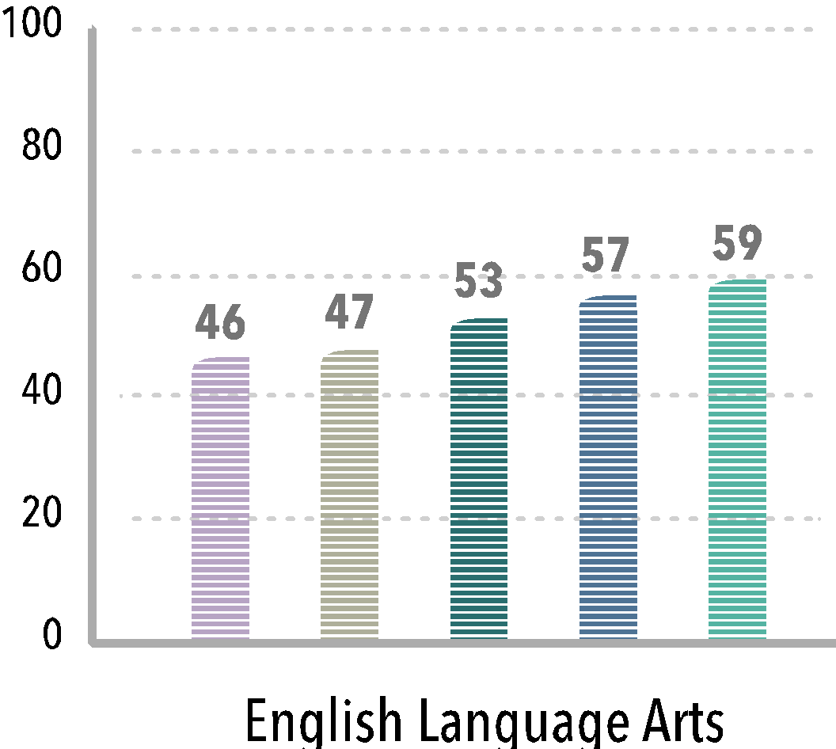
IMPACT
PEOPLE
WHAT PEOPLE DO
OUTCOMES
Tasks
Activities
Routines
Practices
Notes:
What’s missing from goals and strategies…

Slide 22
SCHOOL IMPROVEMENT: A TECHNICAL AND AN ADAPTIVE CHALLENGE
Technical Assistance
Adaptive Supports
Communication
Commitments
Agreements
Understanding
Participation
Feedback
EVIDENCE
EXPERTS
FRAMEWORKS
PLANS
What People Do
MANUALS
TOOLS
PROTOCOLS
Notes:
… because strategy wasn’t communicated.
… because there wasn’t commitment.
… because there wasn’t agreement on what it means to commit… every class every day, or I’ll try it once.
… because there wasn’t understanding.
… because folks aren’t participating for one reason or another.
… because folks are not getting feedback on their implementation efforts.

Slide 23


School Improvement Plans
GOAL
STRATEGIES
TASKS, ACTIVITIES, PRACTICES AND ROUTINES

Slide 24

The Four Domains can strengthen the implementation of priority initiatives.
We Learned

Slide 25
The Four Domains for Rapid School Improvement
1.1 Prioritize improvement & communicate urgency
1.2 Monitor short- & long-term goals
1.3 Customize & target support to meet needs
2.1 Recruit, develop, retain & sustain talent
2.2 Target professional learning opportunities
2.3 Set clear performance expectations
3.1 Diagnose & respond to student learning needs
3.2 Provide rigorous evidence-based instruction
3.3 Remove barriers & provide opportunities
4.1 Build a culture focused on student learning & effort
4.2 Solicit & act upon stakeholder input
4.3 Engage students & families in pursuing educational goals
Notes:
Listed again for reference.
In most cases, a case can be made for all 12 practices to support any priority initiative. The practices are designed to work together.., and the systems are designed to work together.
Monitoring is a crucial function for Districts and States… AND, they have a role to play to support implementation. (or, at least to do no harm).
Example 1: Removing a principal without planning for succession.
Example 2: Changing the school start time and losing the staff due to child care.
https://csti.wested.org/wp-content/uploads/2018/04/CST_Four-Domains-Framework-Final.pdf

Slide 26
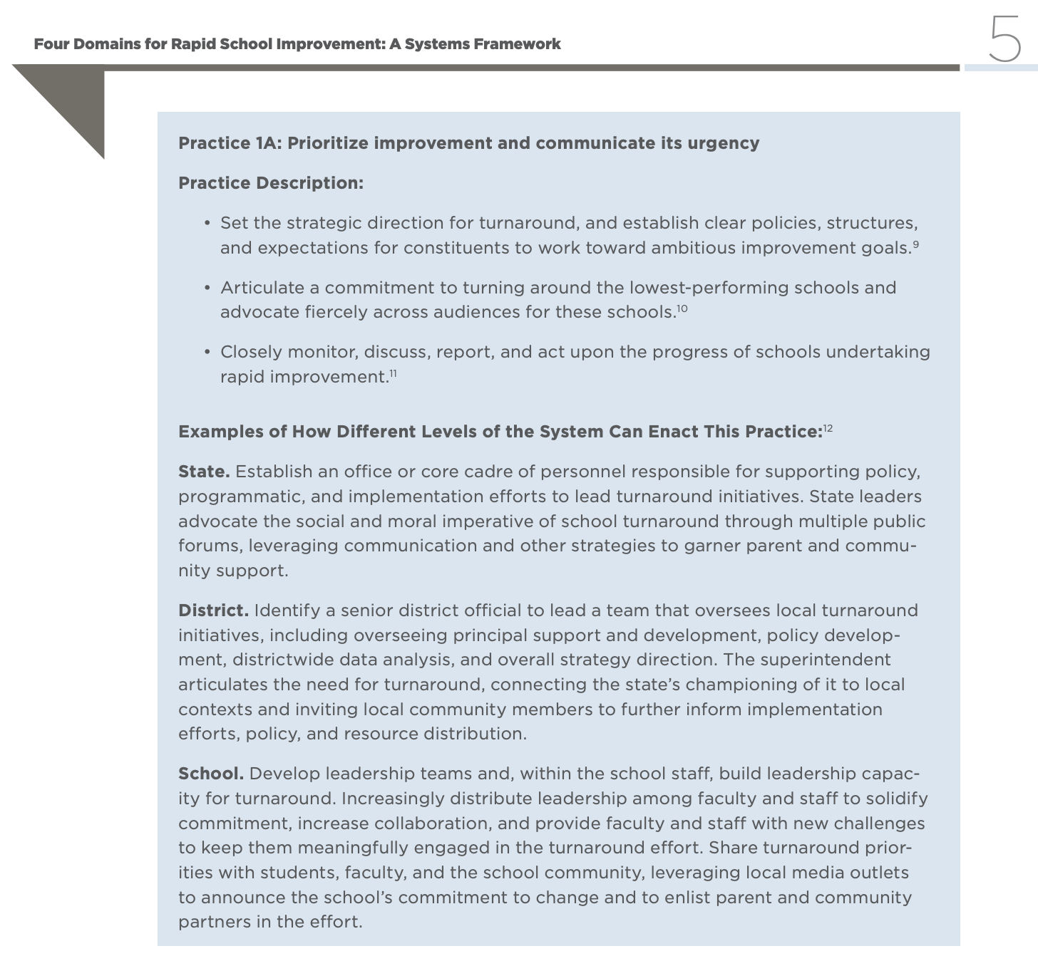
SAMPLE PAGE
Notes:
Earlier in the video clip, you heard Lenay Dunn reference that the intent was to support State, District and School applications.

Slide 27
REFERENCE PAGES
PRACTICE AREAS | SYSTEMS FRAMEWORK (PAGE #’S)
1.1 Prioritize improvement & communicate urgency | 5
1.2 Monitor short- & long-term goals | 6
1.3 Customize & target support to meet needs | 7
2.1 Recruit, develop, retain & sustain talent | 12
2.2 Target professional learning opportunities | 13
2.3 Set clear performance expectations | 14
3.1 Diagnose & respond to student learning needs | 19
3.2 Provide rigorous evidence-based instruction | 20
3.3 Remove barriers & provide opportunities | 21
4.1 Build a culture focused on student learning & effort | 26
4.2 Solicit & act upon stakeholder input | 27
4.3 Engage students & families in pursuing educational goals | 28

Slide 28
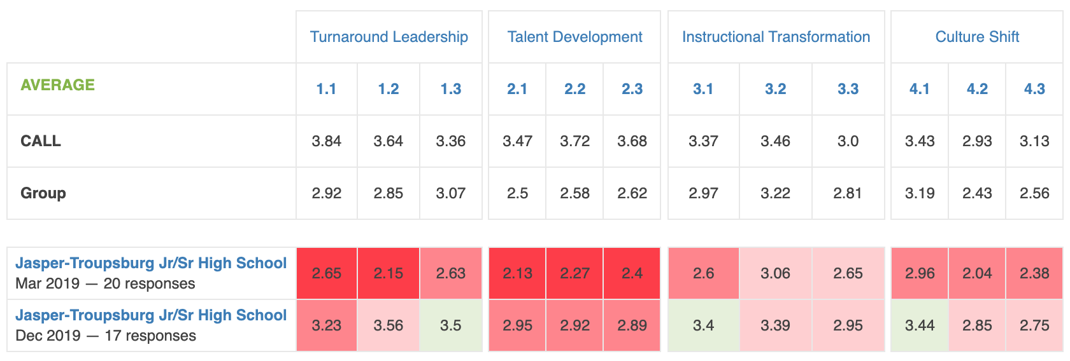
FOUR DOMAINS CALL DATA (MARCH 2019 VS. DECEMBER 2019)
12 of 12 practices trending up
LEGEND
Comparison to CALL Average by Standard Deviation (SD)
2+ SD Below Avg. 1–2 SD Below Avg. 0–1 SD Below Avg.
2+ SD Above Avg. 1–2 SD Above Avg. 0–1 SD Above Avg.
Notes:
We also learned that making data of what people do VISIBLE can help take the conversation off of students and parents and shift the conversation to adults with the power to imagine a different and desired future.
DESCRIBE THE SLIDE, THE SURVEY AND THE SHIFT. (More about how the shift occurred later.)
Focused attention on a practice can impact all initiatives in a school plan.

Slide 29
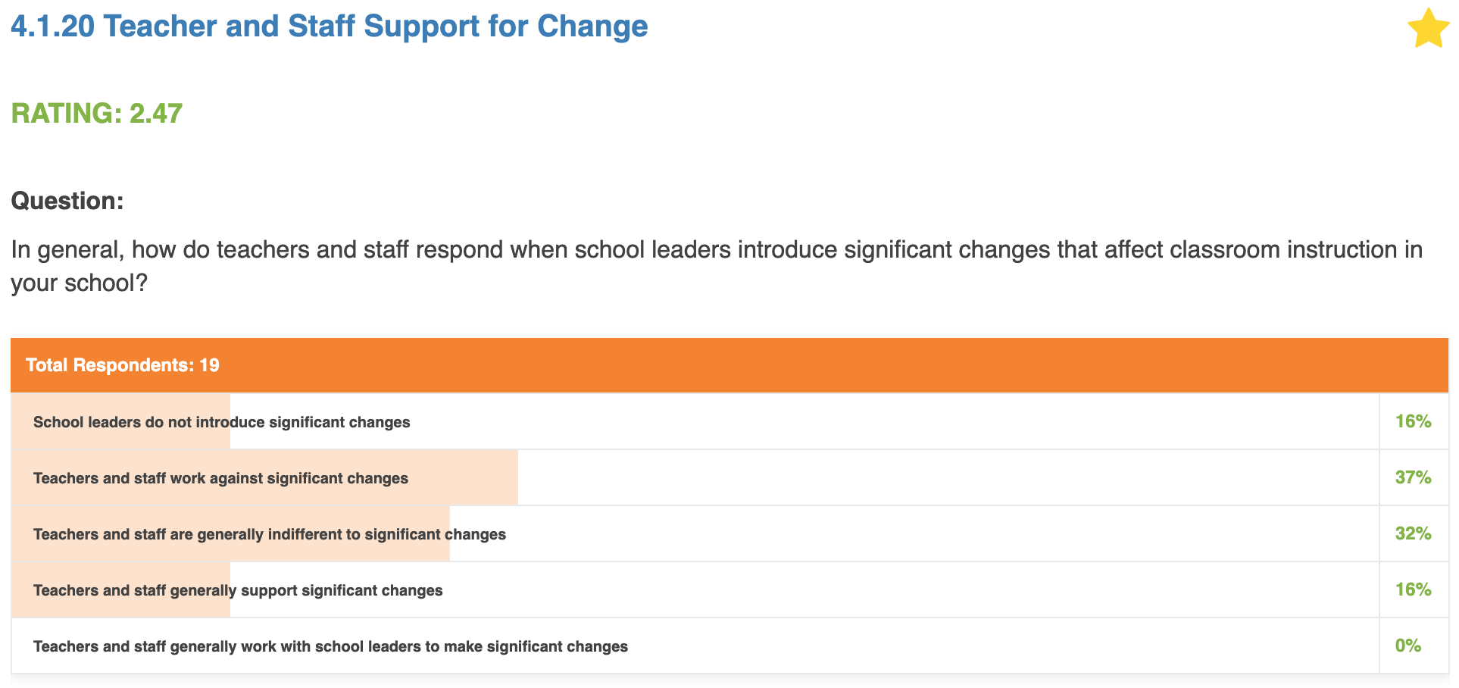
4.1 CULTURE SHIFT – BUILD A CULTURE FOCUSED ON STUDENT LEARNING AND EFFORT
Spring 2019
Current State
16%
Most Favorable Response/
Desired Future State
Notes:
Take a minute to review this slide.
Many folks ask about the RAPID in rapid school improvement.
Find the right practices.., the most impactful… and work on those first with precision and intentionality.

Slide 30
2022-23 Schoolwide Plan Focus Areas
Distribute leadership to grow teacher leaders
Embed systems for teacher professional growth
Adopt priority standards (What will we teach/prioritize?)
Track student progress (How will we measure it?)
Respond to unfinished learning (How will we respond to the data?)

Slide 31
Are the proposed actions likely to change tasks, habits, routines and practices that produce the desired results for ALL students?
Notes:
Every classroom. Every student.

Slide 32
Theory of Action
Student
Growth
Teacher Growth
Routine Opportunities for Feedback (TLCs)
Teaching Improvements Goals
Student Learning Goals
Notes:
Review/recap the article and take aways…
Phase 1 – goal setting using data
Phase 2 – routine opportunities for feedback (Teaching and Learning Cycles –TLCs)
Upcoming slides elaborate a bit more…

Slide 33
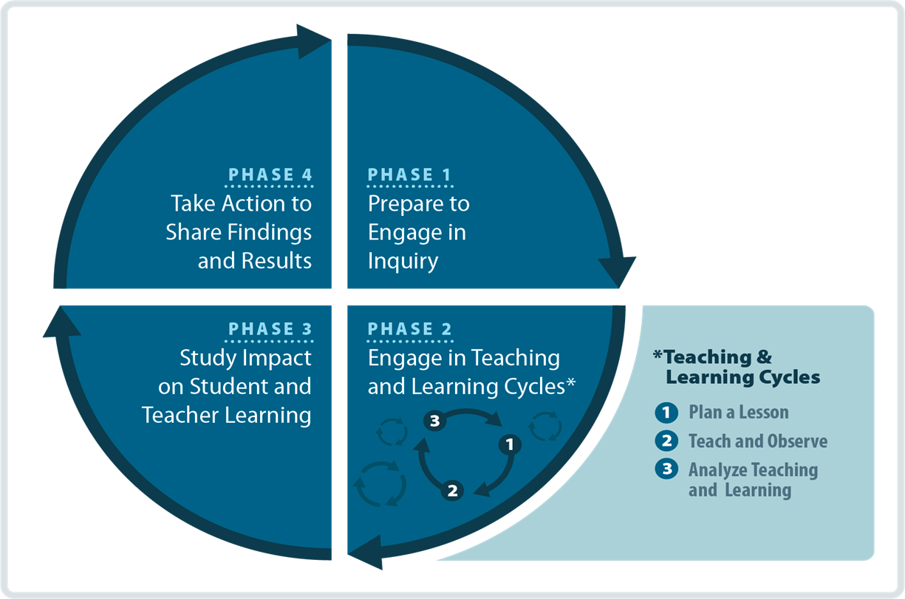

The Heart of Professional Collaboration for Teachers
Teaching and Learning Cycles
Notes:
The heart of VITAL is routinely meeting to analyze teaching practice
POD cycles (plan, observe, deliver)
After the work in phase 1, teams then spend the bulk of their time in Phase 2, sharing artifacts of their teaching practice to make it visible so they can get feedback and improve on their goals. Artifacts include things like lesson plans, videos of their instruction, or samples of student work.

Slide 34
Translating School Improvement Team Meetings into Results
Provide timely minutes (or communication) after each meeting
Reflect on what worked well and what may have worked better
Commit to follow-up actions to support meeting results reaching every classroom

Slide 35
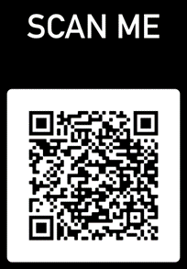



3 Ways to Get The Most From This Session
Think about your unique context, and especially a specific priority initiative. Jot it down!
Decide on one action you plan to complete next school year.
If you have questions during or after today’s session, please reach out.
Notes:
Context is everything. And your context will be important this morning. This morning, I invite you to process the presentation from your own perspective.

Slide 36

csti.wested.org
QUESTIONS
thofer@wested.org

Slide 37
Notes:
Context is everything. And your context will be important this morning. This morning, I invite you to process the presentation from your own perspective.
The Four Domains for Rapid School Improvement Framework was created by the Center on School Turnaround at WestEd, and first shared at the National ESEA Conference in 2018. Since its release, the Framework has supported school improvement planning and implementation efforts at the school, district, and state levels. Within the Four Domains, there are twelve practices that research and experience suggest are central to rapid and significant improvement. This session offers insight into the application of these practices by incorporating the voices of practitioners as they reflect on their own school improvement planning and implementation efforts. Based on the case studies and lessons learned, the presenter will offer considerations for launching new school improvement efforts or jumpstarting existing efforts that may have plateaued.

