Slide 2
Man in the Maze; an Indigenous approach to understanding adolescent tribal youth development

Slide 3
Mario Molina, Ph.D.
Akimel O’odham/Yoeme

Slide 4
Man in the maze
https://m.youtube.com/watch?v=OKT5unmJZPo

Slide 5
The conclusion that is drawn by most social scientists from the data on Indian cultures and Indian intelligence is that the American Indians of today have about the same innate equipment for learning as have the white children of America (B. Berry, 1968, p. 34).

Slide 6

Background
Indian Education T.A. Specialist, WestEd
Consultant, on a hiatus at the moment
Past work: TED Director, Principal, Teacher, Police Officer
My work and research has focused on the development of programming to improve and increase academic achievement in schools that serve my tribal students while also retaining tribal culture, language and heritage of my people – other tribes

Slide 7
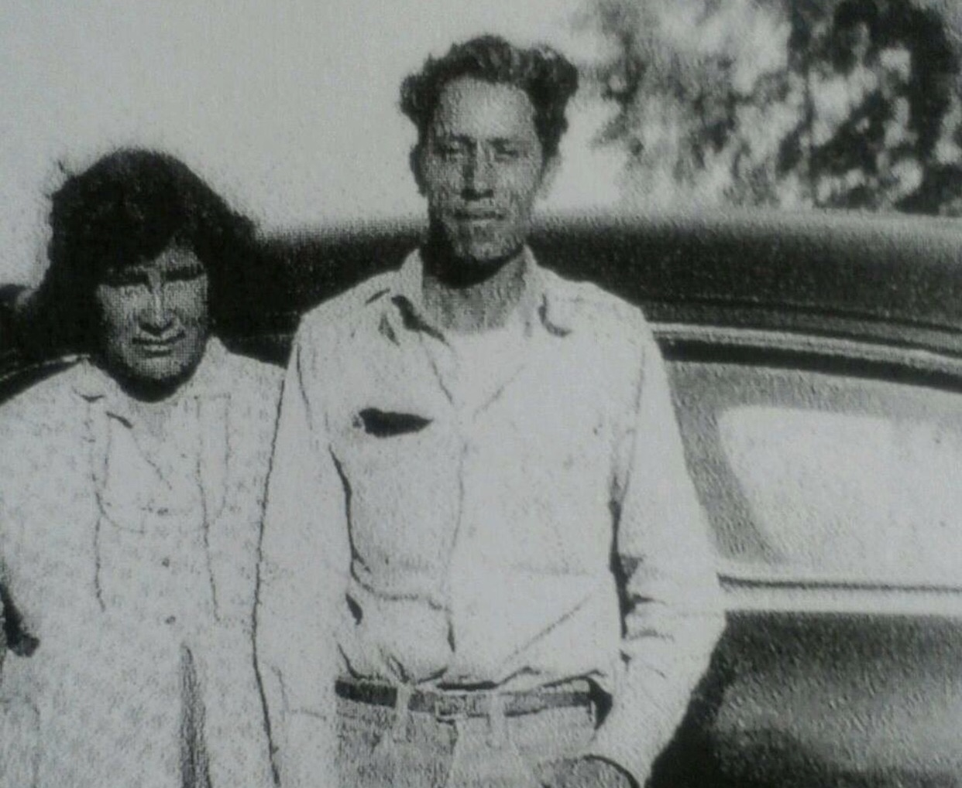
“Even the most severely eroded Indian community today still has a substantial fragment of the old ways left, and these ways are to be found in the Indian family."
Vine Deloria, Knowing and Understanding.

Slide 8
Today
Today, the intent is to provide you with an understanding of human development, specifically tribal human development
How this development impacts learning
How this development impacts the student and family
Provide you with some tools, ideas to implement and practice in the school year

Slide 9
Systems of Human Development Theorists
An insight to the work of Urie Bronfenbrenner
Development of a learner (Western/Indigenous)
Jean Piaget
Eric Erickson Stages of Human Development
The works of V.F. Cordova
The works of Vine Deloria

Slide 10
Systems of Human Development
Bronfenbrenner initially started with 4 systems, later adding a 5th system
Mesosystem
Microsystem
Exosystem
Macrosystem
Chronosystem

Slide 11
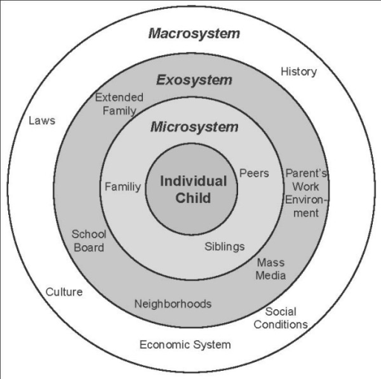

Slide 12
Mesosystem (Invisible on graphic)
The mesosystem creates linkages between home and school, between peer group and family, etc.
The mesosystem identifies the ability or paths for microsystem to work together to either support or not support the thinking or influence of the individual people/communities that could be identified as a microsystem.
The mesosystem can be broken, sustained, or need to be built
This is our focus many times as educators, but sometimes we miss
Communication (cultural/age divide/parenting style)

Slide 13
Microsystem
The microsystem includes the immediate influences that a person may have within their lives and is considered the system in which the individual most directly participates.
How the student/staff reacts to his/her microsystems will influence how the student/staff will develop and influence how the tribal member will be treated in return.
The more microsystems you have, the greater the chance for a more widened base of knowledge and experience will be available for the person.
Examples: i.e., Tribal Culture and Language, Gender, Location, Parents, Siblings, Extended Family, Peers, Clan/Village

Slide 14
Exosystem
The Exosystem references the environment that the person may not be a part of but can have an influence on the tribal student’s/staff’s development.
As the person grows, the Exosystem connects to the microsystem thru the mesosystem, the person uses schemas to draw from and learn, progress.
Examples: Schools, Government, Laws, Parent’s success/nonsuccess, Family’s economic status, school and family expectations, decisions made or directed by family elders.

Slide 15
Macrosystem
Less social and nature, more about intellectual and cultural sphere.
The macrosystem is represented from the vantage that the child/staff must be socialized or shown how to act within a particular pattern of behavior given the situation. Method to validate the student’s knowledge
Using their own schemas, the person maneuvers thru their social situation
Examples: Social and Cultural values of the tribe, community. Native student/staff versus the school social and cultural values (outside expectations)

Slide 16
Chronosystem (Invisible on graph)
The chronosystem refers to the dimension of time in relation to a person’s development. (Visible vs. Invisible).
End point, differs for Native People
The chronosystem is affected by the way our life is based on the history or time we live in and can be influence both change and constancy (positive and negative of development).
Examples: Change in family structure, Family’s economic status (Situational vs. Generational Poverty)

Slide 17
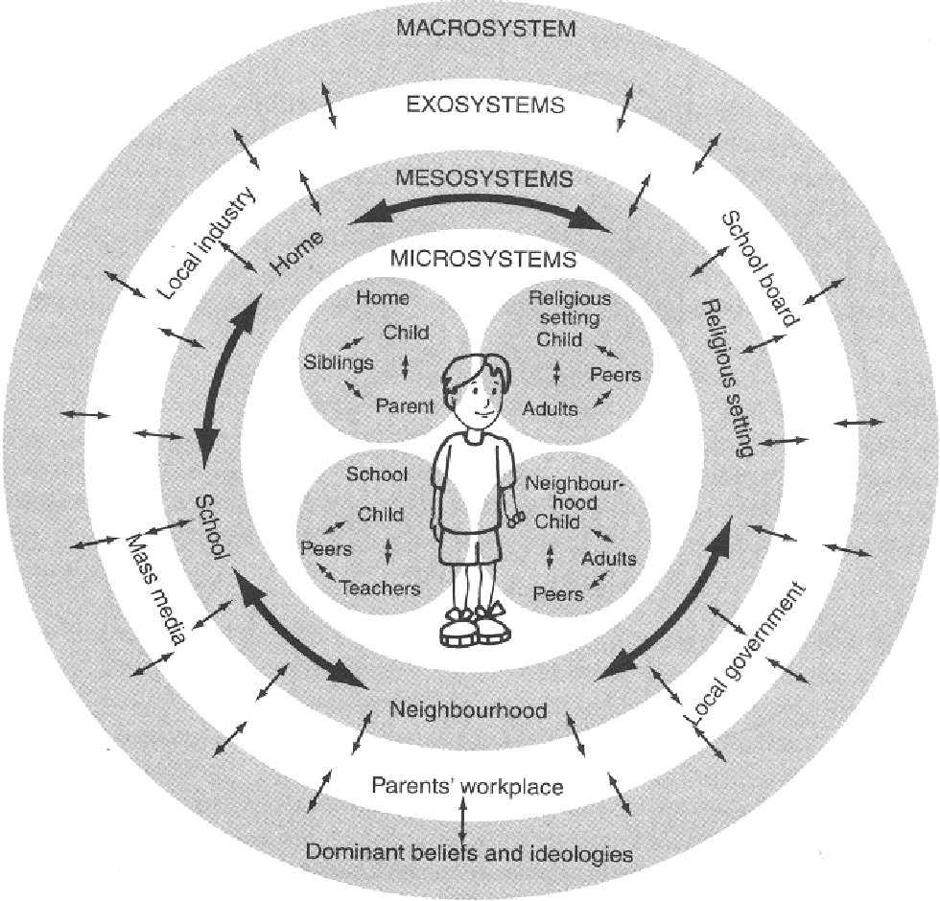
Bronfenbrenner’s Theory, Connecting
WESTERN (A/S)
INDIGENOUS (A/S)

Slide 18
Systems
All 5 systems rely upon the other
These systems can be found in all human development
Regardless of background
Regardless of SES status
Regardless of Race or Ethnicity.
For the Native student, two systems of development may emerge and/or merge (Piaget)
With development of what is success

Slide 19
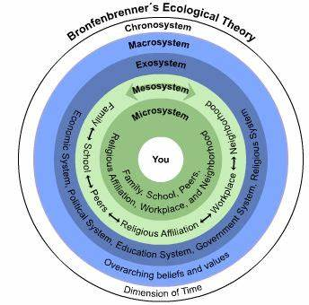

Slide 20
V.F. Cordova
My family stories provide a window to see what I have to say. I exist only in and as a context. I am what the context has created. I did not burst full bloom into the world I confront. I do not have a “hidden,” ”inner,” or “true” self that lies waiting for my discovery. I have been created by my experiences, and I am recreated – over and over again – by each new experience.

Slide 21
2 Ways of Being
Two paths of knowledge
Developmental Theorists Indigenous Theorists
Merged to understand and approach our tribal students and their desire to belong in two worlds; often times having to choose on over the other
Interdependent vs. Independent, a new approach to education

Slide 22
So, what does this mean?
With the onset of adolescence, mixed thoughts begin to emerge and challenge the student internally. (Home vs. School)
Independent: What is promoted within a classroom and school
We encourage this as educators, leaders not followers (Disrespectful)
Interdependent: What is promoted within the tribal household and tribal community
The family expects this, anything out of this area is seen as negative. (Disrespectful)
For the student, these two thoughts conflict, who is right and who is wrong?
For the student, these two traits must be attained simultaneously while recognizing when to use and not use. But often, not the case.

Slide 23
Conflicting thoughts, why is this relevant to education?
Academic Development
Social Development
As educators we wonder if the student is progressing at an expected rate of academic development.
As educators we want the student to be engaged, explore, try something new
As educators, we want the student to be strong for themselves, speak up, take control
As a tribal student we wonder how academic development affects other’s view of us. (tribal and non-tribal)
As a tribal student we wonder how this will be looked upon by our peers and elders (tribal and non-tribal).
As a tribal student we wonder how we will be looked upon by our peers/family and how we will be accepted (tribal and non-tribal)

Slide 24
Two types of tribal members
Accepted Tribal Member
Indigenous Knowledge acquired in Indigenous environment
Neok
Phenotype
Cultural Knowledge
Knowledge of Tribal History
Proximity, familiarity, and/or relationship to land
Commitment to Himdag
Urban Indian
Indigenous Knowledge acquired through schooling
Neok?
Cultural Knowledge?
Tribal History?
Phenotype?
Possesses Tribal Identification card
Family ties to community?

Slide 25
What we haven’t mentioned
The onset of adolescence…. how the human body and mind changes…… A time that we, as humans, question and challenge our environment.
Adding another layer of questions for students, trying to find their place and develop what is called, “Social Capital,” so that they develop a sense of belonging and acceptance.
Consider this:
Does the school or the home understand these two-character traits that are expected of the student?
Does the school or home recognize the onset of adolescence and how it impacts the social and academic development of a tribal student?
Eric Erikson’s theory of human development, 8 stages (Belonging and Acceptance)

Slide 26
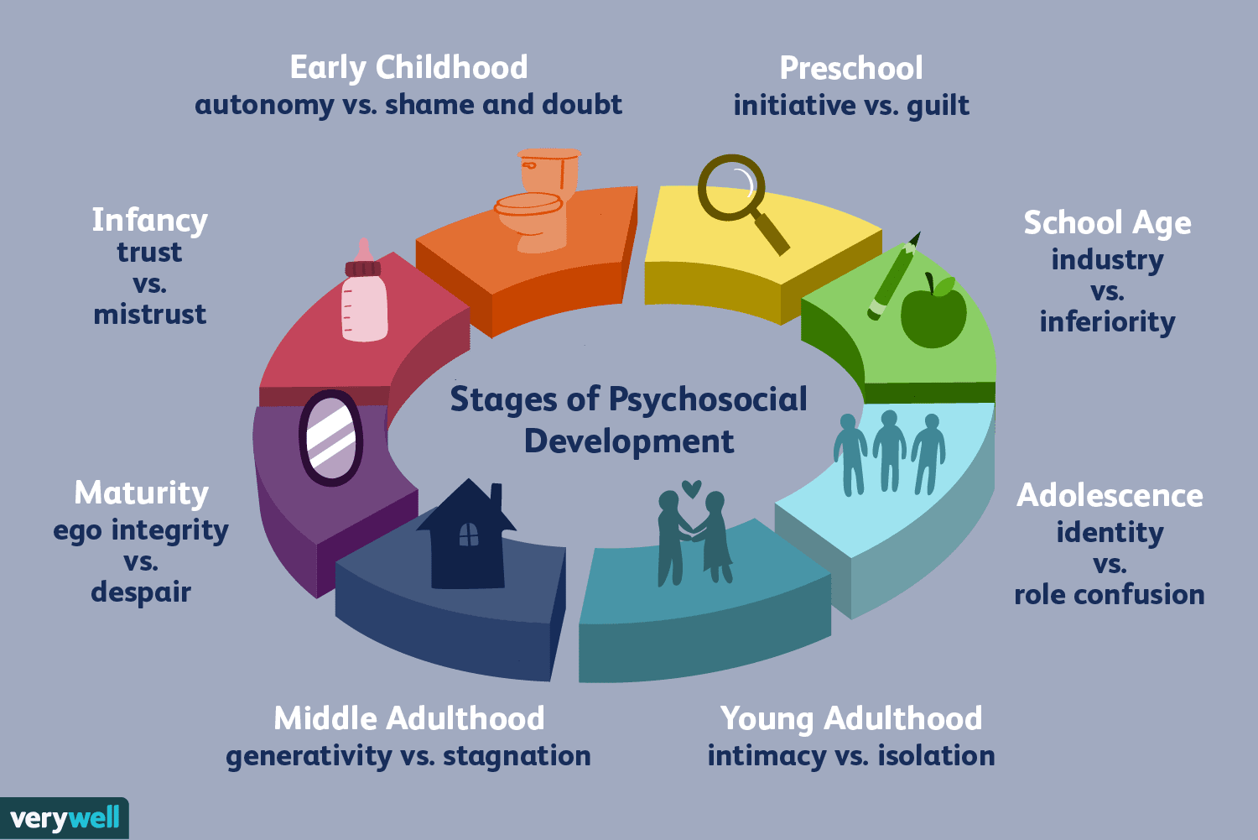
Eric Erikson’s 8 stages Psychosocial Development
To the right, we can identify that a human entering adolescence stage focuses on Identity vs. Role Confusion.
The 5th stage is important in a student’s development (School and Home)
**Teenagers work at developing a sense of self by testing roles and then integrating them to form a single identity, or they become confused about who they are. This occurs in two places… School and Home
**Social Capital in stage five is important for Belonging and Acceptance

Slide 27
Social Capital and belonging and acceptance
What we earn/develop/acquire: (Cool points) Networks of relationships among people who live and work in a particular society, enabling that society to function effectively.
Have you wanted to develop Social Capital?
Have you seen your students wanting to develop Social Capital?

Slide 28
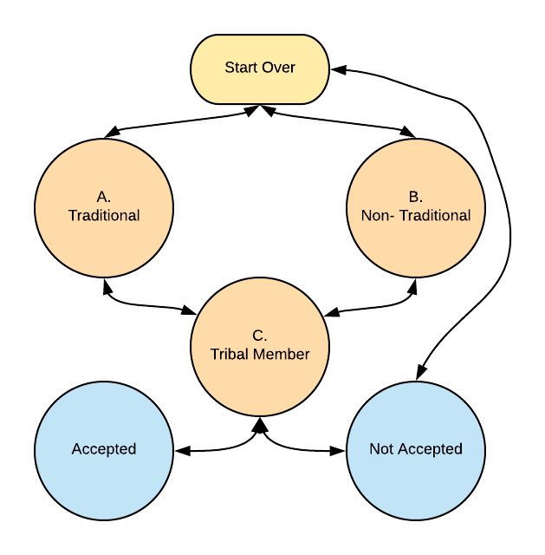
T vs. NT
(Expected/Not Expected
Not Accepted: Student must find a way to belong and feel accepted.
Challenge rules and expectations
A “want” to be like others
Student is challenged to ”choose”
Students will strive to feel a sense of belonging and acceptance, the key is for school and home to recognize this and help the student to understand it is okay to have these feelings and to be different if that is what they want.

Slide 29
Tools and ideas
Understanding the student and their background
Interdependent vs. Independent (Invest more PD time)
Recognizing what development implies (How this applies to learning)
Adjustment of approach to the student and family, parent support vs. parent involvement (family is a better term)
Finding a connection with the student, knowing what they are bringing to school everyday and supporting the student
Lastly, identifying why education is important, BIG PICTURE LEARNING.
Remember, what is important to you and general society may not be the same for the tribal community, as such, you must find a reason to sell education
Two types of community members that are striving to belong and be accepted in their worlds, which are you talking to and for what reason are you wanting to educate the student?

Slide 30
V.F. Cordova
“The problem for the indigenous child lies not so much in his making sense of the facts that he must learn, but of making sense of the unspoken and alien context that his teacher assumes is inherent in the child. Because the new context lies unconsciously in the nonindigenous teacher’s world picture, she cannot teach it to the child. She assumed his is stupid.” (And vice versa)
“The child cannot evade the educational system. It is illegal not to go to school. He is told he is going to learn; he is not told that much of learning consists of proselytizing, or social conditioning for another form of social and cultural community than his own. If he has enlightened parents, they can assist the child in making sense of what he is taught at school.”

Slide 31
THANKS FOR LISTENING
Questions, comments?

Slide 33
CONNECT WITH US!

Slide 34

End of Day Survey

