Slide 1
Multi-State Alternate Assessment (MSAA)
Use Your Checklist!
Training for
Test Administrators and Test Coordinators
Notes:
Hello and welcome to the Use Your Checklist! Training for Test Administrators and Test Coordinators for the Multi-State Alternate Assessment. Before we jump into the checklists, we want to do a quick overview of The Multi-State Alternate Assessment.

Slide 2
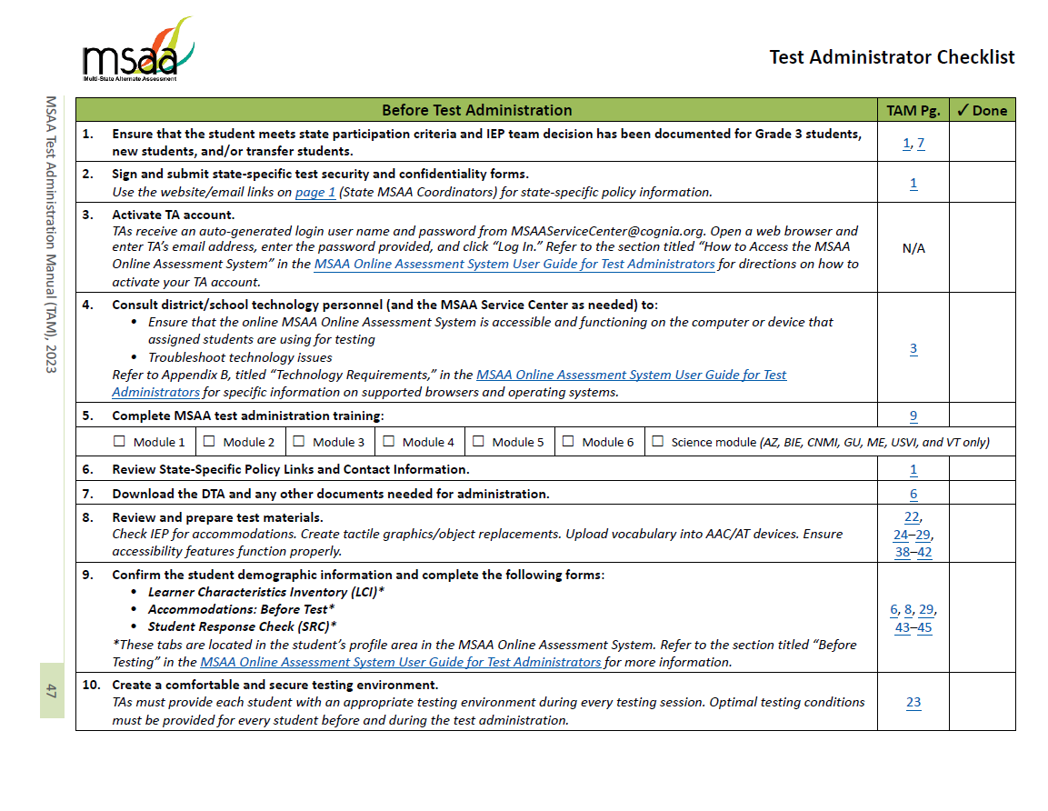
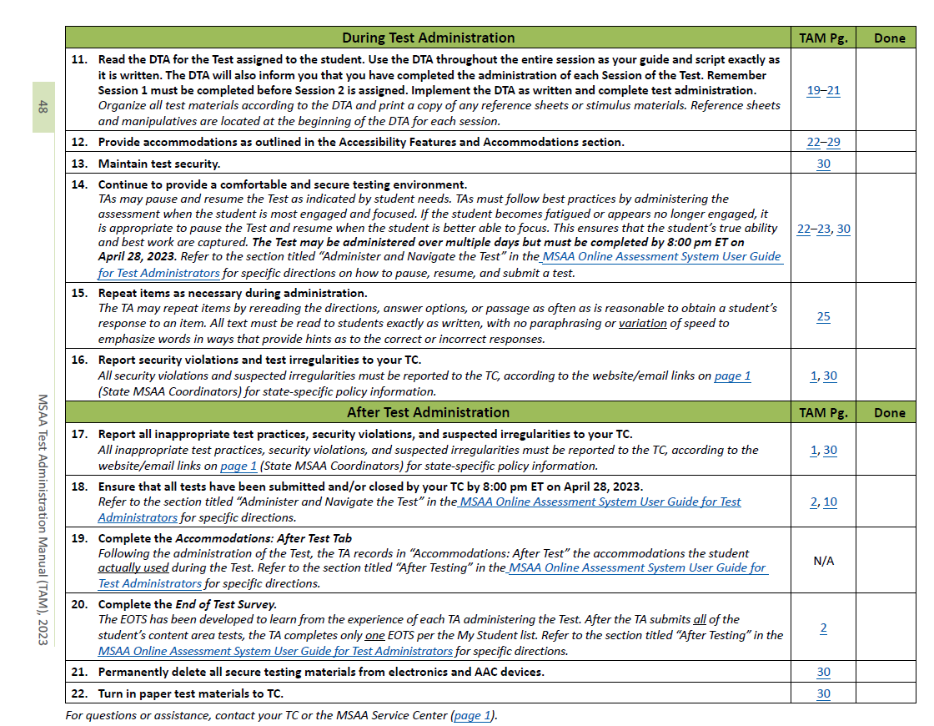
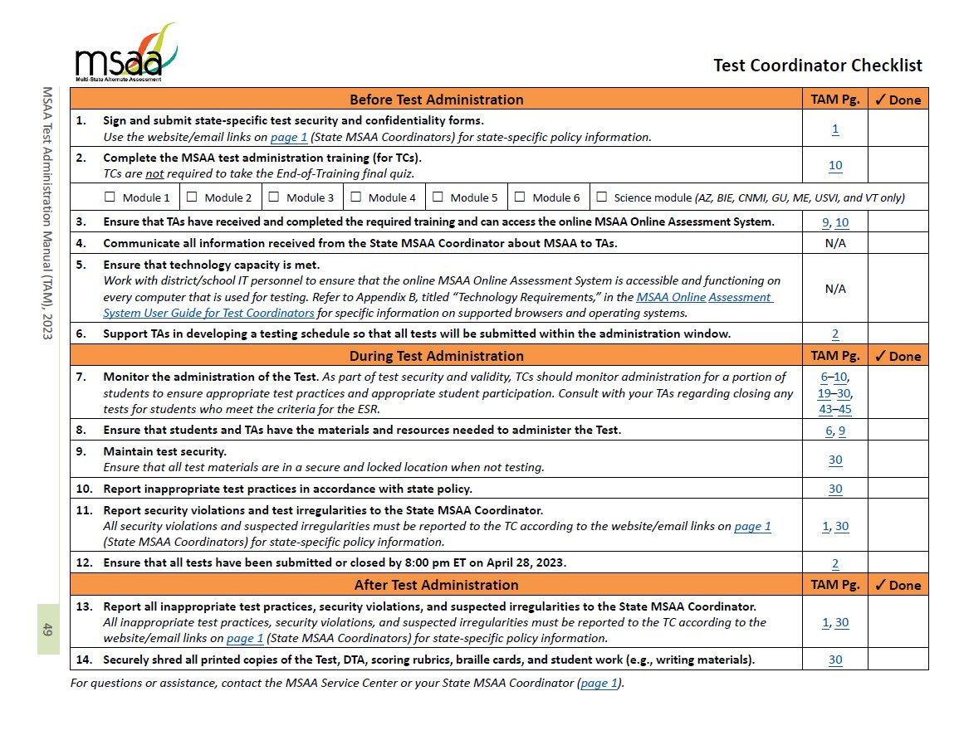
Agenda
Introductions
MSAA overview
TA/TC checklist overview
Before test administration
During test administration
After test administration
Q&A
Notes:
The agenda for today begins with introductions and an overview of the MSAA Test. Then we will go over what the Test Administrator or (TA) [animation] and Test Coordinator or (TC) [animation] checklists are and how to use them specific to your role, which we will do by going through each step. With each step of the checklist, we will provide guidance on how to complete the task.
We will have each of these checklists dropped right into the chat for you to download at this time, but they are also found in Appendix F of the Test Administration Manual, or the TAM for short. The 2023 TAM in full was provided to you when you registered for this training. If you would like to have that out to follow along and take notes as we go over specific topics today you are more than welcome to do so. We have found it helpful to use sticky notes if you have a printed version, or you can use pdf comments if you are viewing the TAM in pdf form. If you had trouble downloading the TAM and need it sent to you, please message Riley privately and that can be provided to you asap.
We should have plenty of time at the end of this training to answer your questions. Feel free to drop them in the chat and we will gather them at the end to answer.

Slide 3
Introductions – Cognia
Jason Brodeur, Senior Program Manager
Riley Emmons, Program Coordinator
Kelly Ickes, Director Content Development
Megan Bairstow, Manager Special Education Test Development
Haley Gardner, Accessibility Assessment Specialist
Anita Franklin, Accessibility Assessment Specialist
Notes:
We would like to introduce some folks from Cognia who will be facilitating the training today. Some may be behind the scenes, and others you will see and hear from during today’s training:
Jason Brodeur, Senior Program Manager
Riley Emmons, Program Coordinator
Kelly Ickes, Director of Content Development
Megan Bairstow, Manager of Special Education Test Development
Haley Gardner, Accessibility Assessment Specialist
Anita Franklin, Accessibility Assessment Specialist

Slide 4
Introductions – Bureau of Indian Education (BIE)
Donald Griffin, BIE Section 504 Program Coordinator, BIE MSAA Program Manager
Dr. Valerie Todacheene, Acting Chief Academic Officer
Dr. Rebecca Izzo, Supervisory Education Specialist, BIE NASIS Program
Aurelia Shorty, Education Specialist, BIE Program Manager for ELA/Math/Science General Assessments
Notes:
For introductions from the Bureau of Indian Education, we will introduce Donald Griffin and allow him to say a few words and introduce others.

Slide 5
Upcoming Participation Opportunities for MSAA
Content Area | Opportunity | Dates | In-person/ Virtual
Science | IRC (Content/Bias & Sensitivity) | March 30-April 3, 2023 | Virtual
Math/ELA | IRC (Content/Bias & Sensitivity) | June 12-16, 2023 | In-person
Science | Standards Setting | July 2023 | In-person
ELA | Passage Review | October 2023 | Virtual
Notes:
Before we begin with the training today, we’d like to provide some information about upcoming opportunities for teachers to participate in the development process for the MSAA.
At the end of March there will be an Item content and bias review meeting for MSAA Science/CSAA which will be held virtually. Recruitment is currently going on for that so if you have interest in being a panelist be sure to reach out to Don and look out for communications about this opportunity.
There is also an in-person item content and bias review meeting for the Math and ELA assessments in Salt Lake City in June, recruitment will begin for that soon.
This summer, there will be an in person standard setting for science, location and date still to be determined, but a great opportunity to learn about the Science assessment and its alignment to standards.
And last but not least, there will be a passage bias review meeting in October that will be held virtually.
Be on the lookout for emails from BIE sharing opportunities to participate as a panelist in these meetings, it is a great way to get involved with the assessment.

Slide 6
MSAA Overview
Notes:
First, let’s start with a quick MSAA Overview.

Slide 7
Overview of the Test
Assesses three content areas
English Language Arts (ELA)
Reading
Writing
Mathematics
Science
ELA & Math: Aligned to the MSAA Core Content Connectors (CCCs)
Science: Aligned to the Extended Performance Expectations (EPEs)
ELA & Math: Grades 3-8 and 11
Science: Grades 5, 8, and 11
All standards can be found at https://www.msaastates.com/standards.html
Notes:
Cognia
The MSAA assesses three content areas, English Language Arts (ELA) which is comprised of reading and writing, Mathematics, and now Science.
The ELA and Math portions of the MSAA are aligned to the MSAA Core Content Connectors, which are the alternate achievement standards.
The science portion is aligned to the Extended Performance Expectations.
All students eligible for alternate assessment in grades 3-8 and 11 will participate in both English Language Arts and Mathematics.
All students eligible for an alt assessment in grades 5, 8, and 11 will also participate in the Science portion of the MSAA assessment.
[ANIMATION] All standards can be found on the MSAA website: https://www.msaastates.com/standards.html

Slide 8
Overview of the MSAA (cont.)
One-to-one test administration
Administered by a trained Test Administrator
Formats (determined by what is appropriate for student)
Computer based format
Paper based format (downloaded from platform)
Test administrator enters student responses in online platform
Notes:
The MSAA is administered in a one-to-one setting by a trained Test Administrator; preferably someone who is familiar with the student.
The assessment is available in two formats, computer or paper-based. Let’s take a closer look at how to customize the formats based on what is appropriate for each student. [Go to Next Slide]

Slide 9
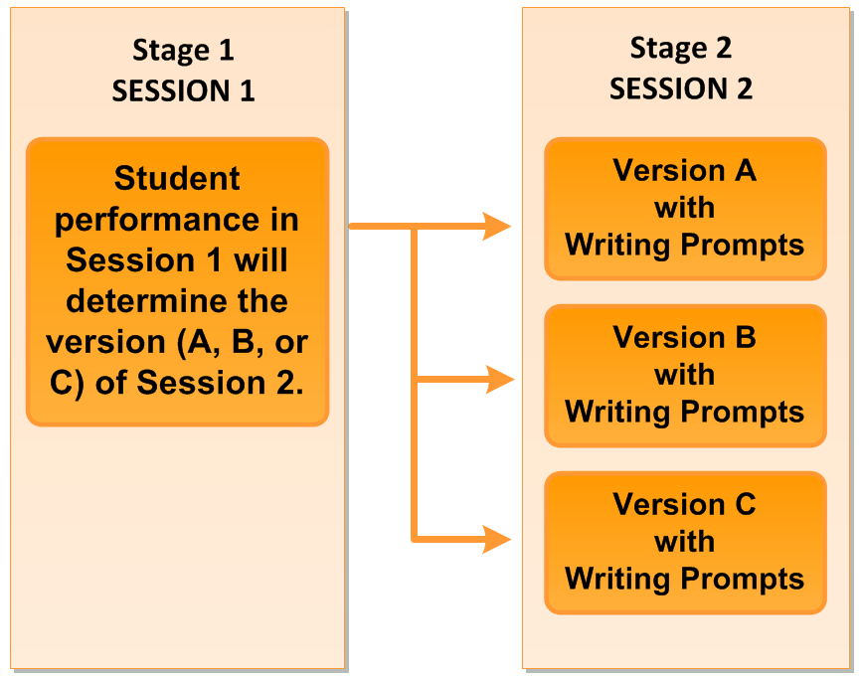
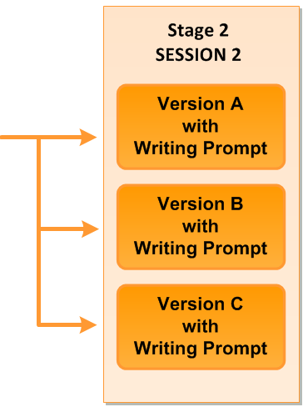
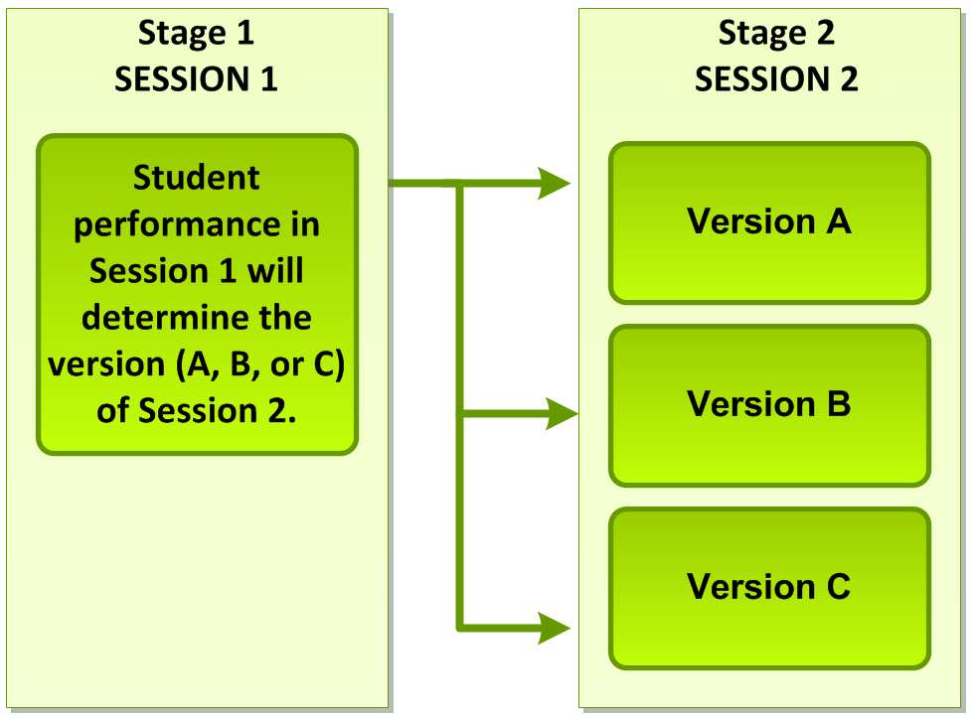

MSAA Test Design
English Language Arts
Mathematics
Session 1 must be submitted into the MSAA system before moving on to Session 2.
Notes:
ELA and Mathematics are stage adaptive and provide students with an experience that assigns the second session of the assessment based on how the student responds to items in the first session.
The versions in the second session vary by difficulty/complexity level. Each student will only take one version of Session 2 (A, B, or C) that is assigned to him/her after submitting Session 1.
For ELA, all students are assessed in Stage 1. Session 1 contains items from a broad range of levels. Upon completion, the student is directed to Session 2 via version A, B, or C.
Version A contains items at a lower-level range of difficulty/complexity. The writing prompt associated with this level utilizes graphic organizers and sentences starters for student work.
Version B contains items at a mid-Level range of difficulty/complexity. The writing prompt associated with this level utilizes graphic organizers and a template for student work.
Version C contains items at a higher-level range of difficulty/complexity. The writing prompt associated with this level utilizes graphic organizers and a template for student work.
The Mathematics assessment will be presented the same way with student responses from Session 1 directing them to a Session 2 with varying levels of difficulty for the assigned version A, B, or C.
[Animation] In order for the student to be routed to the Session 2 that best fits their performance level, the TA must submit Session 1 into the MSAA Online Assessment system prior to moving on to Session 2.

Slide 10
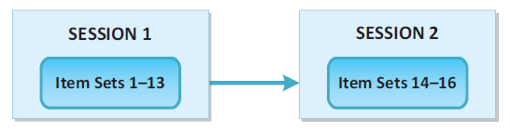
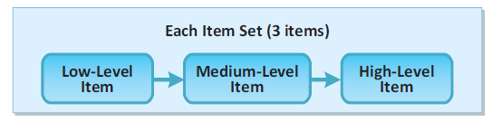
MSAA Test Design (cont.)
Science
Session 1 must be submitted into the MSAA system before moving on to Session 2.
Notes:
[Animation] The MSAA Science assessment is a linear administration in which all items are administered to the student in the order presented. It is comprised of a series of sixteen item sets (forty-eight items total) administered over two sessions within the administration window. Once Session 1 has been submitted, students are NOT able to return to that session.
[Animation] Each item set has three levels of difficulty, which are aligned to the three levels of the Extended Performance Expectations. Items within a set do not share a scenario, with the exception to this being a specialized bundle of item sets referred to as a “cluster”.
[Animation] Note that Session 1 must be submitted into the MSAA system before moving on to Session 2.

Slide 11
MSAA Item Types
Selected-Response: All contents
Constructed-Response: ELA and Mathematics
Student Writing Prompt: ELA
Recommended: Administer the ELA portion of the test first!
Notes:
There are three types of items included in the MSAA assessment.
Selected-Response (SR) Items appear in ELA, Mathematics, and Science portions of the test. All directions and materials needed for administering the SR items are in the Directions for Test Administration (DTA) for the specific content area.
Constructed-Response (CR) Items are in ELA and Mathematics only. These items ask the student to develop an answer instead of selecting an answer from answer options. Each item is presented to the student in a standardized, scripted sequence of steps culminating in the TA scoring the student’s performance using the Scoring Rubrics and entering the response into the MSAA system. Directions and materials needed for administering these items are included in the Directions for Test Administration (DTA).
Writing Prompt: ELA requires students to produce a permanent product in response to a prompt. Each writing prompt DTA contains:
A standardized, scripted sequence of steps for the TA to follow
A graphic organizer for students to make notes and plan their essay
A template to write their essay before it is typed on the computer or uploaded into the system
And a mentor text to present to the student as an example of a finished product are provided in grades 3, 4, 5, and 11 only
The writing prompt submissions are hand-scored. Please administer the ELA portion of the MSAA first because the writing prompt tends to be a little more time consuming.
It is understood that writing prompts are one of the more challenging part of the MSAA test. TA training module 4 goes into a great amount of detail about these prompts and can be accessed any time during the administration window, so please be sure to use this as a resource. Also, there is a best practice video on the MSAA assessment website that is a great resource as well. Which I will show you in the system here shortly.
The sample items available on the platform now for grade 6 have 2 sample writing prompts, and when the new sample items are released in February there will be sample writing prompts in grades 4, 7, & 11 as well.

Slide 12
Use Your Checklist!
Notes:
Now that we have discussed the background information about what the MSAA Test is and entails, lets get into some best practices for administration, which includes following along with the checklists that are provided in the TAM.

Slide 13
TA and TC Checklist Overview
Located in Appendix F of the Test Administration Manual (TAM)
Intended to assist in ensuring a successful administration of the MSAA Test
Before administration
During administration
After administration
Notes:
As previously mentioned, the test administrator and test coordinator checklists can be found in Appendix F of the Test Administration Manual (TAM), which you should all have access to at this point for being here with us today. It can also be found in the MSAA system on the bottom lefthand corner once you have your login credentials, you will be able to get into the system and access the materials from there as well starting 2/27.
The checklists are designed to ensure you have a short document that lays out all of the tasks that you will be required to complete as either a TA or TC before administration, during administration and after administration. These checklists are basically the entire TAM shrunken down into a 1 or 2 page document that highlights your role as either a TA, TC or both. Let’s take a closer look.

Slide 14
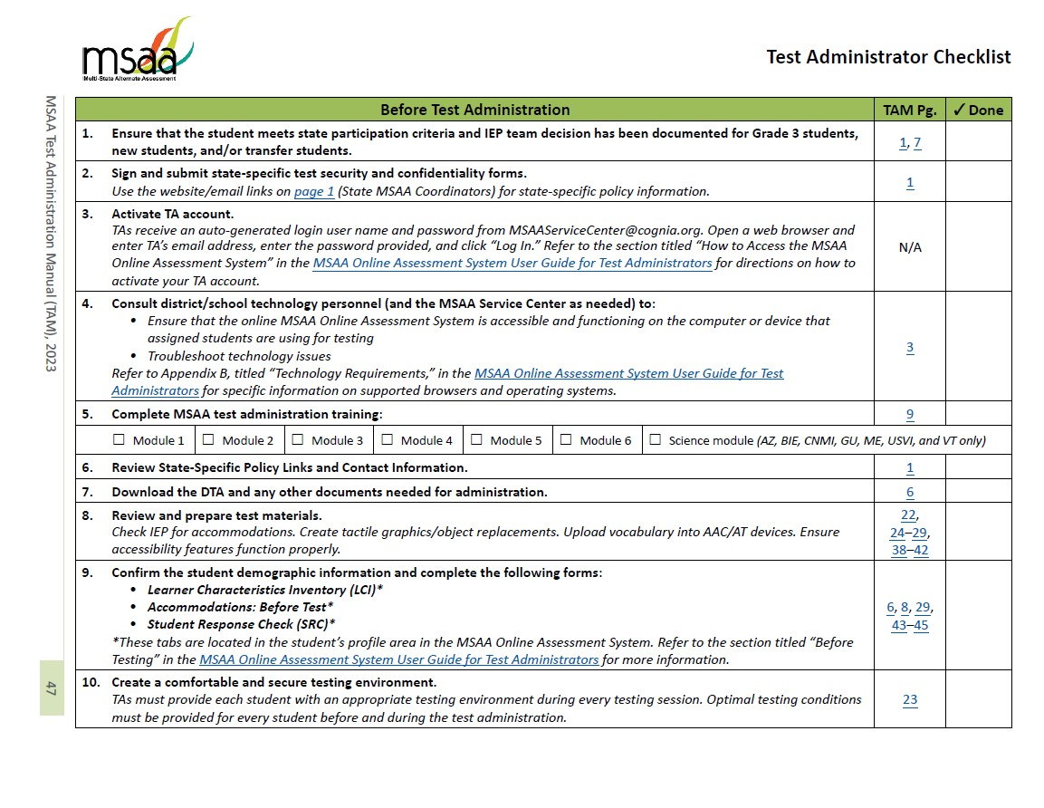
Test Administrator (TA) Checklist
Notes:
Here are the 2 pages of the TA checklist. The first page shown on the left focuses on the Before test administration tasks, while the second page focuses on the during and after test administration tasks.
The first column in the checklist [animation] identifies which part of administration you are focusing on, then lists all the associated tasks below in numerical order.
The second column in the checklist [animation] identifies the page number(s) in the TAM that this topic corresponds with. If you go to that corresponding page in the TAM, it will provide you will all the details required in order to complete the task on the checklist.
And the last column in the checklist [animation] is a place for you to keep track of where you are with your administration, and it always feels good to check something off your to-do list!

Slide 15
Test Coordinator (TC) Checklist
Notes:
This is the Test Coordinator (TC) checklist. It is set up in the same way as the TA checklist, but the tasks are different as they highlight the duties of a Test Coordinator. In contrast to the Test Administrator or (TA) checklist, this document is one page only with the same breakdown for tasks: before, during, and after test administration.
If you are a TA it is beneficial to be aware of the responsibilities of a test coordinator, and as a test coordinator, you must be aware of all expectations of a TA as you will be their first line of support as questions arise during testing. If you are a TC that is also serving as a TA, it will be very important that you are familiar with all tasks on both checklists.

Slide 16
Before Test Administration
Notes:
Our plan is to use the TA checklist to call out each task identified and then show the test coordinator checklist to follow up with how the TC will support those TAs and the tasks that are specific to that role.

Slide 17
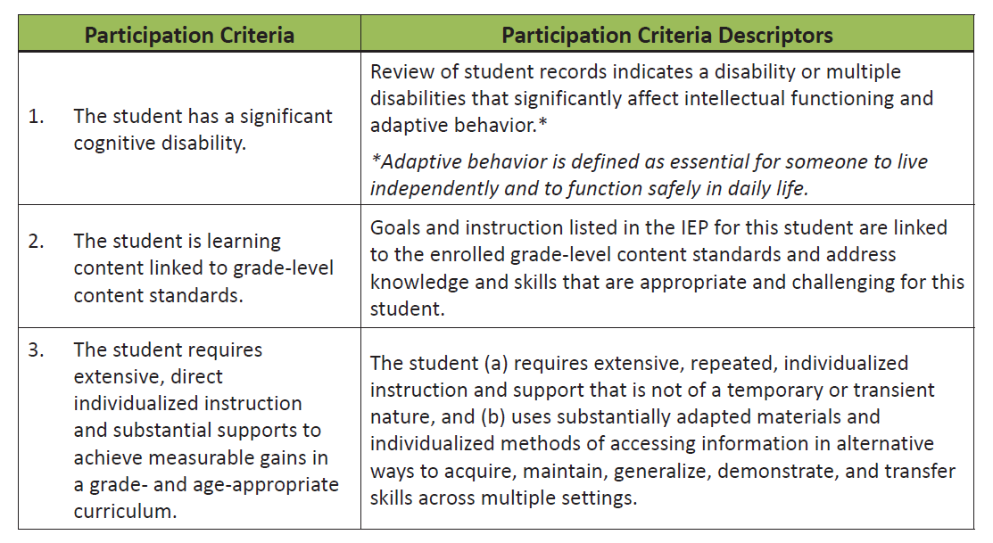
Notes:
Before administering the assessment, you will need to make sure that your student qualifies for the participation of an alternate assessment and MSAA, which is what step 1 of the TA checklist prompts you to do.
The Students who are participating in the MSAA have been determined eligible by their IEP team. You can refer to the Participation Criteria (which is shown on screen here) in the “Who Should Take the MSAA” section of the Test Administration Manual (TAM). And if you have further questions about whether or not your student is eligible that is something you would want to talk to your BIE team with.

Slide 18

Test Security Agreement will be in a pop-up window upon initial login into the MSAA Assessment System
TAs will need to accept agreement to have full access to secure materials
Notes:
Step 2 of the TA checklist is to sign and submit state specific test security and confidentiality forms. The test security agreement shows up in a pop-up window during that very first login into the MSAA system. At that time, you can read and agree to the rules of test security, and you will be granted full access to the secure materials in the system. For BIE, this counts as your test security and confidentiality form.

Slide 19
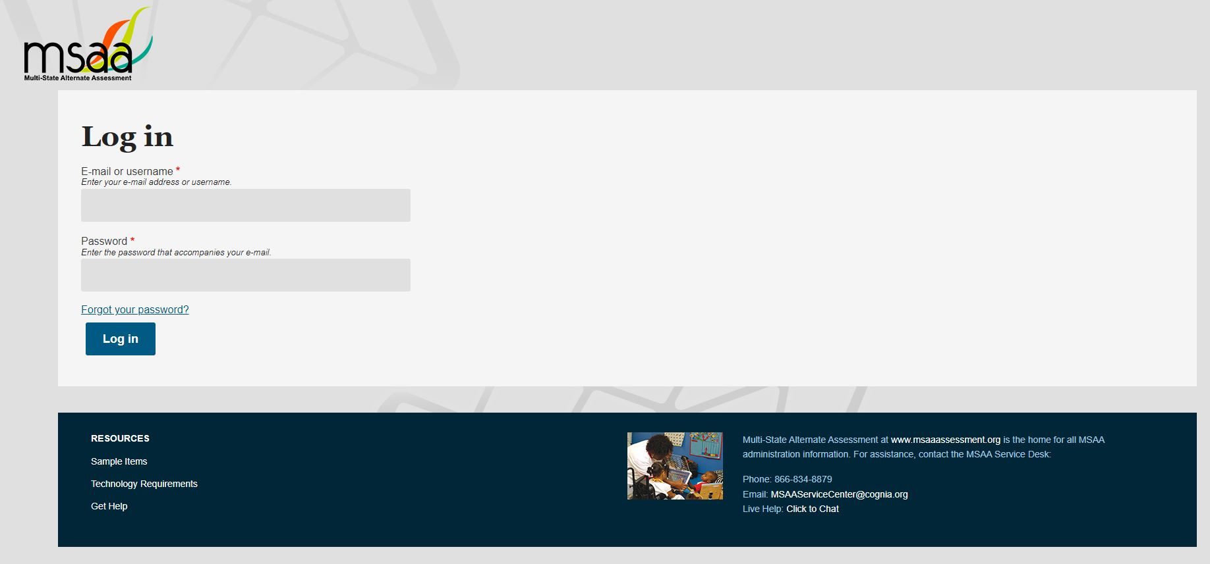
Email will be sent from msaaservicecenter@cognia.org with a link and login credentials
Update password as instructed in the MSAA System
Login to MSAA System at www.msaaassessment.org
Notes:
Step 3 in the checklist is to activate your TA account. Before administration begins, you will receive an email from msaaservicecenter@cognia.org with a link and login credentials that will be used to activate your account. Once you get to the MSAA homepage log in page will be front and center [Animation] and you will put in your credentials. Upon that initial login, you will be prompted to update your password. Once you do that, you will then have an activated TA account that can be accessed by going to www.msaaassessment.org

Slide 20

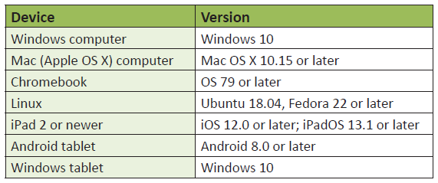
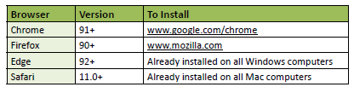
Notes:
Step 4 of the TA checklist - Running into technology glitches while testing is never fun, so you will want to check with technology personnel at your school to make sure that your browsing and operating systems coincide with the technology requirements for administering the MSAA Test prior to testing. Requirements that are shown on screen here can be found in the User Guides, and in the MSAA system under resources if you click on technology requirements.
A friendly reminder - be sure to check ANY device that will be used during the test administration, not just the device that you use for initial login. So, if your student is using an iPad or smart board or their favorite computer in a different classroom, be sure to check those as well.

Slide 21
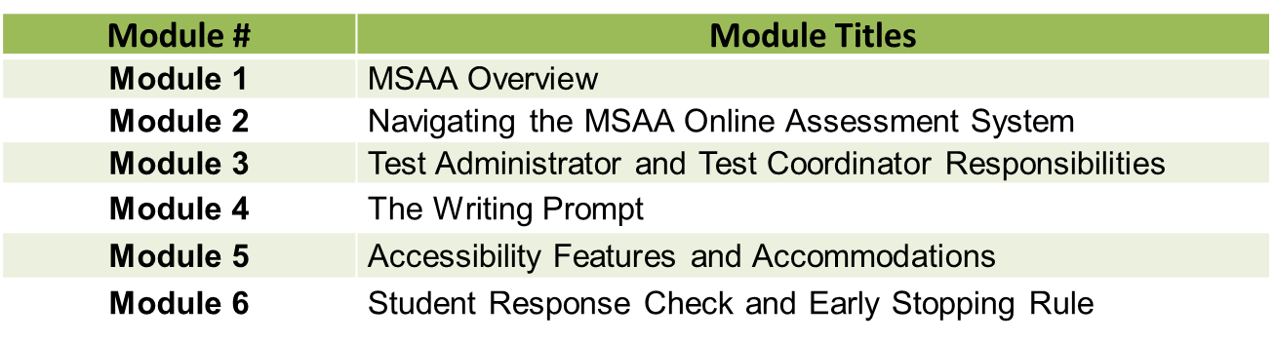
*MSAA Science Training Module
Notes:
Step 5 in the checklist is to complete the training modules and pass the final quiz. TAs will be required to watch the 6 training modules and pass a final quiz with 80% accuracy in order to get access to the secure materials in the MSAA system. [Animation] TAs who have students in grades 5, 8 and high school (grade 11) will also be required to watch the MSAA Science Training Module, however there are no quiz questions associated with that science module in the final quiz.

Slide 22
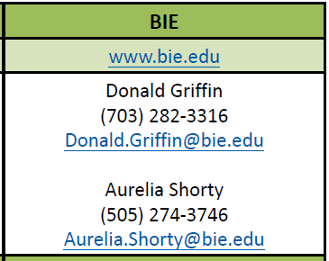
Notes:
Step 6 of the checklist it to review state-specific policy links and contact information. What you see on screen here can be found on Page 1 of the TAM. There are various states and entities who take the MSAA Test and don’t have all the same policies, so if you ever see something in the TAM that says refer to state-specific policies, you will want to go to the BIE website and find the BIE Specific policies information or reach out to your MSAA Contacts for BIE as shown on screen here.

Slide 23
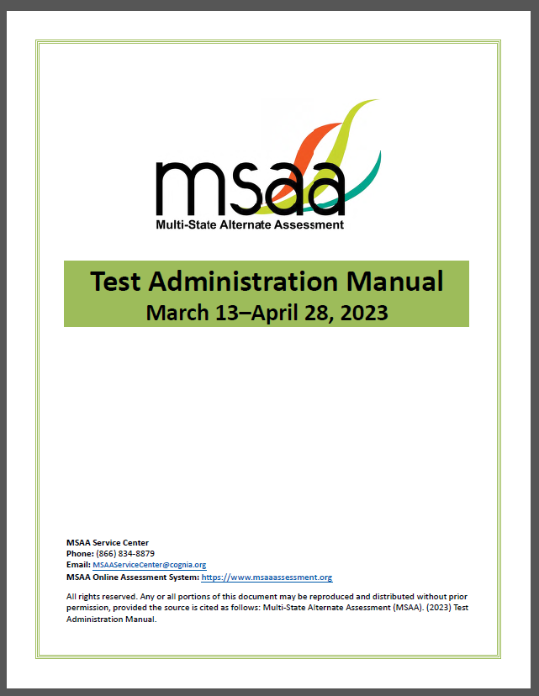
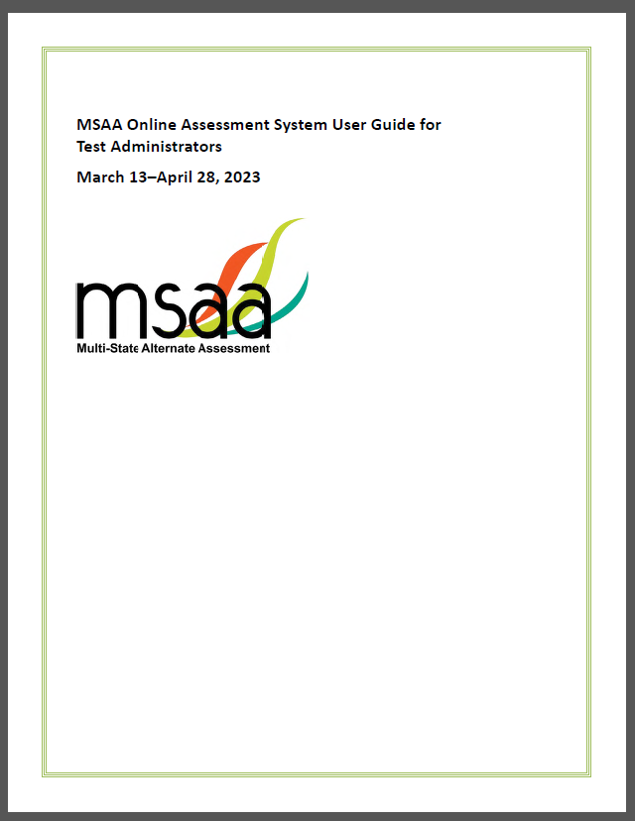
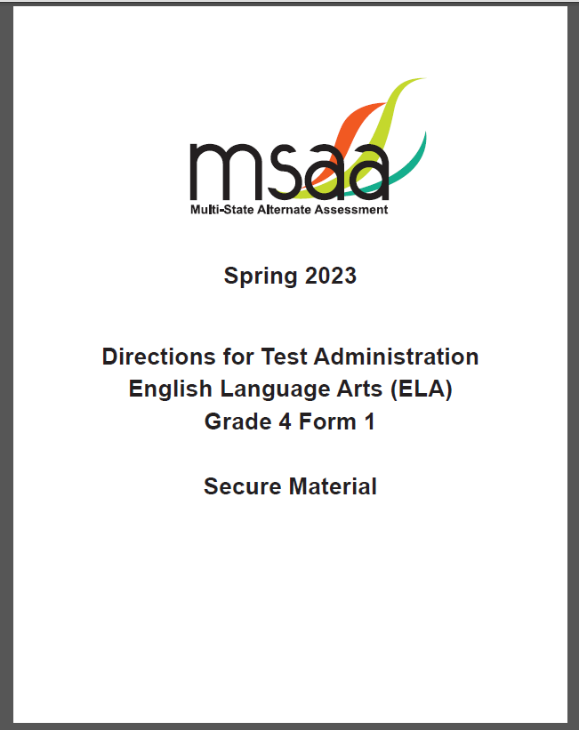
Test Administration Manual (TAM)
Provides policies and procedures for TAs and TC to prepare and administer the MSAA Test
Online Assessment System User Guide
Describes the MSAA System features and provides very detailed directions on how to perform required functions in the MSAA system before, during and after administration.
Directions for Test Administration (DTA)
REQUIRED
Secure material
Contains essential administration information specific to your student’s test
Notes:
Step 7 is to download the DTA and any other documents needed for administration.
There are 3 main documents needed for a successful administration. First being
[animation] the TAM or Test Administration Manual. This is where this checklist is from, and basically all the information we are going over today comes right from the TAM. It is the resource that provides policies and procedures for TAs and TC to prepare and administer the MSAA Test. All information being discussed today can be found in great detail in the TAM.
[animation] Another manual needed for administration is the MSAA Online assessment system user guide. This resource describes the MSAA System features and provides very detailed directions on how to perform required functions in the MSAA system before, during and after administration. There is one user guide for TAs and that shows step by steps procedures for completing the responsibilities as a TA, so if you are in the system and forget how to turn on the read aloud feature or something like that, the user guide is where you would find the “how to”. There is also a TC user guide that has more information related to the TC role, such as assigning students to classrooms in the system and things of that nature. So, for all technology, system-based questions you will want to find the user guides under resources on the MSAA homepage.
[animation] Last but certainly not least is the DTA or the Directions for Test Administration. Where as the other two documents are resources to help you dminister as needed, the DTA is different because it MUST be utilized when administering the test. This is the document that includes all of the scripts, reference sheets, cutouts, scoring rubrics, writing prompts and various other directions and prompts. The Test CANNOT be administered without your student specific DTA. If you do not use a DTA when testing your student, it is not a valid test score. To ensure the test is administered consistently to every student, TAs must follow the directions in the DTA exactly as written for every single item on the test. While the other two documents can be found under resources, this DTA is found in your student profile once a test has been assigned to them. This can be downloaded once the modules are completed and the final quiz is passed since it is a secure material.
The TAM and User guides are not secure materials and will be able to be accessed in the MSAA system under resources on the homepage of the MSAA System once you receive your login credentials.

Slide 24

Directions for Test Administration (DTA)
The DTA must be utilized when administering the Test. It provides all directions for a successful 1:1 MSAA administration and includes the following:
directions and scripts for each item in the Test
details about manipulatives required in order to administer a test item, such as calculators and counters
reference sheets that contain important graphics
scoring rubrics for constructed-response items (CRs)
writing prompt script, mentor text (when applicable), graphic organizer, student response templates, and stimulus materials for all writing prompts in each grade-level ELA DTA
specific directions to administer the braille versions of ELA foundational reading items in grades 3 and 4
Notes:
Continuing on with step 7, lets talk a little bit more about the DTA - The DTA MUST be utilized when administering the test. Regardless of which administration type (computer, paper, or both), regardless of the accommodations and accessibility features being used, all TAs must use the DTA for each assessment they administer. I know that the paper-based test does look very similar to the DTA, but it does not contain all of the materials and information required to validly administer the assessment. The DTA is the only document that contains all directions and materials for a successful 1:1 MSAA administration. Each DTA includes:
Directions and scripts for each item in the test.
Details about manipulatives required in order to administer a test item, such as calculators and counters.
Reference sheets that contain important graphics
Scoring rubrics for constructed response items
Writing prompt script, mentor text (when applicable), graphic organizer, student response templates, and stimulus materials for all writing prompts in each grade-level ELA DTA
And specific directions to administer the braille versions of ELA foundational reading items, and that is applicable for grades 3 and 4 only.
TAs will receive access to their student’s DTAs on February 27, 2023, after the online Test Administration Training modules are completed, and an 80% has been attained on the final quiz.
Prior to administration of the Test, TAs should download, print, and review the Session 1 DTA.
TAs may opt to view the DTA on another computer during administration, but you will still need to print out the student facing materials and prepare them then also provide them as the DTA states during testing.
Please remember [animation] that DTAs are secure material and must be kept in a secure location, given to a TC for shredding after testing, and deleted from all computers after testing.

Slide 25
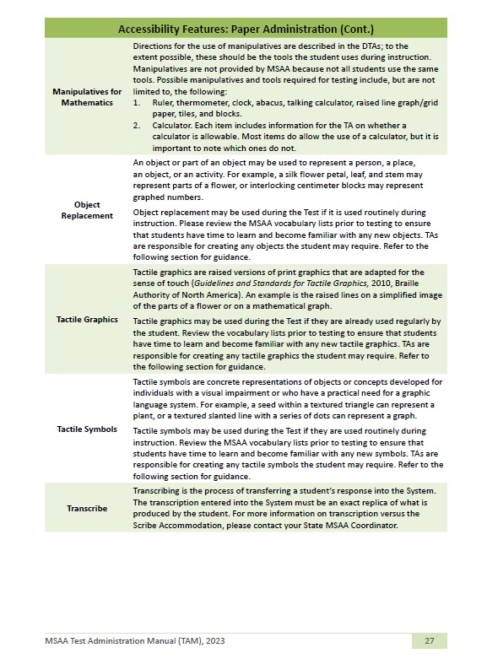
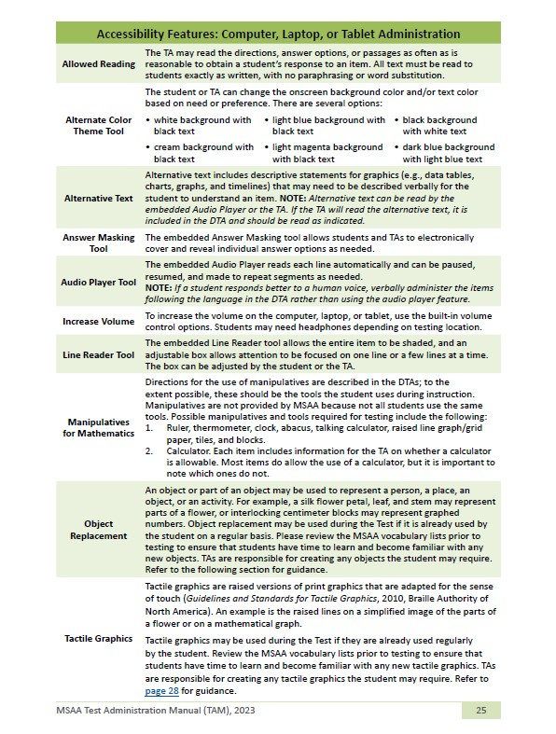
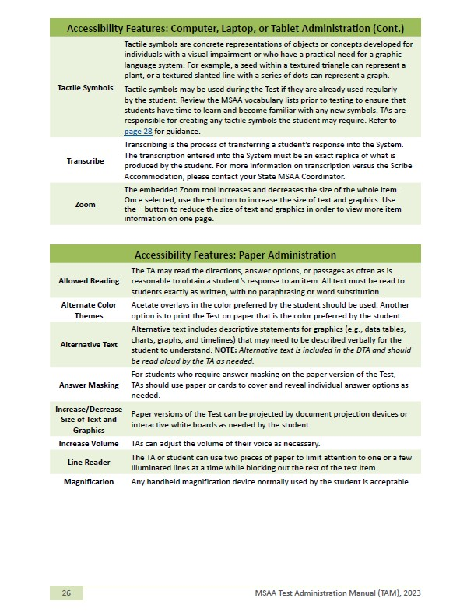
Review your student’s IEP accommodations and compare those to the list in the TAM
Identify the equipment that will be used for testing
Ensure that the accessibility features function properly
Notes:
Moving on to step 8 of the checklist - there are many things that need to be done in order to prepare for test administration. We can start by talking about preparing student accommodations and assessment features.
Reviewing your student’s IEP accommodations and comparing those to the list in the TAM, making sure you are well versed on the guidelines and protocols for using the accommodations with the MSAA test.
You should also identify the equipment that will be used for testing – you may need to make sure that the equipment meets the minimum requirements for testing.
Along with any necessary accommodations, you will also want to discover which accessibility and assessment features will create the best testing environment for your student and then testing them out to make sure they function properly. The TAM has comprehensive lists of features and supports that may be used in the computer-based test and also if you are administering the paper-based test.

Slide 26
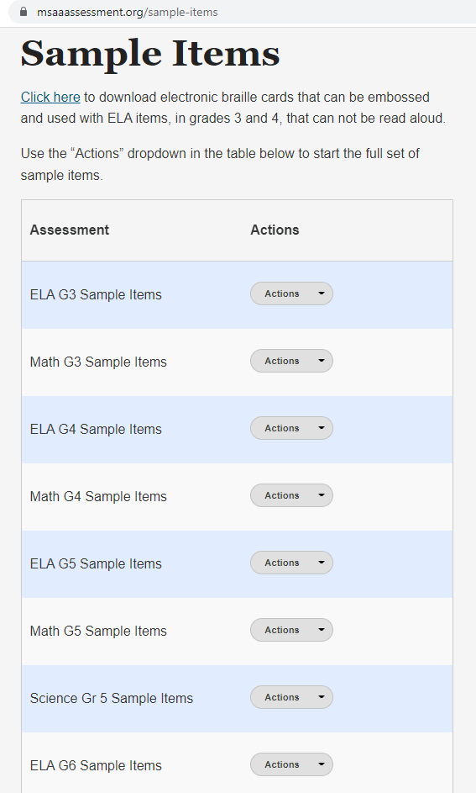
Access the sample items (available all year) and familiarize yourself with the assessment format and features.
Notes:
You can test out the assessment features, accessibility features, and any accommodations by using the [Animation] sample items that are available year-round in the MSAA system (no log in required). Every grade and content has a set of sample items, so getting in there and preparing for the actual test will be very helpful to you and your student. It will give you an idea of what features work best for your individual student so you can create the most optimal testing environment for your student.

Slide 27
Read the DTA!
Create tactile graphics and object replacements
Upload vocabulary into AAC/AT devices
Cutout all CR cutouts beforehand
Find a system that works best for you!
Notes:
Here are some additional tips for preparing test materials:
Read the DTA for the session you are administering and make notes!
Create tactile graphics and object replacements for items as appropriate and as your student typically uses them to access instruction
Upload all vocabulary into AAC/AT devices
Cutout all constructed response cutouts beforehand and have them organized.
And find a system that works best for you! Here are some helpful tips and tricks to help you when preparing test materials.

Slide 28
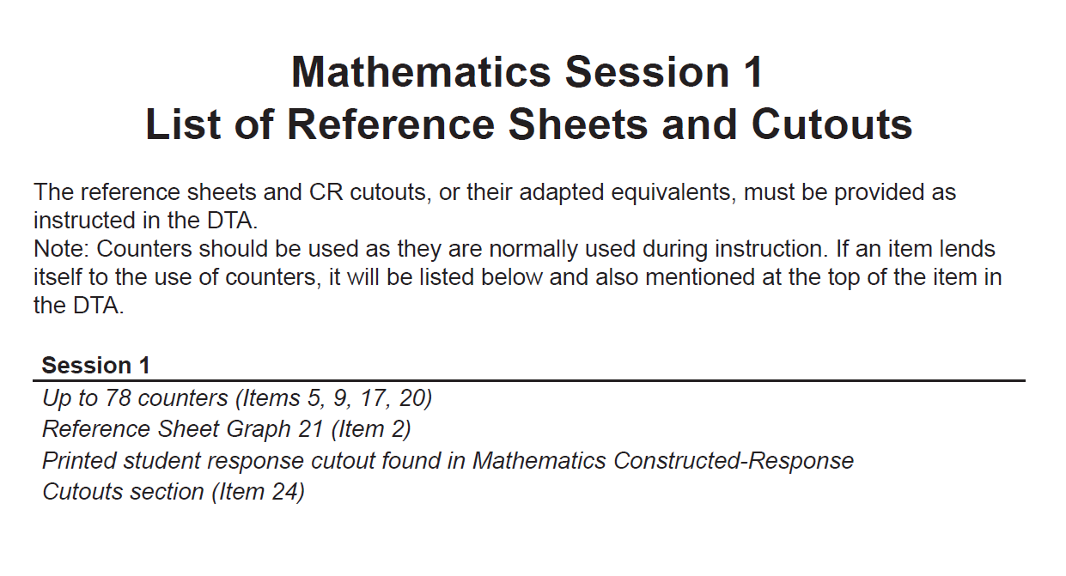
Notes:
Inside each DTA at the beginning of the session, there will be a page that details the Reference Sheets, constructed response cutouts, counters, and writing prompt materials that are to be used on that specific session of the test, as shown on screen here. The materials will be labeled and marked as to which item they correspond to, as you can see the first reference sheet [animation] – graph 21 will be used for item 2, so when you get to item 2 on the test you should be prepared to hand the student the reference sheet.

Slide 29
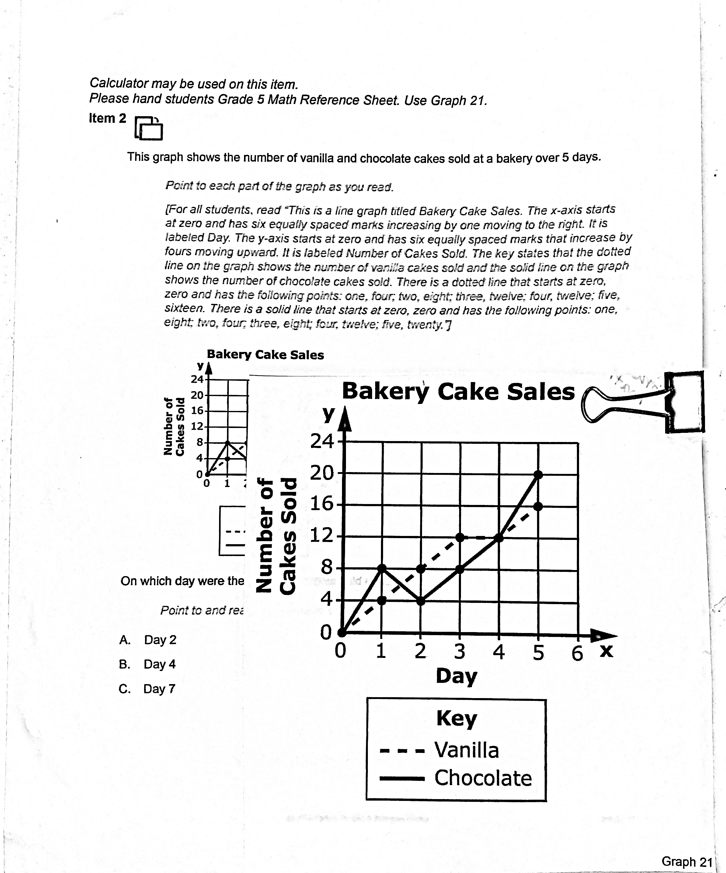
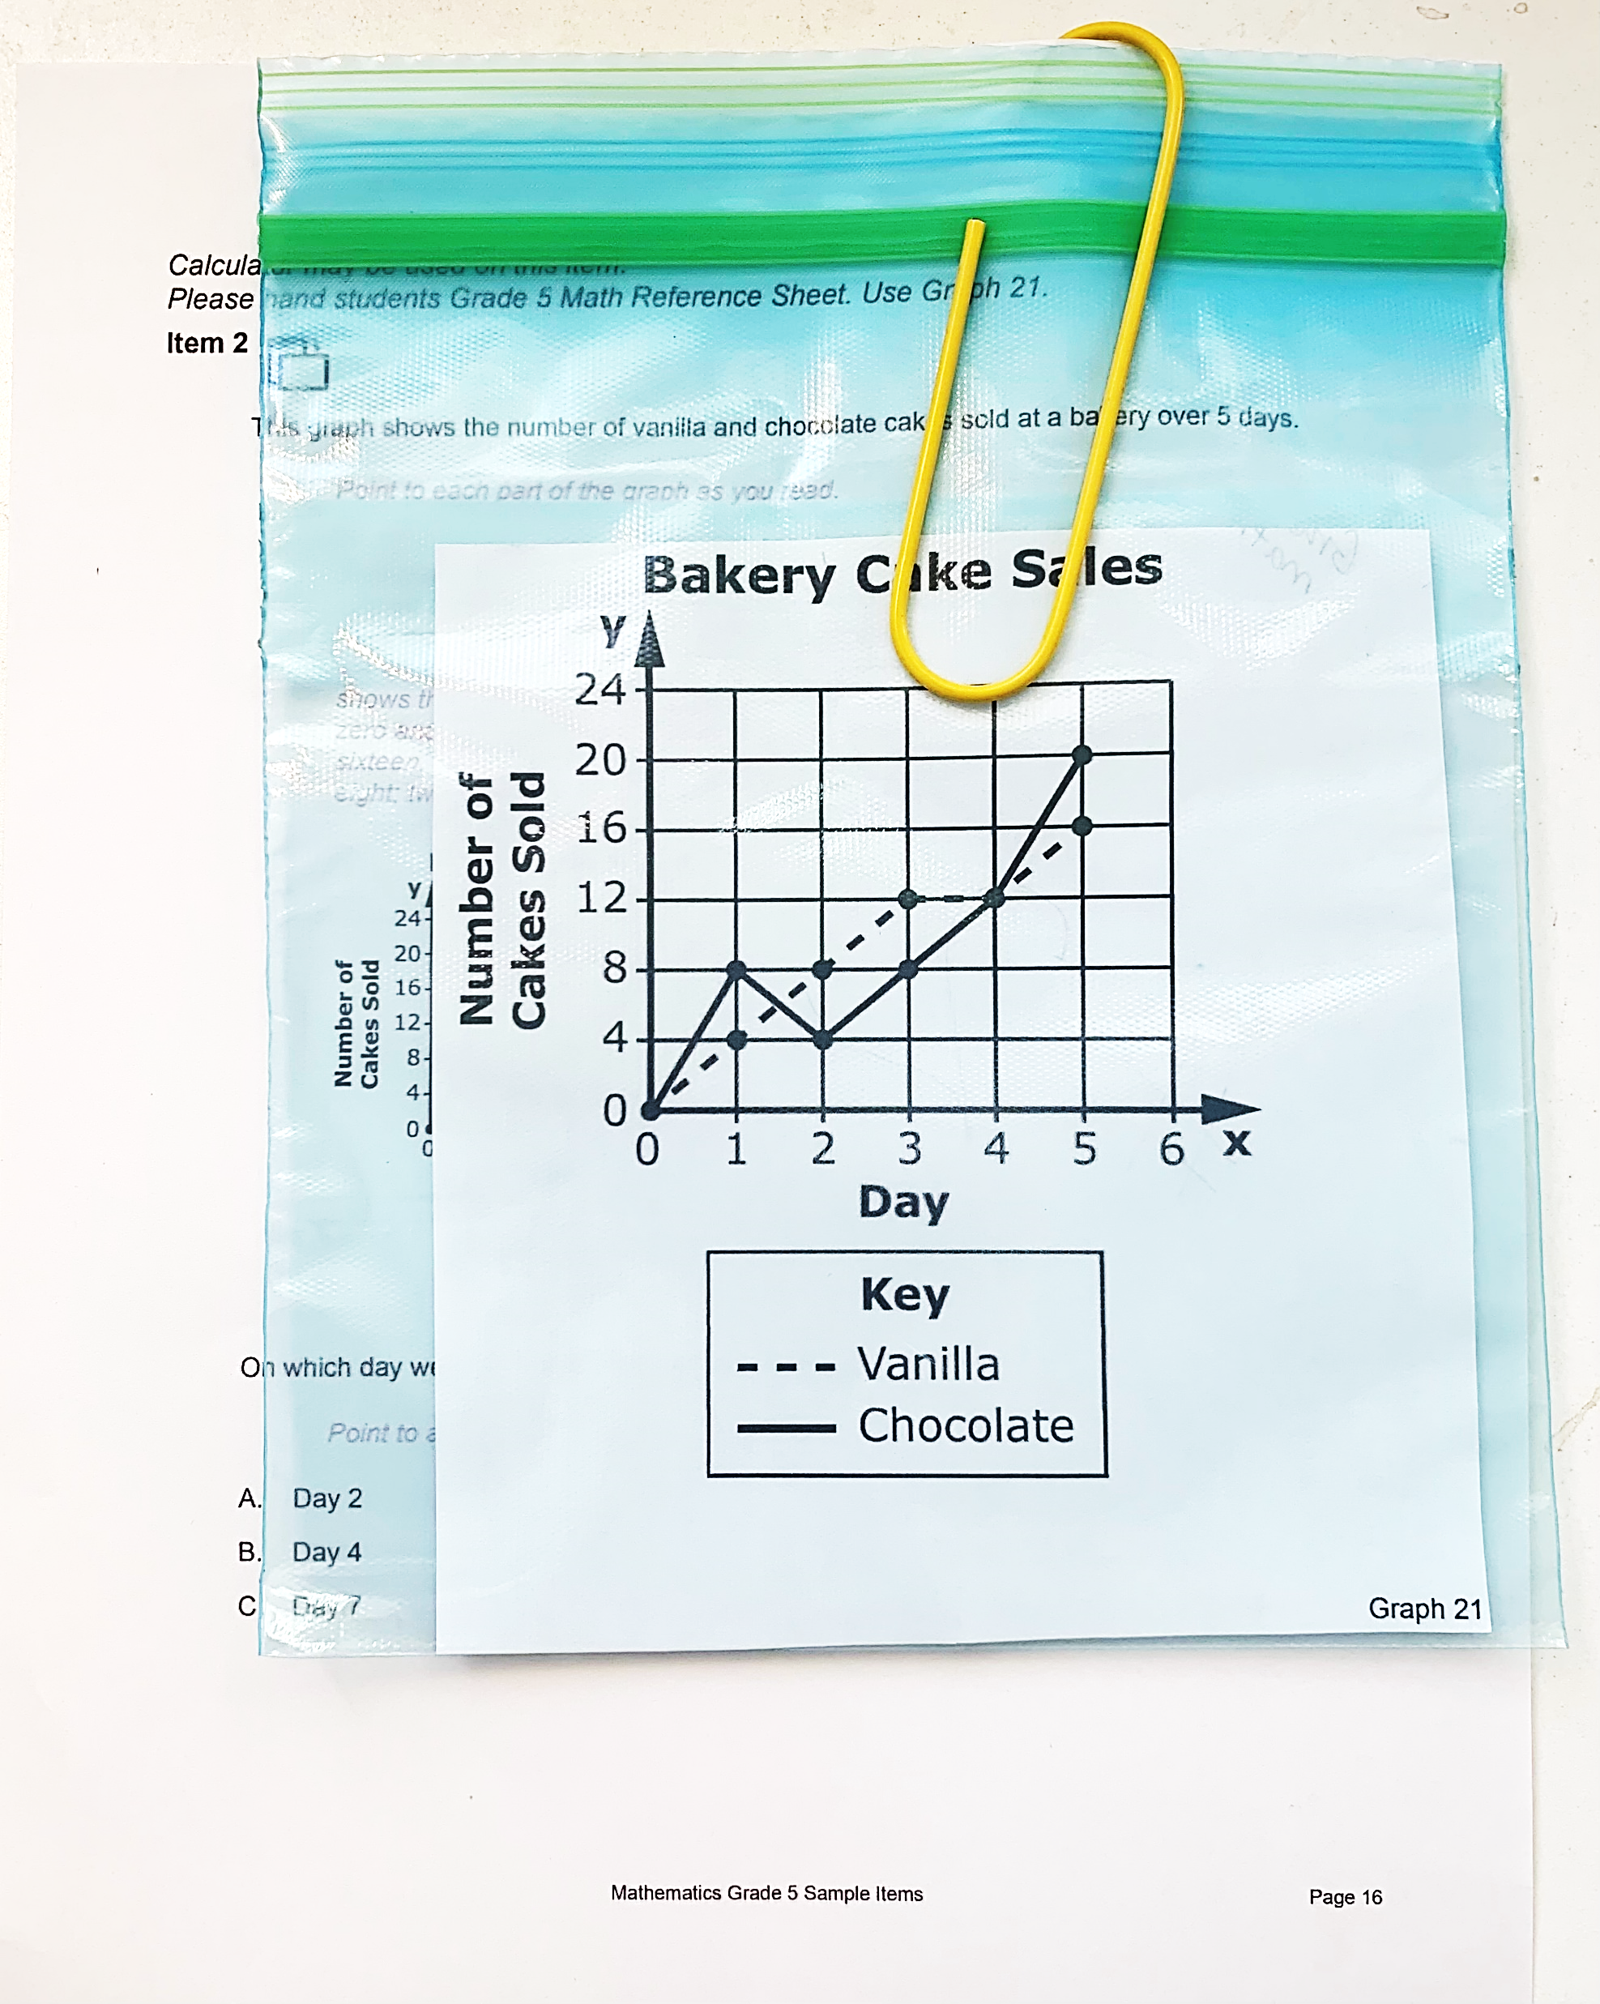

paperclips
binder clips
clear bags
Notes:
On screen here, you can see the page of the DTA (which is teacher facing only) with the reference sheet of the line graph clipped on to the page that it corresponds with. The image on the right has the reference sheet in a little baggy and paperclipped on to that page of the DTA.
Organizational tips such as using paper clips, binder clips, and resealable storage bags are excellent ways of keeping reference sheets and cutouts with the actual item in the DTA. All cut-outs should be cut and ready prior to administration. Many of them are small and will require proper storage so they don’t get lost. Writing the item number on the back of cut-outs is also helpful. If TAs are responsible for administering the assessment to students in multiple grade levels, adding the grade level to the back of the cut-outs or the storage bags may be helpful as well.

Slide 30
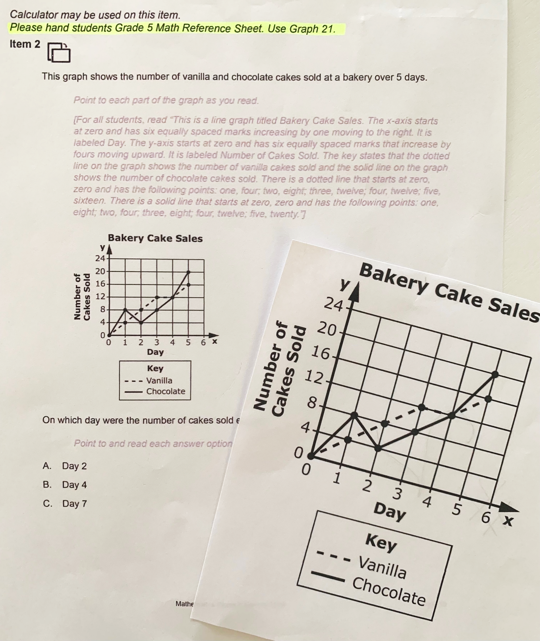
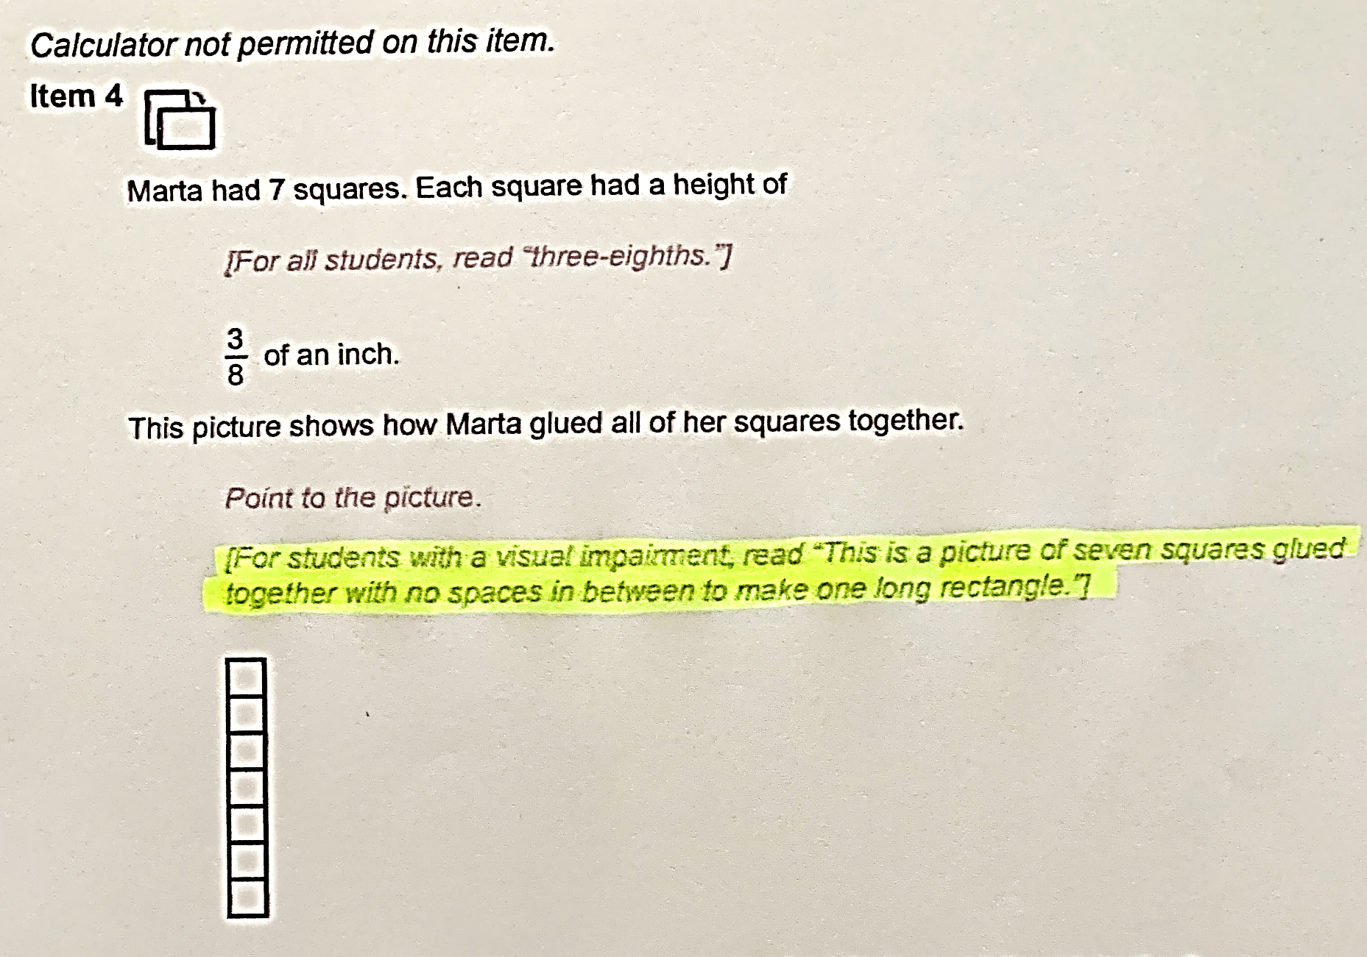

Notes:
The use of highlighters is encouraged as it allows TAs to read through the DTA and make notes of important details throughout the script. Some examples include highlighting items requiring the use of Reference Sheets as well as highlighting any alternative text that should be read for students with visual impairments. In addition, TAs are encouraged to annotate or make notes and write on the DTA as they are reading through it. As a reminder, the DTA is not student-facing, so anything you put in there is to help your administration process.

Slide 31
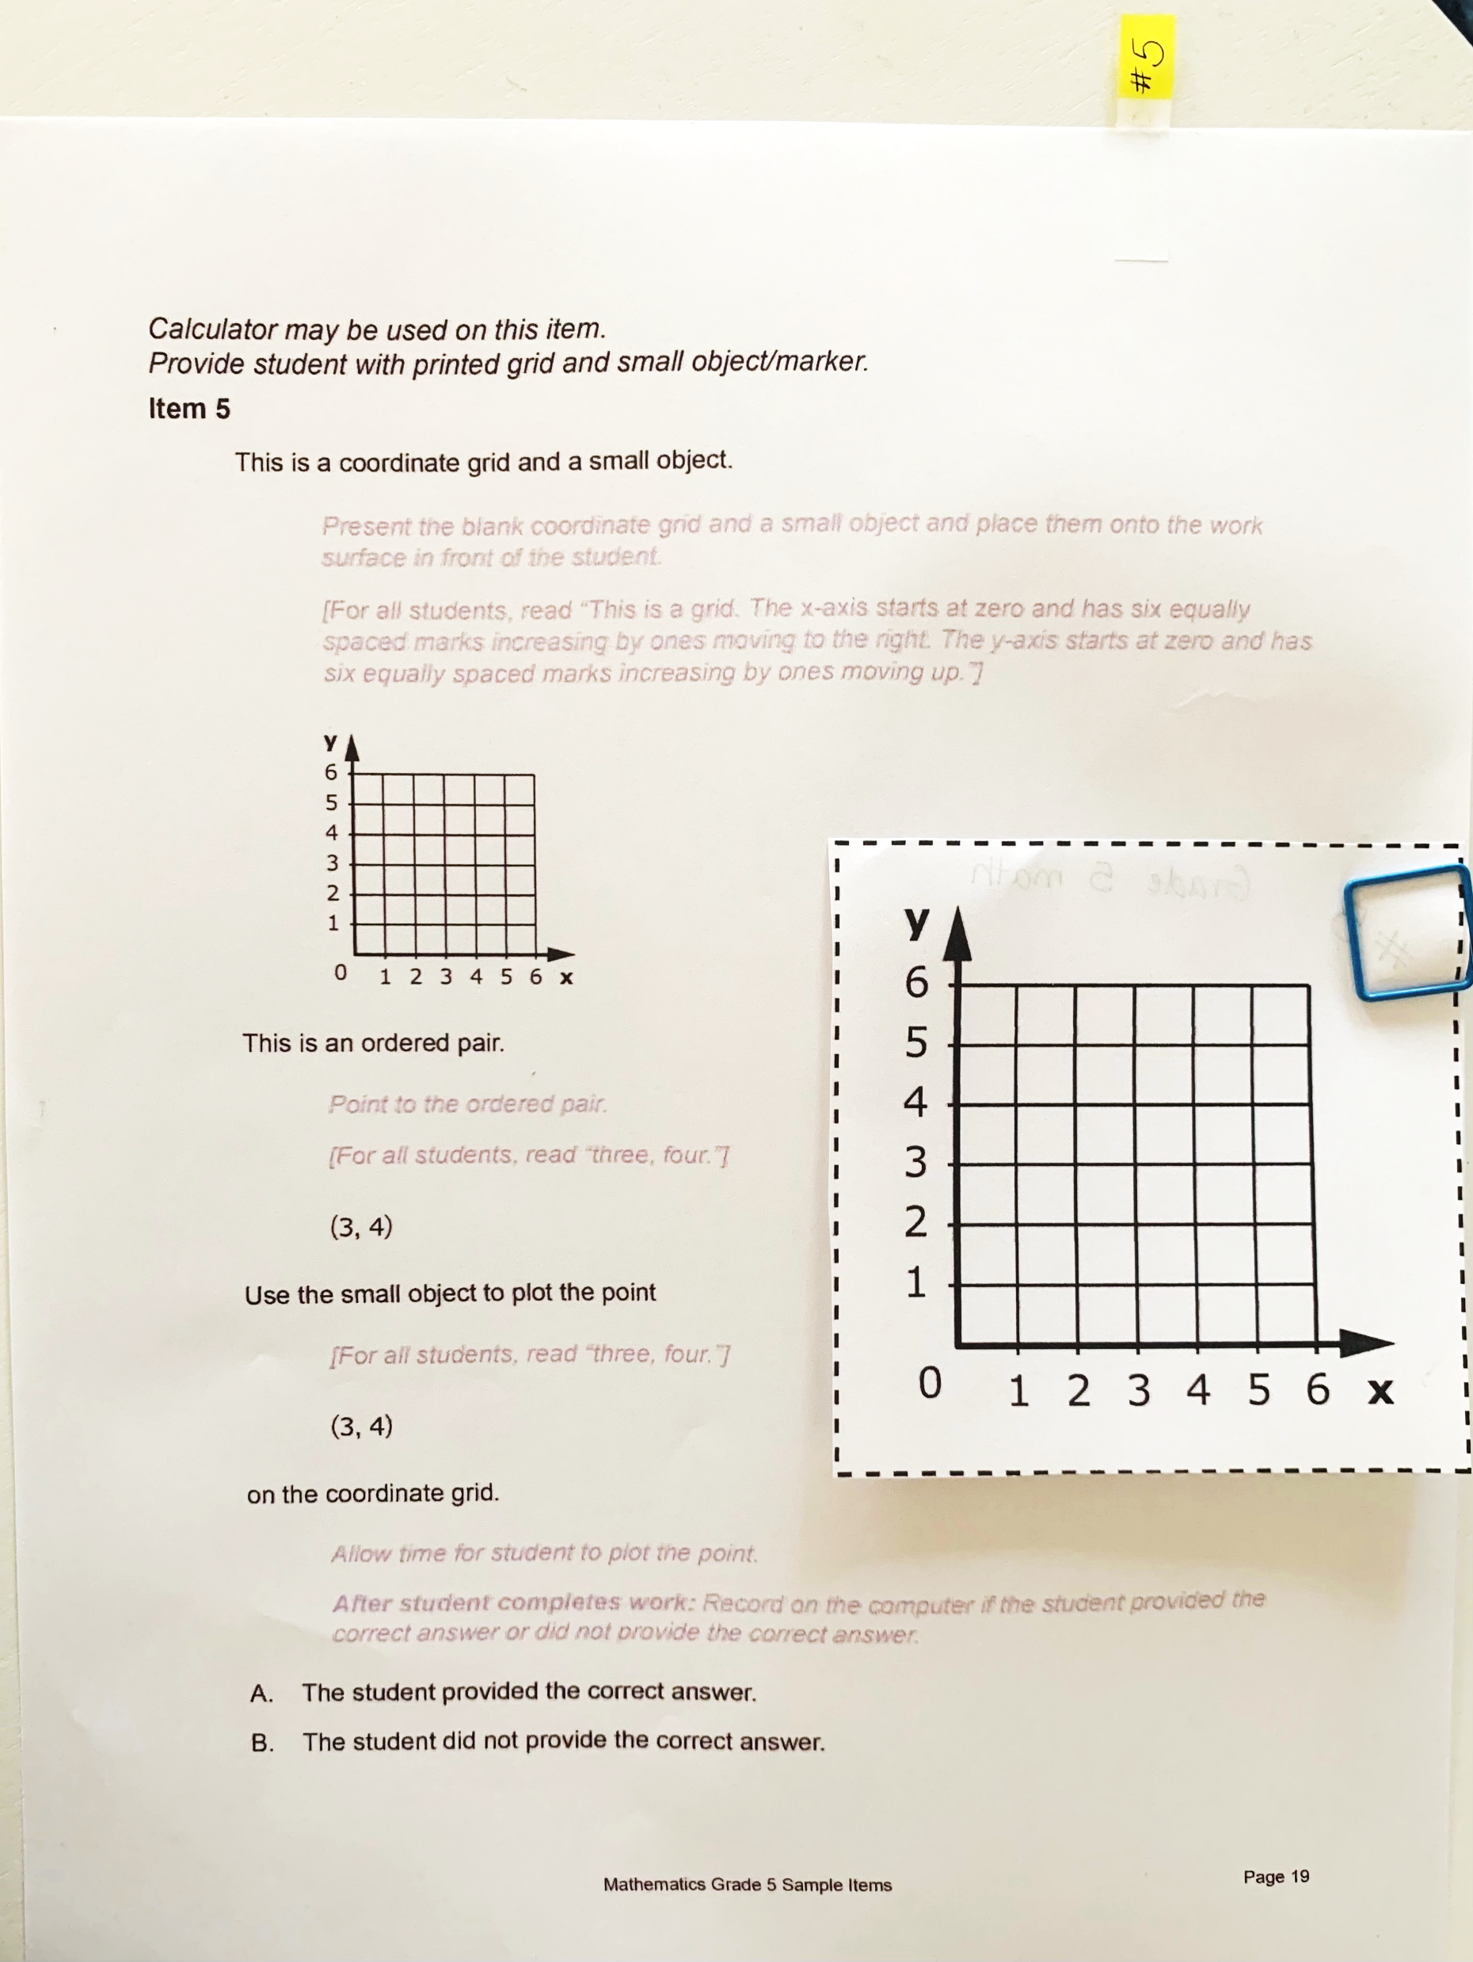

Label items:
requiring supplemental materials
with alt text
as potential stopping points
Notes:
The use of sticky notes is also a great hack. This may call attention to items requiring reference sheets, needing counters or manipulatives, a calculator, as well as items requiring object replacement if appropriate. Sticky notes can also be used to help with determining stopping points for students as the test may be paused and restarted at any time during the testing window.

Slide 32
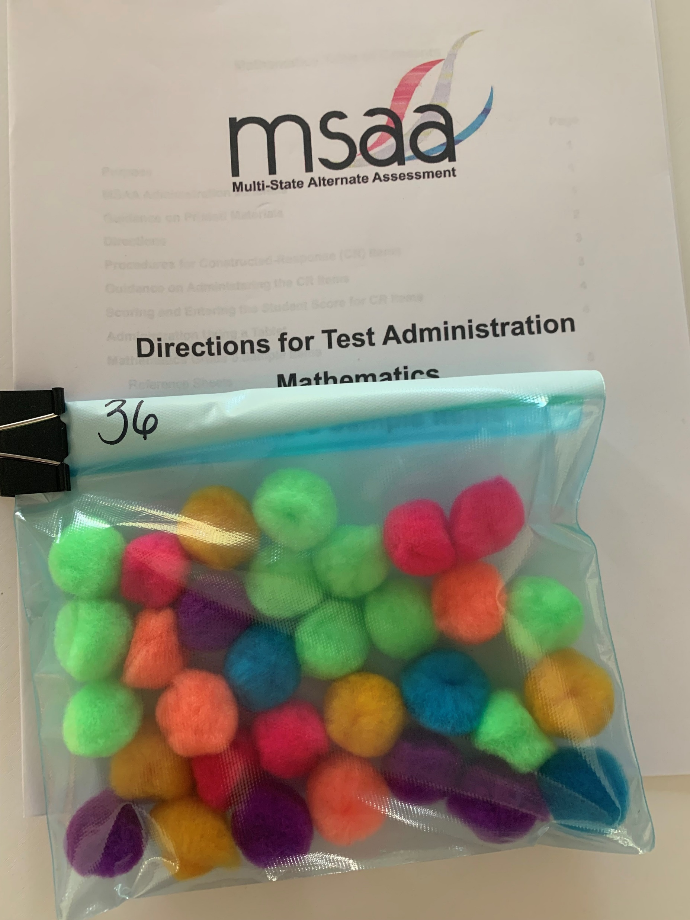

Notes:
Items that lend themselves nicely to the use of counters are called out at the top of items in the DTA and also called out on that materials page at the front of the session. Using the same counters that the student is most familiar with and uses during classroom instruction is preferred. These items may vary according to student age/grade, ability level, and preference. Having the correct number sorted and in a resealable storage bag limits the amount of time you have to spend at the beginning of the item preparing while the student loses all interest.
These are just a few ways to prepare your testing materials to ensure an organized and smooth administration.
We’d like to pause for just a minute and ask if there are any other suggestions that folks might like to add to these? Any tips that have made administration more organized for you? Feel free to add those to the chat as we continue and we can share those along with any questions at the end.

Slide 33

Notes:
Moving on to step 9 on the checklist, you will need to access the student profile in the MSAA system and complete the necessary tabs. Once the student is selected, you will see 5 tabs associated with that student.
[animation] The first tab is demographics – you will want to make sure that all of the student information (student ID, name, birthday, current grade, state, district, school) is all accurate. If there is an error in this information you will want to contact your Test Coordinator, as they have the ability to make changes to that tab.
The next 3 tabs are to be completed by the test administrator.
[animation] The LCI or Learner characteristics inventory tab has 16 different areas to fill out about your student, such as disability category, classroom setting, communication levels and more.
[animation] the accommodations before test tab is where you will select all accommodations that are documented in your students IEP.
[animation] the SRC or Student Response Check tab is where you will determine and/or identify if your student has an observable mode of responding to test items.
The last tab, accommodations after test will be completed after testing.
Let’s take a closer look at the Student Response Check on the next slide.

Slide 34
What is the Student Response Check (SRC)?
A task during which a student is asked to demonstrate their preferred mode(s) of communication.
Used to determine if the student demonstrates an observable response mode.
An observable response mode is a predictable and consistent behavior or movement that is able to be understood by a communication partner as intentional communication.
Ensures that the student will be able to participate in the assessment and respond to test items.
Three question, content-neutral task used to ensure the TA can clearly identify which answer a student chooses for a selected response item.
You do not need to conduct the SRC if you are certain that the student has an observable mode of communication so that you may enter a student’s response in the MSAA System with confidence.
Notes:
So, what is the Student Response Check or SRC? It is …
A task completed prior to testing during which a student is asked to demonstrate their preferred mode(s) of communication.
It is used to determine if the student demonstrates an observable response mode. An observable response mode is a predictable and consistent behavior or movement that is able to be understood by a communication partner as intentional communication.
The SRC ensures that the student will be able to participate in the assessment and respond to test items
It is a 3-question, content-neutral task used to ensure that the TA can clearly identify which answer a student chooses for a selected-response (SR) item.
If you have a student who you know has a reliable response mode, for example they communicate daily and have taken MSAA many times, you do not need to conduct the whole SRC. You just need to select which response mode they will be using to access the Test in the SRC tab, in order for secure materials to come available.
So, in a quick summary, the SRC is done prior to testing, as a way to ensure that your student can select their response option in whichever way best meets their needs and is reflective of how they typically communicate, and it tells the TA whether or not the student will be able to participate in the test.

Slide 35
Early Stopping Rule (ESR)
Ending the testing experience after the SRC is conducted is called the Early Stopping Rule (ESR).
The lack of an observable response mode is the only reason the ESR can be applied.
The ESR cannot be applied based on the students
behavior
stamina
knowledge of the content
frustration level
refusal to participate in the test
TAs do not have permission to apply the Early Stopping Rule and close a test.
Notes:
Ending the testing experience after the SRC is conducted, based on the results, is called the Early Stopping Rule (ESR).
The lack of an observable response mode is the only reason the Early Stopping Rule can be applied.
The ESR cannot be applied based on the students
behavior
stamina
knowledge of the content
frustration level
refusal to participate in the test
So, ending the testing experience for a student means to close their tests and they wouldn’t participate in any subject of the MSAA assessment. Since that is a big deal, there are multiple steps that must be followed before this could even be considered for your student. Also, TAs do not have permission to apply the Early Stopping Rule and/or close a test. This involves communication with the Test Coordinator or TC.

Slide 36
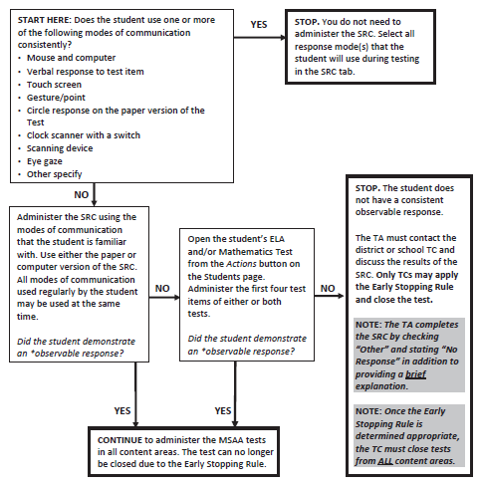
Using the SRC and Early Stopping Rule Flowchart
Notes:
This is the SRC/ESR flowchart, that is found in the TAM. It is a great tool in showing you the steps of how the decision of applying the ESR is come to, and it also is a great way to see how the SRC plays a major role with the ESR.
So, let’s go through this flowchart: We are starting in the top left box where it says start here:
[Animation] START HERE: Does the student use one or more of the following modes of communication consistently? And then it lists out a variety of response modes
Mouse and computer
Verbal response to test item
Touch screen
Gesture/point
Circle response on the paper version of the Test
Clock scanner with a switch
Scanning device
Eye gaze
Other specify
[Animation] If the answer is YES — you can go ahead and STOP. You do not need to administer the SRC. Select all response mode(s) that the student will use during testing in the SRC tab in the student profile in the MSAA system. An example of this would be your student consistently interacts using a switch to make choices, you witness them use it every day and you know as their TA this is something they will have no problem with, you can stop with the flowchart, document their response modes, and move on to the next step in your TA checklist.
[Animation] If the answer to that first question was NO, they do not use one or more mode(s) of communication consistently,— Administer the SRC using the modes of communication that the student is familiar with. Use either the paper or computer version of the SRC. All modes of communication used regularly by the student may be used at the same time. So here is that question again at the bottom of that box, Did the student demonstrate an *observable response?
[Animation] If YES — CONTINUE to administer the MSAA tests in all content areas. At this time., the student showed an observable response mode so the test can no longer be closed due to the Early Stopping Rule.
[Animation] If NO — the student did not demonstrate an observable response to the SRC, the next step will be to open the student’s ELA and/or Mathematics Test. Again, this can be done using the computer-based test or the paper-based test, whatever is most appropriate for your student, and at that time, you will administer the first four test items. This is something that we recommend and that is best practice, to attempt with your student more than once. So, it may be with different content areas, different times of day, different week or just different strategies that may encourage or support your student to show that observable response. After that – the last question of the flowchart,
Did the student demonstrate an *observable response to those first 4 items of the Test?
[Animation] If YES — CONTINUE to administer the MSAA tests in all content areas. The test can no longer be closed due to the Early Stopping Rule.
[Animation] If NO — at this point you would STOP. The student does not have a consistent observable response. The TA must contact the district or school TC and discuss the results of the SRC. Only TCs may apply the Early Stopping Rule and close the test.
Now that it has been determined that the ESR is the appropriate action to take, the TC must close tests for ALL content areas.
We went a little rogue off our checklists to really spend time focusing on this SRC process as it is often a pain point or a confusing part of administration. The big takeaway is that all students must be tested unless they cannot reliably and observably communicate responses.

Slide 37

Determine the optimal assessment time and setting for each individual student.
Familiarize students with the process
Take into consideration specific manipulatives that work for each student.
Mirror the instruction in the classroom.
Use the administration window.
Notes:
Now back to our checklist - The final step on the Before Test Administration Checklist is #10: Create a comfortable and secure testing environment. When considering the optimal testing environment for each student, look at the time of day when a student is most attentive during instruction. Avoid testing during times of day when students may be more lethargic such as after lunch or PE. Also, avoid times of day when students may be excited about recess or an upcoming class and be overstimulated and unable to concentrate.
By using the sample items provided on the MSAAAssessment.org site, TAs and students can become familiar with the assessment process, the layout of the questions and answer options, as well as the language of the assessment. Students can practice using the reference sheets as well as when they can and cannot use items such as calculators. Again, you can use the sample items available on msaaassessment.org as they are available all year long.
If different counters or manipulatives are used by students, please use the counters and manipulatives with which they are most familiar. The assessment script within the DTA should be followed as written, but there are many ways to vary the experience and make it individualized for students.
If a student uses eye gaze in the classroom to communicate, the expectations should remain the same during the administration of the MSAA. Likewise, if a student uses an AAC/AT device during regular classroom instruction, those devices should be used during the assessment.
A comfortable environment should be individualized to the specific learner based on what makes them feel most at ease during testing.
Completing the Before the Administration Checklist before the administration window allows TAs to have the entire window to administer the assessment to students and to be selective about the days and times that students should test. TAs can help students avoid assessment fatigue by using this window efficiently.
Security is also a huge component in a testing environment, and we will talk a little more about that in the during test administration part of this training.

Slide 38
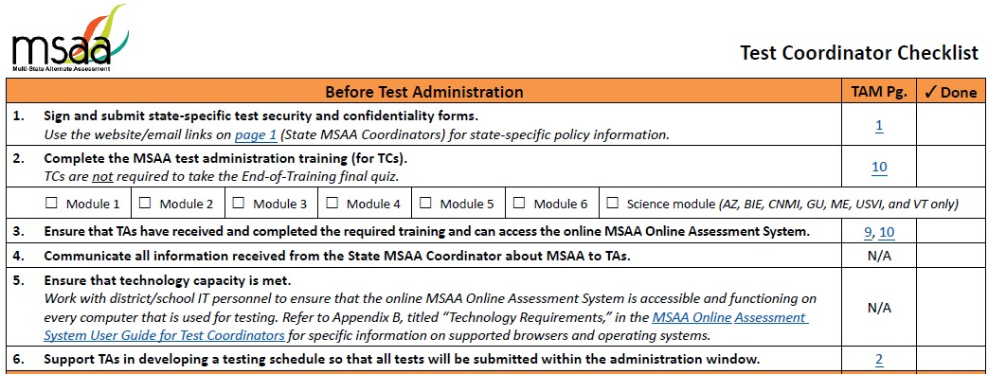
Test Coordinator Checklist – Before Test Admin
Notes:
You can see that the Test Coordinator shares some similar tasks as the TA, and also has some that look a little different. [animation] Just like the TA, the TC is also responsible for signing and submitting those test security agreements and is also required to participate in the MSAA test administration training for Test Coordinators. The difference is that TAs must pass that final quiz with 80% accuracy and for TCs there is no final quiz required unless also acting as a test administrator.
As shown on step 3, [animation] the test coordinator is also responsible for making sure that the TAs that fall under your umbrella is able to access and complete the required training as well as the MSAA Online assessment system.
Test coordinators will also be receiving various updates from the BIE MSAA Coordinator, so it is the responsibility of the TC to make sure that those updates get passed on to the test administrators as well.
Steps 5 and 6 show other ways the TC can support the TAs, [animation] first being to ensure that the district/school that you are coordinating for meets the technology requirements that are outlined in order to access the MSAA test. [animation] TCs should also be working with the test administrators and other school personnel to develop testing schedules, and problem-solve any concerns in that regard to make sure the test administrator has the time carved out to be able to administer the Test.

Slide 39
During Test Administration
Notes:
Now that we have covered the steps in the before test administration portion of our checklists, we are going to look at during test administration.

Slide 40
During Test Administration
Notes:
Let’s look at how the during-test admin is a little different than the before-testing. The first 10 steps on the checklist are to be done in the sequential order in which they are presented. While preparing there is a systematic way to do things, such as completing modules before you can access testing materials, etc. The during [animation] test administration tasks are all reminders of what should be occurring throughout the whole testing administration process. So, as we go through steps 11 through 16, just try and keep in mind that these should all be done while administering the assessment.

Slide 41
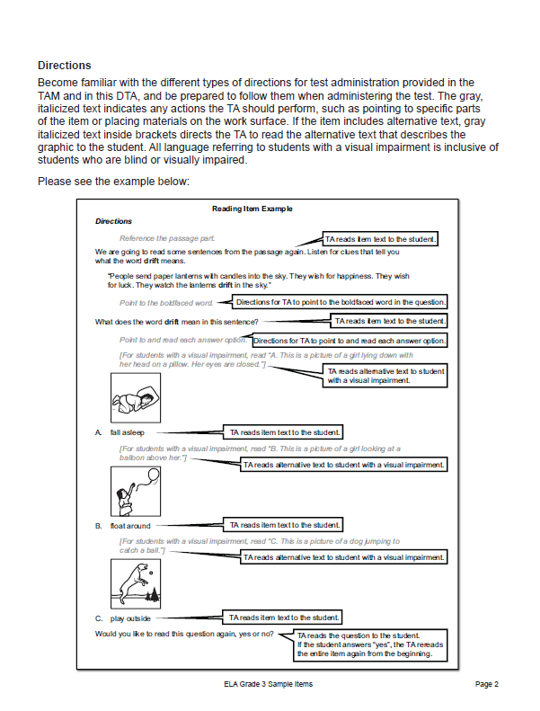
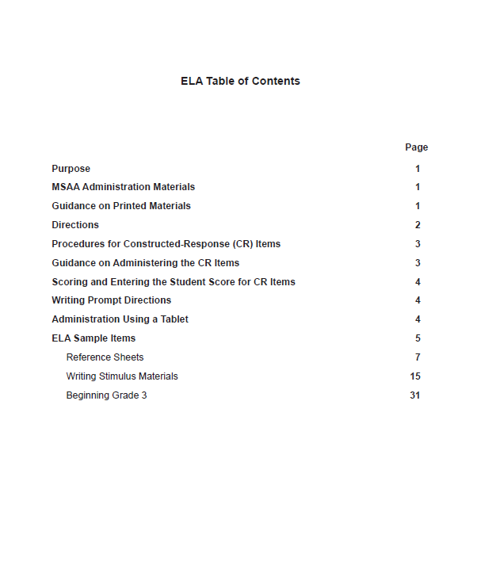

DTA Front Matter
Notes:
We have talked a lot about how required and important the DTA is to this Test, and now we will walk through what the components of the DTA look like and what you should be very familiar with during testing.
[animation] DTAs are assigned to each student and are required throughout every session and every test. It is to be used as your script exactly as it is written. The front of each DTA as well as the TAM, has detailed directions on how to administer the assessment using the directions for test administration. There is specific guidance for scoring constructed response items as well as administering the writing prompt for ELA.
[animation] It shows what font style is read aloud, where cutouts, reference sheets and calculator status is called out, the actions that a TA is to be performing and when, and what alternative text for describing graphics is to read aloud and to whom it should be read aloud to.

Slide 42
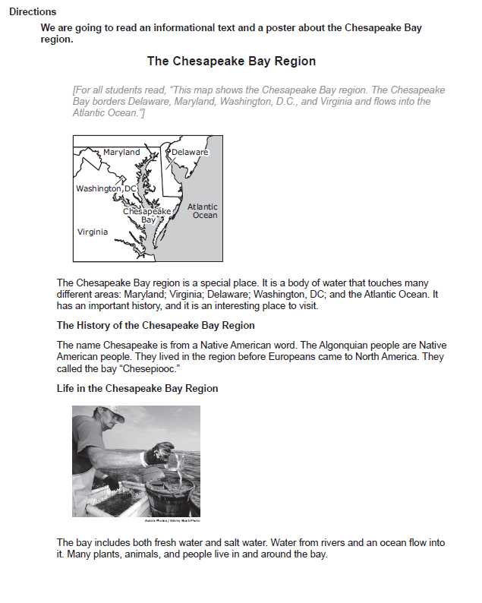
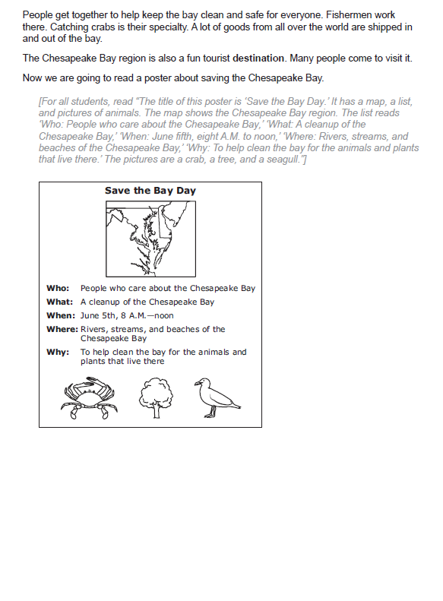
Any script the TA must read aloud to the student is in black.
Any actions the TA must perform are in gray italics.
NOTE: Both types of alternative text will be in brackets with gray italics and should be read aloud as directed in the DTA.
Notes:
A closer looks shows:
[Animation] Any script the TA must read aloud to the student is in black.
[Animation] Any actions the TA must perform are in gray italics.
[Animation] NOTE: Both types of alternative text will be in gray italics AND in brackets and should be read aloud as directed in the DTA.

Slide 43
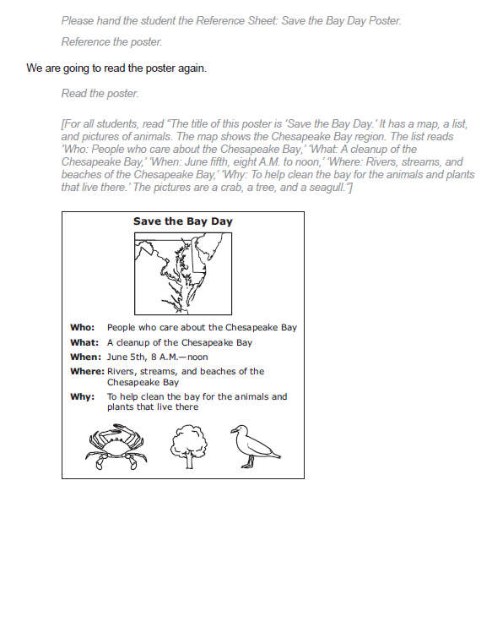
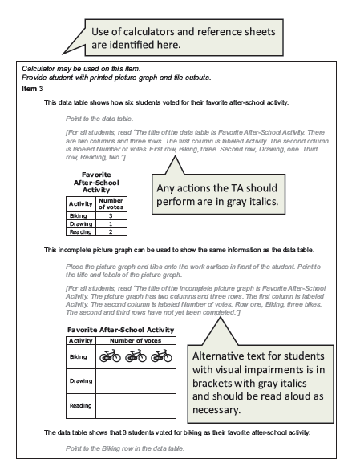

Reference sheets can be found in the beginning of the session and must be provided during testing as instructed in the DTA.
Notes:
[Animation] Reference sheets for ELA and Math will be located in the DTA. [animation] There will be directions at the top of each page for the items requiring the use of those reference sheets. [animation] For Mathematics, there will also be instructions for calculator usage and information about counters at the top.

Slide 44
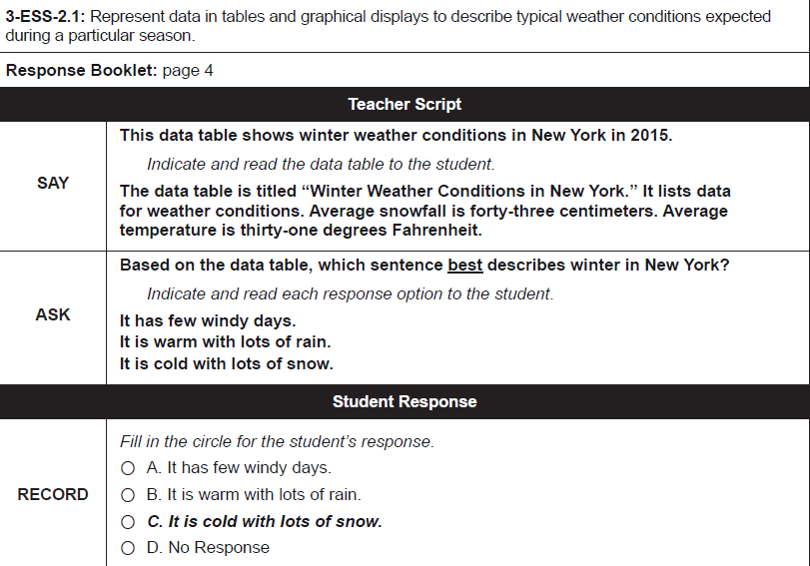
Example Science DTA
Text to be read aloud is in boldfaced black (if TA is reading the assessment).
Any actions the TA should perform are in italics.
Notes:
Here is an example of a Science DTA, which varies slightly from how the ELA/Math is displayed. You can see it is set up in a table that has different sections including say, ask, and record. The Say portion will have the actual item, the ask section has your question and response options, and then there is a record section at the bottom. If a TA is administering the paper based version, they can mark the student response on the paper and then transfer into the system when the student is done for that time.
For Science, the DTAs do not contain the graphics, instead the student sees the graphic and the teacher will just see the graphic description [animation] that corresponds and describes the graphic, which is the bold font. All Text that is to be read aloud to students will be bolded font.
[Animation] Any action that the TA should perform are in italics. So, you can see it says to indicate and read aloud each response option here. So, the TA would indicate in any way that the teacher usually directs the student attention, whether that be pointing with a finger, or the mouse.
Just like with ELA and Math, the script must be followed exactly as written. This allows for a standardized administration.

Slide 45
Accommodations
Accommodations are changes to the standard administration of an assessment that do not alter the construct being measured.
Assistive Technology
Scribe
Paper Version
Sign Language
Notes:
Step 12 on the checklist is ensuring the appropriate accommodations are provided to your student throughout testing.
Accommodations should be provided to the student as identified in their IEPs and used in accordance with the guidelines outlined in the “accessibility features and accommodations” section of the TAM.
Accommodations are changes to the standard administration of an assessment that do not alter the construct being measured. For MSAA, the allowable accommodations that are implemented by the TA are assistive technology, the printed-out version of the test items which is referred to as the paper version, the scribe accommodation, and the use of sign language. Again, if your student uses any of these accommodations during instruction and it is included in their IEPs as well, then they are able to use them during testing.

Slide 46

Security Requirements
Maintain all printed test materials in a secure, locked location.
Protect secure materials from view by other students, teachers, parents, school staff, or other individuals.
Do not duplicate, reproduce, or share items or other secure test materials.
Give all printed test items or other printed material to the TC for secure shredding.
Delete any test materials, items, and information from the computer and any AT used by the student after testing is complete
Notes:
TAs are required to be aware of and follow all security requirements during administration. These requirements include:
Maintain all printed test materials in a secure, locked location. [animation]
Protect secure materials from view by other students, teachers, parents, school staff, or other individuals.
This includes logging out of the MSAA Online Assessment System and closing the browser after each testing session.
Do not duplicate, reproduce, or share items or other secure test materials.
Give all printed test items or other printed material to the TC for secure shredding.
Delete any test materials, items, and information from the computer and any AT used by the student after testing is complete

Slide 47

Notes:
We talked about creating a comfortable and secure testing environment for your student before testing, and during testing you will want to make sure that the testing environment is conducive to the student doing their best work. If you took your student out of the classroom to work in a quiet location and you realize they are trying to see what is going on back in their own class and appear distracted, then maybe their comfortable environment is inside the classroom in a quiet corner, so they don’t feel like they are missing out. If your student typically does reading in one area and Math in another, then maybe those same comfort zones should be used for the corresponding subject of the test. A comfortable environment will be individualized to the student and may take on many different forms throughout the administration process. Just be sure that wherever your kiddo may go, make sure that is also an area where you can maintain the Test security.

Slide 48
Passages
Entire Item
Item Question
Response Options
Graphic Description
Students may require repetition of items or parts of items
TAs can reread as often as possible in order to obtain a student response.
TAs are not allowed to paraphrase or emphasize words that would provide hints to correct or incorrect response options.
Notes:
If students are not providing responses to test items, TAs are allowed to repeat [animation] items as necessary. The TA may reread passages, whole items, graphic descriptions, item questions, response options, etc. as often as is reasonable to obtain a student’s response to an item. All text must be read to students exactly as written with no paraphrasing or variation of speed that may emphasize words in way that provides hints to the correct or incorrect response options.

Slide 49
Examples of Test Irregularities:
Failing to sign/submit the security agreement
Failing to use the DTA
Changing the wording of test directions, items, answer options, or any other text
Using materials other than the DTA
Using materials not indicated in the DTA
Providing students with a preview of the test
Notes:
As a Test Administrator, it is your responsibility to be aware of test irregularities. Step 16 of the checklists ensures you are aware of these irregularities and are reporting them to your TC. Being familiar with the irregularities will ensure you aren’t doing any of them and that if something does come up you will know that it needs to be reported to your TC. [animation] Examples of test irregularities are:
Failing to sign/submit the security agreement
Failing to use the DTA
Changing the wording of test directions, items, answer options, or any other text
Using materials other than the DTA
Using materials not indicated in the DTA
Providing students with a preview of the test

Slide 50
Other Examples of Test Irregularities:
Providing answers, clues or cueing
Manipulating test materials that may hint to correct answer
Changing a student’s answer
Using Test materials for instructional purposes
Sharing test materials with anyone who is not a trained TA/TC or student taking the Test
Leaving the MSAA Online Assessment System unattended while logged in
Administration of the Test by a staff member who did not complete training modules and passed the final quiz
Notes:
Some additional test irregularities include:
Providing answers, clues or cueing
Manipulating test materials that may hint to correct answer
Changing a student’s answer
Using Test materials for instructional purposes
Sharing test materials with anyone who is not a trained TA/TC or student taking the Test
Leaving the MSAA Online Assessment System unattended while logged in
Administration of the Test by a staff member who did not complete training modules and passed the final quiz

Slide 51
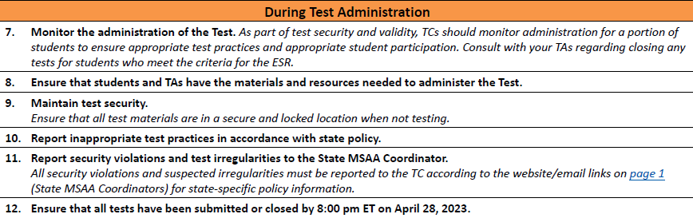

Test Coordinator Checklist – During Test Administration
Notes:
Now let’s check in on how TCs can monitor all those TA responsibilities during the test administration window.
[animation] First, TCs are responsible for monitoring the administration of the test. TCs should be checking for appropriate test practices and student participation. During the administration window, TCs will need to consult with the test administrators to discuss the early stopping rule and work with the TA on determining if closing a test is appropriate. For this reason, TCs will want to be very familiar with the SRC or student response check and the Early Stopping Rule which is called out on the checklist as ESR. There is another training in early February dedicated to the SRC and ESR so stay tuned for information on that, there is also a training module dedicated to this topic so there are many opportunities to learn more about this before administration. As part of test security and validity, TCs should be monitoring and collecting documentation on what is observed during testing.
[animation] As discussed with the TA portion, there are many materials that TAs will need to prepare for administration, so it is the TCs responsibility to make sure that TAs have all the materials accessible to them in order to administer the assessment correctly.
[animation] Also as discussed with the TAs, test security is extremely important. TCs are responsible for checking in with TAs to make sure test materials are stored in a locked location and that they are abiding by the security measures called out in the TAM.
[animation] TCs will be contacted by TAs as inappropriate test practices arise, hopefully there won't be any but just in case – TCs should be familiar with the BIE policies on how to monitor and report these.
[animation] Same as with the inappropriate test practices, TCs will also be responsible for reporting any security violations and test irregularities to the BIE MSAA Coordinator, again Don Griffin.
[animation] and lastly for during test administration tasks, TCs will need to make sure that TAs are on track to administer all contents of the assessment assigned to their student(s) by April 29, 2022. The Test Status Summary tab on the MSAA system website is a great tool for TCs to keep track of their TAs and Students progress during administration, so be sure to check that out.

Slide 52
After Test Administration

Slide 53
Reported by school Test Coordinators to district Test Coordinators
Reported by district Test Coordinators to the State MSAA Coordinator
Reported by Test Administrators to school Test Coordinators
Notes:
We just talked about all the different types of test irregularities and security requirements that require conversation with your TC. Same as you’ll do during test administration, once you have completed administering the assessment if there are any questions regarding test practices, security violations, or suspected irregularities you will need to report those and have those conversations with your TC. These should be addressed as soon as they arise, so typically these conversations should occur during test administration, but as you are wrapping up the final steps of the assessment, if anything about security or any irregularities with the administered test arise, you will still need to bring them up with your TC.

Slide 54
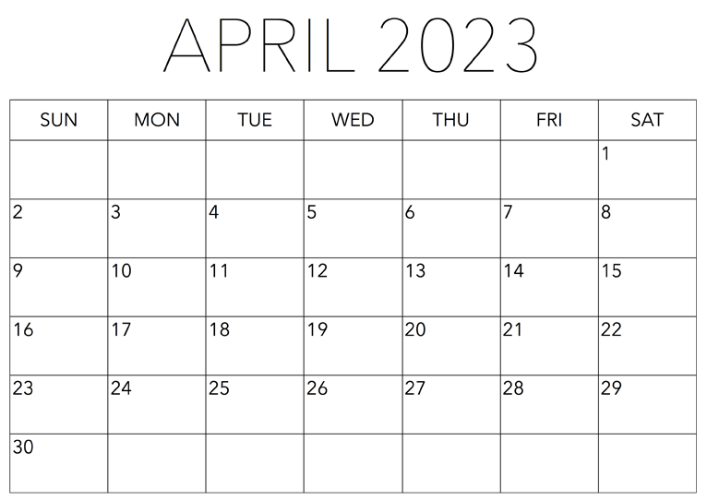
MSAA Tests Due!
Notes:
- As a TA, you’ll need to keep track of your students and their tests, and manage the administration timing to ensure that all test sessions are submitted into the MSAA system by [animation] 8:00 pm ET on April 28, 2023. If the TA and TC have discussed that the early stopping rule (ESR) is the only option for your student due to a lack of an observable response, you will also need to make sure that that student’s test has been closed in the MSAA system before that April 28 date as well. If tests aren’t submitted or closed by this time and date your student’s test will not be scored, so go ahead and add that important date to your calendar!

Slide 55
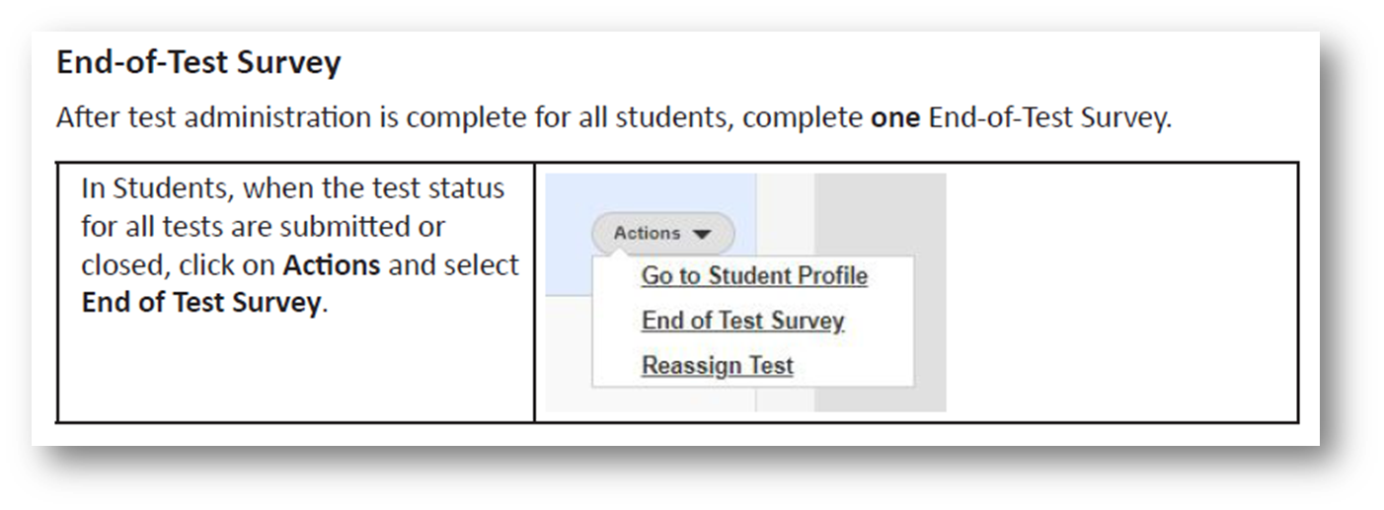
Notes:
Once the tests are submitted, there are two additional tasks that the TA will need to complete in the MSAA system. First, is step 19 on the checklist – completing the accommodations after test tab. This is the last tab in the student profile [animation], and it is asking for the TA to identify what accommodations were actually used during administration. This is important because although many accommodations may be identified in the accommodations before test tab due to what is identified in the student’s IEP, some or all of them may not have been used for each Test or content, so identifying what the accommodations were that were used in order to access and respond to the Test will be identified after administration.
The last thing to do in the MSAA system – step 20 on the checklist - is to complete the End of Test Survey [animation]. The survey can be found in the [animation] actions drop-down on the ‘Students’ page in the MSAA system. Only one survey will need to be completed for each Test Administrator. So, if you have a grade 5 student who would be taking ELA, Math, and Science, you only need to complete ONE survey, not one for every subject. The feedback collected from the survey results helps us track important information over time about the experience of administering the test and the assessment itself.

Slide 56
Delete all secure materials from…
Computers
Tablets
Paper materials for secure shredding…
DTAs
AAC/AT Devices
Paper-Based Tests
Cutouts
Reference Sheets
Scoring Rubrics
Braille Cards
Writing Prompt Materials
Notes:
The very last 2 steps of the checklist are making sure that ALL testing materials are removed from computers, tablets, AAC/AT devices and that all of the accompanying paper materials such as DTAs, paper-based tests, cutouts, reference sheets, scoring rubrics, braille cards, and writing prompt materials are given to your TC who is responsible for shredding it all.

Slide 57
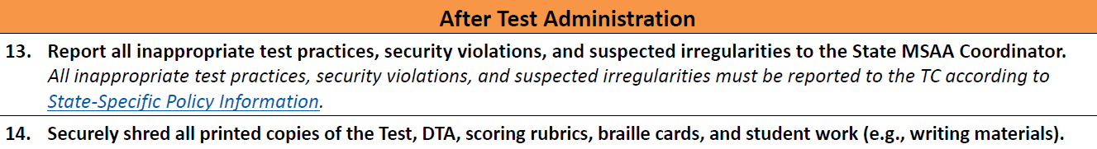
Test Coordinator Checklist – After Test Administration
Notes:
As you can see here there are two final steps that TCs will be required to do in order to support TAs in completing their final steps in a secure manner.
[animation] As TAs bring information forward to TCs about inappropriate test practices, security violations, and suspected irregularities, it is the TCs duty to make sure that those get escalated and reported to Don the MSAA Coordinator for BIE.
[animation] As mentioned in the previous slide, TAs will be required to give all of the printed materials to their TC to ensure that they are shredded in a secure fashion. TCs will want to make sure they have access to a shredder that can handle a decent amount of paper, especially if there are multiple students’ testing materials that will be given to you.

Slide 58
Tips and Tricks
One checklist should be used per student and per subject
Write student name and subject on top of checklist
Keep checklist accessible for frequent and quick reference
If you are administering to lots of students:
Keep one location where all checklists stay (i.e. a binder, file cabinet, bulletin board) OR keep with individual student’s testing materials
Check off steps as you go!
Notes:
One checklist should be used per student and per subject
Write student’s name and subject on top of the checklist
Keep the checklist accessible for frequent and quick reference
If you are administering to lots of students:
Keep one location where all checklists stay (i.e. a binder, file cabinet, bulletin board) OR keep with individual student’s testing materials
Check off the steps as you go!
And when in doubt, contact your people! You have the MSAA service center, test coordinators, and Don your BIE Partner lead who has lots of answers and also our direct contacts he can always reach out to us here at Cognia as well and we can talk through things with you on an individual level.

Slide 59
Questions?
Notes:
Thank you for joining us today! At this time we would love to answer questions. If they are questions about MSAA and administration we are happy to answer those, and if they are BIE specific policy questions then we will direct those questions to Don.
[Cognia PM to read questions and direct to CDA or Don]

