Slide 2
SESSION 1
Chronic Absenteeism & Supporting Graduation Rates

Slide 3



Chronic Absenteeism &
Supporting Graduation Rates
Emily Orngard
Professional Learning Director
emilyo@everydaylabs.com
Cindy Welling
Chief of Staff &
Professional Learning Advisor
cindy@everydaylabs.com
Sheena Shirakhon
Program Manager
sheena@everydaylabs.com

Slide 4
Today’s Agenda
EveryDay Labs - Who are we?
Understanding the Impact of Chronic Absenteeism
Building a System to Tackle Chronic Absenteeism
Tiered Interventions & Next Steps

Slide 5



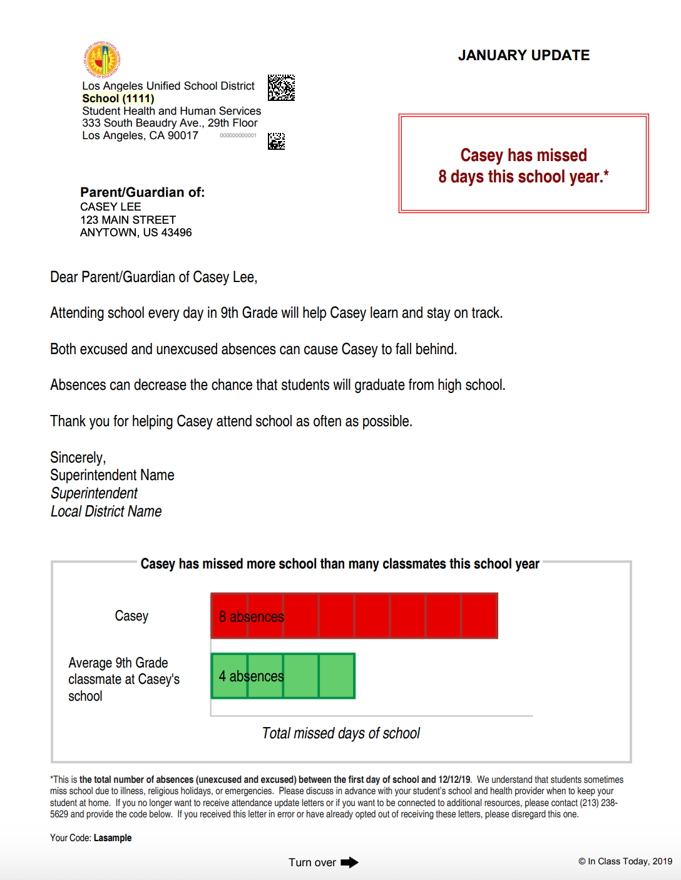
Proven to reduce chronic absenteeism by
10–15%
at scale
Prevention and Early Intervention
for Students and Families
Notes:
EveryDay Labs is an organization that was born out of the Harvard Kennedy school. Our founder, Dr. Todd Rogers is a professor of behavioral science at Harvard and he became very interested in how to use behavioral science to motivate action & change people’s behavior. He did a great deal of work with the Get out the Vote campaign back in 2008 & learned a lot about how to increase voter turnout at the polls. As he became a father, he became very interested in applying similar behavioral insights to education, and seeing if he could improve attendance and reduce chronic absenteeism. Thus, our intervention was born!
Our organization partners with districts all across the county to provide this Tier I Universal Intervention and send snail mail & text messages to families designed to motivate families to help their students come to school more often. We also provide districts access to a data platform that supports districts in the process of analyizing data to find emerging attendance trends & patterns and we offer professional learning as well!

Slide 6

Gallery Walk
Create a T-Chart with Barriers & Strategies
On the left side, write the top barriers your students experience.
On the right side, write the top two (at least!) strategies you’ve utilized to tackle those barriers.
Walk around & take notes on strategies you want to implement
Notes:
t chart
2 different colored post-its,
barriers on yellow post-its
& at least two strategies for tackling those barriers

Slide 7
Spreading the word about absenteeism….
How can you use these upcoming slides and information with your school teams?

Slide 8

Understanding Chronic Absenteeism

Slide 9
Average Daily Attendance (ADA):
ADA: The percent of students who are present per day, on average.
Tracking ADA allows you to
      monitor overall health of school’s attendance
      set school-wide goals
      reward staff/students for improvement
Notes:
One of the critical pieces of a system is making sure that everyone is on the same page when it comes to thinking about ADA.

Slide 10

Truancy
Counts only unexcused absences
Emphasizes compliance
Relies on legal & administrative solutions
Chronic Absence
Counts all absences: excused, unexcused, & suspensions
Emphasizes academic impact of missed days
Uses community-based, positive strategies
Chronic Absenteeism = Missing 10% of Enrolled Days

Slide 11
Chronic Absenteeism - By the Numbers
10% = 18 (2 days/month)
20% = 36 (4 days/month)
30% = 54 (6 days/month)
50% = 90 (10 days/month)

Slide 12
Academic Consequences of Chronic Absenteeism
In Elementary School:
Weaker development of social skills
Less likely to read well by 3rd grade
More likely to be retained
In Middle School
Lower grades and test scores
A warning sign that students will eventually drop out
In High School
Lower grades and test scores
Lower graduation rates
Lower rates of college enrollment & completion

Slide 13
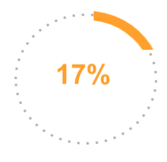
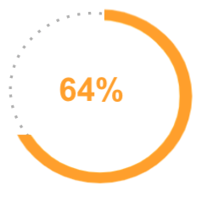
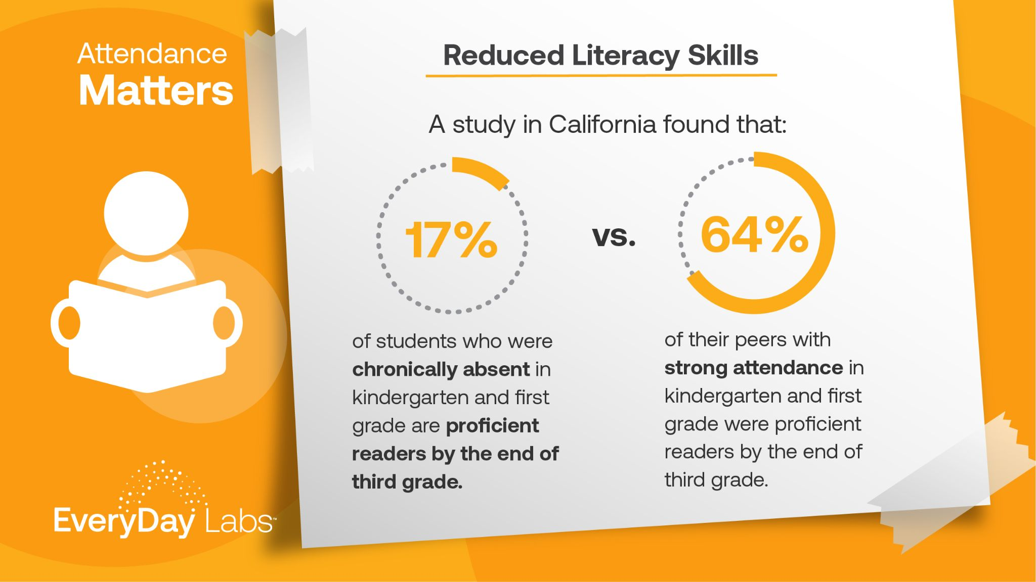
Attendance Matters:
Reduced Literacy Skills
A study in California found that:
Chronically Absent
Strong Attendance
of chronically absent students in K and 1st are proficient readers by the end of third grade.
of strong attendance students were proficient readers by the end of third grade.
Notes:
We are focused on all absences (not truancy only)

Slide 14
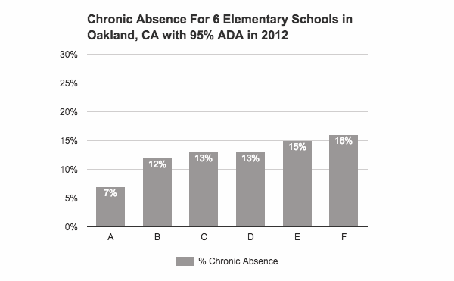
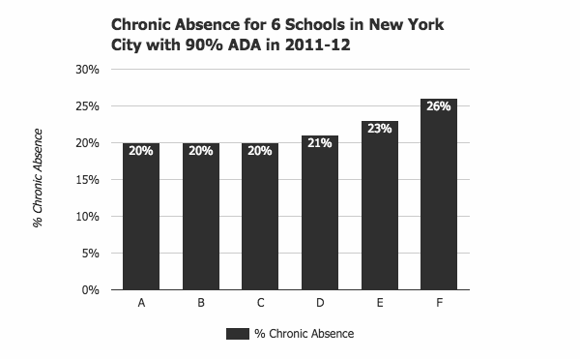
ADA Can Mask a High Chronic Absence Rate
98% ADA = little chronic absence
95% ADA = don’t know–varies by school
93% ADA = significant chronic absence
Notes:
While ADA is
ADA = Is the average number of students that show up on any given day,
Chronic Absenteeism is an individual measure – 200 students with 10 missing every day, is 95% ADA
the question is who are the 10 students who were absent and how often do they miss school?

Slide 15
Attendance Terms
Average Daily Attendance (ADA):
85% ADA means that 85% of students are present each day on average
Truancy:
Counts unexcused absences only
Chronic Absenteeism:
Missing 10% or more of school days
Includes unexcused and excused absences
Notes:
We always start off with by level setting with

Slide 16

Reflection
Which data points are you currently tracking?
  Average Daily Attendance Rates
  Truancy Rates
  Chronic Absence Rates
Which data points would you like to start tracking?

Slide 17
Research on Absences in High School

Slide 18
2019 Academic Study
Every 10 math class absences reduce standardized test scores by 7% of a Standard Deviation
Equivalent to the effect of replacing an average-quality teacher with one from the 20th percentile of the effectiveness distribution
10 years of data
*The short- and long-run impacts of secondary school absences by Jing Liu, Monica Lee, Seth Gershenson
Notes:
Evidence that we start seeing these academic differences at 5%

Slide 19
Absenteeism Link to Graduation
For 9th graders, every 10 math class absences reduce…
  The probability of on-time high school graduation by 8%
  The probability of immediate college enrollment by 7%

Slide 20
Which absences matter most?
Short answer: They all do!
Long answer:
  Spring absences are more harmful than Fall absences
  10 absences in the spring semester reduce course grades by 19% of a SD

Slide 21
Framework for Thinking about Attendance as a System

Slide 22
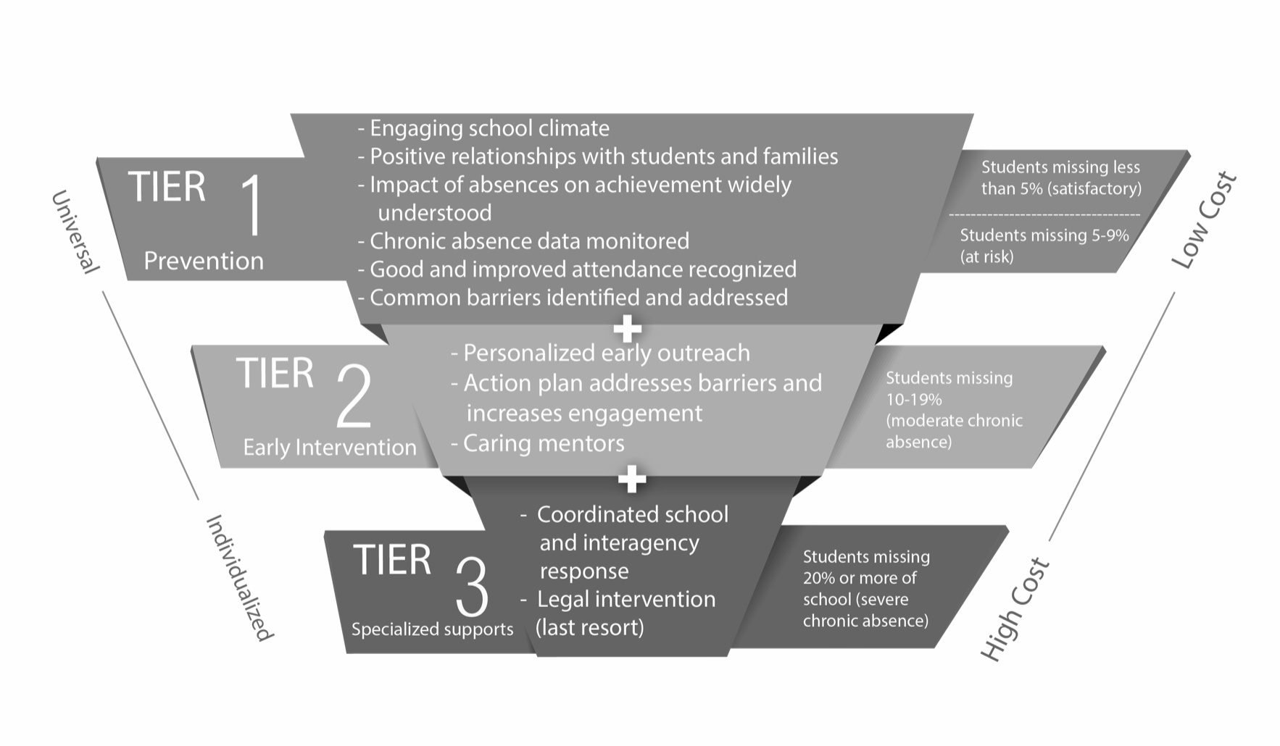
System of Support
District or School Wide Interventions
Small Group Interventions
Individual Interventions
Notes:
First - talk to everyone about their knowledge of Tiers
So, how do we tackle reducing chronic absenteeism??
You may have seen something like this floating around, but this image is really going to guide a lot of the discussions that we have over the next few sessions because it is so encompassing of what the system looks like in its entirety.
Draw eyes to the right side and walk you through a couple of things that I want you to tune into. , and acknowledge that Tier I includes both students that are satisfactory attenders & at risk for becoming chronically absent
We need to have a plan for students that are falling into each tier of absenteeism - so if you look on the right, you’ll see that each Tier encompasess a subset of students ….
And we need to ensure that our resources are being utilized as strategically as possible. We know that we can’t create highly individualized plans for each and every students because of the cost, so we need to have universal preventive interventions in place, to ensure that the students who need those specialized services the most, are able to access them.
next slide

Slide 23
System of Support Details
Tier I strategies are aimed at encouraging better attendance for all students and at preventing absenteeism before it affects achievement.
Tier II interventions address barriers to attendance for students who are chronically absent. These students and families should receive personalized attention as part of the engagement strategy.
Tier III approaches provide intensive support, often involving not just schools but other agencies such as health, housing and social services, and typically requiring case management customized to individual students’ challenges.
Notes:
Often times when we’re focused on attendance, we’re in reactive mode, particularly this year when times are extremely challenging. One of the benefits of having a system in place, is that all students are going to benefit from it.

Slide 24
A Systemic Approach to Attendance
Keys for Success:
Effective Attendance Teams
Access to and Analysis of Data
Tier I Preventative Measures
Tier II Early Interventions
Tier III Specialized Supports
Our Approach must be:
Data Driven
Positive
Problem Solving
Multi-tiered

Slide 25
In an Ideal World…
Tier 1
Tier 2
Tier 3
Resource-Intensive, Individualized Interventions
Group Interventions
Low Cost, Low Lift Prevention and Early Intervention

Slide 26
What often happens…
Tier 1
Tier 2
Tier 3
Too many students end up needing individualized plans
If Tier 1 prevention/early intervention is minimal
Notes:
What does your pyramid look like right now? Is your pyramid fairly balanced, or inverted?

Slide 27
Turn & Talk
Share Name & School
Where do your school teams spend a majority of their time & resources?
Truancy or Chronic Absence
Positive or Punitive Efforts
How can you work with your teams to understand the importance of tracking and working on chronic absenteeism?

Slide 28
Tiered Interventions

Slide 29
Tier 1 Interventions
School-wide Attendance campaigns (posters, fliers, classroom lessons on attendance, positive reinforcement, celebrating goals, communicating with families)
Grade level/class Attendance Incentives
On-site preventive healthcare (vaccines, dental care)
Tier 1
Tier 2
Tier 3

Slide 30
Dress Down Day | Daily Merits | Weekly 5 minute dance parties | Sneaker Days | Monthly VIP lunch
Monthly T-shirts | Pizza Party | Quarterly attendance awards ceremony | Field Trips | Weekly Raffles
Extra Recess | Traveling Trophy | Grade level attendance wars | Daily class trackers towards rewards | Monthly AttenDANCE
Homework Passes | Sports | Clubs | Class/School Jobs | Free Uniforms
Free tickets to school events | Line Leader | Credit Recovery | Mandatory Summer School | Extra Credit
Lunch with local celebrity | No assigned seats | Skip line at report card pick up | School Swag bags random/monthly | Increase awards

Slide 31
Dress Down Day | Daily Merits | Weekly 5 minute dance parties | Sneaker Days | Monthly VIP lunch
Monthly T-shirts | Pizza Party | Quarterly attendance awards ceremony | Field Trips | Weekly Raffles
Extra Recess | Traveling Trophy | Grade level attendance wars | Daily class trackers towards rewards | Monthly AttenDANCE
Homework Passes | Sports | Clubs | Class/School Jobs | Free Uniforms
Free tickets to school events | Line Leader | Credit Recovery | Mandatory Summer School | Extra Credit
Lunch with local celebrity | No assigned seats | Skip line at report card pick up | School Swag bags random/monthly | Increase awards
Notes:
Before we shift into thinking about Early Warning Communications - I want you to look over this list and see if there are any incentives that you could put into place by the end of the week at one of your school sites - jot it down!

Slide 32
Tier 2 Interventions
Check-in/Check-out (Daily check-ins with a trusted adult)
Mentoring Groups (Pairing individual or groups of students with trusted adults that focus on building connection/engagement)
Phone Calls Home + Barrier Assessment
Tier 1
Tier 2
Tier 3

Slide 33

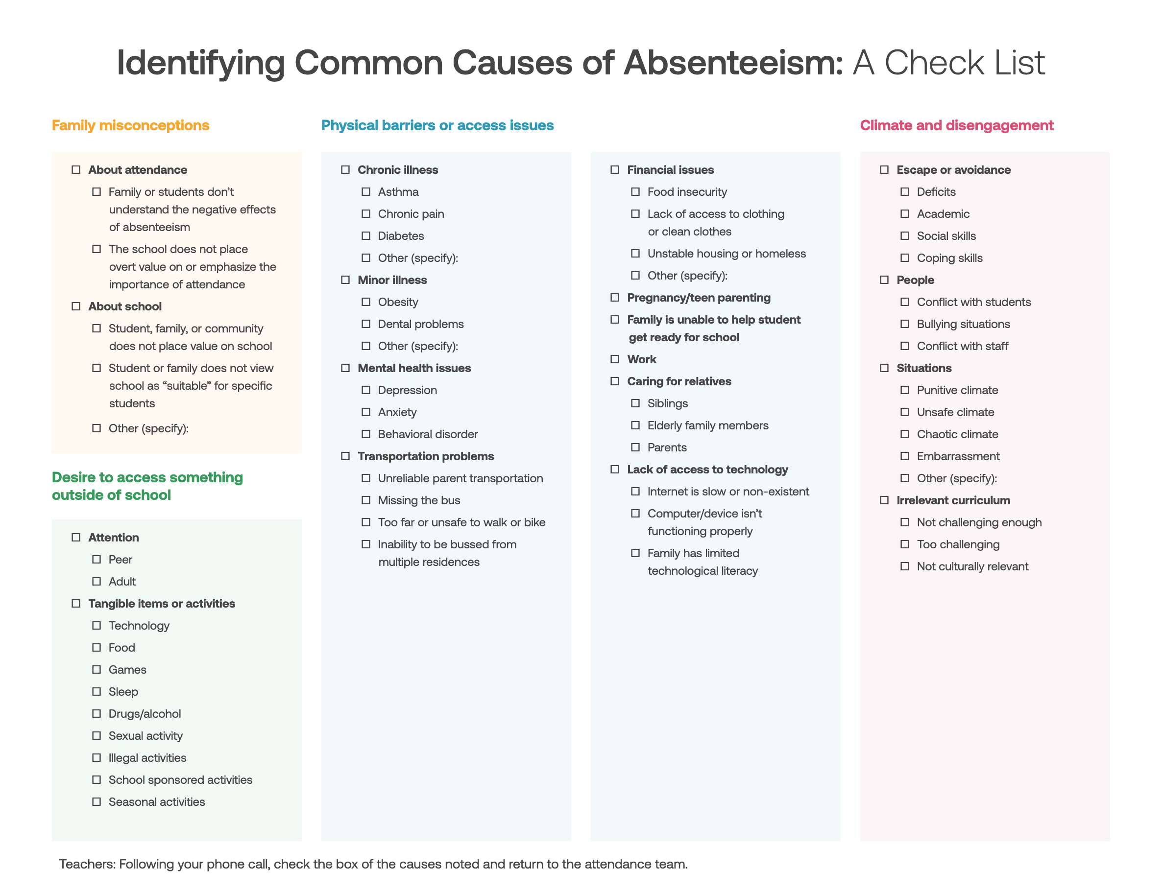
Notes:
animate - show screenshots

Slide 34
Tier 3 Interventions
Home Visits (or park/library visits)
Student/Family Attendance Conference
Individual Attendance Plan
Wrap-Around Supportive Services (mental health, transportation, meals)
Tier 1
Tier 2
Tier 3

Slide 35
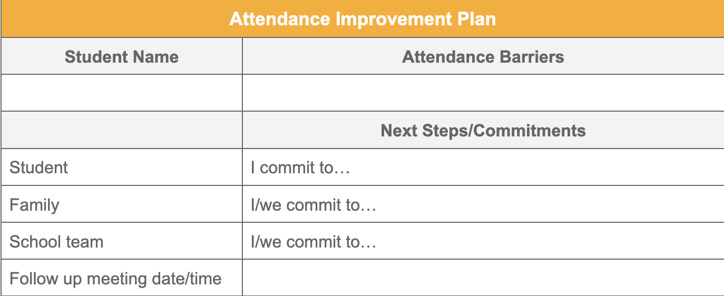
Intervention Plan

Slide 36
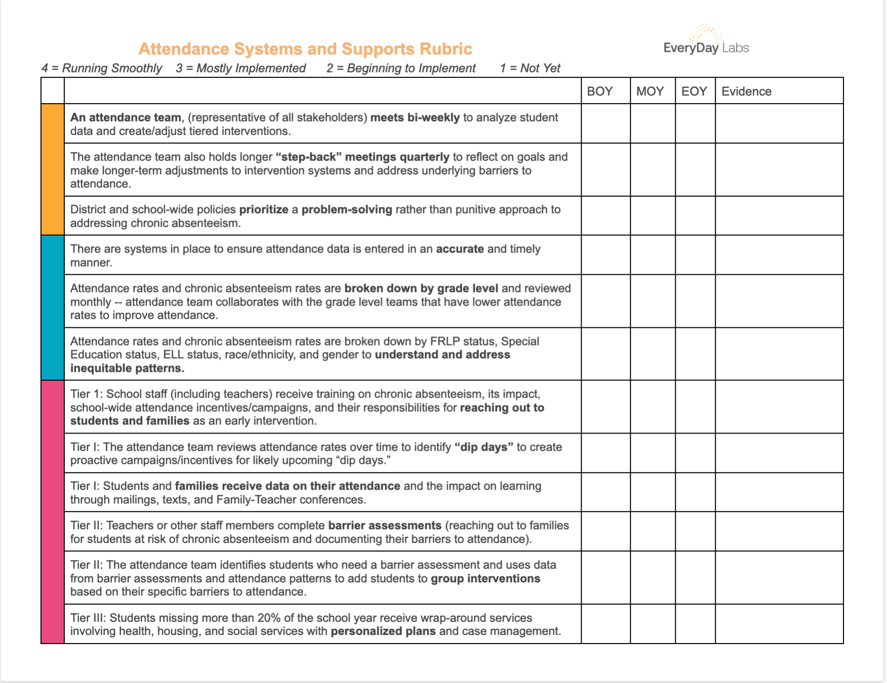
Attendance Systems & Support Rubric

Slide 37
Suggested Next Steps
Before next school year:
Review your school’s chronic absenteeism rates from SY 2020-21 and SY 2021-22
Evaluate how well your team is implementing a system of support for attendance (use rubric).
Choose at least two interventions that were discussed today (Tier I, 2 or 3) to start putting into action for next year.
Notes:
add this to poll next time?

Slide 38
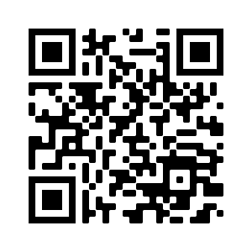
Feedback Survey / Exit Ticket
Please complete our feedback survey as your exit ticket!
Short link: https://forms.gle/5wgSBdVzJ5Zg1ytc7

Slide 39
Questions?
Emily Orngard
Professional Learning Director
emilyo@everydaylabs.com
Cindy Welling
Chief of Staff &
Professional Learning Advisor
cindy@everydaylabs.com
Sheena Shirakhon
Program Manager
sheena@everydaylabs.com

Slide 41
Connect with us!

Slide 43

End of Day Survey

