Slide 1
Notes:
First 3 slides should be relatively quick as an intro

Slide 2
SESSION 9: Culture and Language: Implementing Tribal culture and language within your school
Notes:
First 3 slides should be relatively quick as an intro

Slide 3
Isna Wica Owayawa
Rapid City, SD
Notes:
First 3 slides should be relatively quick as an intro

Slide 4
Mission Slide

Slide 5
Meet our Presenters
GILMA STANDS
Lakota Studies Teacher
STEPHANIE STARR
Gilma’s friend and supporter

Slide 6
AGENDA & LEARNING OBJECTIVES
Agenda
BIE Requirements/Expectations
Understanding Culture and Language differences
Culture and Language: School spotlight
School’s Culture and Language Program overview
Lessons learned
Learning Objectives
At the conclusion of this training, leaders will:
Understand the BIE’s requirements and expectations for Tribal schools.
Recognize the differences between culture and language instruction
Recognize how a school has implemented culture or language in their school
Obtain resources to share with individual schools, lessons learned, scheduling, etc.
2

Slide 7
Culture
Culture is “all the ways of life including arts, beliefs and institutions of a population that are passed down from generation to generation.” In the Lakota culture, we pass down our spirituality, arts, music, values, land and animal-based teachings, education and leadership. Our Lakota culture is our way of life, a daily understanding of how to live in harmony with all that is.
Our culture lessons focus on a concept that we want them to learn. The lesson will begin with a story to set the tone for learning. The students need to know the importance of the lesson they are going to learn for the lesson to actually be learned. Each culture lesson incorporates more than culture.
We must incorporate the Lakota language into these cultural teachings to gain full understanding. This is often a difficult task as our students are English speakers first, then having to have Lakota thought process to fully understand is where we need to work on.

Slide 8
Lakota Language
Teaching the Lakota language is a unique process. The students must hear it and be exposed to it at an early age and on a daily basis. They must learn to “think” as a native language speaker to be able to grasp their native language easier.
Our language lessons begin with the basics of identifying terms in Lakota. We use single work vocabulary in the beginning. As the students progress the lessons gradually become more difficult. They progress from the simple terms, to the simple sentences and commands. After these are mastered, then the conversational lessons are taught.

Slide 9
Unity of Culture and Language
Our program teaches culture and language together. The lessons are intertwined due to the complexity of each topic. One can not be taught without the other. The students must be proud of being Lakota to embrace themselves and grow in their cultural identity.
For our tribal expectations, we work with our local elders in our communities to provide guidance and expertise to our program. We learn as much as we can from our elders, then pass those teachings on to our students.

Slide 10
Culture and Language: School spotlight
Our Lakota Studies program teaches Lakota language and culture to all of the K-8 students.
Our goal is to provide services to each and every student at Isna Wica Owayawa in our effort to produce Lakota language speakers by teaching Lakota language daily.
Another goal is to teach our Lakota history and culture so our students maintain historical and cultural knowledge so they know who they are as a Lakota individual who is empowered by that knowledge.
All of the knowledge that encompasses the Lakota and culture are interconnected and one cannot be taught without the other. A continuous cycle of teaching and learning is needed to tie the Lakota language and culture together for Lakol Wicohan, a Lakota way of life.

Slide 11
School’s Culture and Language Program overview
We are implementing the Oceti Sakowin Essentials and Understandings standards for our curriculum. These standards drive our lesson planning and implementation. We also partner with Technology in Education (TIE) to provide technical assistance and help with the growth of our Lakota Studies instructors. TIE supports the implementation of these standards so they help us with program monitoring and sharing of resources to help our program.
We teach Lakota Studies on daily basis. Our K-5 students get 30 minutes daily and 6th-8th students get at least 45 minutes daily. Our Lakota Studies program teaches a wide variety of topics, including but not limited to, Lakota language, culture, history, government, and traditional arts.

Slide 12
Lessons Learned
Loneman Day School was a BIA school up until 1974, when it became a 638 Contract school. The School Board at the time knew the importance of the students knowing their language, culture and history. With the move to a Contract school, the School Board directed the administration to incorporate Lakota language, culture and history into the curriculum. Every year the program develops into a more comprehensive program based on the need of the students and families.
In developing the school wide program, we realize the need to provide training to our teachers and staff on cultural sensitivity for the benefit of our students. We provide training as identified by the teachers. As for our Lakota teachers, we recruit people who are experts in their respective fields and grow them into the teachers we need them to be. We provide any support and training the teachers and all staff need to be supportive of the Lakota program and the services provided to the students.

Slide 13
Lessons Learned
We learned that we cannot take life for granted. The pandemic taught us that life is precious. We have lost many respected and cherished elders, who took all of their knowledge and expertise with them. We are in the process of having our students design and complete a project which will record our elders sharing their knowledge.
We have identified a few areas of need that we fill focus on in SY22-23. We sincerely believe that our language will die out if we continue on the path we have been on. We are committed to providing Lakota language classes daily, which will focus on conversational language to begin with. We are also providing Lakota language classes to our community members in the evenings. Another focus is on providing more in-depth lessons on our treaties and the various forms of government from our past to our present.

Slide 14
Pilamaya!
Contact information:
Gilma.Stands@isnawica.org
School Phone Number: (605) 867-6875

Slide 15
CONNECT WITH US!

Slide 16
CONNECT WITH US!

Slide 17
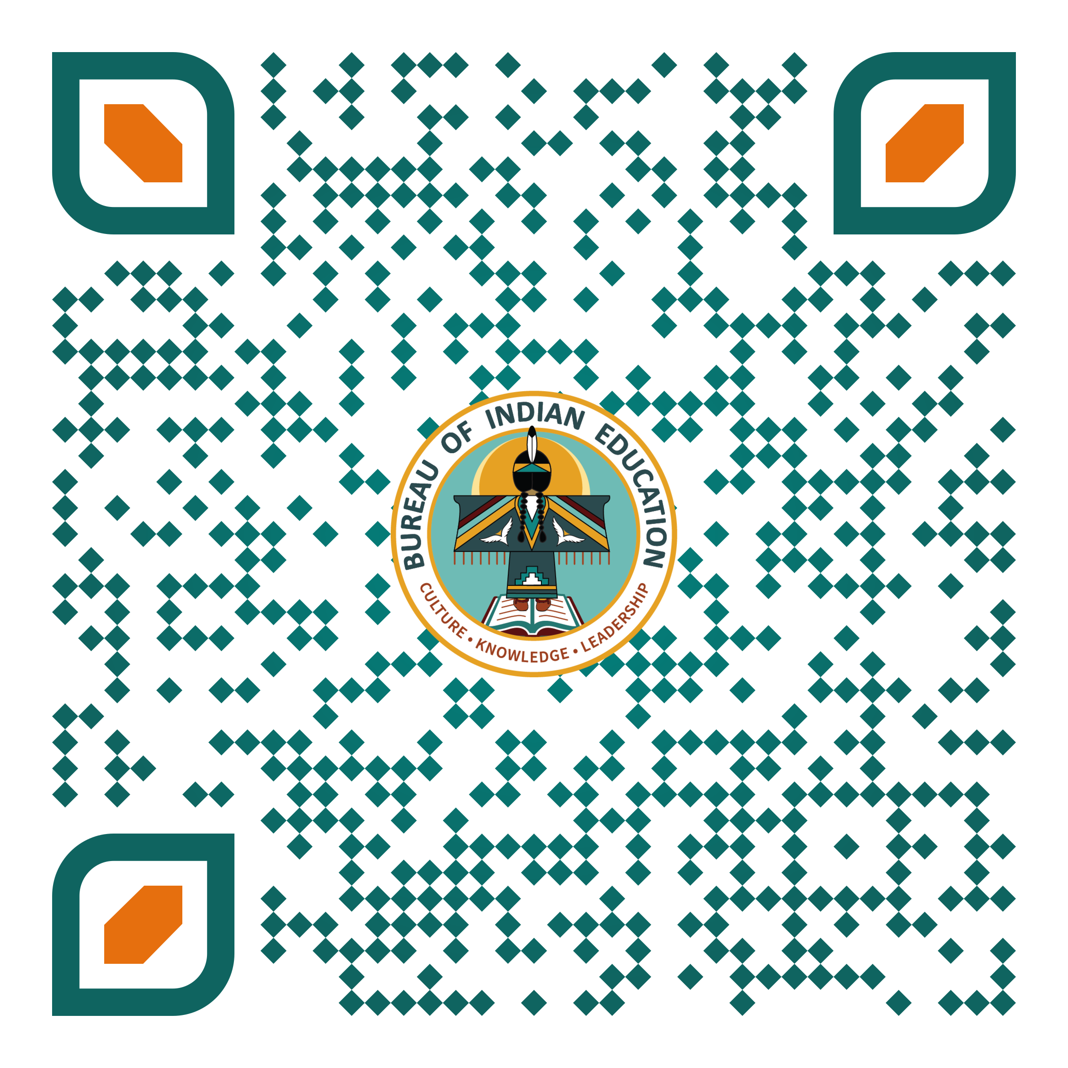
End of Day Survey

