Slide 1
1
Notes:
2 minute

Slide 2
SESSION 10: SOCIAL EMOTIONAL LEARNING (SEL)
A GUIDE FOR LEADERS IN A BLENDED ENVIRONMENT
1
Notes:
2 minute

Slide 3
Carly Knoche
Contractor: Education Research Analyst
BIE STEP eLMS Initiative
educationtraining@bie.edu
1
Notes:
2 minute

Slide 4
AGENDA & LEARNING OBJECTIVES
Agenda
1. What is SEL?
2. Why SEL?
3. SEL Implementation
4. SEL in a Blended Environment
5. Leadership Choice Board
Learning Objectives
At the conclusion of this training, leaders will:
Understand the importance of teaching, modeling, and practicing SEL.
Secure at least 1-2 SEL strategies to implement in classrooms and the school environment.
Obtain resources to share with educators to support and develop SEL practices.
2
Notes:
1 minute
Brief explanation of "Blended Learning"

Slide 5
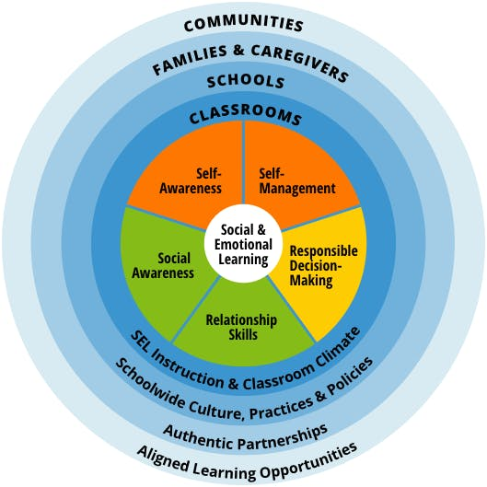
WHAT IS SEL?
As defined by the Collaborative for Academic, Social, and Emotional Learning (CASEL©), SEL is the process through which all young people and adults acquire and apply the knowledge, skills, and attitudes to:
develop healthy identities
manage emotions and achieve personal and collective goals
feel and show empathy for others
establish and maintain supportive relationships
make responsible and caring decisions
(CASEL©, 2022)
3
Notes:
2 minutes
SEL can be used and learning in all environments and subject areas. This learning takes places (regardless if positive or negative) in all areas.
Provide handout to 5 competencies + sub-competencies

Slide 6
INCLUSION ACTIVITY
Think, Ink, Pair
What is our school currently doing to promote SEL?
With staff?
With students?
With families?
With other stakeholders?
What are areas of growth for our school?
Notes:
Personal reflection
7 minutes

Slide 7

WHY NOW?
When the pandemic occurred…
… there was an abrupt change to learning, family lives, and work
… which created an emotional, academic, and mental health crisis.
Notes:
1 minute

Slide 8
WHY NOW?
According to Mental Health America (MHA),
“Native/Indigenous people in America report experiencing serious psychological distress 2.5 times more than the general population over a month’s time.
Although overall suicide rates are similar to those of whites, there are significant differences among certain age groups. The suicide death rate for Native/Indigenous people in America between the ages of 15-19 is more than double that of non-Hispanic whites.
Native/Indigenous people in America start to use and abuse alcohol and other drugs at younger ages, and at higher rates, than all other ethnic groups.”
Geographical and economic barriers are often roadblocks to treatment and supports.
IF NOT NOW, THEN WHEN?
Mindfulness Meditation: Inward Journey by R. Carlos Nakai
Notes:
5 minutes (total)
Read to self + reflect.
3 minute to set intention for our work & center ourselves
Music for the background of guided meditation.

Slide 9

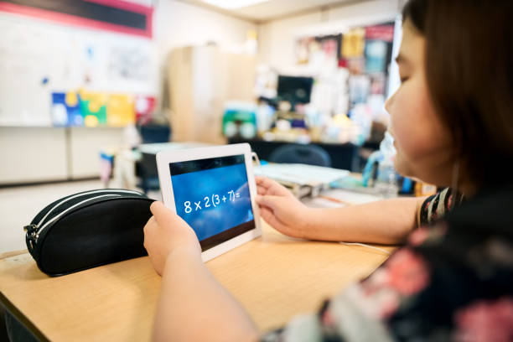
WHY SEL?
Research shows dramatic improvements in overall performance
COVID-19 Pandemic:
Made SEL a priority
Created a desire to recover from learning loss
Increased focus on accessibility (rural internet access, language, disability)
Instilled a need for heightened student agency
Notes:
2 minutes

Slide 10
MASLOW’S HIERARCHY OF NEEDS (1943)
Actualization
Esteem
Belonging
Safety
Physical Needs
8
Notes:
1 minute
Continuum

Slide 11




HIERARCHY OF BLENDED LEARNING NEEDS
Actualization
Intrinsically Motivated, Realization of Talents
Esteem
Grades, Comments,
Awards, Feedback, Recognition, Affirmation
Belonging
Social Media, Learning Communities, Discussions, Team Building, Modeling, Peer Mentorship
Safety
Digital Citizenship, Filters, Safe Searches, Firewalls, Norms, Protocols
Physical Needs
Hardware, Internet, WiFi, Device Access,
People, Resources, Appropriate Locations
9
Notes:
3 minutes
How can we use technology to meet the needs of learners?
Many of the physical Needs & Safety are often only controlled by for administrators and IT staff, but some of these are areas that all staff can support.
Majority of staff should be focused on belonging and esteem to lead to actualization.

Slide 12
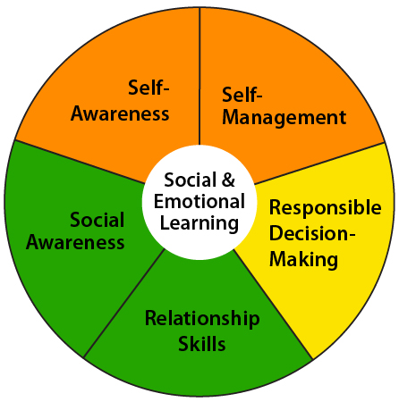
IMPLEMENTATION: NOT “ANOTHER THING”
Stand Alone SEL Curriculum
SEL Integration with Curricula
Through SEL specific topics (health, life learning)
Through real-world topics (computer usage, history, literature character development)
Formative & summative assessments (projects, discussions, 1-2 SEL questions)
Both
Notes:
2 minutes
Examples of stand-alone: Second Step,
Using competencies
All are viable and backed by research. It’s dependent on where you are.
Importance that it isn’t another thing.
When integrated within curricula, it becomes more relevant to students lives and learning is therefore increased.
Assessments: Learn then be able to apply

Slide 13
SEL USING BLENDED LEARNING
Leverage technology tools and your LMS in the classroom or virtually to:
Check for understanding
Encourage collaboration
Allow multiple modalities for language input and output
Differentiate instruction to meet all learners needs
Use CASEL’s Signature Practices
Inclusion Activities
Engagement Strategies
Closure Activities
Provide students with voice and choice in their learning
Notes:
2 minutes
Each classroom is it’s own learning community both virtually and in person and both help it to grow. Personalize your classroom in the LMS just like you would your traditional classroom.
Provide CASEL Signature Practices Playbook
Choice boards

Slide 14
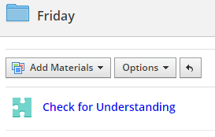
SELF-AWARENESS
Polls, Wellness Check-Ins, & Checks for Understanding
Videos and assignments related to identity, culture, and language
Videos and learning journals using metacognition
Choice boards
Opportunities to connect to real life experiences
Mindfulness meditation
Integrating personal and social identities
Identifying personal, cultural, and linguistic assets
Identifying one’s emotions
Demonstrating honesty and integrity
Linking feelings, values, and thoughts
Examining prejudices and biases
Experiencing self-efficacy
Having a growth mindset
Developing interests and a sense of purpose
Notes:
2 minutes

Slide 15
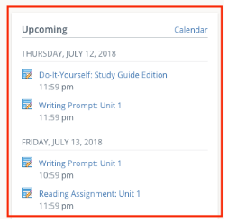
SELF-MANAGEMENT
Choice boards
Agendas
Student planner
Resource folders
Posted objectives
Daily task list
Timelines
Goal setting & check-ins
Flexible seating
Checklists & rubrics
Contracts & agreements
Managing one’s emotions
Identifying and using stress-management strategies
Exhibiting self-discipline and self-motivation
Setting personal and collective goals
Using planning and organizational skills
Showing the courage to take initiative
Demonstrating personal and collective agency
Notes:
2 minutes

Slide 16
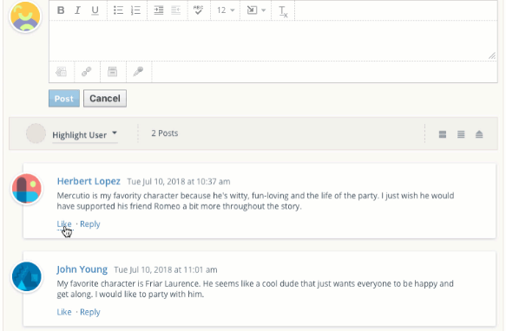
SOCIAL AWARENESS
Video conferencing
Posting comments
Posting work, attachments, photos, GIFs, etc.
Small group feature
Group projects
Discussion boards
Collaborative documents
Exploration of digital museums and historical sites
Discussions/videos with family & community
Shared classroom norms
Taking others’ perspectives
Recognizing strengths in others
Demonstrating empathy and compassion
Showing concern for the feelings of others
Understanding and expressing gratitude
Identifying diverse social norms, including unjust ones
Recognizing situational demands and opportunities
Understanding the influences of organizations/systems on behavior
Notes:
2 minutes

Slide 17
RELATIONSHIP SKILLS
Video conferencing
Posting comments
Posting work, attachments, photos, GIFs, etc.
Small group feature
Group projects
Discussion boards
Collaborative documents
Exploration of digital museums and historical sites
Discussions/videos with family & community
Inclusion & closure activities
Think, Ink, Pair, Share
Communicating effectively
Developing positive relationships
Demonstrating cultural competency
Practicing teamwork and collaborative problem-solving
Resolving conflicts constructively
Resisting negative social pressure
Showing leadership in groups
Seeking or offering support and help when needed
Standing up for the rights of others
Notes:
1 minutes
Very similar to social awareness & include many of the same strategies. This focuses more on the interaction piece.

Slide 18
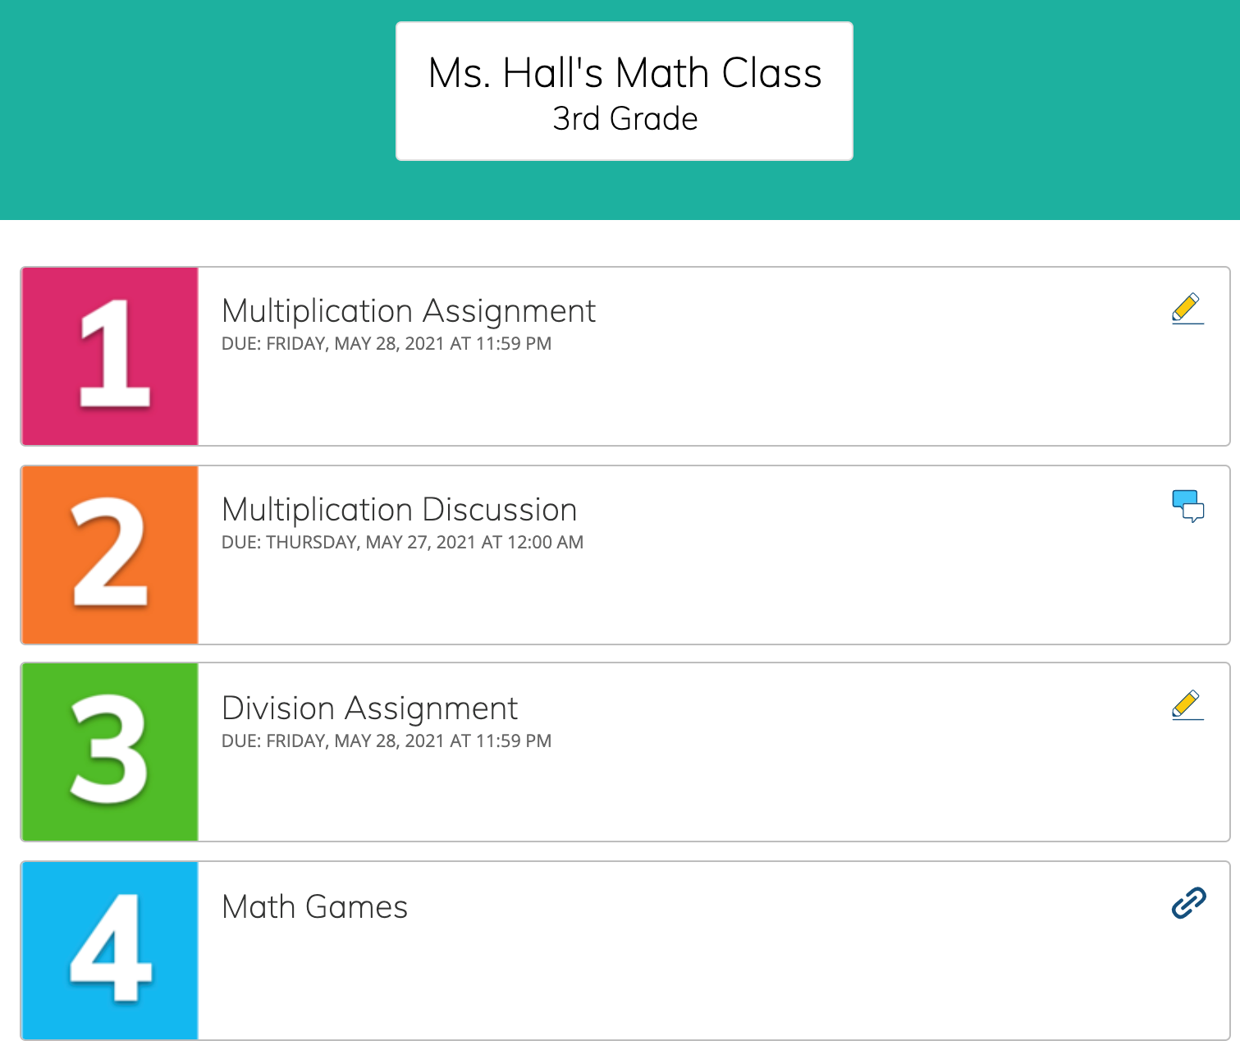
RESPONSIBLE DECISION-MAKING
Video of class norms and expectations sent to families to view with learners
Posted daily tasks and timelines
Posted agenda
Student planner
Embedded scenarios with problems or decisions
Multiple solution problems
Model and practice decision making
Demonstrating curiosity and open-mindedness
Identifying solutions for personal and social problems
Learning to make a reasoned judgment after analyzing information, data, facts
Anticipating and evaluating the consequences of one’s actions
Recognizing how critical thinking skills are useful both inside & outside of school
Reflecting on one’s role to promote personal, family, and community well-being
Evaluating personal, interpersonal, community, and institutional impacts
Notes:
2 minutes

Slide 19
SYSTEMIC TRANSFORMATION
Choice Board: Pick 1 or more.
When you complete one, move to another.
Schoolwide SEL Strategic Reflection & Planning
Complete the Reflection Rubric for Schoolwide SEL Implementation
Begin creating your school Action Plan for Schoolwide Implementation
Mindful Moment (5 minutes maximum)
Please feel free to take care of any pressing personal needs.
During this time, as you are able, consider the following prompts:
What SEL strategies can I take back to my staff that can implemented quickly?
How will I model SEL in my leadership?
What additional information do I need?
Video Reflection
Watch & reflect upon the video of SEL implementation at Marcus Garvey Elementary.
Reflect on your school’s areas of strength and growth.
Question & Answer Session
Notes:
20 minutes
Focus on what you need to create systemic change and implement SEL into your space. Select one or multiple. You decide what is right for you at this time.
INCLUDE LINKS TO DOCUMENTS!!

Slide 20
CLOSURE ACTIVITY
What resonated with you?
What are you still curious about?
What is one thing that you will take back to your staff?
Notes:
2 minutes

Slide 21
19

Slide 22

End of Day Survey

Slide 23
HIERARCHY OF DIGITAL LEARNING NEEDS & SEL
Society
Actualization
Intrinsically Motivated, Realization of Talents
Esteem
Grades, Comments, Awards, Feedback, Recognition, Affirmation
Group
Belonging
Social Media, Learning Communities, Discussions, Team Building, Modeling, Peer Mentorship
Safety
Digital Citizenship, Filters, Safe Searches, Firewalls, Norms, Protocols
Self
Physical Needs
Hardware, Internet, Wifi, Device Access,
People, Resources, Appropriate Locations
Notes:
1 minute
We build SEL skills on a continuum as well and all our needs from Maslow are supported through SEL.

Slide 24
MISSION SLIDE

