Slide 2
DAY 3 SESSION 11-13 ASBESTOS HAZARD EMERGENCY RESPONSE ACT (AHERA)

Slide 3
Henryetta Price and Mark Ulibarri
Environmental Protection Specialists
BIE Branch of Environmental Management

Slide 5



MEET OUR PRESENTERS
Henryetta Price
Mark Ulibarri
Environmental Protection Specialist
Albuquerque-Central Office
Henryetta.price@bie.edu
Environmental Protection Specialist
Navajo BIE-Window Rock Office
Mark.Ulibarri@bie.edu

Slide 6
MEET OUR TEAM
Russell Brigham
Lionel Puhuyesva
BIE Environmental Protection Specialist
Albuquerque-Central Office
BIE Environmental Protection Specialist
Phoenix Southwest Office
Candace Desantis
Karmen Billey-Badonie
BIE Environmental Protection Specialist
Albuquerque-Central Office
BIE Environmental Protection Specialist
Navajo BIE-Window Rock Office

Slide 7
ASBESTOS AWARENESS -DEFINITIONS
Asbestos: chrysotile, amosite, crocidolite, tremolite, anthophyllite, actinolite, and any of these minerals that have been chemically altered; includes PACM
ACM: "asbestos-containing material," any material containing > 1% asbestos
Asbestos-containing building material (ACBM): Surfacing ACM, thermal system insulation ACM, or miscellaneous ACM that is found in or on interior structural members or other parts of a school building.
Encapsulation: The treatment of ACBM with a material that surrounds or embeds asbestos fibers in an adhesive matrix to prevent the release of fibers, as the encapsulant creates a membrane over the surface (bridging encapsulant) or penetrates the material and binds its components together (penetrating encapsulant).
Enclosure: Is an airtight, impermeable, permanent barrier around ACBM to prevent the release of asbestos fibers into the air.

Slide 8
ASBESTOS AWARENESS -DEFINITIONS
Definitions continued:
Friable: When referring to material in a school building means that the material, when dry, may be crumbled, pulverized, or reduced to powder by hand pressure
Nonfriable: Means material in a school building which when dry may not be crumbled, pulverized, or reduced to powder by hand pressure.
School Building: Any structure suitable for use as a classroom, including a school facility such as a laboratory, library, school eating facility, or facility used for school purposes.
Local education agency The Tribe, as an administrative director of the school, qualifies as a LEA pursuant to 40 C.F.R. § 763.83. and must ensure compliance among schools.
Any local educational agency as defined in section 198 of the Elementary and Secondary Education Act of 1965 (20 U.S.C. 3381).
The owner of any nonpublic, nonprofit elementary, or secondary school building.
The governing authority of any school operated under the defense dependent's education system provided for under the Defense Dependents' Education Act of 1978 (20 U.S.C. 921, et seq.).

Slide 9
FEDERAL REGULATIONS
Asbestos is also regulated by the U.S Environmental Protection Agency (EPA) under
15 U.S.C, Title 15, CHAPTER 53, Subchapter II- Asbestos Hazard Emergency Response
40 CFR 763 Asbestos Hazard Emergency Response Act (AHERA)
40 CFR 763 Subpart E – Asbestos-containing Materials in Schools
40 CFR 61 Subpart M National Emissions Standards for Hazardous Air Pollutants (NESHAP) for Asbestos – Renovation and Demolition.
Oversight of AHERA and NESHAP regulations is assigned to BIE’s Environmental Program.
Asbestos is regulated by the Occupational Safety & Health Administration (OSHA) under
29 Code of Federal Regulations (CFR) 1910 General Industry (1910.1001 Toxic and Hazardous Substances – Asbestos) and
29 CFR 1926 Safety and Health Regulations for Construction (1926.1101 Toxic and Hazardous Substances – Asbestos),
Oversight of OSHA regulations fall under the preview of BIE’s Safety Program.

Slide 10
STATE & LOCAL REGULATIONS
Twelve states have an AHERA waiver to implement and oversee their own asbestos in schools' regulations. Those states include Connecticut, Colorado, Illinois, Kentucky, Louisiana, Massachusetts, Maine, New Hampshire, Oklahoma, Rhode Island, Texas and Utah.

Slide 11
WHAT IS ASBESTOS?
Asbestos is a naturally occurring mineral fiber.
There are 6 types divided into 2 main groups. Chrysotile, amosite, crocidolite, anthophyllite, tremolite and actinolite — belonging to the serpentine and amphibole families.
Asbestos is essentially inert.
Asbestos fibers are virtually indestructible.
They are resistant to chemicals and heat, and they are very stable in the environment.
They do not evaporate into air or dissolve in water, and they are not broken down over time.
Asbestos is probably the best insulator known to man. Because asbestos has so many useful properties, it has been used in over 3,000 different products.

Slide 12
EPA POLICY FOR ASBESTOS CONTROL IN SCHOOLS
Although asbestos is hazardous, the risk of asbestos-related disease depends upon exposure to airborne asbestos fibers.
Based upon available data, the average airborne asbestos levels in buildings seem to be very low. Accordingly, the health risk to most building occupants also appears to be very low. However, there is no safe limit for asbestos.
Removal is often not a building owner's best course of action to reduce asbestos exposure. In fact, an improper removal can create a dangerous situation where none previously existed.
EPA only requires asbestos removal to prevent significant public exposure to airborne asbestos fibers during building demolition or renovation activities.
Identified asbestos will pose little risk if it is well maintained under an operations and maintenance program. Improper operations and maintenance also can cause dangerous situations. Therefore, EPA requires a pro-active, in-place management program whenever ACBM is discovered and is not removed.

Slide 13
WHEN WAS ASBESTOS REGULATED?
Asbestos was first identified as a hazardous air pollutant under the Clean Air Act of 1970.
Amendments to the act resulted in several U.S. Environmental Protection Agency regulations governing the use and disposal of asbestos. Giving the agency the authority to ban certain asbestos products.
ASBESTOS PRODUCTS BANNED UNDER NESHAP
1973: Application of spray-applied surfacing material containing asbestos was banned for fireproofing and insulating purposes.
1975: The installation of asbestos pipe insulation and asbestos block insulation on facility components, including boilers and hot water tanks, were banned.
1978: It banned spray-applied surfacing materials for purposes not already banned.
1990: The agency prohibited spray-on applications of materials containing more than 1% asbestos to buildings, structures, pipes and conduits.
People injured by asbestos have advocated for their rights. They work hard to implement regulations that might protect future workers.

Slide 14
ASBESTOS HISTORICAL USES?
The Greeks used asbestos in lamp wicks.
The fire resistance properties of asbestos have been known since ancient times.
It is said that Charlemagne's tablecloth (which according to legend, he threw in a fire to clean) was made of asbestos.
Asbestos was used in fabrics such as Egyptian burial cloth.
Insulation material -- Usually spray-applied, trowel-applied, or manually installed after being preformed to fit surfaces such as pipes for thermal insulation and condensation control.
Acoustical or soundproofing material -- Trowel- or spray-applied. May also be used for decoration. Asbestos was mixed with other materials and sprayed onto ceilings and walls to produce a soft, textured look.

Slide 15
WHERE IS ASBESTOS FOUND?
Asbestos may be found in many different products
and many different places. Examples of products that
might contain asbestos are:
Sprayed-on fireproofing and insulation in buildings
Insulation for pipes and boilers
Wall and ceiling insulation
Ceiling tiles
Floor tiles
Putties, caulks, and cements (such as in chemical carrying cement pipes)
Plaster material
Mastic material (pipe, HVAC, sink)
Roofing shingles

Slide 16
WHAT ARE THE HAZARDS OF ASBESTOS?
Asbestos is well recognized as a health hazard and its use is now highly regulated by both OSHA and EPA. Asbestos fibers associated with these health risks are too small to be seen with the naked eye. Breathing asbestos fibers can cause a buildup of scar-like tissue in the lungs called asbestosis and result in loss of lung function that often progresses to disability and death. Asbestos also causes cancer of the lung and other diseases such as mesothelioma of the pleura which is a fatal malignant tumor of the membrane lining the cavity of the lung or stomach. Epidemiologic evidence has increasingly shown that all asbestos fiber types, including the most commonly used form of asbestos, chrysotile, causes mesothelioma in humans.

Slide 17
WHEN IS ASBESTOS DANGEROUS?
ACM is not generally considered to be harmful unless it is releasing dust or fibers into the air where the fibers can be inhaled.
Many of the fibers will become trapped in the mucous membranes of the nose and throat where they can then be removed, but some may pass deep into the lungs.
Once they are trapped in the lungs, the fibers can cause health problems.

Slide 18
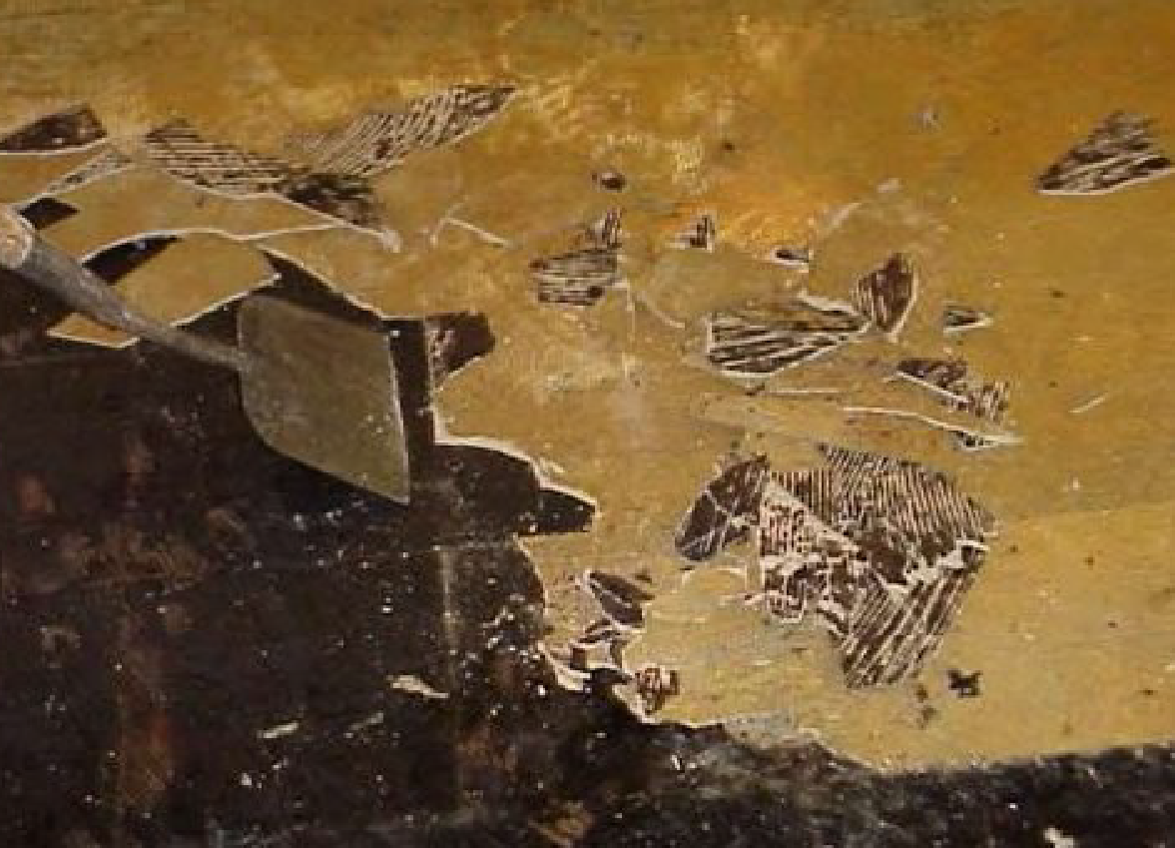
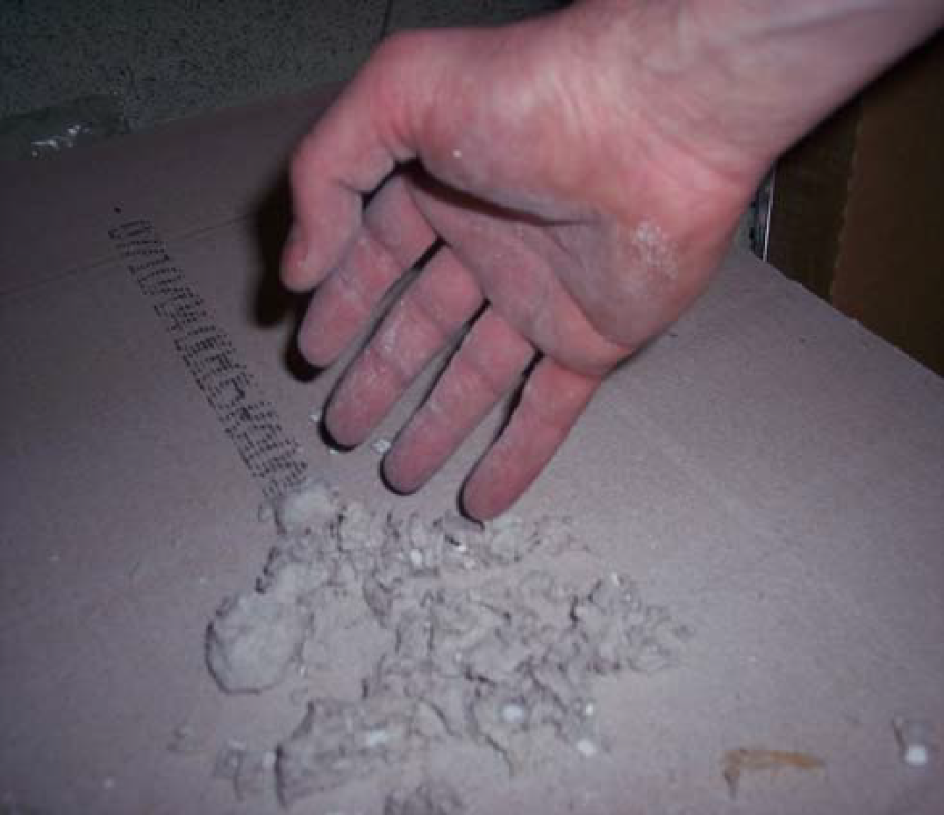
WHEN IS ASBESTOS DANGEROUS?
Continued:
Asbestos is hazardous when it is friable and is disturbed in such a nature that it releases fibers.
The term "friable" means that the asbestos is easily crumbled by hand, releasing fibers into the air.
Asbestos floor tile is non-friable.
Asbestos ceiling tile is friable
There is no "safe" level of asbestos exposure for any type of asbestos fiber. Asbestos exposures as short in duration as a few days have caused mesothelioma in humans.

Slide 19
HOW TO AVOID EXPOSURE
In order to avoid being exposed to asbestos, you must be aware of the locations it is likely to be found. Recent reports and locations are identified in the Asbestos Management Plan.
If you do not know whether something is asbestos or not and it fits the suspect material category, assume that it is until it is verified otherwise.
Remember that you cannot tell if floor or ceiling tiles contain asbestos just by looking at them.
The Division of Occupational Health and Safety has a contractor that can take samples from materials in order to determine whether or not they contain asbestos. If you would like to have materials analyzed or tested for asbestos, please contact DOHS (301-496-3457).
Never try to take a sample yourself unless you have been trained to do so.

Slide 20
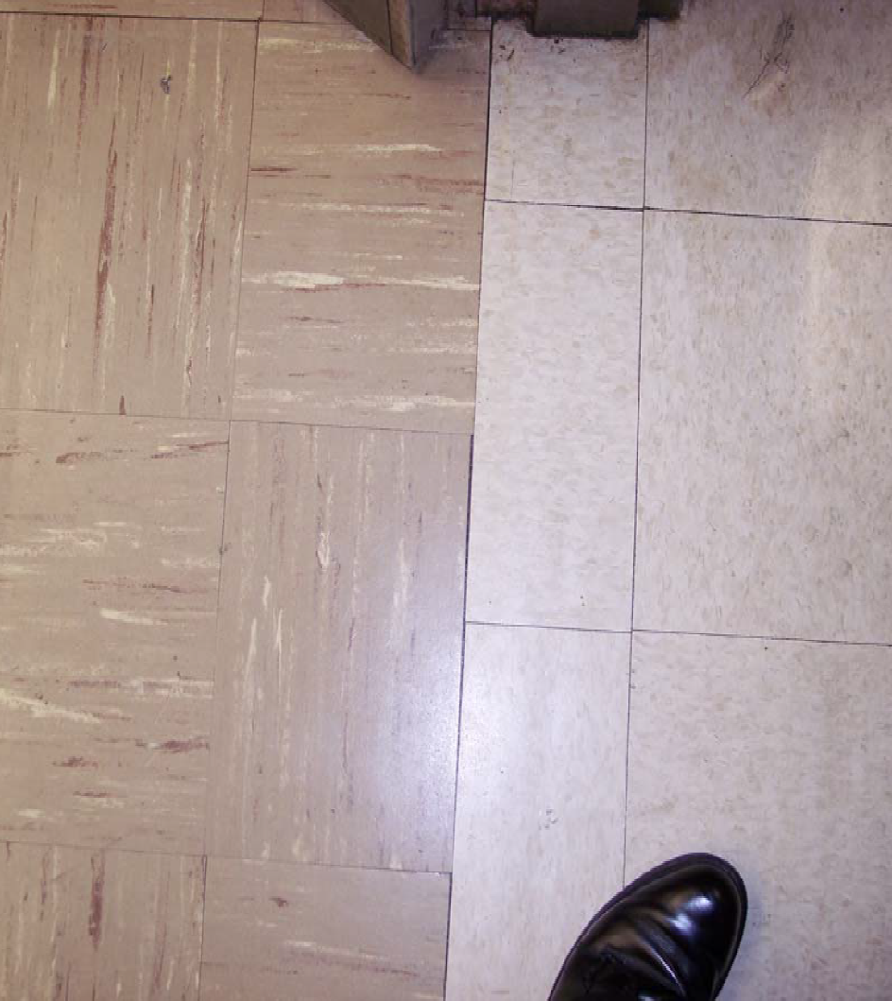
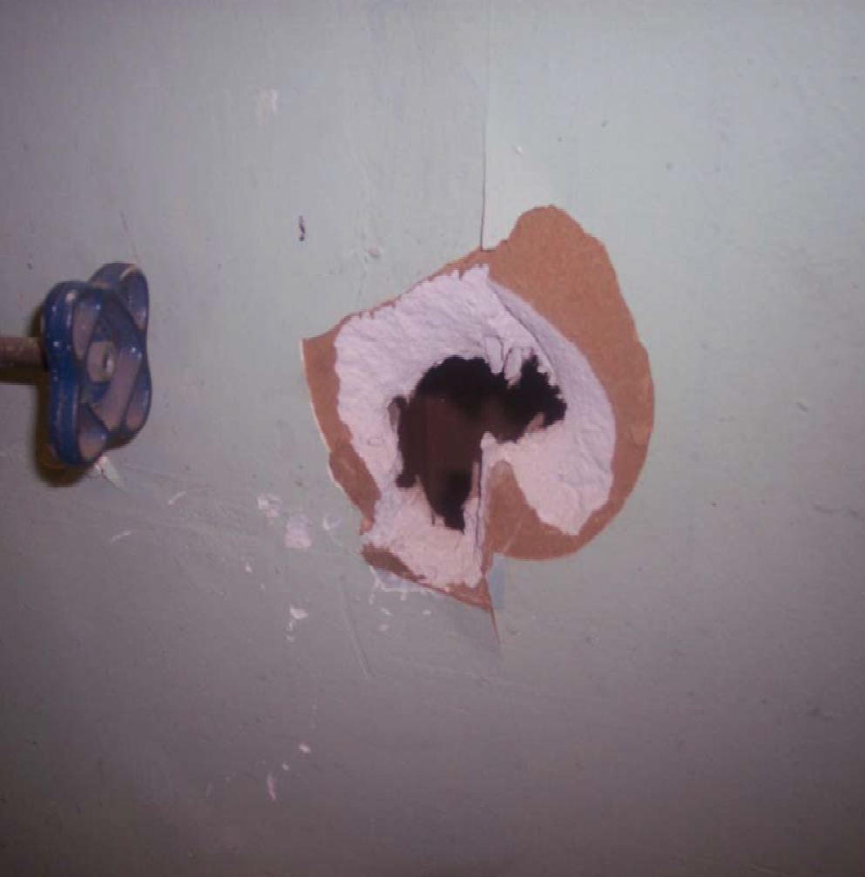
COMMON ASBESTOS ITEMS

Slide 21
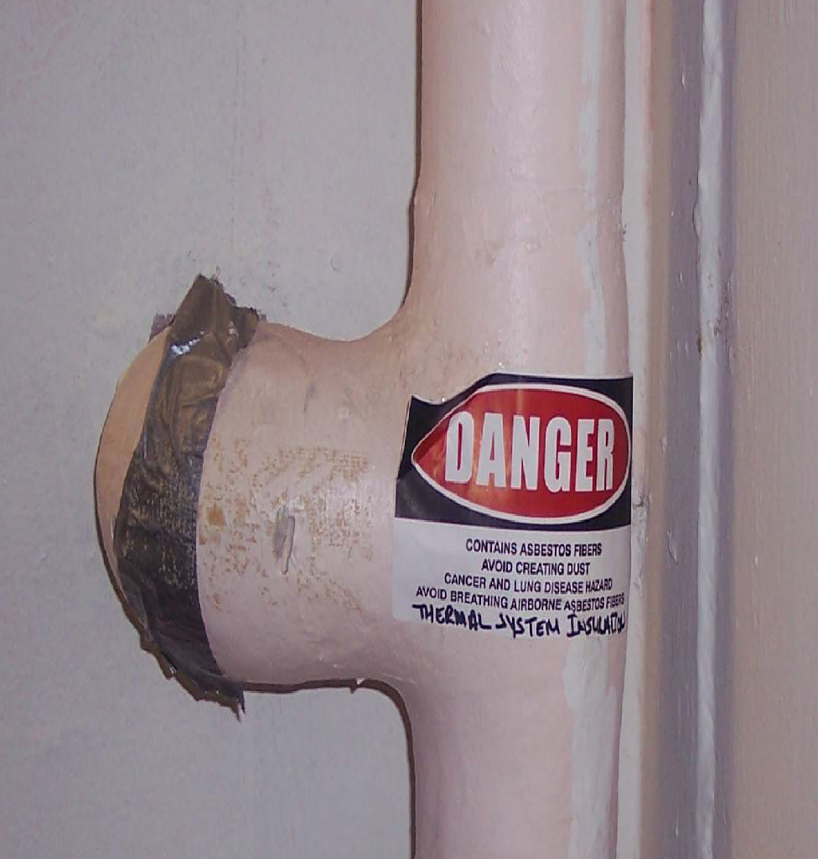
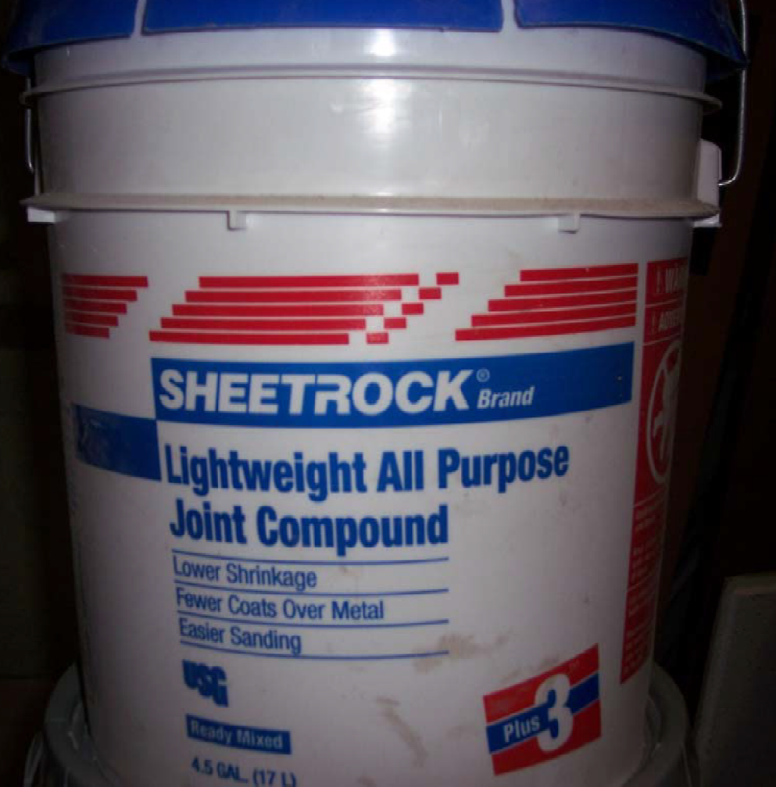
COMMON ASBESTOS ITEMS

Slide 22
ROLES AND RESPONSIBILITIES
Local Education Agencies (LEAs)
Compliance requirements include but not limited to:
Management Plans:
The LEA shall implement an asbestos management plan (AMP) developed by an accredited management planner following the guidelines listed in 40 CFR 763.93.
The AMP for each school to include all school buildings and submit the plan to an Agency designated by the Governor of the State or local Tribe in which the LEA is located.
The LEA shall include any new building in the AMP for the school prior to its use as a school building.
Each LEA shall maintain and update its AMP to keep it current with ongoing operations and maintenance, periodic surveillance, inspection, reinspection, and response action activities.
Each school shall maintain in its administrative office a complete, updated copy of the AMP for that school.
Each LEA shall maintain in its administrative office a complete, updated copy of an AMP for each school under its administrative control or direction.

Slide 23
ROLES AND RESPONSIBILITIES
Local Education Agencies (LEAs) Continued
Initial Inspection:
Shall be conducted by an accredited inspector.
Each school building shall be inspected to identify all locations of friable and nonfriable ACBM.
In the event that emergency use of an uninspected building as a school building is necessitated, such buildings shall be inspected within 30 days after commencement of such use.
The EPA may conduct inspections and review management plans under section 11 of Title I of the Act (15 U.S.C. 2610) to ensure compliance.
Reinspection:
Each inspection shall be made by an accredited inspector.
At least once every 3 years after a management plan is in effect, each LEA shall conduct a reinspection of all friable and nonfriable known or assumed ACBM in each school building.
Surveillance:
At least once every 6 months after a management plan is in effect, each LEA shall conduct periodic surveillance in each building that it leases, owns, or otherwise uses as a school building that contains ACBM or is assumed to contain ACBM.

Slide 24
ROLES AND RESPONSIBILITIES
Local Education Agencies (LEAs) Continued:
Designated Person:
The LEA shall designate a person to ensure that requirements are properly implemented.
The designated person receives adequate training to perform their duties. Such training shall provide, as necessary, basic knowledge of:
Health effects of asbestos.
Detection, identification, and assessment of ACM.
Options for controlling ACBM.
Asbestos management programs.
Relevant Federal and State regulations concerning asbestos, including those in this subpart E and those of the Occupational Safety and Health Administration, U.S. Department of Labor, the U.S. Department of Transportation and the U.S. Environmental Protection Agency.
Consider whether any conflict of interest may arise from the interrelationship among accredited personnel and whether that should influence the selection of accredited personnel to perform the activities.

Slide 25
ROLES AND RESPONSIBILITIES
Local Education Agencies (LEAs) Continued:
Notification:
Ensure that workers and building occupants, or their legal guardians, are informed at least once each school year the availability of the asbestos management plan, inspections, response actions, and post-response action activities, including periodic reinspection and surveillance activities that are planned or in progress.
Ensure that short-term workers (e.g., telephone repair workers, utility workers, or exterminators) who may come in contact with asbestos in a school are provided information regarding the locations of ACBM and suspected ACBM assumed to be ACM.

Slide 26
ROLES AND RESPONSIBILITIES
Local Education Agencies (LEAs) Continued:
Training:
The LEA shall ensure, prior to the implementation of the O&M provisions of the management plan, that all members of its maintenance and custodial staff (custodians, electricians, heating/air conditioning engineers, plumbers, etc.) who may work in a building that contains ACBM receive awareness training of at least 2 hours, whether or not they are required to work with ACBM.
New custodial and maintenance employees shall be trained within 60 days after commencement of employment.
The LEA shall ensure that all members of its maintenance and custodial staff who conduct any activities that will result in the disturbance of ACBM shall receive 14 hours of additional training.

Slide 27
ROLES AND RESPONSIBILITIES
Local Education Agencies (LEAs) Continued:
Operations and Maintenance:
The LEA shall implement an operations, maintenance, and repair (O&M) program under this section whenever any friable ACBM is present or assumed to be ACBM present in a school building. Will also be included within the Asbestos Management Plan
The LEA must comply with either the OSHA Asbestos Construction Standard at 29 CFR 1926.1101, or the Asbestos Worker Protection Rule at 40 CFR 763.120, whichever is applicable.
In the event of a minor fiber release the LEA shall ensure that the procedures described below are followed:
Thoroughly saturate the debris using wet methods.
Clean the area, as described in paragraph (e) of this section.
Place the asbestos debris in a sealed, leak-tight container.
Repair the area of damaged ACM with asbestos-free materials.
In the event of a major fiber release (the falling or dislodging of more than 3 square or linear feet of friable ACBM) the LEA shall ensure that the procedures described below are followed:
Restrict entry into the area and post signs to prevent entry into the area by persons other than those necessary to perform the response action.
Shut off or temporarily modify the air-handling system to prevent the distribution of fibers to other areas in the building.

Slide 28
ROLES AND RESPONSIBILITIES
Local Education Agencies (LEAs) Continued:
Response Actions:
The LEA shall select and implement in a timely manner the appropriate response actions. The response actions selected shall be sufficient to protect human health and the environment. The LEA may then select, from the response actions which protect human health and the environment, that action which is the least burdensome method.
At the conclusion of any action to remove, encapsulate, or enclose ACBM or material assumed to be ACBM, a person designated by the LEA shall visually inspect each functional space where such action was conducted to determine whether the action has been properly completed.
A person designated by the LEA shall collect air samples to monitor air for clearance after each removal, encapsulation, and enclosure project involving ACBM, except for projects that are of small-scale, short-duration.
An action to remove, encapsulate, or enclose ACBM shall be considered complete when the average concentration of asbestos of five air samples collected within the affected functional space meets the requirements listed in 40 CFR 763.90.

Slide 29
ROLES AND RESPONSIBILITIES
Local Education Agencies (LEAs) Continued:
Recordkeeping:
All records shall be maintained in a centralized location in the administrative office of both the school and the LEA as part of the AMP. For each homogeneous area where all ACBM has been removed, the LEA shall ensure that such records are retained for 3 years after the next reinspection.
Warning Labels:
The LEA shall attach a warning label immediately adjacent to any friable and nonfriable ACBM and suspected ACBM assumed to be ACM located in routine maintenance areas at each school building. This shall include:
All labels shall be prominently displayed in readily visible locations and shall remain posted until the ACBM that is labeled is removed.
The warning label shall read, in print which is readily visible because of large size or bright color, as follows:
CAUTION: ASBESTOS. HAZARDOUS. DO NOT DISTURB WITHOUT PROPER TRAINING AND EQUIPMENT.

Slide 30
PROCESSES AND PROCEDURES
No Asbestos Found:
Maintain an Exclusion letter or an Asbestos-free inspection report
Maintain an AHERA Designated Person at each school
Annually notify the Parent Teacher Association (PTA) about the management plan

Slide 31
PROCESSES AND PROCEDURES CONTINUED
Asbestos Found:
Conduct an inspection
Develop maintain and implement an asbestos management plan (notifications, training, document management, etc.)
Conduct periodic (6 mos.) surveillance.
Reinspect every 3 years.

Slide 32
WHAT CAN BE DONE TO REDUCE THE HAZARDS OF ASBESTOS?
Ensure an updated and maintained Asbestos Management Plan is in place.
Facility Managers and custodians should not remove damaged ACBM to reduce risk and hazards to workers and occupants.
Ensure only trained and certified personnel conduct sampling, repairs, and removal while using proper personal protective equipment (PPE).
Utilize trained and licensed contractors during major activities that may involve disturbance or removal of ACBM, such as during improvement or repairs to buildings.

Slide 33

NEARLY ENDLESS RESOURCES…
It can be done: Pine Hill School
OSHA
Asbestos
Notes:
Pine Hill School- Tribally Controlled School- Not sure if we are able to use their AHERA report as an example. Link is only accessible by DOI users.

Slide 34
NEARLY ENDLESS RESOURCES…
IA Fact Sheets
It can be done: Pine Hill School
START HERE
USEPA
Asbestos and School Buildings
School Asbestos Management Plans
Resources for Schools and Parents
Feel free to contact your BIE Environmental Protection Specialists for further guidance!!!
Notes:
Pine Hill School- Tribally Controlled School- Not sure if we are able to use their AHERA report as an example. Link is only accessible by DOI users.

Slide 35
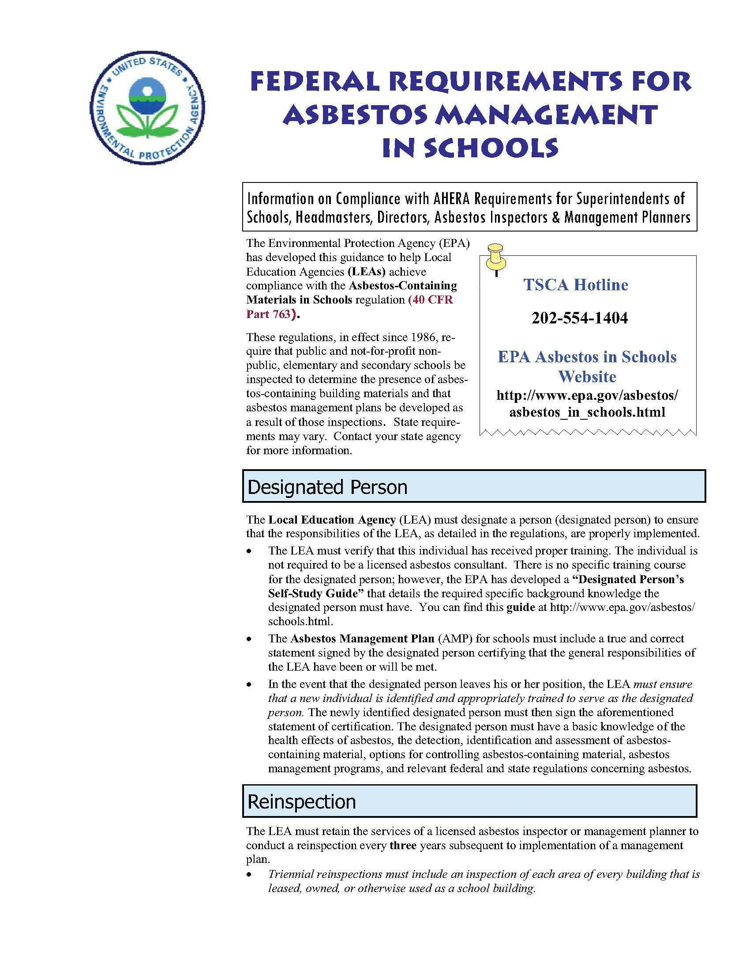
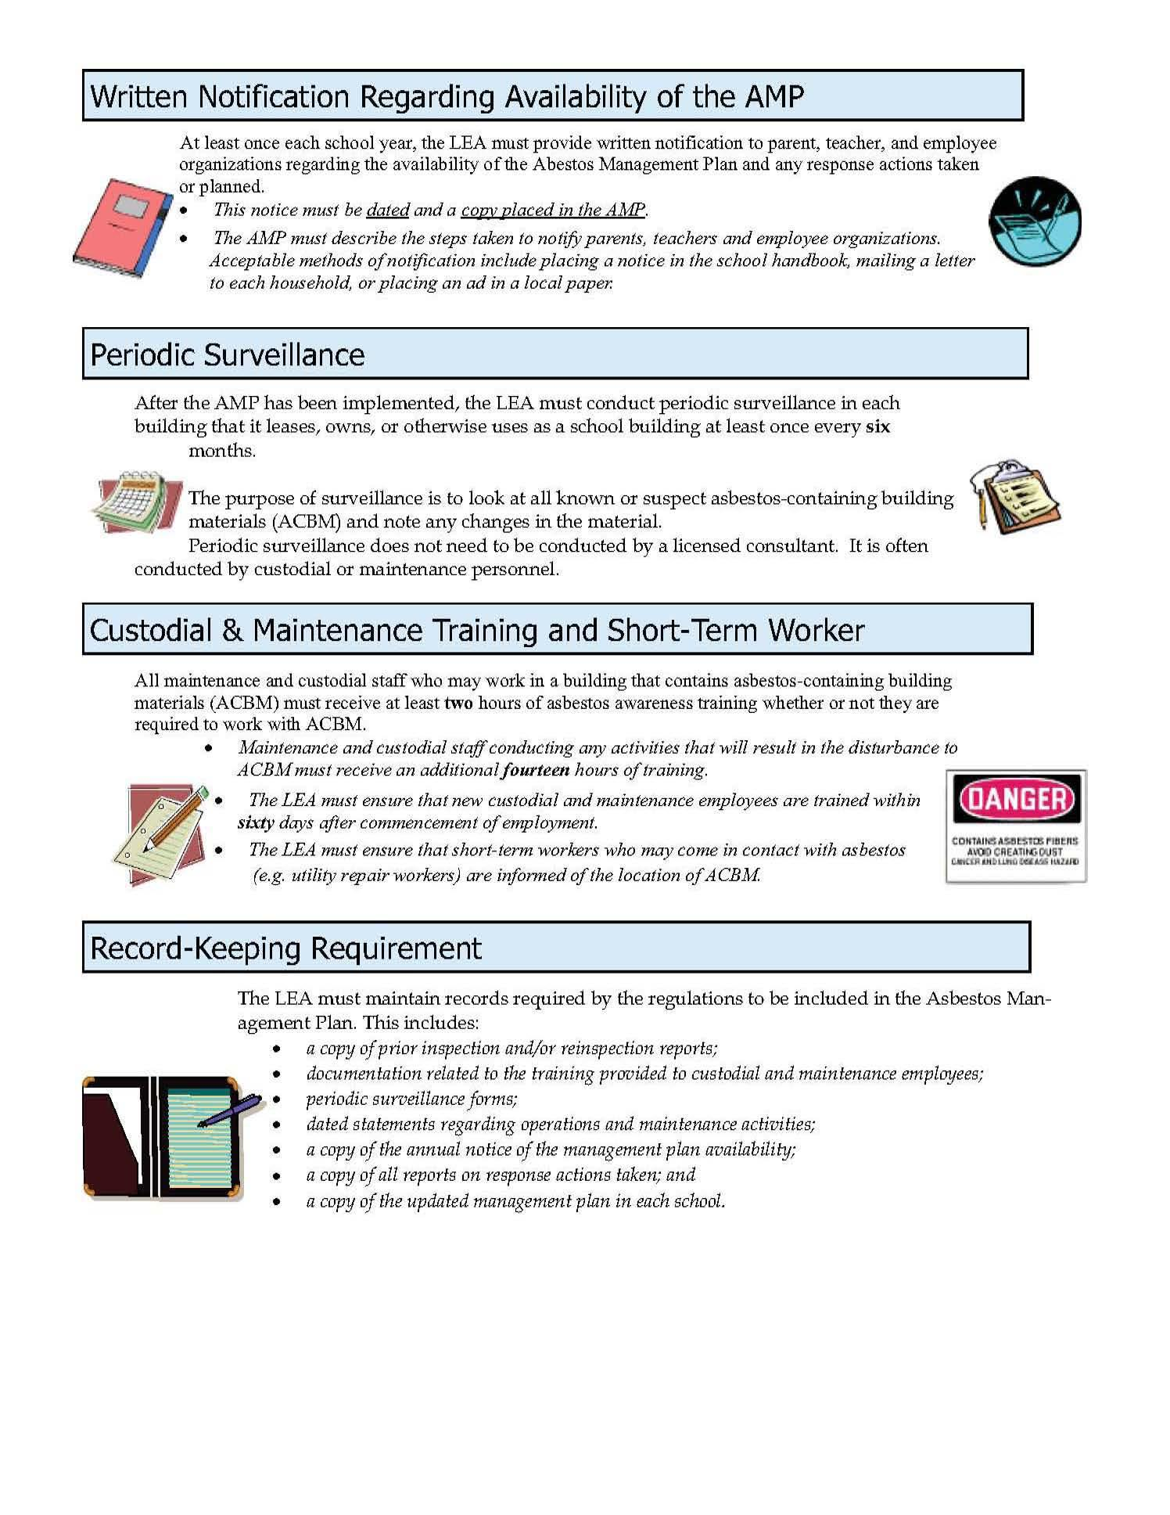
NEARLY ENDLESS RESOURCES…
Notes:
Pine Hill School- Tribally Controlled School- Not sure if we are able to use their AHERA report as an example. Link is only accessible by DOI users.

Slide 36
CONNECT WITH US!

