Slide 2
SESSION 11-13 Safe Drinking Water Act: Consumer Confidence Reporting

Slide 3
Russell Brigham and Lionel Puhuyesva
Environmental Protection Specialists
Bureau of Indian Education, Branch of Environmental Management

Slide 4
Mission Slide

Slide 5
Meet our Presenters
Russell Brigham
Lionel Puhuyesva
Environmental Protection Specialist
BIE Branch of Environmental Management
russell.brigham@bie.edu
Environmental Protection Specialist
BIE Branch of Environmental Management
lionel.puhuyesva@bie.edu

Slide 6
Safe Drinking Water Act: Consumer Confidence Reporting
Notes:
EPA has established protective drinking water standards for more than 90 contaminants, including drinking water regulations issued since the 1996 amendments to the Safe Drinking Water Act that strengthen public health protection. Over 92 percent of the population supplied by community water systems receive drinking water that meets all health-based standards.

Slide 7
Consumer confidence report
Each community water system (CWS) provides an annual water quality report to its customers. This annual water quality report is also called a Consumer Confidence Report (CCR).
Notes:
The Consumer Confidence Reports (CCRs), or annual water quality reports, are a critical piece of the “right-to-know” rules. The purpose of CCRs is to provide customers with information on drinking water quality and allow them to make health-based decisions on drinking water consumption.

Slide 8
Overview CCR
The CCR includes a variety of important information about a CWS, including the drinking water source, any monitored contaminants found in drinking water, and whether a CWS meets tribal, state, and federal drinking water standards.
A CWS must deliver its CCR to customers by July 1st of each year. It must also make a good faith effort to deliver the CCR to consumers who do not directly pay water bills.
Not all schools own a CWS. Most schools will be receiving the CCR from the utility provider and should be reviewed annually.
Notes:
Public Health Related Benefits
- Increased consumer knowledge of drinking water sources, quality, susceptibility
to contamination, treatment, and drinking water supply management.
- Increased awareness of consumers to potential health risks so they may
make informed decisions to reduce those risks, including taking steps toward
protecting their water supply.
- Increased dialogue between drinking water utilities and consumers to increase
understanding of the value of drinking water and water supply services and to
facilitate consumer participation in decisions that affect public health.

Slide 9
Developing your ccr
Identify the responsible (reporting) party
There are eight elements that are the minimum that should be in the CCR
1) Water system information (name and phone number of a contact person; information on public participation opportunities).
2) Source(s) of water
3) Definitions
4) Detected contaminant table
Notes:
The original CCR rule was finalized in 1998. The America’s Water Infrastructure Act of 2018 (AWIA) amended the SDWA and requires EPA to issue revised CCR regulations. The revisions are intended to:
1) Increase the readability, clarity, and understandability of the information in the reports.
2) Increase the accuracy of information presented, and risk communication, in CCRs.
3) Require community water systems serving 10,000 or more people to provide consumers with reports twice per year.
4) Allow electronic delivery of CCRs.
5) AWIA also amended SDWA Section 1414(c)(4)(B) to require community water systems to include information on their corrosion control efforts and identify any corrective actions for action level exceedances in their CCRs.

Slide 10
Developing your ccr
5) Information on monitoring for Cryptosporidium, radon and other contaminants (if detected)
6) Compliance with National Primary Drinking Water Regulations (for example, explanation of violations, potential health effects, and corrective action steps; special notices for Ground Water Rule and Revised Total Coliform Rule)

Slide 11
Developing your ccr
7) If applicable, variances or exemptions (for example, under certain conditions the state or EPA may have granted permission not to meet a maximum contaminant level [MCL] or a treatment technique)
8) Required additional information (such as, explanation of contaminants in drinking water and bottled water; information to vulnerable populations about Cryptosporidium; statements on nitrate, lead and arsenic.)

Slide 12
What else?
Other things to consider are:
The CCR must be placed into the BIE Environmental Management System (EMS) for your school. Contact your local BIE field office for assistance with this requirement.
An explanation or diagram of your CWS’s treatment processes. Consider adding photos or schematics
Additional information on where your source water is geographically located.
A brief summary statement about the quality of your drinking water.
Notes:
CWSs that have a large proportion of non-English speaking residents must include information in the
appropriate language(s) expressing the importance of the CCR, or a phone number or address where
residents may contact the CWS to obtain a translated copy of the CCR or assistance in the appropriate
language.
The primary agency will make the determination of which CWSs need to include this information.

Slide 13
What else?
Other things to consider are:
Water conservation tips
Information about efforts you may have made to promote “green infrastructure”
A statement from the person in charge describing the importance of the CCR and the hard work the CWS does every day to provide safe and reliable drinking water.

Slide 14
What else?
Other things to consider are:
Information to educate customers about water quality concerns in their service area. Including secondary drinking water standard issues such as, taste, color, and odor issues.
Photos that illustrate people enjoying their water.
If there is a large portion of non-English speaking residents, you must include the CCR in the other languages.

Slide 15
Best practices for making a ccr contaminant table
One of the required elements to the CCR is to create a detected regulated contaminants table(s).
This table should be easy to understand and follow to the general public.

Slide 16
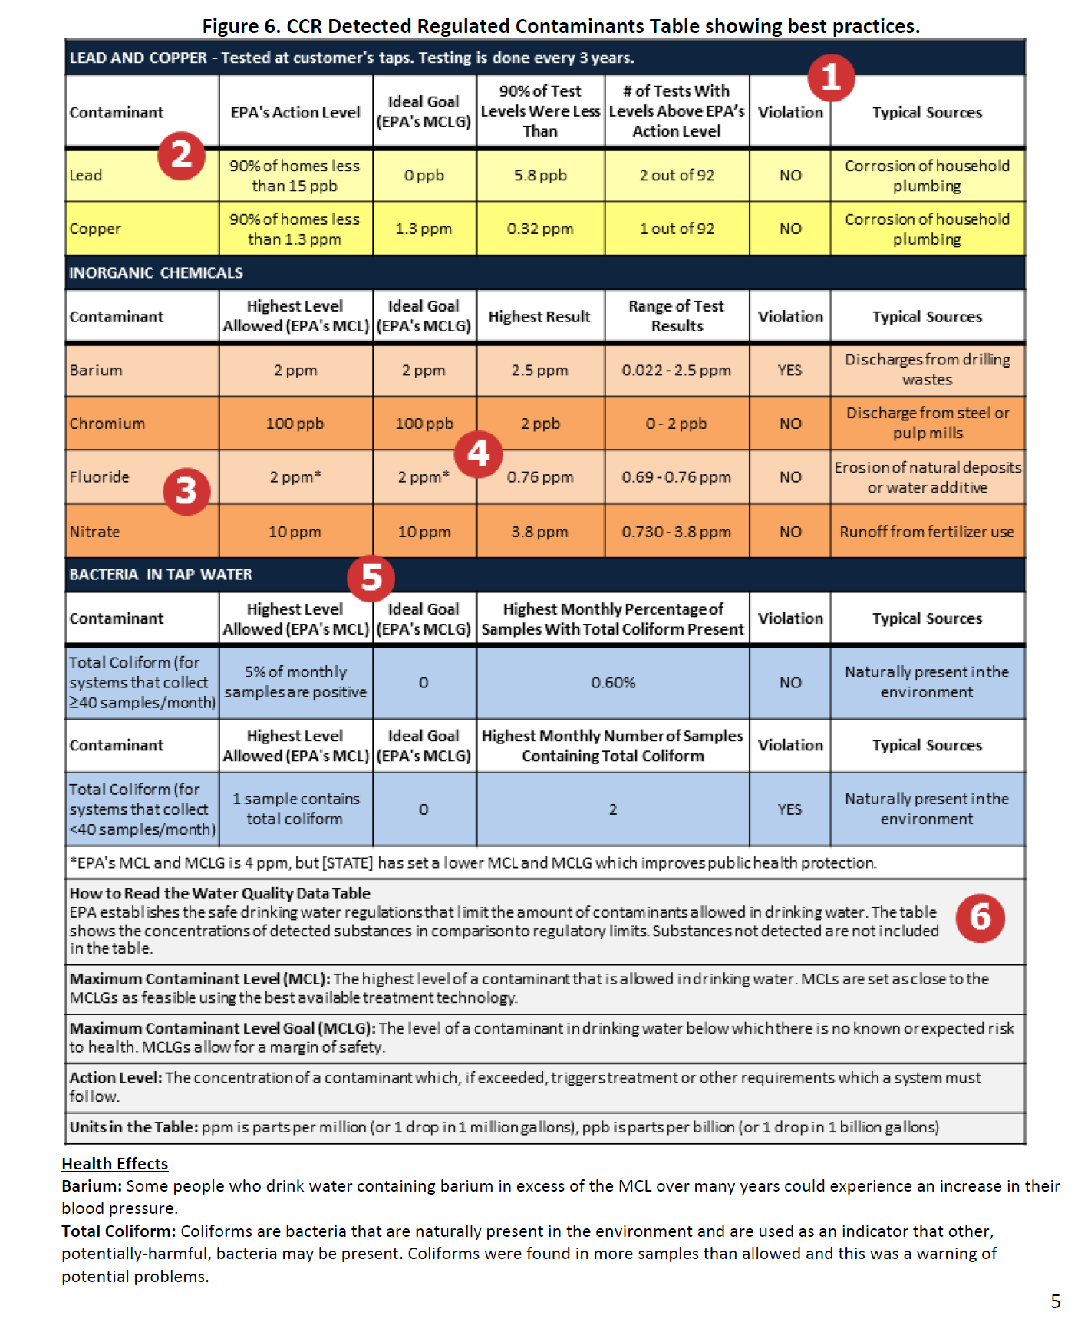
BEST PRACTICES FOR MAKING A CCR CONTAMINANT TABLE
(US EPA, 2015)

Slide 17
(US EPA, 2015)

Slide 18
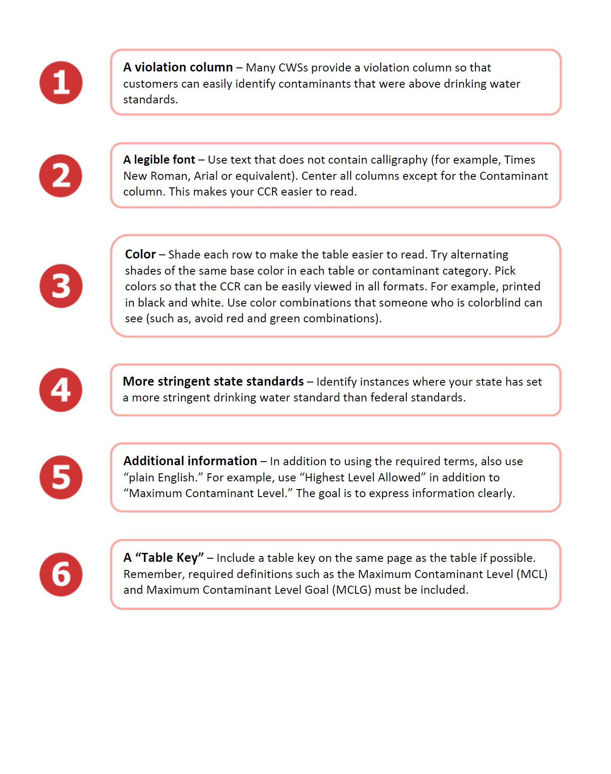
(US EPA, 2015)

Slide 19
(US EPA, 2015)

Slide 20
Developing your ccr
More information may be found at:
http://water.epa.gov/lawsregs/rulesregs/sdwa/ccr/index.cfm.
EPA’s CCR Unit Conversion Factsheet (April 2015)
EPA’s Preparing Your Drinking Water Consumer Confidence Report (April 2010).
EPA’s CCR Rule: Quick Reference Guide (August 2009).
EPA’s Talking to Your Customers about Chronic Contaminants in Drinking Water (October 2007).
EPA’s Compliance Help/Tools for CWSs.
EPA’s CCRiWriter. This online application enables you to produce a regulation compliant CCR.

Slide 21
Completed ccr – now what?
The CCR Rule generally requires each CWS to mail or otherwise directly deliver one copy of its CCR to each customer annually.
The CWS must make a good faith effort to reach all consumers.
Send to consumers by July 1st
Notes:
April 1 – Is the deadline for CWS that sells water to another CWS to deliver the
information necessary for the buyer CWS to prepare their CCR (requirement
outlined in 40 CFR 141.152).
July 1 – Is the deadline for annual distribution of CCR to customers and state or
local primary agency for report covering January 1 - December 31 of previous
calendar year.
October 1 - (or 90 days after distribution of CCR to customers, whichever is first)
Deadline for annual submission of proof of distribution to state or local primacy
agency.
A CWS serving 100,000 or more persons must also post its current year’s report
on a publicly accessible site on the Internet. Many systems choose to post their
reports at the following EPA Web site http://cfpub.epa.gov/safewater/ccr/index.
cfm?action=ccrupdate.
► All CWSs must make copies of the report available on request

Slide 22
Completed ccr – now what?
Directly deliver means any of the following methods:
Mail a paper copy
Mail a notification that the CCR is available on the school website
Email a link (URL) to a website with the current CCR
Email the CCR as an attachment
Email the CCR as an embedded image within the content of the email.
Additional electronic delivery that meets “otherwise directly deliver” requirement (encompasses other methods or technologies from the previous methods
Notes:
CWSs must:
► Mail or directly deliver a copy of the CCR to each of their customers by July 1 annually.
► Make a good faith effort to get CCRs to non-bill-paying consumers, using means recommended by
the state.
► Send a copy to the director of the state drinking water program and any other state agency that the
state drinking water program director identifies when you mail it to customers.
► Submit to the state a certification, within 3 months of mailing, that the CWS distributed the CCR,
and that its information is correct and consistent with the compliance monitoring data previously
submitted to the state.
► Post their CCRs on the Internet (if the CWSs serve 100,000 or more people).
►CWSs may also want to send copies to state and local health departments, as well as local TV and radio
stations and newspapers.

Slide 23
Completed ccr – now what?
Once the CCR is sent out to consumers, Certify that the CCR was distributed by completing the Certification Form.

Slide 24
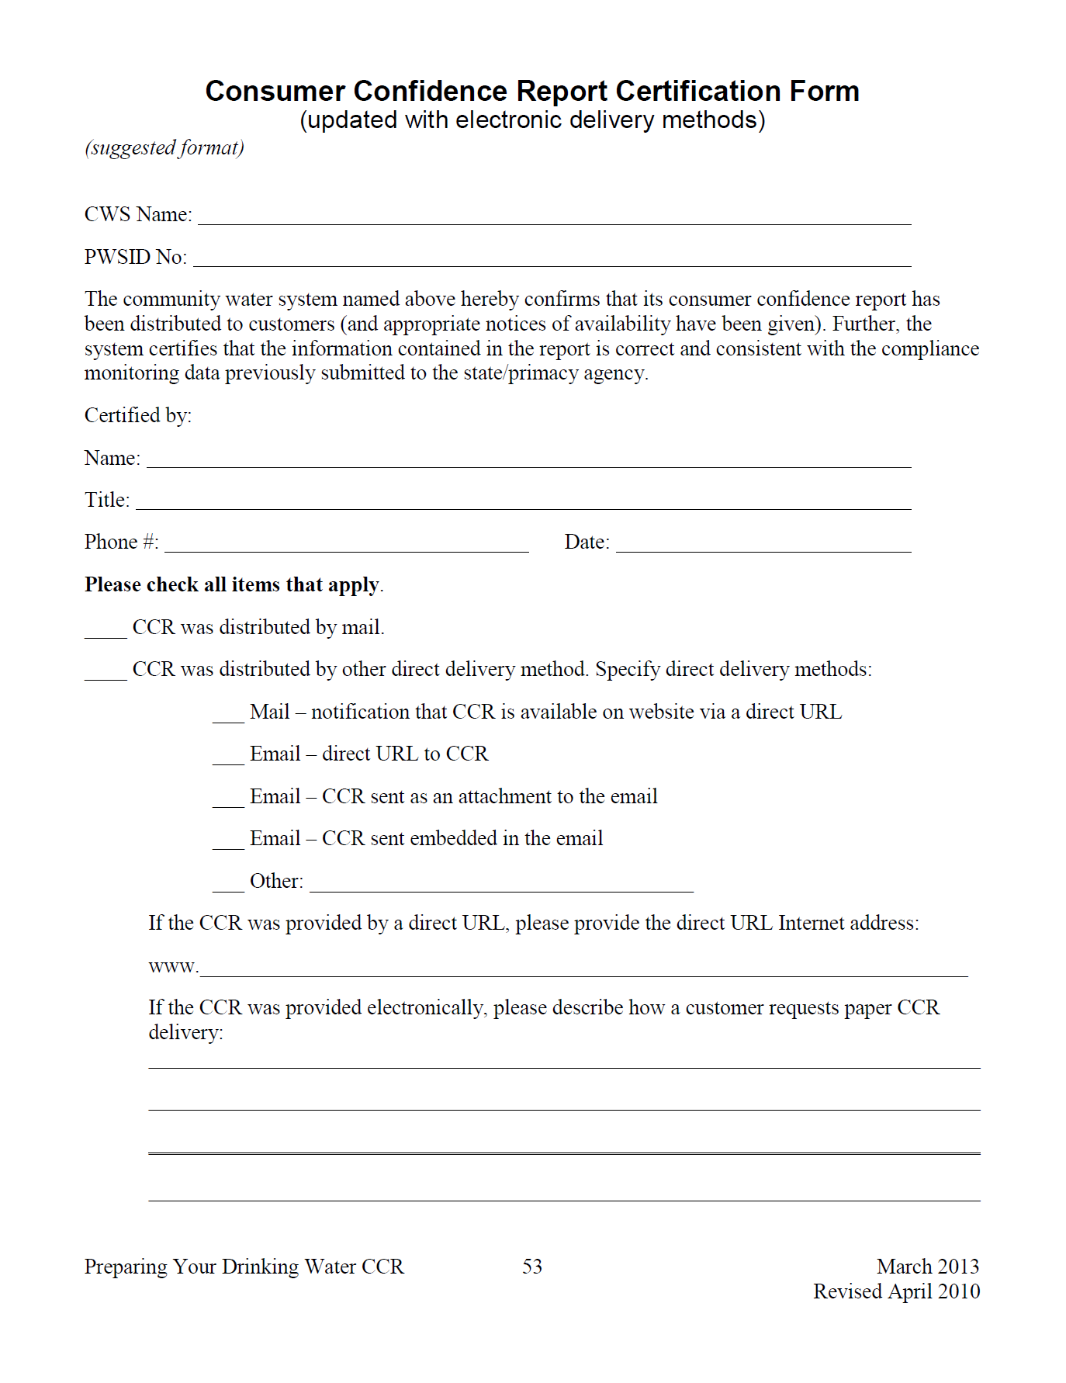
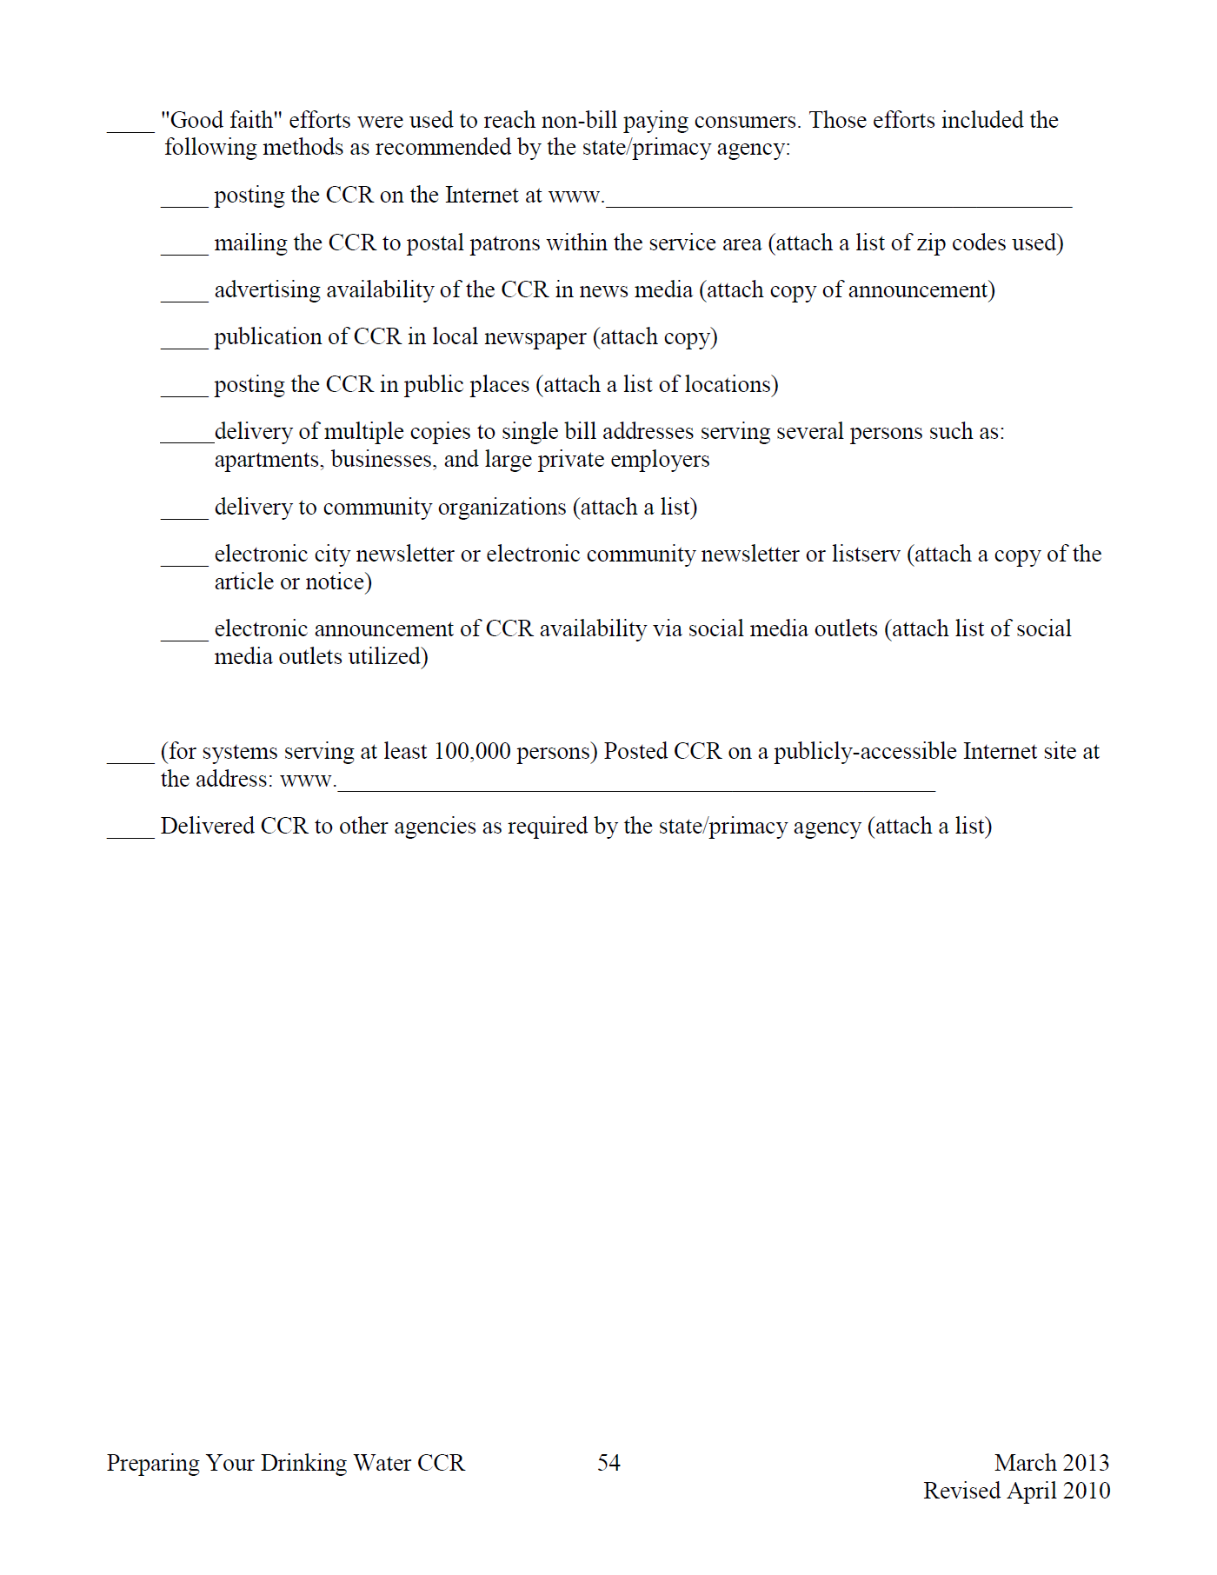
Completed ccr – now what?
Certification Form
Notes:
Here is an example of the CCR certification form.

Slide 25
General tips
Conduct Outreach
Perform outreach to your customers prior to electronic delivery each year.
This is especially important if you currently deliver a paper CCR to each of your customers through the mail and will begin electronic delivery for the first time.
Outreach occurs before the CCR is delivered. It lets you inform customers of your CCR delivery method plans and to receive feedback on how your customers prefer to receive their CCR.

Slide 26
Coming events
BIE Branch of Environmental Management and Public Health Service (PHS) will be conducting Water System Assessments for schools with CWSs.
Later in the year, assessments for all schools will be conducted.
For more information, contact H. John Clymo or Russell Brigham.
Notes:
These assessments will focused on drinking water infrastructure on the school premises. Other assessments are planned for other environmental areas at a later date.

Slide 27
Connect With us!

Slide 28
Contact Information
Please email written comments to:
For More Information:
H. John Clymo, Branch Chief, BEM
Harold.clymo@bie.edu
Russell Brigham, Environmental Protection Specialist
Russell.brigham@bie.edu
Or
Lionel Puhuyesva, Environmental Protection Specialist
Lionel.puhuyesva@bie.edu

