Slide 2
SESSION 11-13
PROPERTY INFORMATION

Slide 3
Presented by the BIE Branch of Property Representatives
Property Management Specialist

Slide 4
TOPICS
Custodial Property Officer
Inventory
Fleet Management

Slide 5
Custodial Property Officer: Role
Without a CPO there is no property controls in Financial and Business Management System inventory.
Identify/Designate/Issue a Custodial Property Officer Designation Letter – Signed acceptance to Property Management Specialist.
Complete UAR Form for access to Financial & Business Management System.
Active Directory
VPN Access
SAP GUI
Need to inform the Property Management Specialist of your computer background. Is your computer a BIE Imaged or BIA Imaged background.
Must have an active CPO for GSA leased vehicles.

Slide 6
Custodial Property Officer: Roles & Responsibilities
Designated Custodial Property Officer
Receive & Sign the Designation Letter
Completes the UAR Form
Assigned courses in DOI Talent
Must maintain access to FBMS
Completes acceptance of assets in FBMS

Slide 7
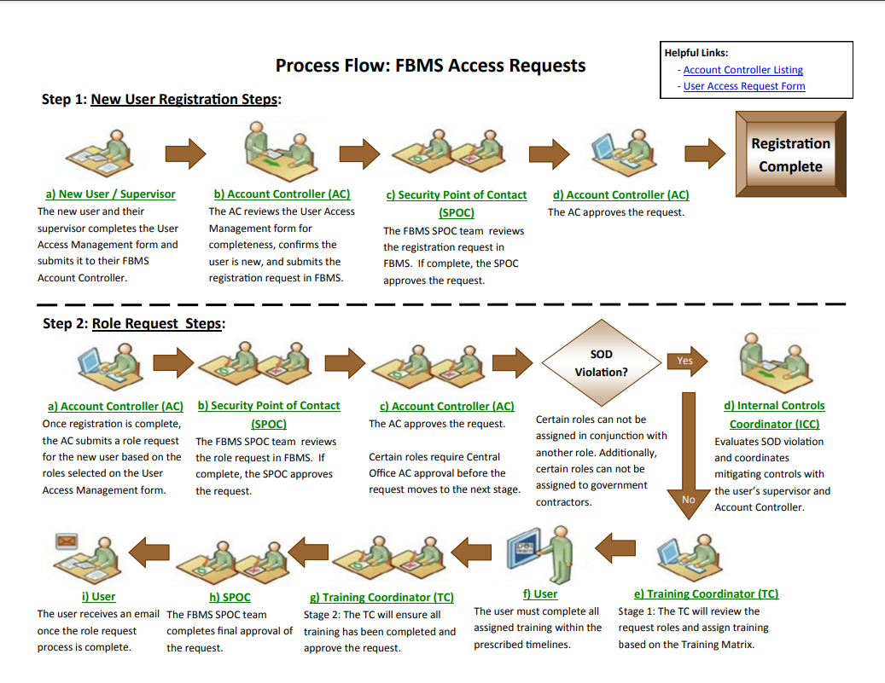

Slide 8
Inventory: Timeline
FY Inventories will be downloaded and published out to the schools by first week in January and inventory training
February - weekly inventory reporting on progress each Friday to the Property office until complete
Should an extension be required for the inventory completion, the extension must be submitted to the Director, Office of Facilities & Safety Management (OFPSM) NLT last workday in March
Physical Inventories will be completed, and all supporting documentation will be submitted to your Property Management Specialist by last workday in April
Each year dates will be announced when inventory begins, training provided and deadlines to meet.
All adjustments will be made in FBMS by Property Management Specialist by last workday in May
Inventory Certification statements due the last workday in June

Slide 9
Inventory: Forms
DI 105, Receipt of Property – Back bone of all property – nothing happens without the DI-105.
Forms needed for Removing Equipment from Inventory: * Mandatory Turn In
DI-103 Report of Survey for all equipment not found.*
DI- 103A Unserviceable Property Report (disposition of equipment). *
DI-104 Transfer of Property.
DI-105 Receipt for Property-supports DI 104.
Submit documents no later than requested by the assigned Office Hub Property Management Specialist/Accountable Property Officer.

Slide 10
Fleet Management
GSA Leasing Guide
Explains what GSA Fleet is about and what it is authorized to do.
Used when placing a request for a new or replacement vehicle.
Use of the GSA Fleet Card Issued with the Vehicle.
Maintenance and Repairs - A Maintenance Control Center (MCC) that provides GSA Fleet customer agencies, drivers, and vendors with one-stop service for mechanical repairs and record-keeping on vehicle repair history.
Accident or Incidents – Accident Management Center providing GSA Fleet’s customer agencies and drivers with one-stop service.
Vehicle Insured.
Reporting Requirements-refer to BIE Property.
Contact for GSA Fleet Service Representative – Do you know who that is for you?

Slide 11
Fleet Management – Point of Contacts
Need to Know:
Fleet Service Representatives (FSR) are there for GSA Fleet customers throughout the entire vehicle leasing process.
Utilization Clerk:
Enters current and accurate mileage that is critical to ensure timely billing and PM notifications. It is the agency’s responsibility to monitor mileage reporting.
Also called Fleet Maintenance Clerk.
Property Management Specialist (Fleet) and Accountable Property Officers are to be notified for new and returned vehicles.
GSA DriveThru POC are to be kept current.
GSA Drive Thru Account – Custodial Property Officer/Report mileage to Utilization Clerk or to BIE Property

Slide 12
Fleet Management – GSA Fleet Cards
GSA Fleet cards are accepted by most branded fueling stations and by maintenance facilities for under $100 transactions, excluding tires, batteries, or glass replacement which require preauthorization by contacting GSA’s MCC or AMC at 1-866-400-0411.
Only use the GSA Fleet Service Card assigned to your specific vehicle.
Educate drivers on proper GSA Fleet Service Card use.
Keep cards secure when not in use.
Do not buy anything that is not for that vehicle. Example: NO FOOD.

Slide 13
Fleet Management: License Plate
The Federal Management Regulations for vehicle identification, license plates, and exemption can be found at FMR 102-34.85 through FMR 102-34.195.
A list of assigned agency license plate prefixes is found in the appendix to FMR Bulletin B-11 :U.S. Government License Plate Codes”.
The General Services Administration (GSA) Memorandum of Understanding (MOU) can be sent to vehicle.policy@gsa.gov
Vehicle Identification Card:
The U.S. Government Vehicle Identification card is NOT an actual registration card. It is an identification card that states that the Federal license plates and Motor Vehicle Identification Number (VIN) are registered in FMVRS, and provides vehicle, license plate, and insurance information that may be useful if stopped by law enforcement.
Vehicle Identification Cards are downloaded from within FMVRS. FMVRS - Data Base for every motor vehicle.

Slide 14
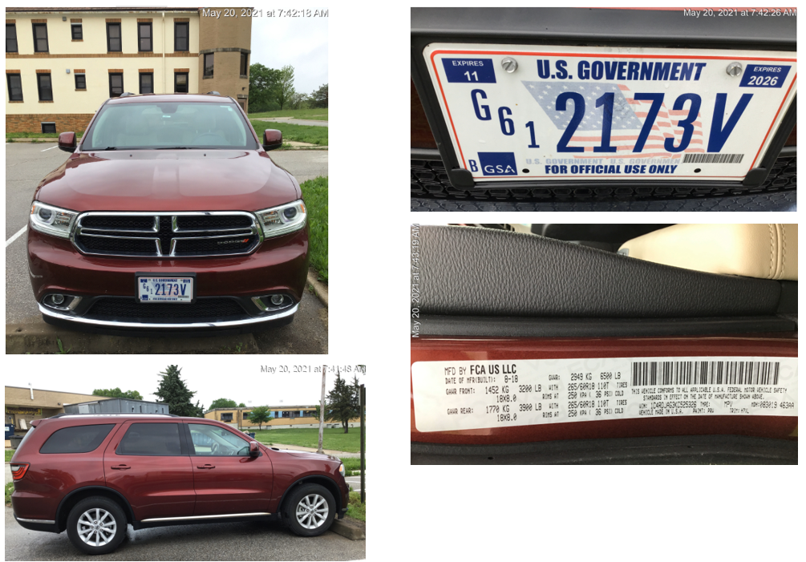
Fleet Management – License Plate Con’t
License plates are displayed in accordance with FMR 102-34.100 and FMR 102-34.110 through 150. Federal sedans and trucks, buses must display 2 U.S. Government license plates even if the State in which the vehicle is operating only requires one plate. Note that trailers and motorcycles are only required to display one license plate on the rear of the vehicle.
License Plate Display
2 plates for front and back
Expiration date and expire in 8 years

Slide 15
Fleet Management – License Plate Con’t
Purchasing License Plates
License Plates are purchased from UNICOR during the procurement during the acquisition through an online store using an account set up by BIE for that purpose.
Returning License Plates – Only return U.S. Gov’t License Plate
Return to BIE Property Management Specialist (Fleet) for all owned BIE Vehicles.
GSA Leased Vehicles require working with the FSR.
U.S. Government license plates that are expired, removed, replaced, damaged or unneeded must be returned to UNICOR for destruction. There is no charge for the return shipment of excess license plates.
UNICOR will provide a certificate of destruction for returned plates.
Local destruction of U.S. Government license plates is not permitted.

Slide 16
Fleet Management – License Plate Con’t
Lost or Stolen License Plates – Report Immediately.
FMR 102.34-135 contains a list of actions that must be taken when a license plate is lost or stolen. For U.S. Government license plates, agencies should:
Report to your local security office (or equivalent);
Report to your local police department;
Report to GSA Fleet when a GSA Fleet leased motor vehicle is involved; and
Update the status of the license plates in the Federal Government Motor Vehicle Registration System.
Include your BIE Property Management Specialist (Fleet).
Recommend that agencies report lost or stolen plates to the Federal Protective Service via the Service’s National Toll-Free Number at 1-877-437-7411.

Slide 17
Fleet Management – License Plate Con’t
Missing License Plates
Missing U.S. Government license plates pose a very serious security concern. It is important that a missing license plate has its FMVRS status changed to “missing” as soon as it is noticed. Do not wait until after a search is made to locate it. Change the status immediately. If the plate is used by unauthorized persons and spotted by law enforcement, law enforcement will receive a message through NLETS that the plate is missing and to approach with caution.
Your quick action to change the missing plate’s status to “missing” in FMVRS is critically important. If the license plate is later found and reattached to the vehicle, the status can be changed back to “attached”.
There is no penalty for listing a plate as missing and it just might help avoid a tragedy.

Slide 18
Fleet Management – License Plate Con’t
Off-road identification plates are not required to be registered in Federal Motor Vehicle Registration System (FMVRS).
Use of “off-road identification plates” for identifying vehicles and equipment that is NEVER operated on a public road.
Examples: Forklifts, UTVs, and construction equipment.
Note: UTVs that do travel on a public road must have a U.S. Government license plate.

Slide 19
References that cover Property Management
25 U.S.C. Part 900- Contracts under the Indian Self-Determination and Education Assistance Act Subpart I - Property Donation Procedures
40 U.S.C. Subtitle I: Federal Property and Administrative Services
P.L. 93-638, Indian Self-Determination and Education Assistance Act, as amended
41 CFR 101, Federal Property Management Regulations
41 CFR 102, Subchapter B, Federal Management Regulation (FMR) - Personal Property
23 IAM Chapter 1 Property Overview
Federal Management Regulations 102-34.85 through FMR 102-34.195
Financial and Business Management System Training Team Workflow Diagram

Slide 20
Albuquerque Office
Loren Morgan
loren.morgan@bie.edu
Bernadine Letcher
bernadine.letchr@bie.edu
Work Phone: (505) 377-4852
Bloomington Office
Michael Soman
michael.soman@bie.edu
Phoenix Office
Tracey Ayze
tracey.ayze@bie.edu
Work Phone: (505) 377-4365
Fleet Question(s)
Jarred Bekis
Jerrod.bekis@bie.edu
Window Rock Office
In-Progress
Common Property Forms

Slide 22
CONNECT WITH US

