Slide 2
SESSION 11-13 Safety for the Leader!

Slide 3
Donald “DJ” Dryer
Occupational Safety & Health Manager
School Operations/Safety Division

Slide 4
Objectives
The primary goal of this presentation is to highlight the components of an effective Safety program for your schools.
Upon completion of this presentation, participants will be able to:
Understand the requirement for a CDSO / Safety Committee
Have Knowledge of the recommended EAP Template
Know the most common Accidents in BIE
Understand the Safety Inspection Program

Slide 5
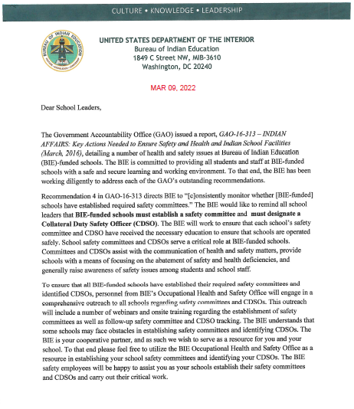
CDSO & Safety Committee
Notes:
This is the memorandum that Director Dearman signed this year. This is not a new requirement, but rather updates previous guidance from 2018. Before the transition from BIA to BIE, BIA indicated that every school had a CDSO and was conducing monthly Safety Committee meetings as required. With COVID-19, and remote learning, it is understandable why this program may have been ignored or fallen from a priority task. But we must be back to 100% this year, in fact, we must be there “NOW”.
This requirement is also codified in federal regulation: under CFR 29CFR1960 and 29CFR1910.
The Presidential executive Order 12196, originally signed by President Ronal Regan, and confirmed by every President since also grants authority for CDSOs, Committees, and Inspections.

Slide 6
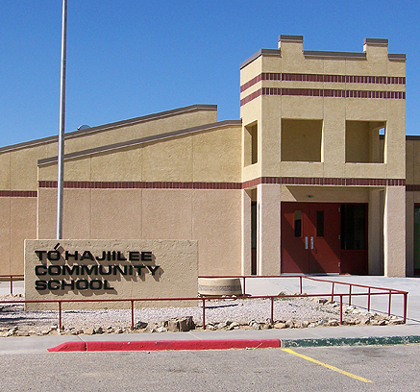
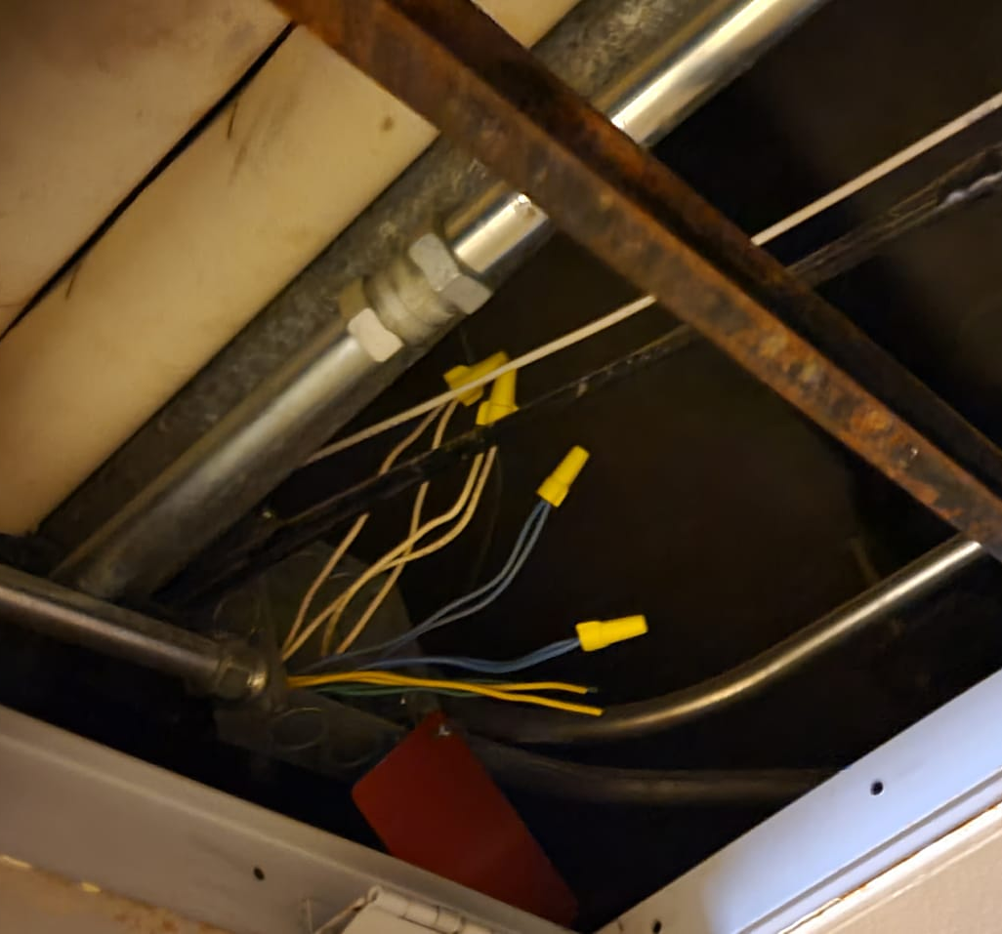
Requirements of the CDSO
Access to the School
Ability to drop and go
Access to the Principal
Trained (within 6mo)
Notes:
Many times, people look at these basic requirements and automatically think: Maintenance. Please get that out of your mind. A maintenance team might sound right, but consider competing priorities.
If you have a priority repair at your school, like rebuilding the entrance sign, but you have exposed wires in the girl’s locker room show (the Top photo comes from a general internet search – the bottom photo was taken at a BIE School, in the Girls Locker room Shower.) a Maintenance Professional might consider the shower less of an emergency (especially if the school is not in session or impacted by COVID).
Consideration should be made as to who is the best fit for this responsibility.
CDSO Training starts with our office. We are making it available to all TSC and BOS schools either through DOI Talent, or DOI University. Additionally, my team will conduct CDSO training based on topics, with individual schools or hold adhoc training to support the schools as a whole.

Slide 7
Safety Committee
Made up of:
Principal
CDSO
Janitor/Custodian
School Nurse
Facilities Manager
Notes:
The safety program is the responsibility of the senior leader on campus. At the end of the day, the “Buck stops there”. For that reason, the Principal needs to be holding this meeting themselves.
The Schools Safety person (the CDSO) should be present, and will often lead the discussion.
The rest of the team should be made up of individuals that are most likely to be aware of the ongoing activities at the school. Such as the Janitor/Custodian, the school nurse, and the facilities manager. This is the recommended list, but it can be adjusted. If you have other individuals that you would like to add or take off this list. Please reach out to my office and discuss this choice. I will listen and give advice, but at the end of the day – it is the Principals Choice who participates. The ultimate goal would be to identify hazards on campus, that can be addressed to make it a safer place to learn.

Slide 8
Safety Committee
Topics to discuss:
Injuries since last meeting
Identified hazards
Safety related complaints (Parents, students, staff)
Material Failures that should be addressed higher

Slide 9
How often?
Monthly Meetings!
Notes:
The safety committee should happen at least monthly. The meeting doesn’t require a lunch, or special circumstances. IT can be informal or formal but should cover the topics presented in the previous slide. In what ever timeline it takes to make that presentation. If the meeting can be held in 10 minutes, that is acceptable. However, if there has been a traumatic event during the last 30 days, don’t expect the meeting to meet any specific timelines. Ensure that the meeting has time to discuss the important topics that are to be presented. In the event of a fatality or catastrophic injury, myself or a member of my time may be on campus to participate in your safety meeting.

Slide 10
Emergency Action Plan
What it is:
Emergency Action Plan (EAP)
Emergency Operations Plan
What it is not:
Continuity of Operations (COOP)
Notes:
Many schools have Emergency Operations Plan and some have Emergency Action Plans. In most cases, they are the same thing. However, this is not always the case – and you need to know that a COOP plan (which is also considered an Emergency Operations Plan) is something entirely different.
An Emergency Action plan is what to do at the onset of an emergency. A continuity of operations plan is how to get back to normal after the emergency.
For example:
Fire would be covered in the EAP, how to evacuate, how to contact local authorities, families, and emergency response. How to account for everybody.
A coop plan would be who to call to have the damage repaired, after the fire. Who to contact to get drywall repaired, after the fire. How to get the phone lines turned back on, after the fire.
Both plans are important, but the EAP will save lives. The COOP plan will get back to normal operations sooner.
BIE Safety has developed a template EAP Plan. Right now it is being staffed through BIE for final approval. So it is not a requirement to use. However, it is recommended, especially if you don’t have a specific EAP in place. For this, you take it, fill it out with local contacts, and you make it available for everybody to read. They have a right to know.

Slide 11
Most Common Accidents
Slips, Trips and Falls
Material Handling
Crush
Assualt
Notes:
The leading cause of injury within BIE is slips trips and falls. Our staff experience these more than 4 x as often as the next three causes of injury.
Prevention for falls:
Clean up spills in walk ways
Salt and blow parking lots
Salt and shovel sidewalks
Good house keeping
Material Handling:
Lift with Legs
Buddy lift (2 person)
Make sure the leading person leads (Never push against a person that is walking backwards)
Limit lifting to strength abilities
Crush Injuries:
Wear protective clothing, gloves
Watch where your hands are
Avoid pinch points
Assault:
Pay attention to your surroundings
Be aware that troubled youth may act out violently

Slide 12
Inspection Program
Every School, Every Year
Assigned Safety Specialists
Follow up Assistance Visits (if needed or requested)
Notes:
Every year my teams visits your schools to conduct a safety inspection. We are trying to adjust our schedule so that we can visit you earlier and earlier each year to provide you with the opportunity to have additional visits if time and budget allows.
We have assigned specific individuals to each of your schools. This allows for both a friendly face, and continuity. You don’t have to work with somebody new every year. And you can have more personal support individually by working with your assigned safety representative in conjunction with your own CDSO. My team can better support your team on a more frequent basis.
By arranging our schedules, my team is better able to address the major issues at schools that need the most help. We can come back and provide assistance visit. For example, if you school is in need of major training topics ( my team can provide those via Teams or even live on site). We can help your facilities managers understand and implement temporary mitigation measures to protect students, while you are waiting for funding approval to handle major issues that are beyond O&M Funding.

Slide 13
Inspection program
Not intended to “I Gotcha”
Ask in advance or ask on site
Training while inspecting
Notes:
Out inspections are not intended to be “Gotcha” moments. Nobody is going to take away your birthday or fire you for having deficiencies. The point is to identify what can kill a child. This is often taken for granted, but any Safety rule that exists, exists because somebody died as a result of the same issue in the past. There is not one safety rule out there, that I am aware of, that was established after a worker received a single stitch after an accident.
Your schools should be receiving an advanced notice before we come out to your campus. This should include a copy of previous deficiencies (usually in the form of the previous inspection report), but it could be a simple deficiencies list. You should also be asked, about two weeks before the inspection, what other things the Safety Rep can provide to you during their visit. This is your chance to ask. Ask for specifics, if you need a play ground inspection (say it). If you need fire alarms inspected or fire extinguishers inspected ask for it. Not everybody on my team is qualified as a playground inspector, or a fire extinguisher inspector – but several are. And if you ask, early enough, we might be able to send one of those team members there. Keep in mind – my team can’t do 200 play ground inspections. If they have time, they will help out. These are things that we check to ensure are inspected, and it is still your responsibility to get them inspected annually.
My team can also provide training. For example: Bloodborne Pathogens, Lock Out Tag Out, Fire extinguisher are some of the training that is required annually. Most schools have a need for these. My team can provide this training during their visit – or they can schedule this training with you as a follow up. One more thing, that I expect out of my team (and if you are not getting this, please let me know) is that when they are walking around your campus, they are trying to explain the “Why this is important” and not just saying “This is wrong”. When I first came to BIE – I heard a lot of complaints from schools about why did they site me for having MSDS sheets up. Nobody explained that MSDS sheets went away years ago, and that they have been SDS sheets for 6 years now. There Hazard Communications is another annual training requirement. So these things shouldn’t be a surprise. I want my team to educate when they are on campus too.

Slide 14
Contact Information
Assigned School Safety Specialists:
Please email written comments to:
Bloomington:
Marcel Felicia (505)382-5941
Mike Quigley (612)449-4082
Mike Okeke (505)377-5479
Shawn Damberger (701)390-2845
Dan Schmokel (402)578-8021
Phoenix:
Wil Begoody (480)528-7598
Window Rock:
Tito Noveron (505)382-6095
Tommy Belone (505)563-5092
Albuquerque:
Omar Dela Cruz (505)273-0371
Mark Dixon (505)377-4980
Anson Damon (505)870-4916
Mr. Donald J. Dryer, MA, CP12, CSO
Donald.dryer@bie.edu
(334) 447-1734

Slide 16
CONNECT WITH US

