Slide 1
Notes:
First 3 slides should be relatively quick as an intro

Slide 2
SESSION 2 PROGRAMMATIC REQUIREMENTS: LEVERAGING PLANS TO IMPROVE STUDENT LEARNING
Notes:
First 3 slides should be relatively quick as an intro

Slide 3
Division of Performance and Accountability Supplemental Education Programs (DPA-SEP)
Notes:
First 3 slides should be relatively quick as an intro

Slide 4
MISSION SLIDE

Slide 5
MEET OUR PRESENTERS

Slide 6

All Students Learning to High Standards
Academic, Social, Emotional needs are met
Fruit
Monitor Progress regularly
Hold each other accountable
Self-Correct, when needed
Leaves
Focus on learning and instruction
Build Collective Efficacy
Create a sense of urgency
Foster safe, healthy, and supportive environments
Trunk
Needs Assessment with goals (all stakeholders)
Schoolwide Program Plan
Aligned Schoolwide Budget
Roots
Notes:
Spend no more than two minutes per slide to ensure all content is covered.

Slide 7
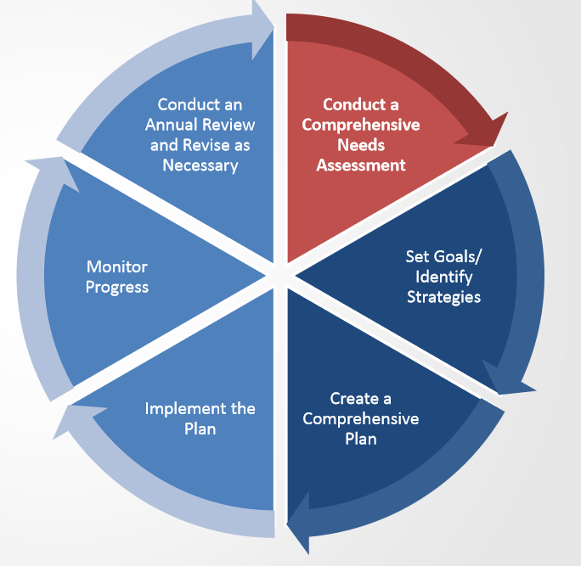
CONTINUOUS SCHOOL IMPROVEMENT
A school must undertake a specified year-long planning process.
A school can use this planning process to update or revise existing plans.
The planning process begins with the required comprehensive needs assessment.
ESSA, Title I Section 1114(b)(2)(B)
Notes:
A Schoolwide Plan begins with a Needs Assessment…

Slide 8
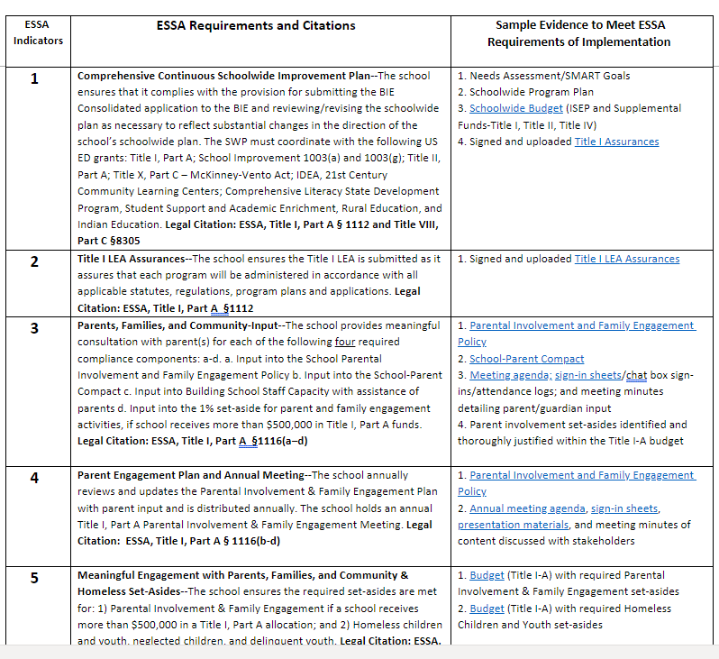
DPA-SEP ESSA PROGRAMMATIC REQUIREMENTS
The DPA SEP unit utilizes a set of ESSA indicators to ensure schools create, implement, monitor, and evaluate a schoolwide improvement program at each of the 180+ Bureau-funded schools.
The ESSA indicators may also be seen as a framework for the continuous school improvement process for schools to improve student outcomes.
Each school’s improvement process is driven by a review of data, stakeholder input, identification and implementation of evidence-based strategies/practices/programs to meet the needs of the entire learning community.
Notes:
This slide is a preview of the next 22 slides discussing the indicators in detail. This photo is a screenshot part of the indicator list and does not include them all.

Slide 9

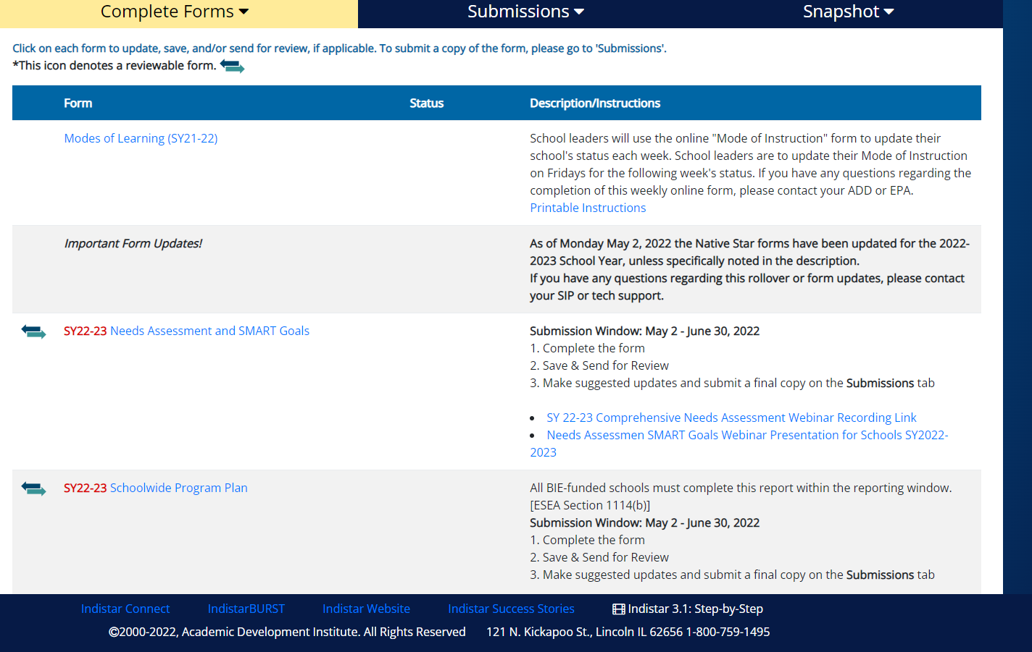
Comprehensive Continuous Schoolwide Improvement Plan- The school ensures that it complies with the provision for submitting the BIE Consolidated application to the BIE and reviewing/revising the schoolwide plan as necessary to reflect substantial changes in the direction of the school’s schoolwide plan. The SWP must coordinate with the following US ED grants: Title I, Part A; School Improvement 1003(a) and 1003(g); Title II, Part A; Title X, Part C – McKinney-Vento Act; IDEA, 21st Century Community Learning Centers; Comprehensive Literacy State Development Program, Student Support and Academic Enrichment, Rural Education, and Indian Education. Legal Citation: ESSA, Title I, Part A § 1112 and Title VIII, Part C
INDICATOR 1
Needs Assessment/SMART Goals
Schoolwide Program Plan
Schoolwide Budget (ISEP and Supplemental Funds-Title I, Title II, Title IV)
Signed and uploaded Title I Assurances
Sample Evidence
Notes:
Only point out that this indicator references the 4 components of the ConApp and are to be completed in NS. They all should be aligned and coordinated with the school's Title programs

Slide 10
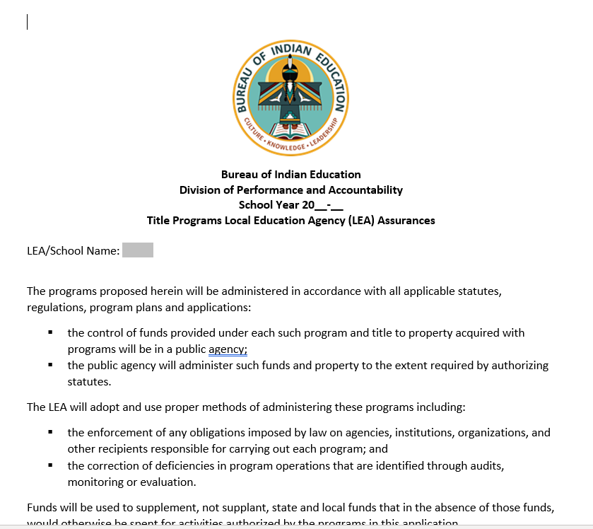
INDICATOR 2
Title I LEA Assurances--The school ensures the Title I LEA is submitted as it assures that each program will be administered in accordance with all applicable statutes, regulations, program plans and applications. Legal Citation: ESSA, Title I, Part A §1112
Sample Evidence

Slide 11
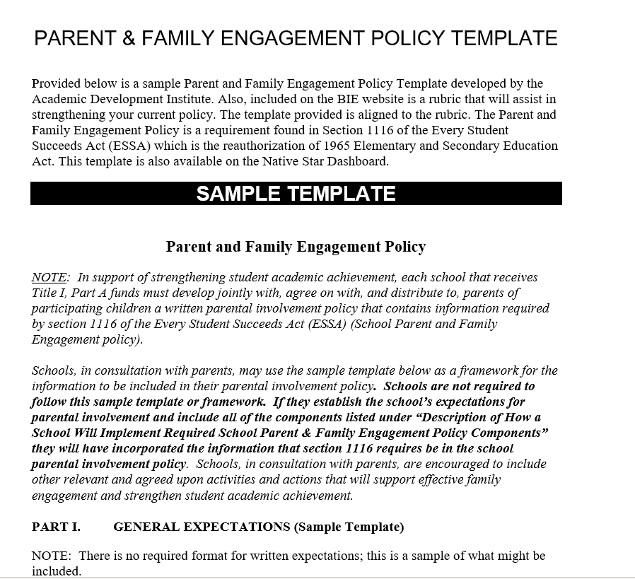

INDICATOR 3
Parents, Families, and Community-Input - The school provides meaningful consultation with parent(s) for each of the following four required compliance components: a-d. a. Input into the School Parental Involvement and Family Engagement Policy b. Input into the School-Parent Compact c. Input into Building School Staff Capacity with assistance of parents d. Input into the 1% set-aside for parent and family engagement activities, if school receives more than $500,000 in Title I, Part A funds. Legal Citation: ESSA, Title I, Part A §1116(a–d)
Parental Involvement and Family Engagement Policy
School-Parent Compact
Meeting agenda; sign-in sheets/chat box sign-ins/attendance logs; and meeting minutes detailing parent/guardian input
Parent involvement set-asides identified and thoroughly justified within the Title I-A budget
Sample Evidence

Slide 12
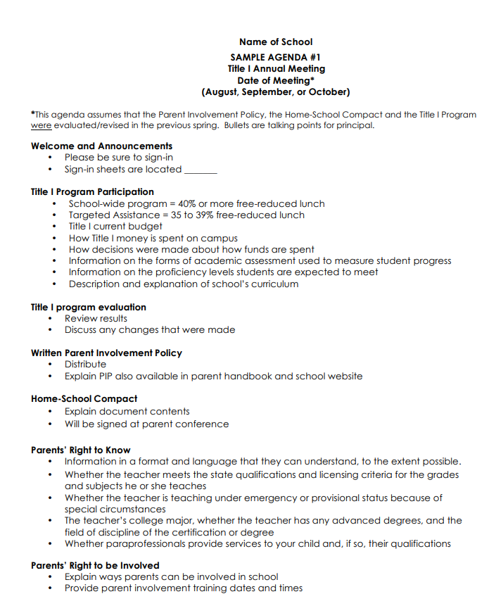

INDICATOR 4
Parent Engagement Plan and Annual Meeting--The school annually reviews and updates the Parental Involvement & Family Engagement Plan with parent input and is distributed annually. The school holds an annual Title I, Part A Parental Involvement & Family Engagement Meeting. Legal Citation: ESSA, Title I, Part A § 1116(b-d)
Parental Involvement and Family Engagement Policy
Annual meeting agenda, sign-in sheets, presentation materials, and meeting minutes of content discussed with stakeholders
Sample Evidence

Slide 13
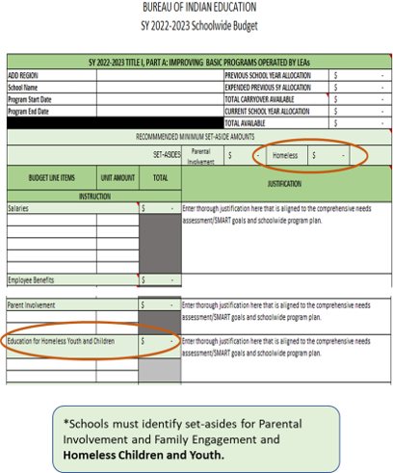
INDICATOR 5 AND 15
Meaningful Engagement with Parents, Families, and Community & Homeless Set-Asides--The school ensures the required set-asides are met for: 1) Parental Involvement & Family Engagement if a school receives more than $500,000 in a Title I, Part A allocation; and 2) Homeless children and youth, neglected children, and delinquent youth. Legal Citation: ESSA, Title I, Part A, §1113(c)(3)(A)(i) and §1116 (a)(3)
Budget (Title I-A) with required Parental Involvement & Family Engagement set-asides
Budget (Title I-A) with required Homeless Children and Youth set-asides
Sample Evidence

Slide 14
INDICATOR 6
Well-Rounded Education--The school offers a well-rounded education. (English, Reading or Language Arts, Science, Technology, Engineering, Mathematics, Foreign Languages, Civics and Government, Economics, Arts, History, Geography, Computer Science, Music, Career and Technical Education, Health, Physical Education, and any other subject allowing students to an enriched curriculum and educational experience). Legal Citation: ESSA, Title I, Part A §8101(52)
Core and supplemental curricula is documented
Education Program Plan detailing courses offered at the school
School Master Schedule
Course Syllabi
School Handbooks (academic and home living)
Before and/or Afterschool Programming and Courses Offered
Career and Technical Education (CTE) Programming
College/University Partnerships (dual enrollment)
International Baccalaureate (IB) Programming
Local Business/Community Partnerships
Student Services (school counseling, school health, college/career preparation, transition programming)
Sample Evidence

Slide 15
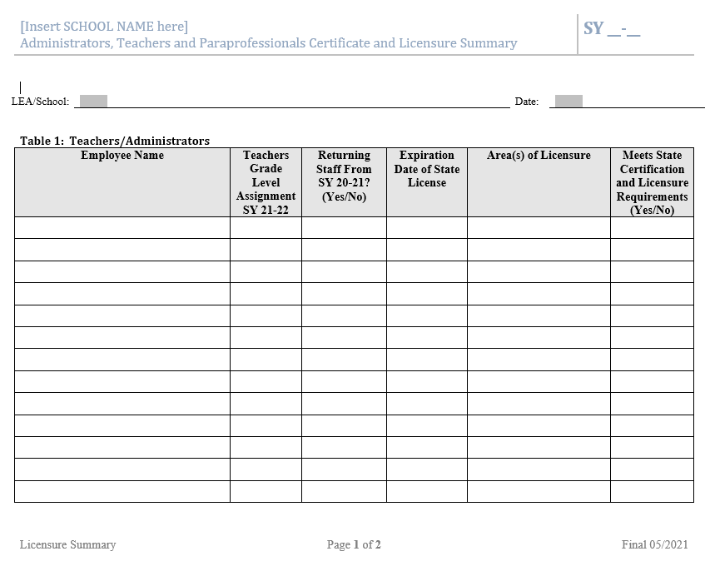
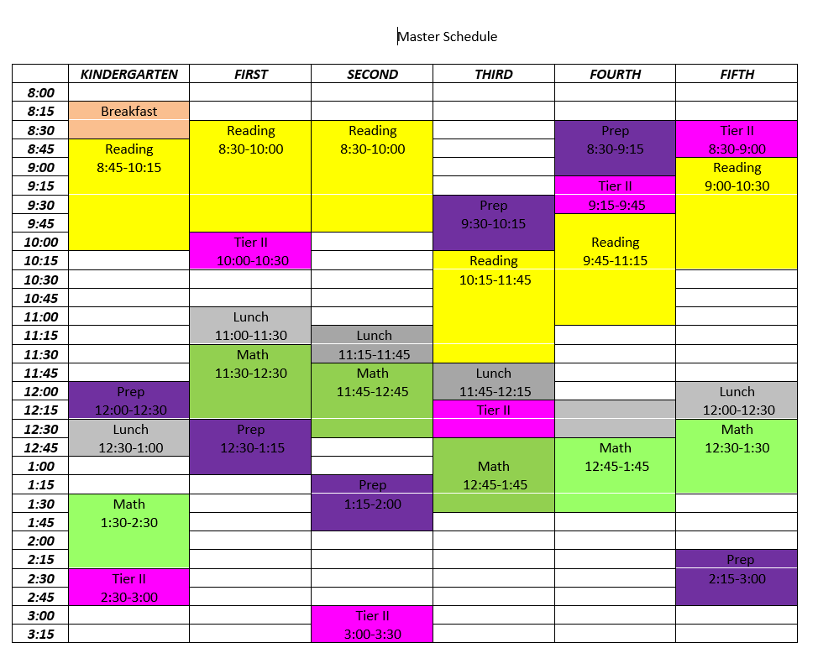
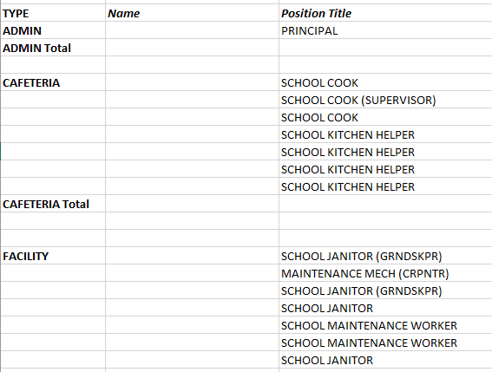
INDICATOR 7
All teachers and Paraprofessionals Meet State Certification Requirements--Teacher and Paraprofessional Qualifications: a. The LEA/school ensures that paraprofessionals meet the professional qualifications required by the state on the day before ESSA was enacted. (Paraprofessional certification or the equivalent.) b. The LEA/school ensures teachers meet state certification/ licensure requirements. Legal Citation: ESSA, Title I, Part A §1111(g)(2)(J) and (M)
Teacher and paraprofessional attestation form;
Staff Roster
Master Schedule (ES, HS)
Sample Evidence

Slide 16
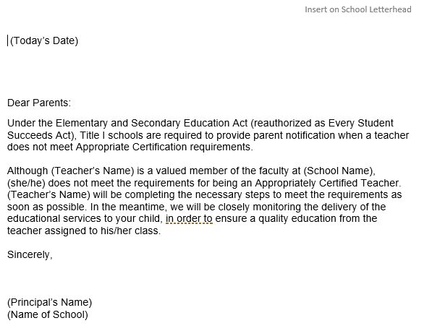
INDICATOR 8
All teachers and Paras Meet State Certification Requirements-Parent Notification--The LEA/school ensures parent notification is conveyed in a timely manner if the student has been assigned or has been taught for four (4) or more consecutive weeks by a teacher who is not meeting certification requirements. Legal Citation: ESSA, Title I, Part A §1112(e)(1)(B)(ii)
Parent notification letters if a teacher is teaching out of field/paraprofessional is providing core instruction for a grade level/content area
Sample Evidence

Slide 17
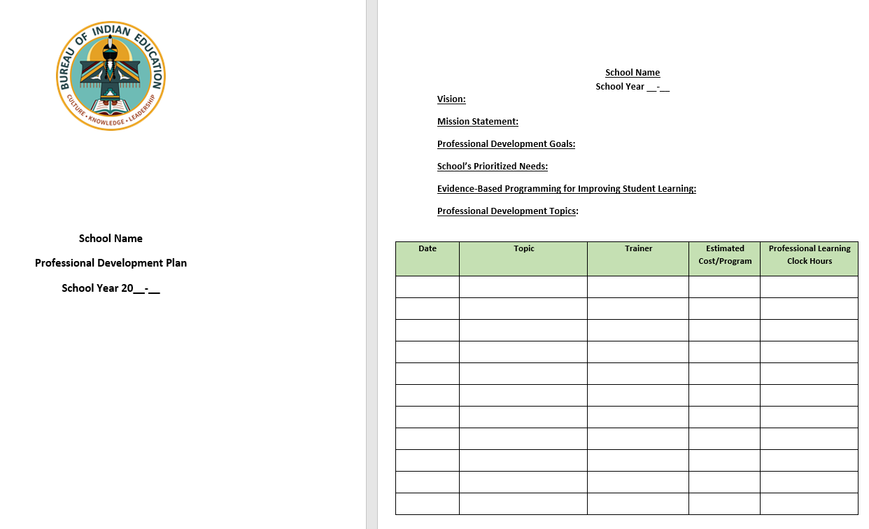
INDICATOR 9
All teachers and Paras Meet State Certification Requirements-Professional Development--The school ensures paraprofessionals, teachers and administrators initiate professional goals/plans for applicable paraprofessionals, teachers, and administrators inclusive of personnel with alternate certification such as Career and Technical Education. Legal Citation: ESSA, Title I, Part A § 1112 (c)(6)
Professional Development Plan
Title II-A budget identifies professional learning that is aligned with the needs assessment and schoolwide program plan
Department Professional Learning Plans
Individual Development Plans (IDPs)
Sample Evidence

Slide 18
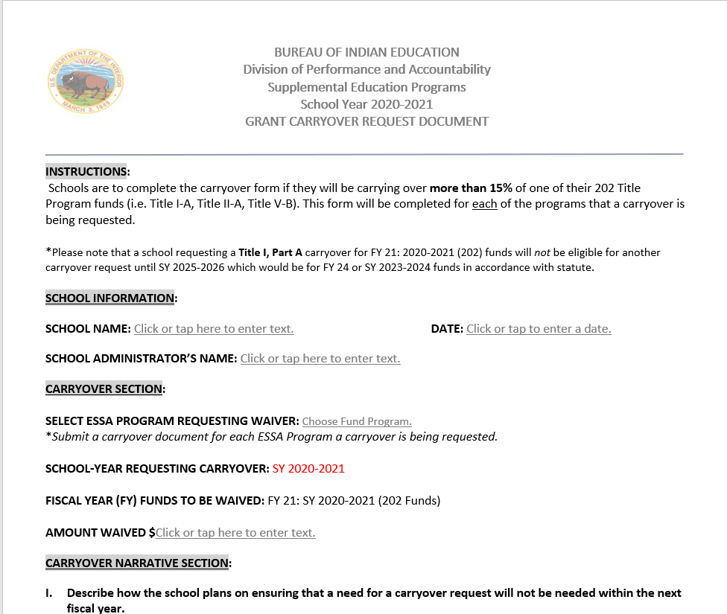
INDICATOR 10
Title I, Part A Carryover Limitation--The school is ensuring Title I, Part A monies are spent within the 15-month period, and that if the need to carryover more than the 15-percent carryover limit, the school is submitting a Carryover Waiver to the BIE for approval. Legal Citation: ESSA, Title I, Part A, Section 1127(a), 2 CFR Part 225
Quarterly Budgets by Program
Notes from Financial Reviews (BOS)
Schoolwide Budgets
SF-425 Federal Financial Reports
A133 Audit Report
Expenditure reports
Carryover Waiver (allowed every three years)
Sample Evidence

Slide 19
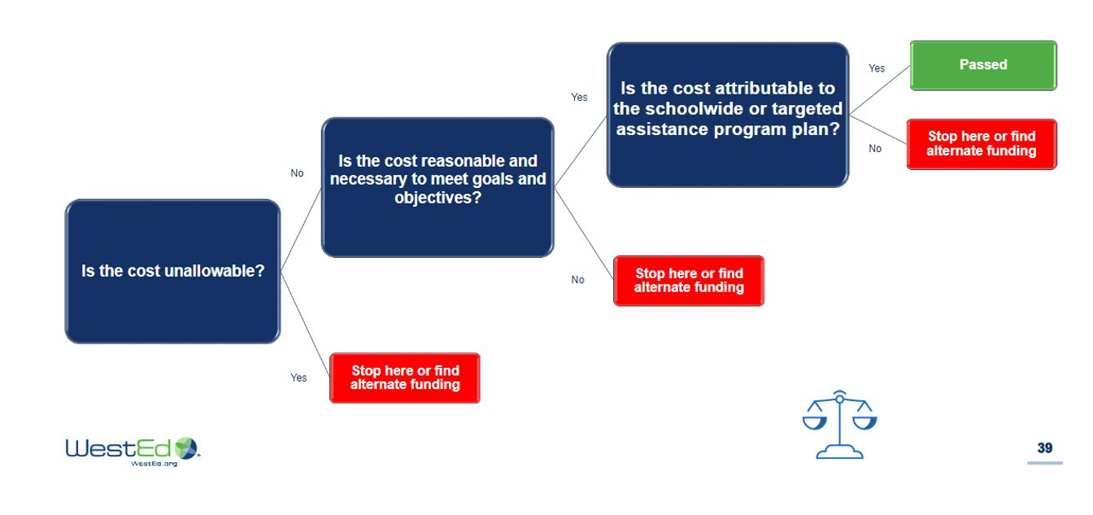
INDICATOR 11
Title I, Part A Reasonable and Necessary, Allowable, and Allocable Costs--The school is utilizing Title I, Part A funds to ensure effectiveness of funded activities are supplemental and implemented towards improving academic achievement of students. Legal Citation: Title I §1001 and 2 CFR Part 225
Alignment of:
Needs Assessment/SMART Goals
Schoolwide Program Plan
Schoolwide Budget (Supplemental Funds-Title I, Title II, Title IV)
Supporting quarterly financial and expenditure reports
Title programming support documents (professional development plans, parent involvement policy, homeless policy, etc.)

Slide 20
INDICATOR 11

Slide 21
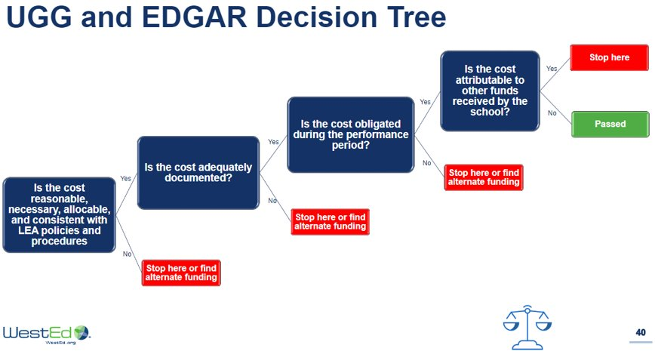
INDICATOR 12
Title I, Part A Personnel Allowable Costs--The school has ensured that all teachers and paraprofessionals paid with Title I, Part A monies meet state certification /licensure requirements. Legal Citation: ESSA, Title I, Part A §1111 (g)(2)(J) and(g)(2)(M)
Teacher and Paraprofessional rosters and certification areas, dates of licensure
Teacher and paraprofessional attestation form;
Schoolwide Budget (Supplemental Funds-Title I, Title II, Title IV)
Expenditure reports (personnel, salaries, and benefits)
Master Schedule (ES, HS)
Position Descriptions

Slide 22
INDICATOR 12
Sample Evidence

Slide 23
INDICATOR 13
Title II, Part A Reasonable and Necessary, Allowable, and Allocable Costs--The school is utilizing Title II, Part A funds to ensure they are providing professional development for teachers, principals, and school leader effectiveness. Legal Citation: ESEA Title II, Part A §2123(A-B) and 2 CFR Part 225
Professional Development Plan
Title II budget identifies professional learning that is aligned with the needs assessment and schoolwide program plan
Expenditure reports (personnel, salaries, and benefits)
Induction/Mentorship Programs (teacher/leader)
Grow Your Own Plans
Teacher/Leader Recruitment/Retention Plan
Department Professional Learning Plans
Individual Development Plans (IDPs)
Sample Evidence

Slide 24
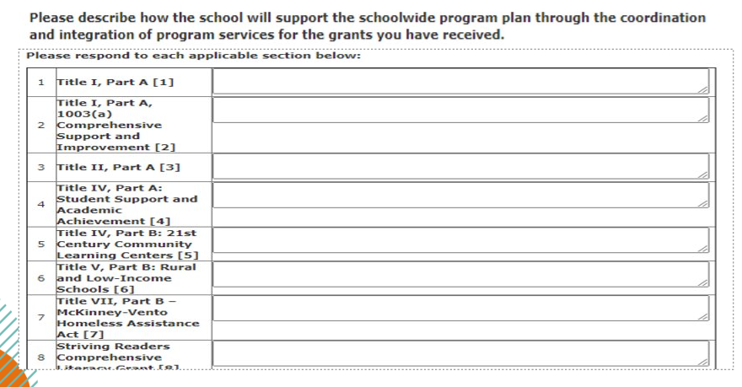
INDICATOR 14
Coordination of Title I and Title II, Part A Programs--The school has ensured there is coordination of Title I and Title II, Part A funds and professional development activities. Legal Citation: ESSA, Title I, Part A §2102(b)(2)(F).
Needs Assessment/SMART Goals
Schoolwide Program Plan
Schoolwide Budgets (Supplemental Funds-Title I, Title II, Title IV)
Expenditure reports
Title programming support documents (professional development plans, parent involvement policy, homeless policy, etc.)
Professional Development Plan
Induction/Mentorship Programs (teacher/leader)
Grow Your Own Plans
Teacher/Leader Recruitment/Retention Plan
Department Professional Learning Plans
Individual Development Plans (IDPs)
Sample Evidence

Slide 25
INDICATOR 16
Title IX, Part A, Education for Homeless Children and Youth-Method of Determination Needs Assessment -- LEA shall identify the number and educational needs of the homeless children and youth, including unaccompanied youth. Legal Citation: ESEA section 1113(c)(3)(C)(i); 42 U.S.C. 11433(b)(1)
BIE Consolidated Application - Comprehensive Needs Assessment, Schoolwide Program Plan, and Schoolwide Budget MV Subgrantees Only - A copy of the most recently completed needs assessment instrument used by the school to determine needs of homeless children and youth, including unaccompanied youth, and the process for conducting this needs assessment.

Slide 26
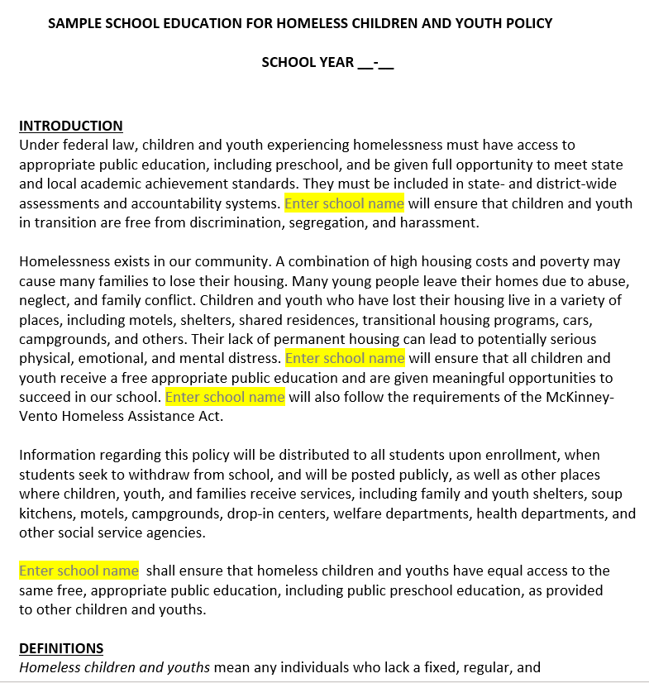
INDICATOR 17
Title IX, Part A, Education for Homeless Children and Youth-Policy-- The LEA has written procedures for the education of homeless children and youth that identify and remove any barriers. The written procedures must include identification, school selection (including feeder school protocol if applicable), enrollment, transportation, disputes, and credit for full or partial coursework inclusive of ensuring homeless children and youths are not stigmatized or segregated on the basis of their status as homeless. Legal Citation: U.S.C. 11432(g)(1)(B); 11432(g)(3)(E); 11432(g)(3)(C); 11432(g)(1)(F)
Updated, signed Education of Homeless Children and Youth Policies and Procedures
Written procedures for Education for Homeless Children and Youth indicating annual revision and/or review date (month, date, and year).
The written procedures must include:
Identification,
Selection (including feeder school protocol if applicable),
Enrollment,
Transportation,
Disputes, and
Credit for full or partial coursework
Sample Evidence

Slide 27
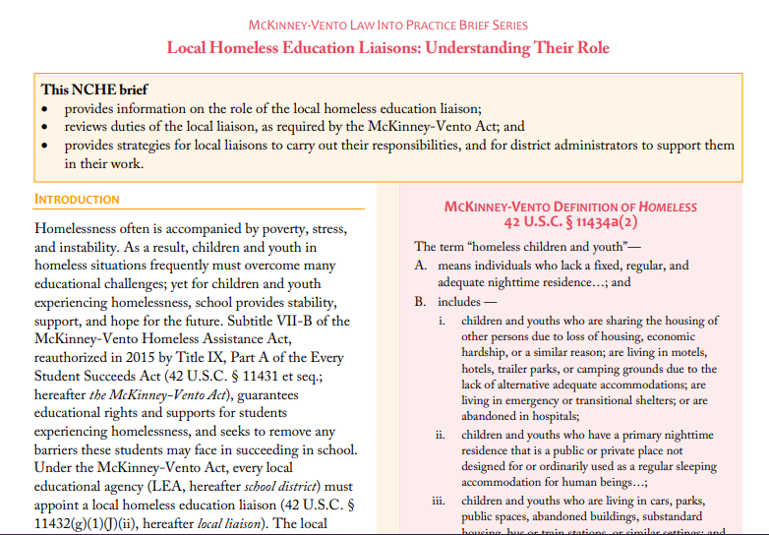

INDICATOR 18
Title IX, Part A, Education for Homeless Children and Youth-Liaison-- The school designates a liaison for homeless children and youth that has sufficient training, resources and time to carry out the duties of the Act. Legal Citation: 42 U.S.C. 11432(g)(1)(J)(ii); 11432(g)(6)
Identify and designate an appropriate staff as a Homeless Liaison who will work with the local school and training received. (tribal, state, federal offices)
Homeless Liaison Position Description
Schoolwide Budget (partial salary or stipend for liaison)
Budget expenditure reports
Communicate local Homeless Liaison information and resources within the community (Tribal, state, federal offices)
Copies of agendas, meeting minutes, emails and/or sign-in sheets for professional development activities received by the LEA homeless liaison and other LEA personnel responsible for the implementation of the McKinney-Vento grant program
Sample Evidence

Slide 28

INDICATOR 19
Title IX, Part A, Education for Homeless Children and Youth-Awareness--The school has procedures for providing awareness and contact information of Homeless Liaison to parents, guardians, and all school personnel. This applies whether the school receives a McKinney-Vento subgrant or not. Legal Citation: 42 U.S.C. 11432(g)(1)(D)
Copies of flyers, handouts, program brochure, posters that identify Homeless Liaison with contact information
List of community locations where information is posted
Training session schedules, emails, minutes, sign-in sheets, agendas, materials (including the LEA homeless policy) for all school personnel training
Sample Evidence

Slide 29
INDICATOR 20
Title IX, Part A, Education for Homeless Children and Youth-Comparable Services -- The LEAs shall provide services comparable to services offered to all children in the school including, but not limited to, programs for Title I, special education, English learners, gifted and talented, career and technical education and before and after school programs. Legal Citation: 42 U.S.C. 11432(g)(4)
Student rosters, meeting minutes, emails, agendas, sign-in sheets and should include comparable services provided (ex. Title I, 21st Century, EL, IDEA, CTE, gifted and talented programs)

Slide 30
INDICATOR 21
Title IX, Part A, Education for Homeless Children and Youth-Coordination--LEAs will collaborate with state, local, non-profit and social service agencies or programs to ensure that services are available for homeless children and youth. Legal Citation: 42 U.S.C. 11432(g)(5)
Lists of additional coordinating agencies, their mission, and services provided to homeless children and youth required. Copies of memoranda of agreements, contracts, etc. with coordinating agencies, if applicable
Coordination of Services detailed on the Schoolwide Program Plan and Schoolwide Budget

Slide 31

INDICATOR 22
ESSA-Educational Stability of Foster Care Students--The school is assuring education stability for foster care children by collaborating with state, local, tribal, non-profit, and child welfare agencies or programs. The school should designate a point of contact to ensure that services are available for children in foster care. Legal Citation: ESEA, Title I, Part A §1112(c)(5)(A)
Foster Care Liaison identified at the school
Foster Care program resources are communicated to stakeholders
Foster Care program contact information is posted throughout the school/website
School partners with local, state, tribal, federal, non-profit, child welfare agencies or programs to ensure children in foster care are provided an education
Foster Care set-asides identified and thoroughly justified within the Title I-A budget
Sample Evidence

Slide 32
GREAT NEWS!

Slide 33
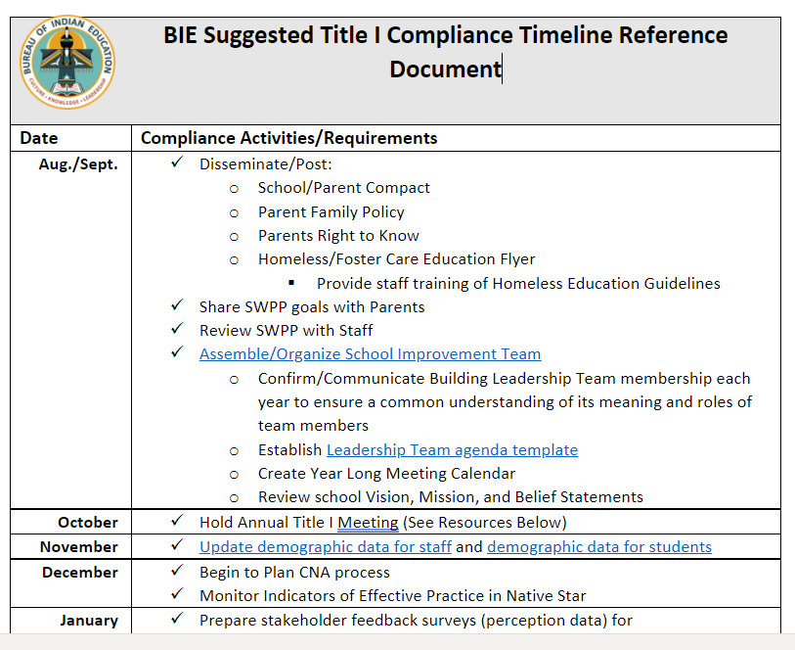
TITLE I COMPLIANCE DOCUMENT
Serves as a desk reference for planning Title I activities with sample documents/templates (Quick Demo)
Click Here

Slide 34

Margo DeLaune, Associate Deputy Director, Division of Performance and Accountability​ Location: Albuquerque, NM​ margo.delaune@bie.edu​ C: 202-860-4209​
Dr. Carmelia Becenti, Acting Supervisory Education Program Specialist​ Location: Shiprock ERC​ Shiprock and Pine Ridge (BOS) ERCs​ carmelia.becenti@bie.edu​ C: 202-860-5202​ Comprehensive Support Improvement (CSI) – Title I, Part A 1003(a), BIE State Coordinator​
 | Wanda Belgarde​ Location: Bismarck ERC​ Belcourt (BOS), Bismarck (TCS), and Flandreau (TCS) ERCs​ wanda.belgarde@bie.edu​ C: 202-860-2808​ Title II, Part A – Supporting Effective Instruction, ​ BIE State Coordinator​ ​ | Andrea Bia​ Location: Albuquerque, NM​ Albuquerque (BOS) and Minneapolis (TCS) ERCs​ andrea.bia@bie.edu​ C: 202-860-4967​ Comprehensive Literacy State Development (CLSD),​ BIE State Coordinator​ | Dr. Regina Bitsoi​ Location: Gallup, NM​ Crownpoint and Seattle (TCS) ERCs​ regina.bitsoi@bie.edu​ C: 202-860-6168​ Parent Involvement & Family Engagement and ​ Title V, Part B – Rural and Low-Income Schools, ​ BIE State Coordinator​ ​ | Cheryl Johnson​ Location: Phoenix​, AZ Chinle and Window Rock ERCs​ cheryl.johnson@bie.edu​ C: 505-895-2864​ Comprehensive Support Improvement (CSI) – Title I, Part A 1003(a),​ BIE State Coordinator​ ​
Alison Keplin​ Location: Belcourt, ND Kyle (TCS) and Tuba City ERCs​ C: 701-550-9505​ alison.keplin@bie.edu ​ Title II, Part A – Supporting Effective Instruction, ​ BIE State Coordinator​ ​ | Freddy Poitra​ Location: Phoenix, AZ Seattle (ERC)​ fredrick.poitra@bie.edu​ C: 505-252-4435 Title IV, Part A – Student Support and Academic Enrichment (SSAE), ​ BIE State Coordinator​ | Cheryl Quimayousie​ Location: Albuquerque, NM​ Albuquerque (TCS) ERC ​ cheryl.quimayousie@bie.edu​ C: 202-860-5032​ Nita M. Lowey 21st Century Community Learning Centers, BIE State Coordinator​ ​ | Marie Silverhatband​ Location: Chinle ERC​ Chinle and Window Rock ERCs​ marie.silverhatband@bie.edu​ C: 202-860-4188​ McKinney-Vento Education for Homeless Children and Youth (MCV), ​ BIE State Coordinator​ ​ | Jacqueline Wade​ Location: Phoenix ERC​ Nashville (TCS) and Phoenix (BOS) ERCs​ jacqueline.wade@bie.edu​ C: 202-860-4261​ Title IV, Part A – Student Support and Academic Enrichment (SSAE), ​ BIE State Coordinator​ ​

Slide 36

End of Day Survey

