Slide 1
Notes:
First 3 slides should be relatively quick as an intro

Slide 2
SESSION 3 NASIS
Notes:
First 3 slides should be relatively quick as an intro

Slide 3
Principal Leadership Academy Training
Notes:
First 3 slides should be relatively quick as an intro

Slide 4
MISSION SLIDE

Slide 5
MISSION OVERVIEW: NATIVE AMERICAN STUDENT INFORMATION SYSTEM (NASIS)
The Native American Student Information System (NASIS) is the Bureau of Indian Education (BIE) designated student information system for supporting school administrators, teachers, school staff, students, parents, and BIE State staff.
The BIE in partnership with Infinite Campus collaborates on NASIS.
NASIS supports schools with the day-to-day operations and instructional planning needs.
This includes data input, collection, and reporting for a variety of functions such as,
attendance
course scheduling
grades
behavior tracking
assessment
program enrollments
other areas of need

Slide 6
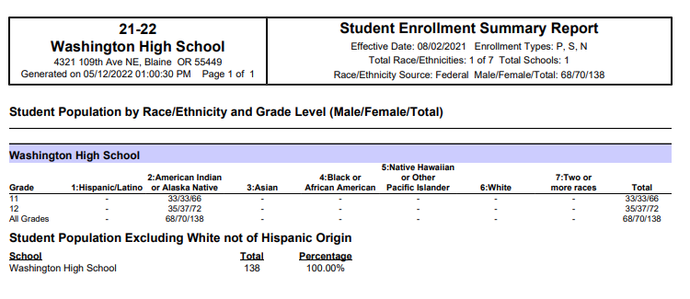
ENROLLMENT SUMMARY REPORT
Path: Student Information > Reports > Enrollment Summary Report
This report lists a breakdown of enrollments grouped by school, grade, gender and race/ethnicity.

Slide 7
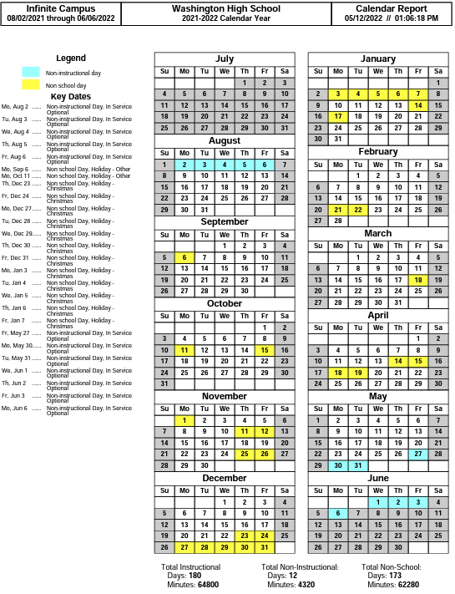
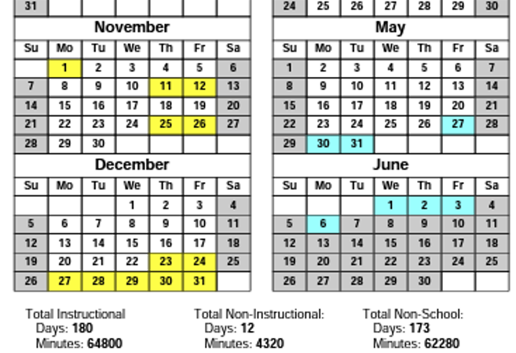
CALENDAR DAYS REPORT
PATH: System Administration > Calendar > Calendar > Days > Print > Generate Report
This report shows the academic calendar which captures the total instructional hours to identify hours less than the regulated ISEP hours as per 25CFR.
ISEP regulations (KG = 720, 1st-3rd = 810, 4th-8th = 900, 9th-12th = 970)

Slide 8
Notes:
First 3 slides should be relatively quick as an intro

Slide 9
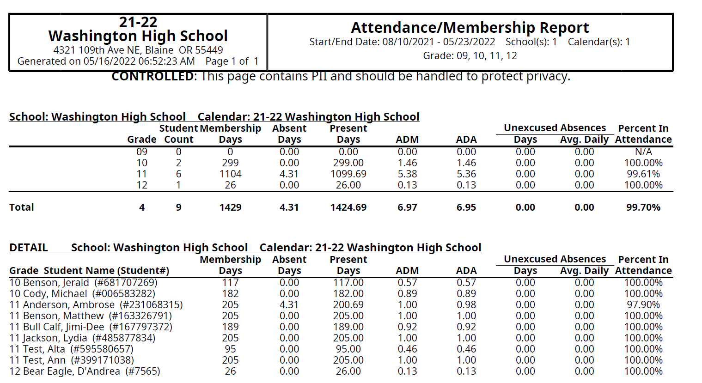
AVERAGE DAILY MEMBERSHIP (ADM) & AVERAGE DAILY ATTENDANCE (ADA)
PATH: Attendance>Reports>ADM/ADA
This report calculates Percent in Attendance and the ADM/ADA. It displays Membership, Absent and Present Days.

Slide 10
Notes:
First 3 slides should be relatively quick as an intro

Slide 11
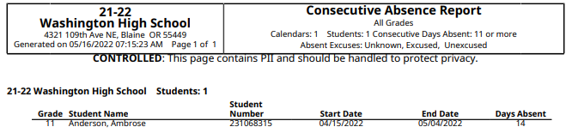
CONSECUTIVE ABSENCE REPORT
PATH: Attendance>Reports>Consecutive Absences
The report contains students with consecutive absences during a specified date range.
25 CFR 39.210 When must a school drop a student from its membership
If a student is absent for 10 consecutive school days, the school must drop that student from the membership for ISEP purposes of that school on the 11th day.

Slide 12
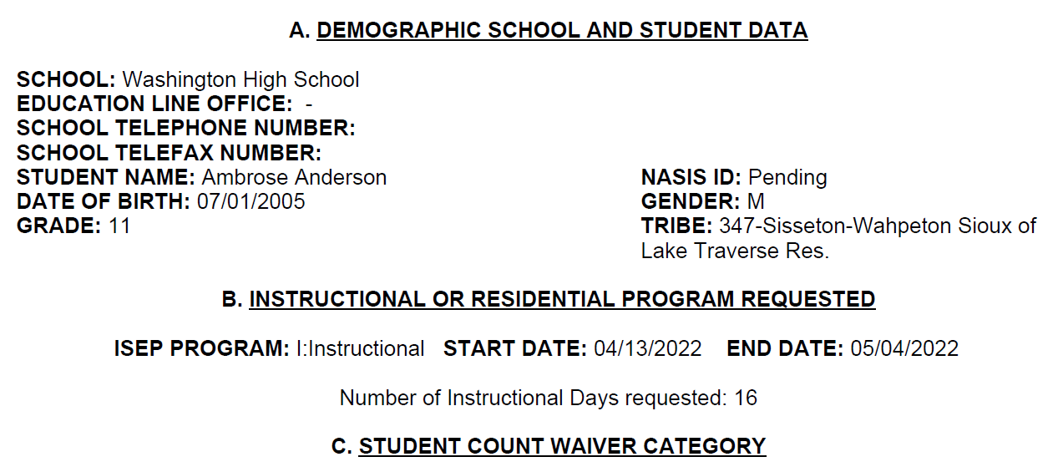
ISEP STUDENT COUNT WAIVER REQUEST FORM
PATH: Student Information >General >Student Count Waiver tab
The student waiver request may be used for those students absent more than 10 consecutive school days.
Circumstances under which student can be included in the school’s membership:
The student is temporarily confined to the home for medical, family emergency, or other reasons required by law or regulation;
The student is being provided by the school with at least 5 documented contact hours each week of academic services by certified educational personnel; and
Appropriate documentations is on file at the school.

Slide 13
Notes:
First 3 slides should be relatively quick as an intro

Slide 14
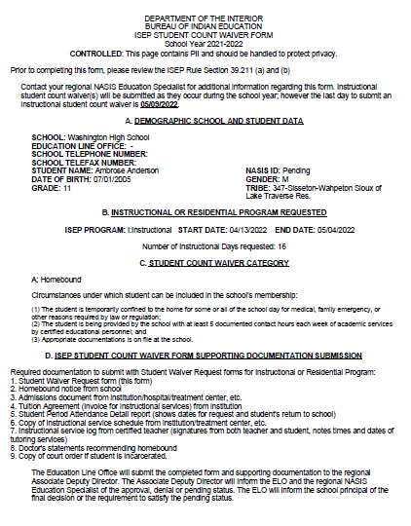
Notes:
First 3 slides should be relatively quick as an intro

Slide 15
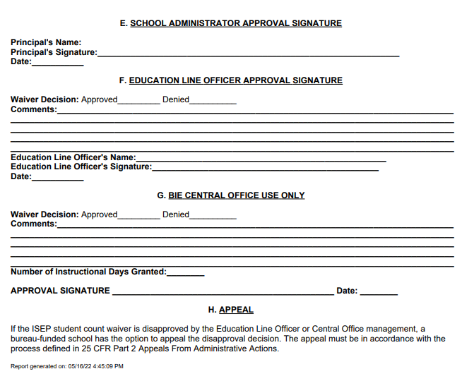
Notes:
First 3 slides should be relatively quick as an intro

Slide 16
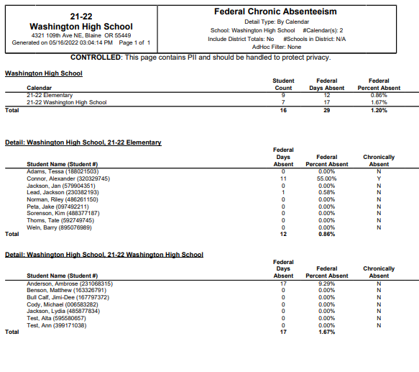
FEDERAL CHRONIC ABSENTEEISM REPORT
PATH: Attendance>Reports>Federal Chronic Absenteeism
Students missing 10% or more of the instructional days are included in the Federal Chronic Absenteeism Report.
Includes both excused and unexcused absences

Slide 17
Notes:
First 3 slides should be relatively quick as an intro

Slide 18
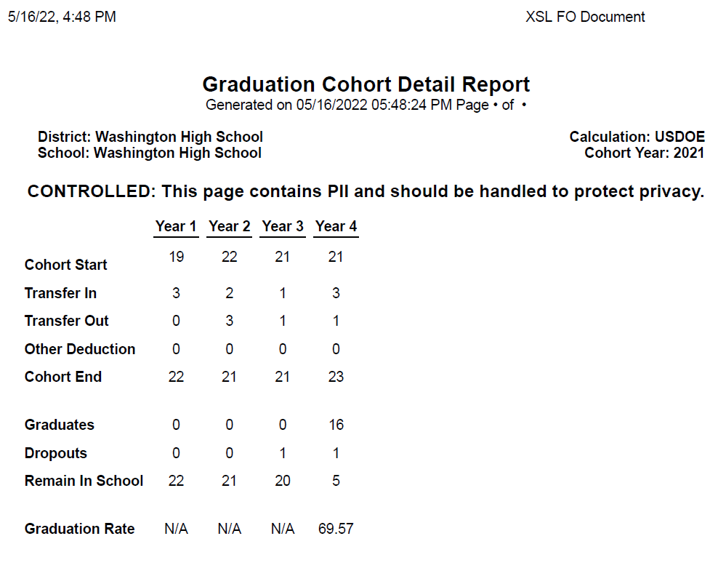
BIE GRADUATION RATE REPORT
PATH: >Student Information >Reports >Graduation Rate
The Graduation Report extracts and calculates graduation rates for a cohort of students.
Cohort Detail Report
Cohort Summary Report

Slide 19
Notes:
First 3 slides should be relatively quick as an intro

Slide 20
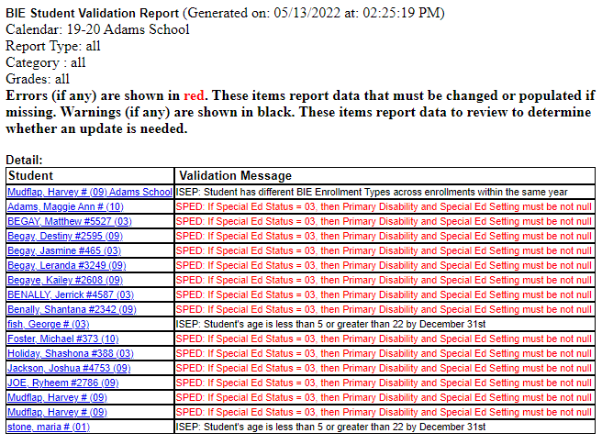
BIE VALIDATION REPORT
PATH: BIE Reports > BIE Validation Report
The BIE Validation Report allows users to validate reporting fields for data integrity.
Examples:
If a Birth Certificate is lacking, the parent/guardian signature, and/or immunization student will have Non-ISEP in the drop-down.
If a student is receiving Native language, the appropriate checkbox(es) will be noted.
If a student is participating in Gifted and/or Talented program, the appropriate fields will be identified.
If a student is or has received services in SpEd, the appropriate selection will be made in the SpEd fields.

Slide 21
Notes:
First 3 slides should be relatively quick as an intro

Slide 22
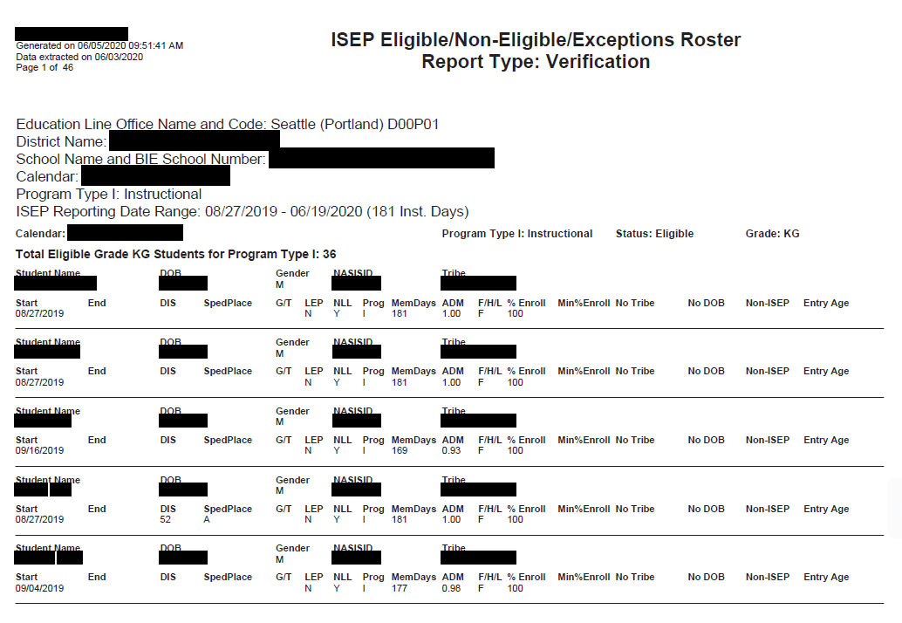
BIE INSTRUCTIONAL ISEP VERIFICATION REPORT
PATH: BIE Reports > BIE Validation Report
The ISEP Instructional Verification Report collects the required information for verification of student eligibility and is used in calculating and distributing of ISEP funding.
Examples:
Demographics
Instructional program enrollments
Residential program enrollments

Slide 23
Notes:
First 3 slides should be relatively quick as an intro

Slide 24
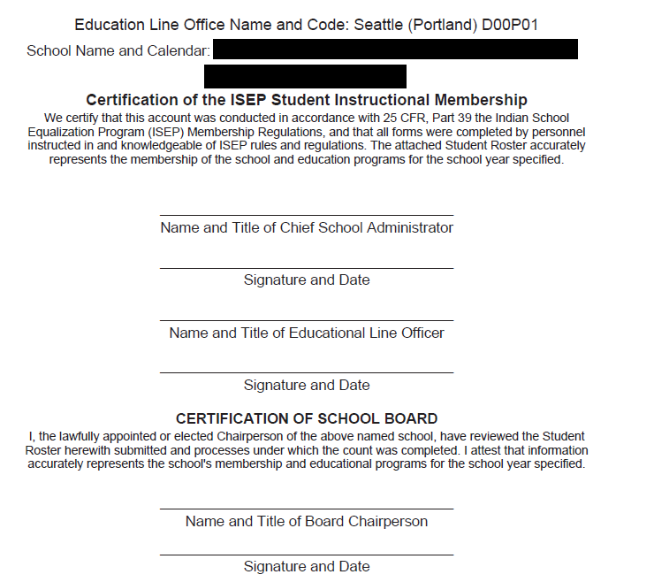
BIE INSTRUCTIONAL ISEP CERTIFICATION REPORT
Path: BIE Reports > BIE ISEP Instructional Certification Report
This certification report is the official endorsement of the student roster.
The school and ERC confirm that the data is accurate in the Verification Report, then the Certification Report (a formal roster) is run.
The data is printed and signed by the school principal, school board chairperson, and the EPA.

Slide 25
Notes:
First 3 slides should be relatively quick as an intro

Slide 26
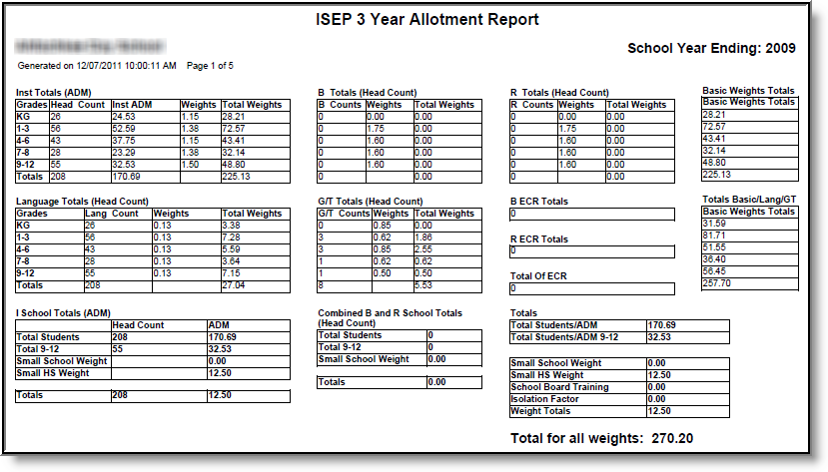
BIE ISEP 3 YEAR ALLOTMENT REPORT
Path: BIE Reports > BIE ISEP 3 Year Allotment Report
The BIE 3 Year ISEP Allotment Report is used to allocate congressionally appropriated funds to Bureau of Indian Education-funded schools (based on all Instructional and Residential calendars combined).
This report defines the same information as the ISEP Allotment Report but provides three years’ worth of data along with three year totals and averages.

Slide 27
Notes:
First 3 slides should be relatively quick as an intro

Slide 28
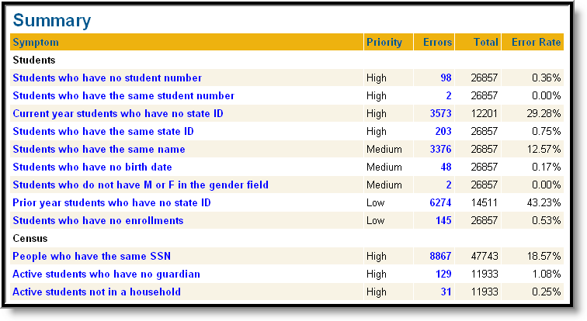
BIE DATA HEALTH CHECK
Path: System Administration > Data Utilities > Data Health Check
The BIE Data Health Check report shows areas to be reviewed to ensure accuracy and increase overall data quality.
The report provides an audit of the NASIS modules and lists symptoms that may need to be corrected.
These are typical situations where erroneous data may have occurred.

Slide 29
Notes:
First 3 slides should be relatively quick as an intro

Slide 30
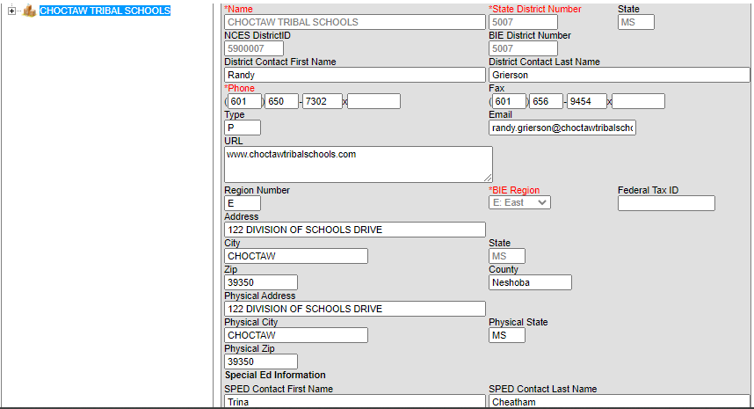
DISTRICT INFORMATION
PATH: >System Administration >Resources >District Information
All schools are listed as both district and school unless the schools have been defined as part of a district such as the Choctaw schools are listed in the District Information as Choctaw Tribal Schools and listed individually in the School module.

Slide 31
Notes:
First 3 slides should be relatively quick as an intro

Slide 32
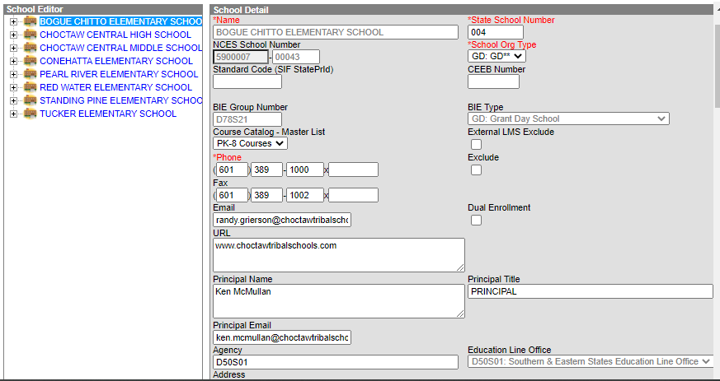
SCHOOL INFORMATION
PATH: >System Administration >Resources >School
All schools are listed as both district and school unless the schools have been defined as part of a district such as the Choctaw schools are listed in the District Information as Choctaw Tribal Schools and listed individually in the School module.

Slide 33
Notes:
First 3 slides should be relatively quick as an intro

Slide 34
NASIS CONTACTS
NAME | CONTACT INFORMATION
REBECCA IZZO-MANYMULES, PHD, SUPERVISORY EDUCATION SPECIALIST | Email: rebecca.izzo@bie.edu Mobile Phone: 703-282-0328 Fax: 505-563-3043
SUSAN MCCABE | Email: susan.mccabe@bie.edu Mobile Phone: 703-282-2043 Fax: 602-265-0293
KATHERINE RENVILLE | Email: katherine.renville@bie.edu Mobile Phone: 703-282-5270 Fax: 605-997-2601
COLE BOWERS | Email: cole.bowers@bie.edu Mobile Phone: 703-282-5646 Fax: 202-208-3312
CHERYL RODRIGUEZ | Email: cheryl.rodriguez@bie.edu Mobile Phone: 703-282-5932 Fax: 505-563-3043
VALARIE JONES | Email: valarie.jones@bie.edu Mobile Phone: 703-340-7417 Fax: 505-563-3043
SANDRA POOLAW | Email: sandra.poolaw@bie.edu Mobile Phone: 703-282-1936

Slide 36

End of Day Survey

