Slide 1
Allowable Use of IDEA Part B Federal Funds
2022 Principal Leadership Academy
BIE Division of Performance & Accountability—Special Education
June/July 2022

Slide 2


Meet our Presenters
Delphina Shunkamolah
Arlene Davis
Education Specialist DPA/IDEA
Education Specialist DPA/IDEA
Notes:
BIE Team
Introduce presenters

Slide 3
Session Objectives
Develop an understanding of regulations governing the allowable use of IDEA funds.
Review the concepts of obligation and period of performance.
Learn to utilize decision trees to determine allowability of costs.
Share related resources.
Notes:
BIE Team

Slide 4
Agenda
Regulations Governing Allowable Uses of IDEA Part B Funds
Factors Determining Allowable Costs under UGG
Allowable Uses of IDEA Federal Grants
Practice Your Knowledge for IDEA
Notes:
BIE Team

Slide 5
Question 1
How would you rate your knowledge of allowable uses of IDEA Federal funds?
Very strong
Strong
Fair
Weak
Notes:
BIE Team

Slide 6
Introduction
Regulations Governing Allowable Use of Federal Funds
Notes:
BIE Team
Let’s do a quick review of the federal regulations process to better understand their structure, identify the correlation between those regulations, determine which one are important for a school administrator when making decisions regarding allowable use of ESSA & IDEA funds.

Slide 7
Acronyms
CFR – Code of Federal Regulation
EDGAR – Education Department General Administrative Regulations
IDEA – Individuals with Disabilities Education Act
LEA – Local Educational Agency
NCLB – No Child Left Behind
SWD – Students with Disabilities
UGG – Uniform Grant Guidance
U.S.C. – United States Code
Notes:
Let’s start with a review of the different acronyms that will be used during this presentation:
CFR – Code of Federal Regulation
EDGAR – Education Department General Administrative Regulations
ESSA – Every Student Succeed Act
IDEA – Individuals with Disabilities Education Act
LEA – Local Educational Agency (BIE bureau operated and tribally controlled schools)
NCLB – No Child Left Behind
SWD – Students with Disabilities
UGG – Uniform Grant Guidance
U.S.C. – United States Code

Slide 8
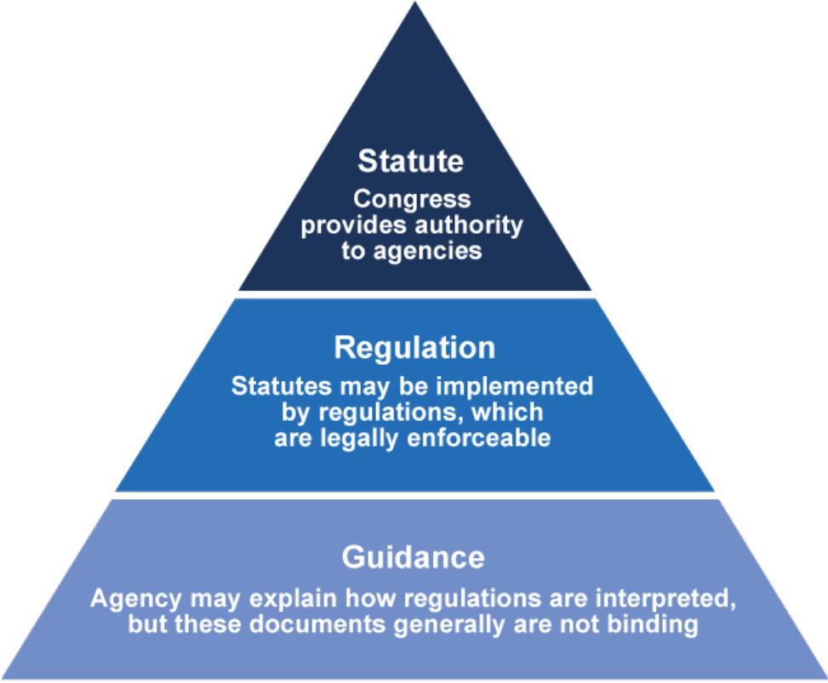
Federal Laws and Regulations
  A United States Code (U.S.C.) is a law that has been passed by the US Congress
  A Code of Federal Regulation (CFR) is the interpretation of the law by the relevant federal agency
  A non-regulatory guidance is the interpretation of the regulation by the relevant federal agency
Notes:
Let’s do a little bit of federal laws and regulations mapping:
A United State Code (U.S.C.) is a law that has been passed by the US Congress
A Code of Federal Regulation (CFR) is the interpretation of the law by the relevant federal agency
Non regulatory guidance are the interpretation of regulation by a federal agency
Regulations stem from statute, and non-regulatory guidance stems from regulations. This is a top-down graphic.

Slide 9
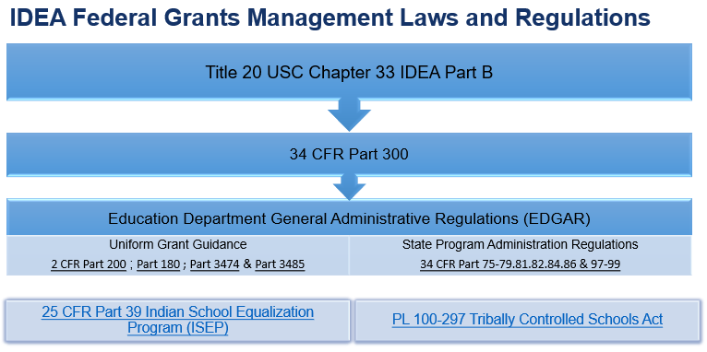
Notes:
Staff who manage federal grants are required to navigate through different regulations to help them make informed decisions. Federal grants management of IDEA Part B requires a good understanding of the correlation between the following laws and regulations: IDEA, EDGAR, Uniform Grant Guidance, and BIE specific regulations.
EDGAR and its applicable regulations are divided in two sections:
- The Uniform Grant Guidance: 2 CFR Part 200 ; Part 180 ; Part 3474 & Part 3485 are federal grants management rules that apply to all awards issued by all federal awarding agencies. EDGAR adopted the UGG back in 2014 through 2 CFR section 3474.1, except for sections 2 CFR Section 102(a) and 207(a).
And additional regulations from the US Department of Education: 34 CFR Part 75-79.81.82.84.86 & 97-99
We understand that the Indian School Equalization Program are federal regulations and PL 100-297 is a statute or law; however, when managing IDEA Part B Federal grants, the rules related to IDEA laws and regulations usually carry more weight because that are specifically designed for the program.

Slide 10
Question 2
Which one of the following is a law and/or regulation governing Allowable Use of Funds under IDEA?
IDEA
EDGAR
39 Indian School Equalization
All the above
Notes:
Read slide
Correct answer “d”

Slide 11
Allowability Of Cost
Factors for Determining Allowability under EDGAR and UGG Applicable to All Federal Grants
Notes:
Now that we finished the review of the structure of critical regulations, let’s talk about the factors that must be used to determine allowability of costs under IDEA and EDGAR.

Slide 12
)
Uniform Grant Guidance
Allowable Cost Criteria §200.403 Grant (
Necessary, reasonable and allocable to the federal education program
Consistent with policies and procedures
Consistency of treatment (i.e., indirect cost)
Not a cost used to meet other cost sharing or matching requirements
Be adequately documented
Incurred during the approved budget period
Notes:
Read slide

Slide 13
Uniform Grant Guidance (UGG)
Obligations Definition 2 cfr §200.71
Obligations are orders placed for property and services, contracts and subawards made, and similar transactions during a given period that require payment by the non-Federal entity during the same or a future period.
Notes:
Read slide

Slide 14
Uniform Grant Guidance(ugg) Period Of Performance 2cfr §200.77
Period of performance means the time during which the non-Federal entity may incur new obligations to carry out the work authorized under the Federal award
Notes:
Read slide

Slide 15
EDGAR
Obligations and Reimbursements
34 cfr §76.708
LEA may start to obligate funds from the later of the following two dates:
The date that the BIE may begin to obligate funds.
The date that the LEA submits its application to the BIE in substantially approvable form
BIE may not reimburse an LEA for obligations until a final approval of the application
Notes:
Read slide

Slide 16
Edgar
Obligations Timing 2CFR §76.707
If the obligation is for: | The obligation is made:
(a) Acquisition of real or personal property | (a) On the date on which the State or subgrantee makes a binding written commitment to acquire the property
(b) Personal services by an employee of the State or subgrantee | (b) When the services are performed
(c) Personal services by a contractor who is not an employee of the State or subgrantee | (c) On the date on which the State or subgrantee makes a binding written commitment to obtain the services
(d) Performance of work other than personal services | (d) On the date on which the State or subgrantee makes a binding written commitment to obtain the work
(e) Public utility services | (e) When the State or subgrantee receives the services
(f) Travel | (f) When the travel is taken
(g) Rental of real or personal property | (g) When the State or subgrantee uses the property
Notes:
Read slide

Slide 17
Question 3
Which of the following is not a criteria for allowable costs under Uniform Grant Guidance?
Reasonable and necessary
Consistent treatment
Allocable and adequately documented
Less expensive
Notes:
Now it is time to verify if you were paying attention.
Which of the following is not a criteria for allowable costs under Uniform Grant Guidance?
Reasonable and necessary
Consistent treatment
Allocable and adequately documented
Less expensive
Correct answer is “d”

Slide 18
Allowable Use of IDEA Part B Funds
Overview of IDEA Regulations & Fiscal Requirements

Slide 19
IDEA: Use of Funds
34 CFR §300.202
Must be used only to pay the excess costs of providing special education and related services to children with disabilities
Must be used to supplement State, local, and other Federal funds and not to supplant those funds
Notes:
Read slide

Slide 20
Isep: Bie Special Education Funds 25 CFR §39.105
Schools may supplement the 15 percent base academic funding reserved under §39.104 for special education with funds available under part B of the Individuals with Disabilities Education Act (IDEA).
IDEA funds are available only if the school demonstrates that funds reserved under §39.104(a) are inadequate to pay for services needed by all eligible ISEP students with disabilities
Notes:
Read slide

Slide 21

idea Grant Period Of Performance
Period of Performance is a 27-month period when LEA can obligate IDEA funds and includes:
Forward Funding Period of three (3) months: July 1, 2022 - September 30, 2022.
Award Year Funding Period of twelve (12) months: October 1, 2022 - September 30, 2023.
Tydings Funding Period of twelve (12) months period carry over for expenses not obligated in the fiscal year for which they were appropriated: October 1, 2022 - September 30, 2023.
Notes:
Read slide

Slide 22
Question 4
How long is the IDEA performance period?
Three (3) months Forward Funding Period
Twelve (12) months Award Year Funding Period
Twelve (12) months Tydings Period for carry over
Twenty-seven (27) months
Notes:
Read slide
Correct answer is d. 27 months

Slide 23
Idea Allowable Cost Decision Trees
Use a Decision Matrix and Test Your Knowledge
Notes:
Now that we discussed regulations in depth, it is time to learn how to use those regulations in the decision-making process. We developed a framework using decision trees to help LEAs come with the best conclusion possible to determine whether a cost might be allowed to be paid with IDEA funds.

Slide 24
Question 5
An LEA wants to buy a helicopter for a child with disability in a special education program. Is this an allowable expense for IDEA Part B funds?
Yes
No
It depends
Notes:
LEA wants to buy a helicopter for a child with disabilities in a special education program. Is this an allowable expenses for IDEA Part B funds?
Yes
No
It depends
Allowable use of funds in IDEA is a complex topic
You will not often be wrong if your answer is “it depends”
Several factors play into a final determination
Correct answer is “c”

Slide 25
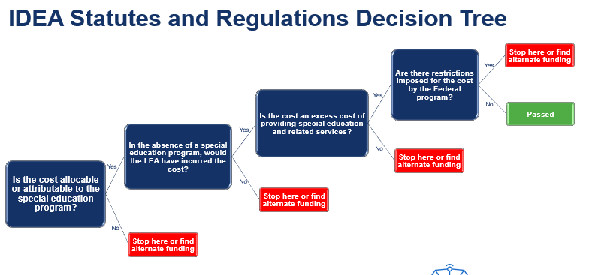
Notes:
Read slide

Slide 26

UGG and EDGAR Decision Tree
Is the cost reasonable, necessary, allocable, and consistent with LEA policies and procedures?
Is the cost adequately documented?
Is the cost obligated during the performance period?
Stop here or find alternate funding
Is the cost also charged to ISEP 15% base funding?
Stop here or find alternate funding
Stop here or find alternate funding
Stop here
Passed
Yes
Yes
Yes
No
Yes
No
No
No
No
No
Notes:
Read slide

Slide 27
Final Decision Tree
Allowable under UGG and EDGAR
Allowable under IDEA laws and regulations
Restrictions placed by the Federal agency
Stop here or find alternate funding
Allowable under BIE codes, rules, and policies?
Stop here or find alternate funding
Stop here or find alternate funding
Stop here or find alternate funding
Passed
Yes
Yes
Yes
No
Yes
No
No
No
Notes:
Read slide

Slide 28
Special Education Staff Salary
Cost associated with salaries and benefits of Special Education Director, Teacher, Paraprofessional
Allowed
Notes:
Cost associated with salaries and benefits of Special Education Director, Teacher, Paraprofessional. Is this allowable?
Yes
No
It depends (maybe)
Presenter: After each question, always ask why participants think the answers is yes, no, or it depends.

Slide 29

Nurse - School Based
Costs associated with salaries and benefits for LEA employees or costs for contracted nursing services
May be allowed
Costs must be IEP-driven or related to the evaluation of a child
Not Allowed
For day-to-day costs of nursing services provided to all students
Notes:
Costs associated with salaries and benefits for LEA employees or costs for contracted nursing services. Is it allowable?
Yes
No
It depends (maybe)
Presenter: After each question, always ask why participants think the answers is yes, no, or it depends

Slide 30
Do It Yourself
Practice Your Knowledge with a Decision Matrix
Notes:
We talked about the critical concepts of allowable use of funds. Now it is time to put your knowledge into practice. This section of the presentation will be more interactive, and we encourage everyone to participate. Do it yourself by practicing using the decision matrix framework. Consider how you would document justification for each cost if they are allowable.
Presenter note: All slides in this section are animated for participants engagement. Can also use poll question to encourage interaction with the audience.

Slide 31

Business Manager/Tech Salary
Costs associated with salaries and fringe benefits of business manager/tech with IDEA Funds
Not allowed
Not a direct cost of the program
2 CFR 200.413
Notes:
Costs associated with salaries and fringe benefits of business manager. Is it allowable?
Yes
No
It depends (maybe)
Presenter: After each question, always ask why participants think the answers is yes, no, or it depends

Slide 32

School Principal/Administrator Pay
The salary and benefits of the school principal or administrator with IDEA Part B Funds
Not Allowed
The school will incur these costs in the absence of IDEA Part B funds.

Slide 33

Computers For Students
Costs of the acquisition of computers for students with IDEA Funds
Not Allowed
Acquisition of computers are NOT an excess cost, and therefore not allowed if the LEA has decided to equip all classrooms in a school and simply charges the IDEA grant a prorated amount based upon the number of children with disabilities in the school
May be allowed
Computer purchase must be related to a specific need for the education of students with disabilities
Notes:
Costs of the acquisition of computers for students. Is it allowable?
Yes
No
It depends (maybe)
Presenter: After each question, always ask why participants think the answers is yes, no, or it depends

Slide 34

Bus Purchase, Lease Or Rental
Costs of the vehicle purchase or lease, insurance, repair, and maintenance with IDEA Funds
May be allowed
With BIE prior approval.
Only for vehicle to transport children with disabilities who require special assistance in transportation
Notes:
Costs of the vehicle purchase or lease, insurance, repair, and maintenance. Is it allowable?
Yes
No
It depends (maybe)
Presenter: After each question, always ask why participants think the answers is yes, no, or it depends

Slide 35

Remodeling or Construction
Costs associated with remodeling due to the unique needs of a student or students with a disability
May be allowed
With BIE prior approval: Remodeling costs must be excess costs of special education. Remodeling must meet the needs of one or more children with disabilities
2 CFR 200.439 (b)(1)
Never allowed
Remodeling costs for the general purpose of bringing facilities into compliance with Section 504 and ADA requirements are not allowed
Notes:
Costs associated with remodeling due to the unique needs of a student or students with a disability. Is it allowable?
Yes
No
It depends (maybe)
Presenter: After each question, always ask why participants think the answers is yes, no, or it depends

Slide 36

Equipment - Capital
Costs of equipment to support special education and related services
May be allowed
BIE prior approval needed. Capital equipment is equipment with a useful life of more than one year that costs $5,000 or more per unit
2 CFR 200.439 (b)(2)
Notes:
Costs of capital equipment to support special education and related services. Is it allowable?
Yes
No
It depends (maybe)
Presenter: After each question, always ask why participants think the answers is yes, no, or it depends

Slide 37
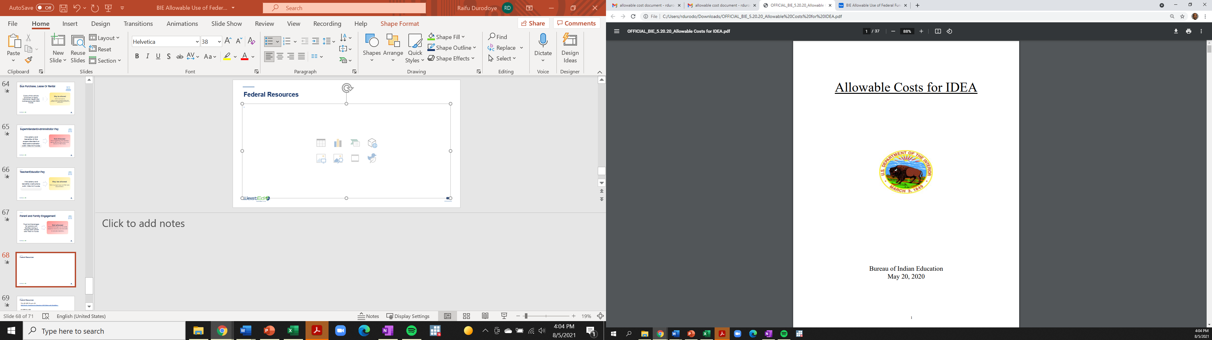
Federal Resources
Notes:
Posted in the BIE website and Native Star. A copy will be emailed to participants.

Slide 38
Federal Resources Cont.
  Title 20 USC Chapter 33
  IDEA Part B - Assistance for Education of All Children with Disabilities
  34 CFR Part 300
  Assistance to States for the Education of Children with Disabilities
  2 CFR Part 200
  Uniform Administrative Requirements
  34 CFR Part 75-79
  Education Department General Administrative Regulations (EDGAR)

Slide 39
Federal Resources Cont.
  Office of Elementary and Secondary Education (US Dept. of Ed.)
  Improving Basic Programs Operated by LEAs (ESEA Title I, Part A)
  Office of Elementary and Secondary Education (US Dept. of Ed.)
  Title I Resources
  Every Student Succeeds Act (US Dept. of Ed.)
  ESSA Resources
  ESSA Fiscal Primer (CCSSO)
  Summary of Spending and Fiscal Rules

Slide 40
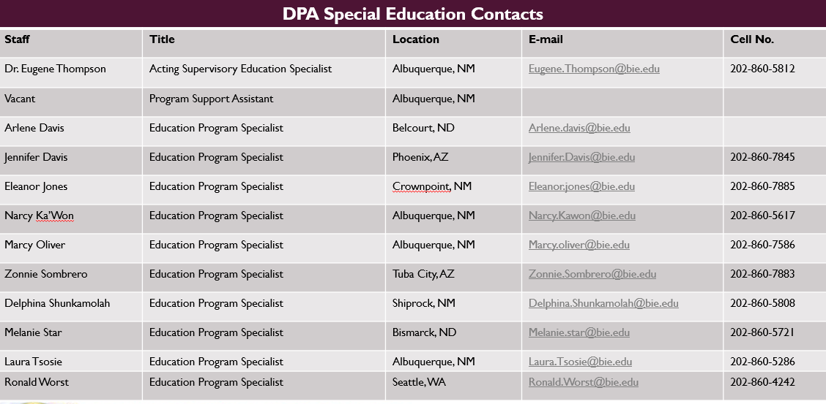

Slide 41
Connect With us!

Slide 42
Thank You

