Slide 2
BUREAU OF iNDIAN eDUCATION STEP INITIATIVE AND elms

Slide 3
Dr. Maureen Lesky
eLMS Project Manager, Office of the Director
Stuart Ott
Deputy Associate Chief Information Officer for the
Bureau of Indian Education

Slide 4
STEP VISION STATEMENT
To improve educational outcomes by empowering Students, Families, Tribal Communities, Teachers, Staff, and Administrators through innovation

Slide 5
Blank layout title (3)
THE BUREAU OF INDIAN EDUCATION’S STEP PROJECT
INCLUDES THREE MAJOR INITIATIVES:
Adoption of an Education Learning Management System (eLMS) to Bureau-operated schools with an option for Tribally-controlled schools to adopt.
Implementation of a sustainable and dynamic BIE technical infrastructure and connectivity to support educators, students,
and families.
Establishment of Communities of Practice (CoP) within multiple BIE functions fostering continuous improvement and collaboration.

Slide 6
Blank layout title (1)
THE STEP INITIATIVE HAS THE OPPORTUNITY TO
POSITIVELY CHANGE THE FUTURE FOR UP TO:
47,000 students
2,000 educators and administrators
500 support team members
GOALS AND OUTPUTS OF THE STEP INITIATIVE
Improve access to digital material and help close the digital divide
Improve school programs, activities, and services
Increase enrollment numbers and graduates
Improve academic performance
Align resources, curriculum, and academic content standards

Slide 7

Blank layout title (2)
STUDENTS CAN LOOK FORWARD TO:
• Improved school engagement and performance
• Increased educational opportunities
• Relevant student-centered experiences
• Increased academic achievements
• Improved college and career readiness
• Individual, family, and community self-advocacy

Slide 8
Blank layout title (1)
THE STEP INITIATIVE AND OBJECTIVES WILL BE
IMPLEMENTED THROUGH A PHASED APPROACH
Phase One Implementation Begins August 1, 2022, for twelve schools.
Phase Two Schools Implementation Begins August 2023
Phase Three Schools Implementation Begins August 2024

Slide 9
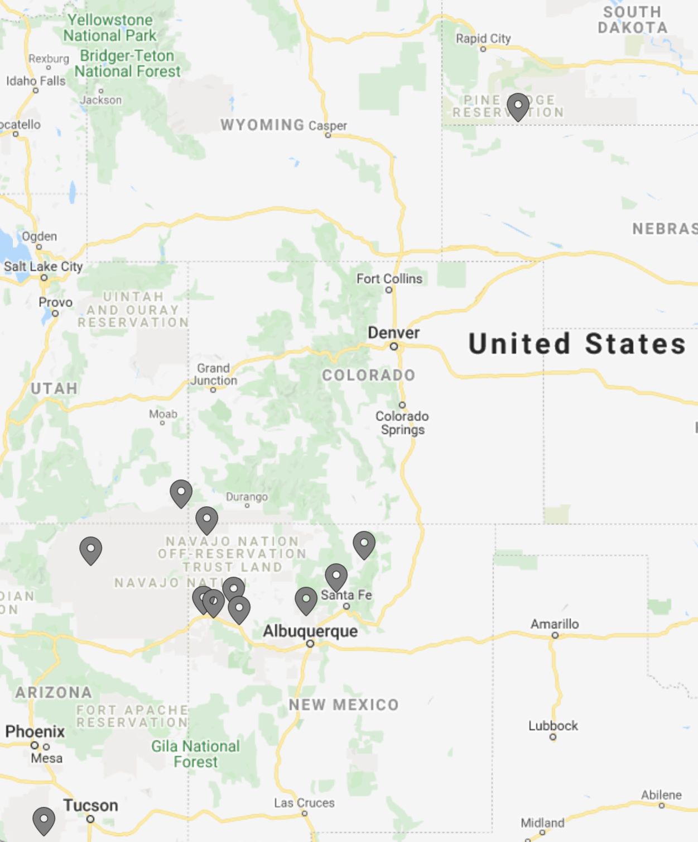
PHASE ONE SCHOOLS
Aneth Community School
Pine Ridge School
Lake Valley Navajo
School
Beclabito Day School
Tonalea Day School
Taos Day School
Bread Springs Day School
San Ildefonso Elementary School
Wingate Elementary School
T’siya Day School
Tohono O'odham High School
Baca-Dlo’ay Azhi
Community School

Slide 10



STEP Initiative has two stages:
eLMS implementation
education transformation to establish a blended learning environment for digital learning and teaching
eLMS Implementation
Educational Transformation
eLMS Implementation
provides the technologies
needed to deliver digital teaching and learning
Transformation leverages the technologies inside and outside the classrooms to improve teaching and learning
Today’s Blended Learning
Digital Instruction
Classroom Instruction

Slide 11
ROAD TO TRANSFORMATION
Plan for education centered technology with benchmarks to measure success
Leveraging innovation and CoPs to improve educational outcomes is SUCCESS
eLMS Go Live August 1 -
Educational Transformation
STARTING LINE
1
3
5
eLMS IMPLEMENTATION
EDUCATIONAL
TRANSFORMATION
2
4
6
Set the conditions for educational outcomes
Implement the education plan and measure effectiveness
Continuously Improve and expand with lessons learned

Slide 12
STEP Initiative #1
Adoption of an Education Learning Management System (eLMS) to Bureau-operated schools with an option for Tribally-controlled schools to adopt.

Slide 13
Blank layout title (5)
HOW DOES THE eLMS SUPPORT THE VISION?
Enhances traditional education with emerging learning techniques and digital content.
Integrates face-to-face classroom practices with digital delivery methods.
Empowers teachers and students through digital learning resources and active learning methods to improve experiences and outcomes.
THE eLMS WILL NOT REPLACE TEACHERS,
IT WILL ENHANCE, EMPOWER AND INTEGRATE EVERYTHING
THEY DO FOR STUDENTS.

Slide 14
Blank layout title (1)
HOW WILL THE eLMS IMPACT USERS?
ADMINISTRATORS: enables essential communications, records, assessments, and standards in one collaborative and responsive platform
EDUCATORS: streamlined administrative tasks and communication that promotes individual, group, and differentiated learning
STUDENTS: the most up-to-date digital resources, instruction, communication, organization, and digital learning while identifying student strengths or challenges, creating more opportunities for differentiated learning and growth
FAMILIES: real-time communication and access to enhance collaboration, confidence, and opportunities

Slide 15

IS THE STEP eLMS PLATFORM
• RAJ Technologies (RTI) is the primary contractor
• Schoology is the Platform, provided by RTI
• Power School acquired Schoology as an education product
Arrow Alliance is contracted to support the STEP and eLMS Initiative

Slide 16
Blank layout title (1)
SCHOOLOGY AND BLENDED LEARNING
WILL BE IMPLEMENTED IN A
CRAWL, WALK, RUN MODEL.

Slide 17
Crawl, Walk, Run Flowchart
School Design Plans Complete
Begin Training Phase 2 Schools
June 14
Specific School Trainings Continue
Jan 31
CWR Kickoff
School Training Begins
Star Teacher Recognition
May 5
Sept 7
March 7
2022
July 21
May
June
July
Aug
Sept
Oct
Nov
Dec
Jan
Feb
March
April
Goal Setting School Design Plans
Year 2 Planning
Crawl
Orientation 1 Digital Assignment per Week
Creating Assignments
Writing Assignments Communities of Practice Authentic Feedback Assess Results
Goal Setting School Design Plans
Walk
Orientation 2 - 4 Digital Assignments per Week
Year 2 Planning
Curriculum Purchased or placed in the LMS
Pacing Curriculum Customization Advanced Grading Grouping Assess Results
Goal Setting School Design Plans
Orientation 5 or more Digital Assignments per Week
Run
Pacing Curriculum Editing Video Creation Objective Alignment Grouping Assess Results
Curriculum Purchased or placed in the LMS
Technology Intermediate SEL/ Technology Technology Applications Adv SEL Video Library Importing Content Choosing Curriculum Alignment of Objectives in Schoology
SEL Principals Training
Digital Learning Schoology Train the Trainer
General Training
Family and Parent Strand: Introduction to Digital Learning/ Technology Logging In Orientation Navigation Student Success Monitoring Progress

Slide 18







Three Year Transformation
YEAR 1
PARTIALLY BLENDED CLASSROOM
YEAR 2
BLENDED CLASSROOM
YEAR 3
TRANSFORMATION
TEACHER/ LEARNING METHODS
Lecturer/ Coordinator
Facilitator
Coach/ Leader
TECHNOLOGY UTILIZATION
LMS and Supplemental Digital Tools Introduced and Used Sparingly
LMS and Tools are Daily and Fully Integrated into the Daily
Learning Routines
LMS and Tools are Used Regularly
DATA USAGE
Data is Reviewed with Adjustments at Class and Student Level
Data is Reviewed with Daily Adjustments at Class and
Student Level
Data is Available and Reviewed

Slide 19

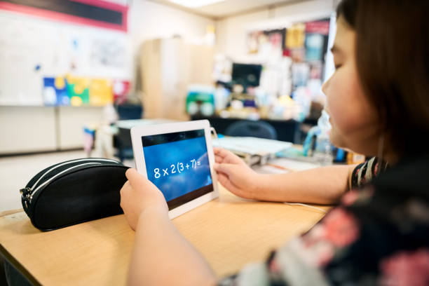
What is blended learning?
Blended learning is “any formal education program in which a student learns at least in part through online learning, with some element of student control over time, place, path, and/or pace” (Horn, Staker, and Christensen, 2015, p. 34)
Blended learning can be implemented through a variety of ways, generally using a combination of one or more models.

Slide 20
Four models of blended learning
Rotation Model
Flex Model
A La Carte Model
Enriched Virtual Model
A model that includes any course or subject in which students rotate between various modalities, one of which is online. There are four common types of this model: Station Rotation, Lab Rotation, Individual Rotation, and Flipped Classroom.
Courses that students take entirely online while attending school in person. This is typically done in high schools for foreign language and AP courses.
A model that offers face-to-face sessions and allows students complete their work online from a location of their choosing.
A model in which students schedules are flexible based on their needs. Teacher support and instruction are flexible and used as-needed while students work through courses online.

Slide 21




Station rotation
Students rotate within a classroom or a set of classrooms.
Online Instruction
Teacher-Led Instruction
Collaborative Activities and Stations
If students rotate between classrooms, a floating teacher, paraprofessional, or educational technologist often support.

Slide 22
Lab rotation
Students go to a computer lab for the online-learning portion of the course.
Teacher-Led Instruction
Teacher-Led Instruction
Teacher-Led Instruction
Computer Lab
A floating teacher, paraprofessional, or educational technologist is often used to support the computer lab.

Slide 23


Individual rotation
Students rotate between online learning and other modalities based on an individually customized schedule among learning. This is often done in a large, central learning lab.
Group Projects
Teacher-Led Instruction
Computer Lab or Central Learning Lab
Intervention
Seminar
A floating teacher, paraprofessional, or educational technologist is often used to support the computer lab.

Slide 24


Flipped classroom
Students receive lessons online and independently, whether at home or during a study hall period. Time in the classroom is used to complete homework with teachers assisting, as needed.
School: Practice and Projects
Home: Online Instruction and Content

Slide 25
CONTINUOUS IMPROVEMENT
TRANSFORMATION TO BLENDED LEANRING HIERARCHY
TRANSFORMATION LEVEL
ADAPTION LEVEL
DEVELOPING INDEPENDENT LEARNERS AND INTEGRATING BLENDED LEARNING INTO THE ENTIRE CURRICULUM
ADOPTION LEVEL
DATA DRIVEN CLASSROOM AND BEST PRACTICE
IMPLEMENTATION​
ENTRY LEVEL
SELECTING eLMS TOOLS & INTEGRATING LESSON PLANS INTO
THE eLMS​
INTRODUCTION TO BLENDED LEARNING

Slide 26
STEP Initiative #2
Implementation of a sustainable and dynamic BIE technical infrastructure and connectivity to support educators, students, and families

Slide 27
CONTINUOUS IMPROVEMENT
TRANSFORMATION OF CONNECTIVITY AND INFRASTRUCTURE
HIERARCHY
IMPLEMENTATION AND INSTALLATION
PLANNING AND PROCUREMENT
EQUIPMENT BUILT, INSTALLED OR REPAIRED TO TRANSFORM SCHOOL CONNECTIVITY
SYSTEMS
INTEGRATION
TRIAGE
SCHOOL RECEIVES TRIAGE REPORT AND DETAILED PLANS TO IMPROVE CONNECTIVITY
DEVICE MANAGEMENT
ON-SITE ASSESSMENT
HEAT MAPS
INFRASTRUCTURE TESTS
BANDWIDTH TESTS
INVENTORY
IT TEAMS VISIT CAMPUS FOR INITIAL ASSESSMENT

Slide 28
SUPPORT FOR IT IMPROVEMENTS
BISON SUPPORT
Work continues to have BSS ready to support eLMS on roll out to include licensing and developer assistance.
New Equipment and infrastructure improvements for all schools coming
1Gb Wide Area Network circuits installing
ERATE PROGRAM
Additional Priority 2 (school site) support being provided – also supporting new funding model to help fund school applications.
Consortium (network) work continues; validating FRL counts.
New BIE IT support organization will support 3 full time E-Rate specialists

Slide 29
SUPPORT FOR IT IMPROVEMENTS
NASIS INTEGRATION
NASIS APIs provide interchange of student, teacher and curriculum data – Gradebook integration also available (NASIS premium feature)
One interconnection made to sandbox environment for training
Expansion of Schoology for 1-1 NASIS integration change order received and being processed.
PRIVATE AND PUBLIC SOURCES
FOR CONNECTIVITY IMPROVEMENTS
Recruitment for a Public Private Partnership (PPP) business analyst coming soon. Identify and solidify agreements for leveraging commercial broadband opportunities and WiFi.
Engage interest groups, NIEA, AIHEC, Tribal Consortiums, and more in industry to deliver connectivity solutions to schools and communities

Slide 30
STEP Initiative #3
Establishment of Communities of Practice (CoP) within multiple BIE functions fostering continuous improvement and collaboration.

Slide 31
WHAT IS A COMMUNITY OF PRACTICE?
A group of people that share a concern or an interest for something
they do and learn how to do it better as they interact regularly
WHAT'S THE VISION FOR THE STEP COMMUNITIES OF PRACTICE?
Build educator, staff, student, and community collective capacity and
self-advocacy skills by building knowledge and experience across multiple disciplines that support the STEP
Attain knowledge and develop skills through personalized, relevant,
and timely professional experiences, sharing, and engagement

Slide 32
HOW ARE CoPs DIFFERENT THAN PROFESSIONAL LEARNING COMMUNITIES?
Purpose
CoP - build collective knowledge based on shared interests and goals.
PLC - collaborate in grade-level or subject-area teams about curriculum and
instruction using a continuous improvement model.
Structure
CoP - an organized as a network of one or more school systems or organizations.
PLC - organized as face-to-face groups that are generally located within one school or district.
Focus
CoP - systemic improvement.
PLC - student learning (academic and behavioral).

Slide 33
SUPPORTING THE STEP AND EDUCATIONAL TRANSFORMATION
Education and Training – Dr. Tamarah Pfeiffer
Information Technology – Stuart Ott
Policy and Procedure – Chelsea Wilson
Logistics – Bernadine Letcher
Communication – Klarissa Jensen
Project Management Team – Dr. Maureen Lesky
Arrow Alliance, RTI, PowerSchool, Schoology

Slide 34
Blank layout title (3)
LOOKING FORWARD:
PHASE 1 SCHOOLS GO-LIVE DATE AUGUST 1, 2022
PHASE 2 SCHOOLS ANNOUNCED FALL 2023
PHASE 3 SCHOOLS ANNOUNCED FALL 2024

Slide 35
CONTACTS & MORE INFORMATION
Dr. Maureen Lesky
Project Manager, Office of the Director
Bureau of Indian Education
Maureen.Lesky@bie.edu
Stuart Ott
Deputy Associate Chief Information Officer for the Bureau of Indian Education
Stuart.Ott@bia.gov

Slide 37

End of Day Survey

Slide 38
BACK UP SLIDES

Slide 39
Shared Vision
Leadership Team
Blended Learning Recognition Program
Annual Progress Report
Personnel
Digital Specialists
Communication and Collaboration
Policy
Continuous Improvement
Procurement
Collaborative Decision-Making
Tools
Policy Content and Maintenance
Strategic Alignment
Vision Development
Information Campaign
Professional Development
Annual Blended Learning Conference
Digital Teaching Skills
Teacher Leaders
Culture
Wifi Status
School and Board
Strategic Alignment
Student Centricity
Data Collection
Systemic Adjustment
Digital Content Selection
Network Accessibility
Connectivity
Leadership

Slide 40
Professional Learning
Professional Learning Focus
Focus of Digital Teaching and Learning
Professional Learning Format
Setting Size
Professional Learning Participation
Source of Opportunities
Digital Learning Frameworks
Content-Specific Strategies
Blended Learning
Educator Expectations
Blended Learning Models
Customization
Ongoing Support
Settings
Communities of Practice
Administration
Bleneded Learning in Specific Roles

Slide 41
Content and Instruction
Educator Role
Changing Role
Student-Centered Learning
Student Access to Digital Tools
Future Ready Learning Spaces
Connecting Beyond the Classroom
Technology Infrastructure and Devices
Outside of School
Data-Informed Instruction
Digital Citizenship
Teacher understanding of Fair Use guidelines
LMS
Partnerships
Assessments use Digital Tools
Teacher Competencies
Customizing Digital Content
Teacher/Student Partnership
Evidence-based practices
Problem Solving
Student Personalization
Student Role
Classroom Arrangement
Library Media Center
Support of LMS
BYOD
Access to Internet
Student Data
Digital Performance Data
Student Data Analysis
Teaching of Fair Use guidelines
Digital Social Interaction
Teaching of Digital Citizenship
Global Engagement

Slide 42
Technology Infrastructure and Development
End-User Devices
Device availability
Learning Environments
Display Capabilities
Technical Support
Existence
Network Services
Out of School
Inventory Mgmt
Access to Internet Outside of School
Remote Management of Devices
Devices Aligned to Instructional Programs
Personal Devices
Power receptacles
Peripheral Devices
Learning Spaces
Response Time
Org Structure
Policy & Procedure
Tracking System
Inventory Management
Single Sign-On
Content Filtering
Accessibility
Guest Devices
Partnerships
Provider Discounts
Off-Premise Filtering

Slide 43
Data and Assessment
Data Use Culture
Data-informed Decisions
Learner Profiles
Student Learner Profiles
Value of Student Growth over Student Achievement
Use of Teacher-Created Assessments
Use of Multiple and Varied Assessments
Professional Learning Opportunities related to Data
Administrators use Student Data
Student Use of Performance Data

