Slide 2
SESSION 7: STANDARDS, ASSESSMENT, AND ACCOUNTABILITY JUNE 2022

Slide 3
Presenters:
Aurelia Shorty &
Dr. Valerie Todacheene
Chief Academic Office

Slide 4
PURPOSE
To provide an overview of the Bureau of Indian Education’s Standards, Assessment and Accountability System

Slide 5
TOPICS FOR THIS SESSION
Overview
Standards/Assessment Requirements
Unified Assessment
Accountability
Indicators
Accountability Status
Tribal Waivers

Slide 6
EVERY STUDENT SUCCEEDS ACT (ESSA)
Reauthorizes the Elementary and Secondary Education Act (ESEA) to create a long-term, stable federal policy that gives states additional flexibility and encourages innovation, while at the same time holds them accountability for student achievement results.
Final Rule published on March 26, 2020
Link– https://www.govinfo.gov/content/pkg/FR-2020-03-26/pdf/2020-06148.pdf

Slide 7
ESSA OVERVIEW
ESSA reinforces state authority over standards, accountability and other key education policies
Prohibits any U.S. Secretary of Education from requiring states to adopt specific standards or assessments
Law does require that states align standards with college and career readiness skills

Slide 8
BIE AGENCY PLAN
BIE’s Agency Plan approved by the U.S. Department of Education in January 2021
BIE implemented requirements for standards, assessments, and an accountability system pursuant to regulation.
Adoption of Standards Assessments and Accountability Final Rule, 25 CFR PART 30, went into effective April 2020.
The Unified System implemented in School Year 20-21 pursuant to ESEA Section 1111(k), with state requirements for standards and assessments.

Slide 9
BIE STANDARDS
BIE College and Career Ready Standards in Math, K-12
BIE College and Career Ready Standards in English Language Arts, K-12
Next Generation Science Standards, grades 5, 8, & 11
English Language Proficiency Development Standards, K-12

Slide 10
ASSESSMENT REQUIREMENTS
Each state including BIE is required to implement a set of high-quality student academic assessments in:
Math, Reading, or Language Arts in grades 3-8 and 11
Science - designated grades in grade bands 3-5, 6-8, and once in high school
Alternate as specified in a student’s Individual Education Plan (IEP)
English Language Proficiency for English Learner (EL)

Slide 11
ASSESSMENT TIMELINE
Phase One
Off-the-shelf- assessments aligned to College and Career Readiness Standards
Phase Two
SY 2022-2023 and beyond
Cultural Relevant Customized Assessment
Item development for ELA & Math SY 2021-2022
Pilot Test SY 2022-2023
Phase Three
Addition of Tribal Civics (Standards ?)

Slide 12
BIE UNIFIED ASSESSMENTS
Subject | Standards | Name of Assessment | Grades
English Language Arts & Math | College & Career Readiness | BIE ELA & Math | 3-8, & 11
Science | Next Generation Science | BIE Science | 5, 8, & 11
Alternate Language Arts, Math, & Science | College & Career Readiness, Next Generation Science | Multi-State Alternate Assessment | 3-8, & 11 5, 8, 11
English Language Proficiency | English Language Development | ACCESS for ELLs | K - 12

Slide 13
BIE ELA/MATH INTERIM ASSESSMENT
A school has the option to provide formative assessment three times a year to insure timely adjustment for instructional purposes.
Test Coordinators at each school can register in the PAN portal the students who will be taking an interim assessment and when.

Slide 14
ACCOUNTABILITY INDICATORS
Accountability Indicators | Grade Span |  | Points
 | K-8 | H.S. | K-8 | H.S.
Academic Achievement: Proficiency on ELA & Math Assessment * | Yes | Yes | 50 Points | 50 Points
Other Academic: Proficiency on Science Assessment * | Yes | N/A | 20 Points | N/A
English Learner Progress – applicable to all schools with 10+ * | Yes | Yes | 15 Points | 15 Points
4 – Year Cohort Graduation Rate * | N/A | Yes | N/A | 20 Points
SQSS Chronic Absenteeism * | Yes | Yes | 15 Points | 15 Points
95% Participation Rate | Yes | Yes | N/A | N/A
Total: |  |  | 100 Points | 100 Points

Slide 15
ACCOUNTABILITY STATUS - DURING PANDEMIC
School Year | Assessments | Sch. Improvement Status | Sch. Accountability Determination Status
2018-2019 | YES | YES | NO, (under ESEA)
2019-2020 | NO, BIE granted a Waiver due to COVID-19 | Status Quo from 2018-2019 | NO, US Dept. of Ed. granted BIE a Waiver due to COVID-19
2020-2021 | YES, 1st year of BIE Unified Assessment | Status Quo from 2018-2019 | NO, data from SY 2020-2021 used to calculate for SY 2021-2022
2021-2022 | YES | YES, based on assessment given in SY 2020-2021 | YES, (under ESSA) will calculate based on SY 20-21 data & Agency Plan indicators

Slide 16
TESTING WINDOWS: SY 2022-2023
Subject | BIE ELA & Math ( 3-18 and 11) | BIE Science (5,8, and 11) | BIE MSAA - Alternate ELA, Math, Science | BIE ACCESS - English Lang. Prof. ( K-12)
Proposed Windows | Mar. 20-April 28, 2023 (6 wks.) | April 3-May 12, 2023 (6 wks.) | Mar. 13-April 28, 2023 (7 wks.) | Jan. 23-Mar. 3, 2023 (6 wks.)
Proposed Training | January 2023 | Feb.-Mar. 2023 |  | Aug.-Dec. 2023

Slide 17
HOW AND WHEN TO SUBMIT A TRIBAL WAIVER
25 CFR part 30

Slide 18
SCOPE OF THIS PRESENTATION:
Tribal waivers of standards, assessments, and/or accountability under BIE’s regulations (25 CFR part 30) and ESEA section 8204(c)
Under such waivers, the Tribe and or School Board requests to use different standards, assessments, and/or accountability system from BIE’s.

Slide 19
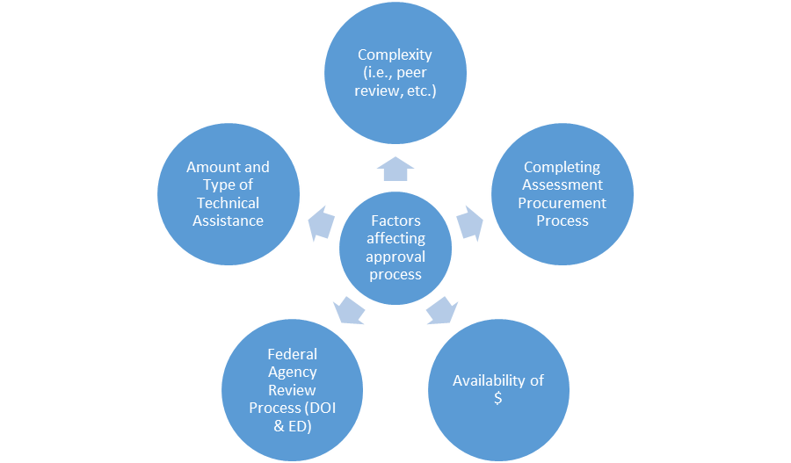
FACTORS AFFECTING WAIVER TIMELINE

Slide 20
OPTION A – REQUESTING TO WAIVE STANDARDS AND ASSESSMENTS
Note: A Tribe/School Board may request to waive either BIE's standards and assessments (together), or BIE's standards, assessments and accountability system in whole.
A Tribe/School Board should not request to waive only standards or only assessments.

Slide 21
OPTION A – REQUESTING TO WAIVE STANDARDS AND ASSESSMENTS
Examples:
Replacing the BIE Assessment with another assessments that is off-the-shelf, peer reviewed, and is aligned to content standards being used (e.g. standards and assessments of the State the Tribe is in)
Replacing the BIE Assessment with ACT in high school.
Timeline for approval is approximately a few weeks to 6 months, depending on the request and whether funds are needed. Highly recommend waiver comes in by November 2022.

Slide 22
EXAMPLES OF OPTION B –REQUESTING TO WAIVE STANDARDS, ASSESSMENTS AND ACCOUNTABILITY
Replacing a peer-reviewed assessment like WIDA with a new customized assessment where new test items need to be developed
Designing a separate accountability system
Timeline for approval is approximately 1 year or longer, depending on the request and whether funds are needed.

Slide 23
RECOMMENDED SUBMISSION TIMELINE:
Recommended Timeline for Waiver Submission – Submit by or before November of the same school year (SY), i.e., November 2022 for SY 2022-2023
Include and attach an MOU with State if using their assessments including Data Sharing agreement to meet the BIE accountability requirements.
Waivers must be submitted to:
CC: Tamarah Pfeiffer, BIE Chief Academic Officer and Adyel Duran, Office of School Support and Accountability, U.S. Department of Education
Tony L. Dearman
BIE Director
Bureau of Indian Education
U.S. Department of the Interior
1849 C Street, NW
Washington, DC 20240
James F. Lane, Ed.D.
Senior Advisor, Office of the Secretary
Delegated the Authority to Perform the Functions and Duties of the Assistant Secretary
Office of Elementary and Secondary Education
U.S. Department of Education
400 Maryland Ave, SW
Washington, DC 20202

Slide 24
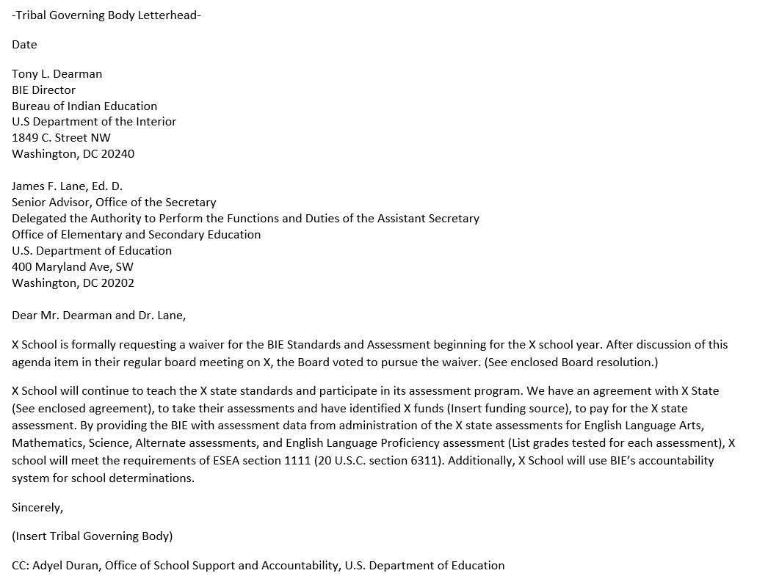
EXAMPLE OF A LETTER TO WAIVE STANDARDS AND ASSESSMENTS
EXAMPLE

Slide 25
POINTS OF CONTACT
Dr. Tamarah Pfeiffer
Chief Academic Officer
tamarah.pfeiffer@bie.edu
Adyel Duran
Program Officer, Title I, Part A
US Department of Education
OESE.TitleI-A@ed.gov

Slide 27

End of Day Survey

