Slide 1
Video reflection activity
Summer Leadership Academy
SEL: A Guide for Leaders

Slide 2
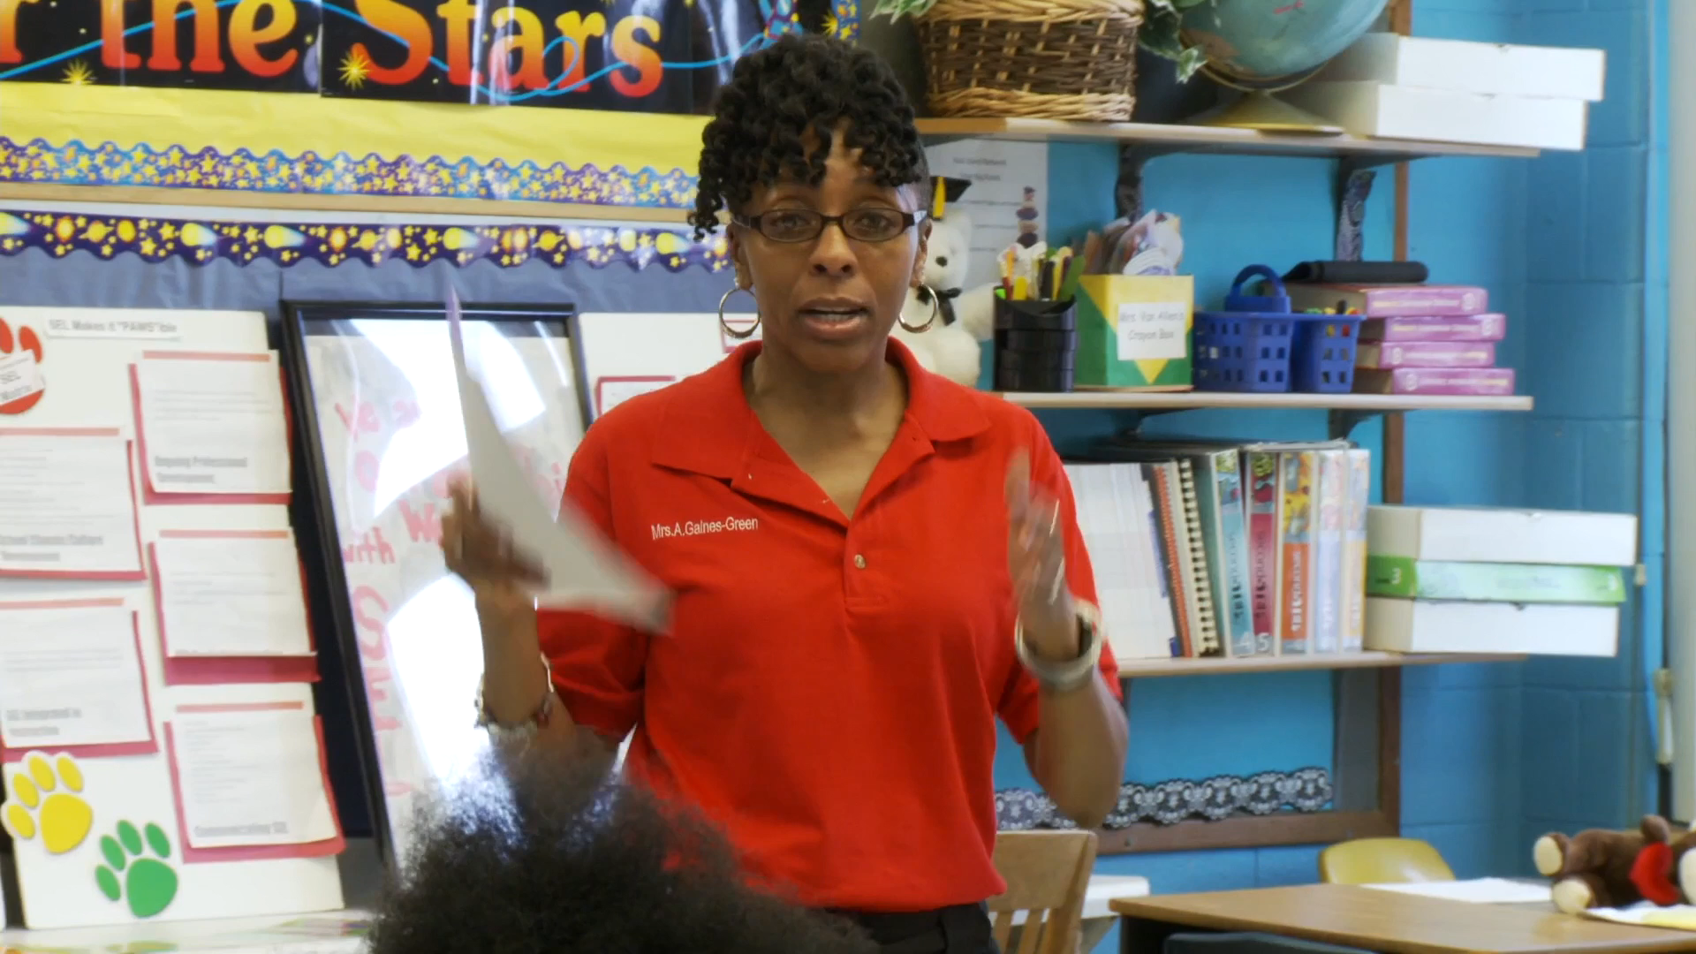
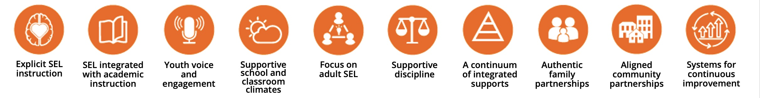
Marcus garvey elementary school
ChicagO
Think/Ink/Share
As you watch:
What indicators did you notice that Marcus Garvey has in place?
What work do you think the school did to put those indicators into place?
Notes:
Additional videos: Indicators of Schoolwide Social and Emotional Learning - YouTube

Slide 3
School reflection
Highlight, note, and discuss:
What are areas of strength for your school? Why?
What are areas of growth for your school? Why?
Which areas do you believe are the most important for your school at this moment? Why?
Note: Use the Reflection Rubric to support your work.
Notes:
Small group conversations using Schoolwide SEL Reflection Rubric

