Slide 1
FERS
Federal Employees Retirement System
Overview

Slide 2
“to DREAM of retirement is good, to plan for retirement is better!”

Slide 3
Agenda
Retirement Systems
Leave and Earnings Statements(LES)
Electronic Official Personnel File (eOPF)
Standard Form 50 (SF-50)
Types of Retirement
Civilian Deposits / Redeposits
Military Deposits
Unused Sick Leave
Annuity Computation
Retirement Application Forms
Survivor Annuity Election
FEHB
FEGLI
FEDVIP/FSA/FLTCIP
TSP
Estimates & Retirement Process

Slide 4
Retirement systems
FERS | FERS-RAE | FERS-FRAE
Effective 01/01/1987 3-tier benefit package Basic Annuity Thrift Savings Plan Social Security Employee contributes: FERS 0.8% Social Security 6.2% Medicare 1.45% | Effective 01/01/2013 3-tier benefit package Basic Annuity Thrift Savings Plan Social Security Employee contributes: FERS-RAE 3.1% Social Security 6.2% Medicare 1.45% | Effective 01/01/2014 3-tier benefit package Basic Annuity Thrift Savings Plan Social Security Employee contributes: FERS-FRAE 4.4% Social Security 6.2% Medicare 1.45%

Slide 5
FERS
FERS is a 3-tiered retirement system
FERS annuity (pension) is the smallest component
TSP is expected to make up the largest portion of your total retirement
Thrift Savings Plan
Social Security
FERS Annuity
(Possible FERS Annuity Supplement up to age of 62)

Slide 6
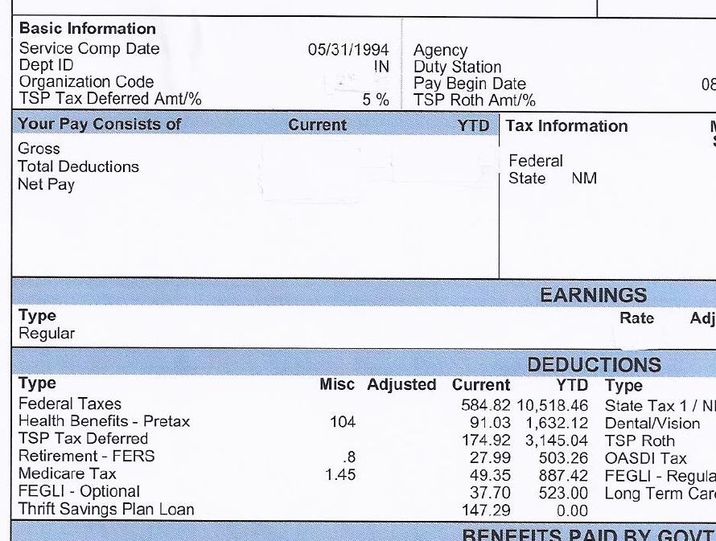
Earnings and Leave Statement

Slide 7
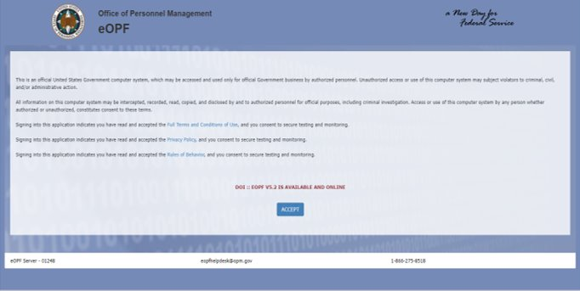
EOPF
Electronic Official Personnel File
eOPF Website: https://eopf.opm.gov/doi/

Slide 8
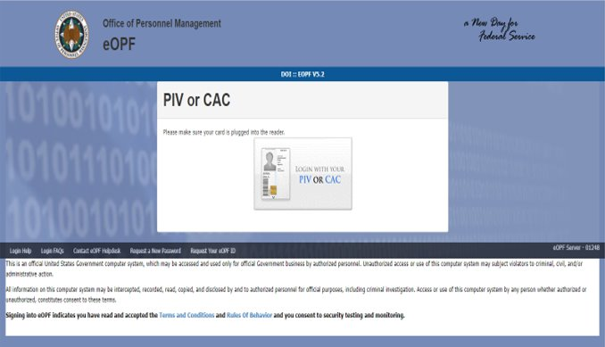
EOPF
Electronic Official Personnel File
eOPF Website: https://eopf.opm.gov/doi/

Slide 9
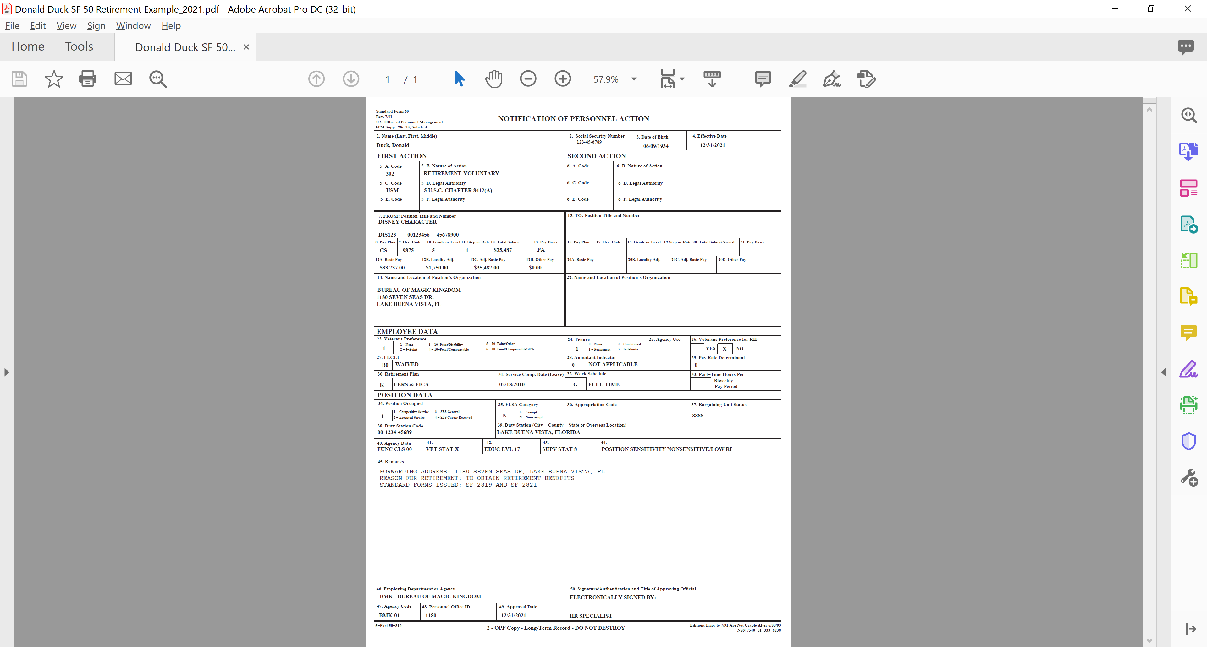
Standard Form 50 (SF 50)

Slide 10
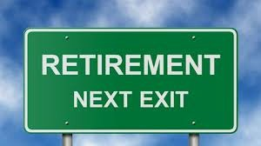
retirements

Slide 11

General eligibility
Have at least 5 years of creditable civilian service with the Federal government
Meet Minimum Retirement Age (MRA)
Must separate from a position subject to FERS coverage

Slide 12
RSCD
Retirement Service Computation Date
Used to determine retirement eligibility and to calculate retirement annuity (Pension)
May not be the same as your Leave SCD (SCD that appears on your SF 50 & LES)
Not all service that is creditable for leave is creditable for retirement
School year employees will receive full credit during summer months so long as their leave without pay (LWOP) does not exceed 6 months of non-pay in a calendar year. LWOP in excess of 6 months in a calendar year, will impact your RSCD.

Slide 13
Minimum retirement age
Year of Birth | MRA is Age
Before 1948 | 55
1948 | 55 & 2 Months
1949 | 55 & 4 Months
1950 | 55 & 6 Months
1951 | 55 & 8 Months
1952 | 55 & 10 Months
1953 -1964 | 56
1965 | 56 & 2 Months
1966 | 56 & 4 Months
1967 | 56 & 6 Months
1968 | 56 & 8 Months
1969 | 56 & 10 Months
1970 & After | 57

Slide 14
Types of retirement
Optional Retirement
Deferred Retirement
Disability Retirement

Slide 15
Optional retirement
Also Referred as a Voluntary Retirement
Minimum Retirement Age (MRA) with 30 years service
60 years of age with 20 years service
62 years of age with 5 years service
MRA with at least 10 years but not more than 30 years service:
5% reduction for each year under age 62 (permanent reduction)
NOT entitled to an annuity supplement
Annuity accrues on the first day of the following month of your retirement

Slide 16
MRA+10
Postponing Retirement Benefits
You can reduce or eliminate the 5% age reduction by postponing the commencing date of your MRA+10
FEHB and FEGLI coverage may be reinstated prospectively if at time of separation you were eligible to continue coverage into retirement
Sick leave is creditable in the computation of the annuity
Must elect to have annuity commence on any day after the first day of any month following separation up to and including the second day before turning age 62

Slide 17
Deferred retirement
Leaving Federal Service Before Eligible for Immediate Annuity
Receive a deferred annuity at age 62 with at least 5 years service or at MRA with at least 10 years of service (5% age reduction) IF:
You are not eligible for an immediate annuity within 1 month of separation
You meet the minimum 5 years of creditable civilian service requirement at the time of separation
You do not take a refund of your retirement deductions after separating from Federal service
FEHB and FEGLI will NOT be reinstated at the time your annuity commences. Application is sent directly to OPM
NOTE: FERS annuity supplement is NOT payable

Slide 18
Disability retirement
Disability – Unable to render useful and efficient service because of disease or injury
Must be in a position covered by FERS
Minimum of 18 months creditable civilian service
Medical condition is expected to continue for at least 1 year.

Slide 19
Disability annuity amount
If under age 62 at separation:
First 12 Months:
60% x high 3 salary – 100% of Social Security Benefits
After 12 Months:
40% x high 3 salary – 60% of Social Security Benefits
Disability annuity is recomputed at age 62 to an amount that represents the annuity you would have received if you had continued working until the day before your 62nd birthday and then retired under non-disability provisions

Slide 20
Disability annuity amount
You will receive an “earned annuity” based upon the general FERS computation formula as opposed to disability calculation if:
You are 62 years old or older
Meet the age and service requirements for regular, unreduced immediate retirement (MRA with 30 years, age 60 with 20 years)

Slide 21
Disability retirement
Not eligible for a FERS annuity supplement
Required to apply for Social Security Benefits
Submit all forms for regular retirement
Plus:
  SF 3112A – Applicant’s Statement of Disability
  SF 3112B – Supervisor’s Statement
  SF 3112C – Physician’s Statement
  SF 3112D – Agency Certification of Reassignment and Accommodation Efforts
  FedMER Eligibility Statement or proof that applied for Social Security Disability
  Medical Records that support your claim
  Most Recent Appraisal
  Current Job Description

Slide 22

Civilian deposit / redeposit

Slide 23
Deposit service
Retirement Was Not Withheld
Any period of potentially creditable service during which retirement deductions are not withheld:
Generally, non-career time such as temporary or indefinite service
Also known as non-deduction service
Service that is now considered Federal employment, due to a change in the law that allows credit for retirement annuity computation purposes (Peace Corps, VISTA)

Slide 24
Deposit service
Non-Deduction Service prior to 01/01/1989
Deposit Made
Deposit Not Made
Credit for eligibility (RSCD) and Annuity Computation
No Credit for eligibility (RSCD) or Annuity Computation

Slide 25
Deposit service
Non-Deduction Service on or after 01/01/1989
Deposit NOT Allowed
No Credit for Eligibility or Annuity Computation

Slide 26

redeposit service
What is Redeposit Service?
A sum of money paid into the Retirement System by an employee or survivor to cover a period of service during which deductions were withheld but later refunded.
Cost is the amount of refund plus interest

Slide 27
redeposit service
Refunded FERS Service
Redeposit Made
Redeposit Not Made
Credit for eligibility (RSCD) and Annuity Computation
Credit for eligibility (RSCD) and No Credit in Annuity Computation

Slide 28

Military Deposits
Military Buyback / Post 56

Slide 29
Military Deposits
Title 10 Service – called to service by the President (Active Duty or Reserve Time)
Title 32 Service – service under the State (Service Schools, NCO and Officer Courses usually fall under Title 32). Not creditable unless under USERRA Law
Must be Honorable
DD 214 with character of service
Military Orders MUST be accompanied by statement of service which reflects character of service and time lost

Slide 30
Military Deposits
In Receipt of Military Retired Pay
Based on Non – Combat Disability or Length of Service
Based on Combat Disability or Chapter 1223, Title 10 (Reserves)
No Credit unless military retired pay is waived & deposit is paid
Must pay to receive credit for Eligibility (RSCD) & annuity computation

Slide 31
Military Deposits
Military Service on/after 01/01/1957
Must pay to receive credit for eligibility (RSCD) & annuity computation
Amount of Deposit:
3% of basic pay earned + interest (2 years interest free) (Interest will vary)

Slide 32
Paying Military deposits
Military deposits MUST be paid in full prior to separation
Complete RI 20-97, Estimated Earnings During Military Service, and send to the appropriate military finance center. Include copies of all your DD 214s with character of service.
Upon receipt of estimated earnings (ensure dates are correct) forward to your Benefits Specialist. Your Benefits Specialist will calculate an estimate of the deposit owed and retirement estimates with and without the military service.
IBC will issue a paid in full letter once last payment is received. Provide a copy to Benefits Specialist to be added to EOPF.
More Information is available at https://www.opm.gov/retirement-services/fers-information/service-credit/#military

Slide 33
Unused leave
Annual Leave
(All T-5 Employees)
Annual Leave is paid out approximately 2 pay periods after separation
Vacation Leave
(Year Long T-25 Employees)
Leave unused at the time of separation will be forfeited.
Personal Leave
(School Year T-25 Employees)
Leave is paid out approximately 2 pay periods after separation if you complete your School Year contract

Slide 34

Unused sick leave
Must retire on an immediate annuity or postponed annuity
Added to length of service for computation purposes only
Additional time computes on the basis of a 2087-hour work year

Slide 35
sick leave chart
DAYS | 1 Day | 1 Month | 2 Months | 3 Months | 4 Months | 5 Months | 6 Months | 7 Months | 8 Months | 9 Months | 10 Months | 11 Months
0 1 2 3 4 5 | 0 6 12 17 23 29 | 174 180 186 191 197 203 | 348 354 359 365 371 377 | 522 528 533 539 545 551 | 696 701 707 713 719 725 | 870 875 881 887 893 899 | 1044 1049 1055 1061 1067 1072 | 1217 1223 1229 1235 1241 1246 | 1391 1397 1403 1409 1415 1420 | 1565 1571 1577 1583 1588 1594 | 1739 1745 1751 1757 1762 1768 | 1913 1919 1925 1930 1936 1942
6 7 8 9 10 | 35 41 46 52 58 | 209 214 220 226 232 | 383 388 394 400 406 | 557 562 568 574 580 | 730 736 742 748 754 | 904 910 916 922 928 | 1078 1084 1090 1096 1101 | 1252 1258 1264 1270 1275 | 1426 1432 1438 1444 1449 | 1600 1606 1612 1617 1623 | 1774 1780 1786 1791 1797 | 1948 1954 1959 1965 1971
11 12 13 14 15 | 64 70 75 81 87 | 238 243 249 255 261 | 412 417 423 429 435 | 586 591 597 603 609 | 759 765 771 777 783 | 933 939 945 951 957 | 1107 1113 1119 1125 1130 | 1281 1287 1293 1299 1304 | 1455 1461 1467 1472 1478 | 1629 1635 1641 1646 1652 | 1803 1809 1815 1820 1826 | 1977 1983 1988 1994 2000
16 17 18 19 20 | 93 99 104 110 116 | 267 272 278 284 290 | 441 446 452 458 464 | 615 620 626 632 638 | 788 794 800 806 812 | 962 968 974 980 986 | 1136 1142 1148 1154 1159 | 1310 1316 1322 1328 1333 | 1484 1490 1496 1501 1507 | 1658 1664 1670 1675 1681 | 1832 1838 1844 1849 1855 | 2006 2012 2017 2023 2029
21 22 23 24 25 | 122 128 133 139 146 | 296 301 307 313 319 | 470 475 481 487 493 | 643 649 655 661 667 | 817 823 829 835 841 | 991 997 1003 1009 1015 | 1165 1171 1177 1183 1188 | 1339 1345 1351 1357 1362 | 1513 1519 1525 1530 1536 | 1687 1693 1699 1704 1710 | 1861 1867 1873 1878 1884 | 2035 2041 2046 2052 2058
26 27 28 29 | 151 157 162 168 | 325 330 336 342 | 499 504 510 516 | 672 678 684 690 | 846 852 858 864 | 1020 1026 1032 1038 | 1194 1200 1206 1212 | 1368 1374 1380 1386 | 1542 1548 1554 1559 | 1716 1722 1728 1733 | 1890 1896 1901 1907 | 2064 2070 2075 2081

Slide 36
example
Computing Total Service with Unused Sick Leave
TOTAL SERVICE
2024-12-31 (DOR)
- 1992-03-12 (RSCD)
32-09-19
+ 00-06-16
Unused Sick Leave
1136 hours = 6 m 16 d
32-15-35 =
33-04-05

Slide 37
High-3 average salary
Weighted average of highest 3 years of basic pay (including locality pay / local market supplement)
Must be 3 consecutive years and is usually the last 3 years
Is the highest salary, not the highest grade
Normally, the beginning date of the 3-year period is determined by subtracting 3 years from the date of retirement
School Year and Short-Term Contracts:
  MDR x # Paid Days= Annual Salary + Short Term contracts worked after School Year = Higher Annual Salary
  PH Rate x Hours Per Day x Paid Days = Annual Salary + Short Term contracts worked after School Year = Higher Annual Salary

Slide 38

Annuity computation
Formula for Computing Annuity for Voluntary Retirement
High-3 avg salary X 1.0% X years and months of service
High-3 avg salary X 1.1% X years and months of service, IF you retire at or after age 62 with 20 + years of service

Slide 39
Annuity computation
Example:
  20 years service, age 60 = 20% of high-3 average salary
  $50,000 high-3 x 20% = $10,000 annual annuity ($833/month)
Work 2 more years and receive 1.1%
  22 years service, age 62 = 24.2% of high-3 average salary
  $50,000 high-3 x 24.2% = $12,100 annual annuity ($1,008/month)

Slide 40
Fers annuity supplement
An estimated amount of Social Security benefits earned during FERS service
Benefits paid until age 62 to certain FERS employee who retire before age 62 and are entitled to an immediate annuity
Must have at least 1 calendar year of FERS service
Not eligible for supplement:
  Disability retiree
  MRA+10
  Deferred
  Retiring at age 62 or older
  CSRS

Slide 41

Fers annuity supplement
Supplement is tested for earnings above the Social Security exempt amount ($22,320 for 2024)
Earnings include wages and self-employment income
Income from severance pay (including VSIP), pensions, savings and investments are NOT subject to the earnings test
Annuity supplement will be offset by $1 for every $2 over this amount

Slide 42
Best Date to retire
As a FERS Title 25 contract education employee, the best day to retire is the last day of your contract, so that you do not break the contract. Your annuity will commence the first day of the month following your retirement date.
As a FERS Title 5 employee the best day to retire is the last day of the month you plan to retire. Your annuity will commence the first day of the month following your retirement date.

Slide 43
Retirement forms
Request retirement application packet from your servicing Benefits Specialist
  SF 3107 Application for Immediate Retirement
  SF 3107 Schedule A, B, C
  SF 3107-1 Certified Summary of Federal Service
  SF 3107-2 Spousal Consent for Survivor Election
  SF 2818 Continuation of Life Insurance Coverage
  W-4P and State Tax withholding forms
  Copy of marriage certificate, if married
  SF 2823 Designation of Beneficiary (FEGLI), optional
  SF 3102 Designation of Beneficiary (CSRS/FERS), optional

Slide 44
Reductions & Deductions
Reductions:
Age Reduction (MRA+10)
Election of Survivor Benefits
Part-time Proration
Deductions:
Health Insurance
Life Insurance
Taxes
Federal Employee Dental and Vision Program (FEDVIP)
Federal Long Term Care Insurance Program (FLTCIP)

Slide 45
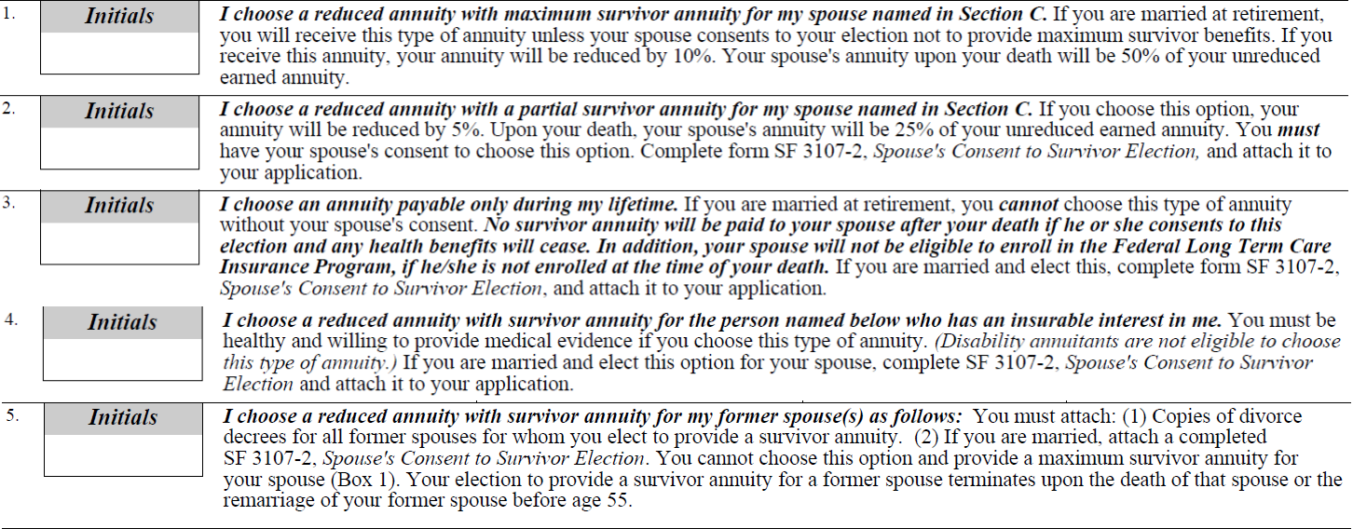
Survivor elections
An election MUST be made. If you are single
And not leaving a survivor annuity
please initial block 3

Slide 46
Survivor benefit
Cost / Reduction
Full/Max (50%) = 10% of annuity
Partial (25%) = 5% of annuity
Example: Maximum (50%) Elected
Basic Annuity = $12,000
$12,000 X 10% = - 1,200 yearly cost
After Reduction = $10,800 yearly annuity
Survivor will receive 50% of annuity = $6,000
Example: Partial (25%) Elected
Basic Annuity = $12,000
$12,000 X 05% = - 600 yearly cost
After Reduction = $11,400 yearly annuity
Survivor will receive 25% of annuity = $3,000

Slide 47

Survivor benefit payments
The survivor benefit is payable for life unless the survivor remarries before the age of 55
Benefits will be restored if the remarriage terminated in death, annulment or divorce

Slide 48

beneficiary
Beneficiary Forms:
SF 2823 (FEGLI)
SF 3102 (FERS)
Order of Precedence:
Court Order
Designation of Beneficiary
Widow or Widower
Children (and/or descendants of deceased children)
Parents
Executor or Administrator of Estate
Next of Kin
TSP Beneficiary Designation:
www.tsp.gov (My Account)
ThriftLine: 1-877-968-3778
Email at thriftline@tsp.gov

Slide 49
cola
Cost of Living Adjustments
Effective 1 Dec each year
Payable in Jan (1/12th of COLA for each month)
Must be 62 or older to receive
Disability annuitants and survivors receive COLA at any age

Slide 50

FEHB
Federal Employees Health Benefits
Self Only
Self & Family
Self Plus One
Additional Information:
https://www.opm.gov/healthcare-insurance/healthcare/
OPM Telephone: 1-888-767-6738

Slide 51
FEHB
To take FEHB into retirement you MUST:
Retire on an immediate annuity
Be insured on the date of retirement
Be covered for the 5 years of service prior to retirement or since your FIRST opportunity to enroll
Coverage as a family member under FEHB or TRICARE counts toward the 5-year requirement (employee must be enrolled in FEHB prior to retirement)

Slide 52
FEHB
Cost of FEHB is the same for retirees and active employees except that premiums are paid on a monthly vs bi-weekly basis
Same Open Season and Qualifying Life Event (QLE) opportunities as active employees
Same FEHB plans available
Once you cancel FEHB in retirement, you can never re-enroll
Retirement is not a QLE for changing your FEHB enrollment
At age 65, enrollment in Medicare is optional, however, if enrolled in Medicare it becomes your primary and FEHB becomes secondary

Slide 53
FEHB
Retirees can suspend FEHB for TRICARE, Medicaid (or similar state sponsored program) or Medicare Advantage (Medicare Part C) and return to FEHB coverage during Open Season or immediately upon involuntarily losing non-FEHB coverage
Retirees DO NOT participate in Premium Conversion
Your spouse is eligible to continue FEHB coverage after your death only if you have them covered and you elect to provide a survivor benefit at retirement

Slide 54

medicare
Part A (Hospitalization) – No Cost
Enroll at age 65
Enrollment is automatic at age 65 if you are receiving Social Security Benefits
Part B (Medical) – Monthly premium based on yearly adjusted gross income
Part C – A plan offered by a private company
Part D (Drug) – Monthly premium
https://www.medicare.gov/
Phone 1-800-633-4227

Slide 55

fegli
Federal Employees’ Group Life Insurance
Additional Information:
https://www.opm.gov/healthcare-insurance/life-insurance/
OPM Telephone: 1-888-767-6738

Slide 56

fegli
Continuation into Retirement
Retire on an immediate annuity
Insured on the date of retirement
Enrolled in each Option and Multiple for the 5 years of service prior to retirement OR since your FIRST opportunity to enroll
Election Form: SF 2818 – Continuation of Life Insurance

Slide 57
fegli
Basic Life Insurance Options
Basic Insurance Amount (BIA) is your final annual salary rounded up, plus $2,000.
75% Reduction | Basic Insurance Amount reduces 2% per month at age 65 until 25% remains
50% Reduction | Basic Insurance Amount reduces 1% per month at age 65 until 50% remains
No Reduction | Basic Insurance Amount remains the same

Slide 58
fegli
Basic Life Insurance Options:
OPTIONS
BEFORE AGE 65
AFTER AGE 65
75% reduction
BIA x 0.3467 (per $1,000)
NO COST
50% reduction
BIA x 1.0967 (per $1,000)
BIA x .75 (per $1,000)
NO reduction
BIA x 2.5967 (per $1,000)
BIA x 2.25 (per $1,000)

Slide 59
FEGLI EXAMPLE
Monthly Cost: $50,000 Basic Life Insurance
Basic Life Insurance | Before Age 65 | After Age 65 | BIA after age 65
75% Reduction | $17.34 | Free | Reduces 2% per month until $12,500 (37.5 months)
50% Reduction | $54.84 | $37.50 | Reduces 1% per month until $25,000 (50 months)
No Reduction | $129.84 | $112.50 | $50,000

Slide 60
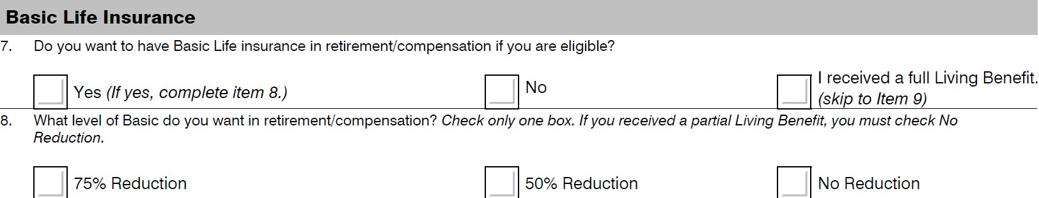
fegli
Basic Life Insurance Elections

Slide 61
fegli
Option A Standard Coverage ($10,000)
Age Group | Monthly Cost
Under 35 | $0.43
35 through 39 | $0.43
40 through 44 | $0.65
45 through 49 | $1.30
50 through 54 | $2.17
55 through 59 | $3.90
60 through 56 | $13.00
65 and above | No Cost
At age 65 coverage reduces by 2% per month for 37.5 months until it reaches $2,500

Slide 62
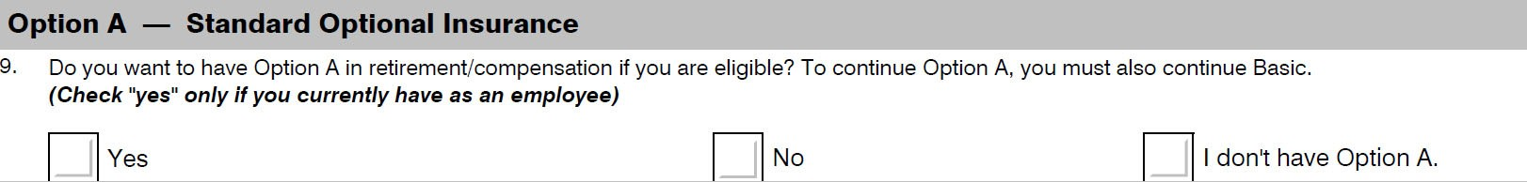
fegli
Option A Elections

Slide 63
fegli
Option B (1-5 Multiples of Pay)
Option B – Ex: Annual Salary $51,400 1x Multiple elected = $52,000
Age Group | Cost per $1,000
Under 35 | $0.043
35 through 39 | $0.043
40 through 44 | $0.065
45 through 49 | $0.130
50 through 54 | $0.217
55 through 59 | $0.390
60 through 64 | $0.867
65 through 69 | $1.040
70 through 74 | $1.863
75 through 79 | $3.900
80 and above | $6.24

Slide 64
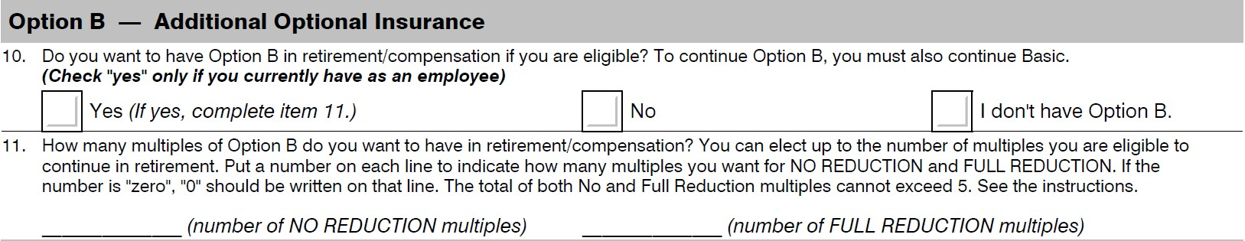
fegli
Option B Elections
Full Reduction: At age 65, no cost & coverage reduces by 2% per month for 50 months at which time coverage will end
No Reduction: Coverage and premiums will continue

Slide 65
fegli
Option C: Family Coverage (1-5 Multiples)
Spouse = $5,000 (1 x Multiple) / Each Child = $2,500 (1 x Multiple)
Age Group | Monthly Cost per Multiple
Under 35 | $0.43
35 through 39 | $0.52
40 through 44 | $0.80
45 through 49 | $1.15
50 through 54 | $1.80
55 through 59 | $2.88
60 through 64 | $5.27
65 through 69 | $6.13
70 through 74 | $8.30
75 through 79 | $12.48
80 and above | $16.90

Slide 66
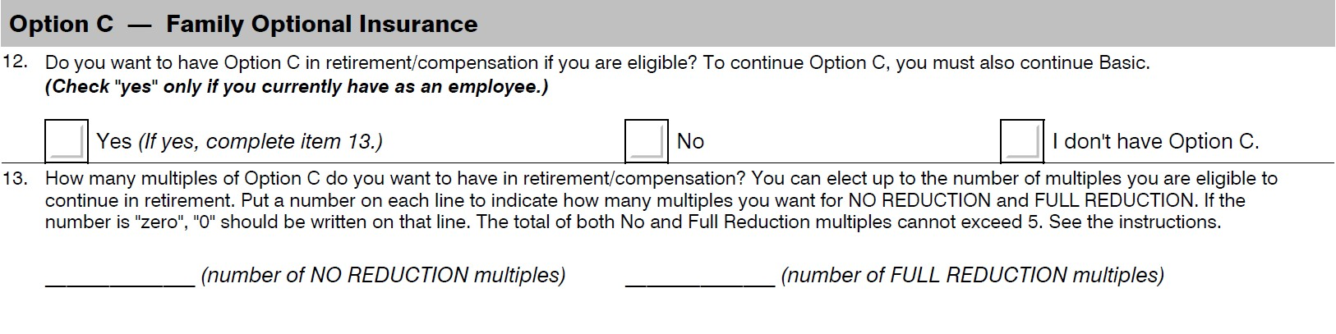
fegli
Option C Elections
Full Reduction: At age 65, no cost & coverage reduces by 2% per month for 50 months at which time coverage will end
No Reduction: Coverage and premiums will continue

Slide 67
fedvip
Federal Employees Dental & Vision Insurance Program
No five (5) year enrollment requirement
Can enroll during Open Season after you retire even if you were never enrolled
Can enroll in dental, vision or both
Phone:
1-877-888-FEDS (1-877-888-3337)
TTY: 1-877-889-5680
Mail:
BENEFEDS–FEDVIP
P.O. Box 797
Greenland, NH 03840-0797
https://www.benefeds.gov/

Slide 68

fsa
Flexible Spending Accounts
Retirees are NOT eligible to continue FSA and CANNOT participate after retirement
Phone:
1-877-372-3337
TTY: 1-800-952-0450
Call Center Hours:
Monday – Friday
9 a.m. - 9 p.m.(ET)
Closed Saturday - Sunday and Federal holidays.
https://www.fsafeds.gov

Slide 69

LTCI
Long Term Care Insurance
Phone:
1-800-582-3337
TTY: 1-800-843-3557
Call Center Hours:
Monday - Friday
8 a.m. - 6 p.m. (ET)
Closed Saturday - Sunday and Federal holidays
https://www.ltcfeds.gov

Slide 70

tsp
Thrift Savings Plan
Thriftline: 1-877-968-3778
Email: thriftline@tsp.gov
Monday through Friday
7:00 a.m. – 9:00 p.m. ET
Thrift
Savings
Plan
https://www.tsp.gov

Slide 71

tsp
Automatic cash out (accounts less than $200)
Leave money in the TSP
Partial distribution of a specified amount
Total distribution
Annuity Purchase
Installments (automatic withdrawals)
https://www.tsp.gov/withdrawals-in-retirement/
To request a withdrawal or distribution log in to My Account or contact the ThriftLine at 877-968-3778

Slide 72

Retirement planning

Slide 73
Steps to retire
Request a retirement estimate
  Retirement application forms are included for estimate dates within one year
Review estimate and write down questions
Schedule a consultation
  Virtual or in-person (must have appointment)
  Bring estimate packet and questions
  Social Security and TSP statements optional
Complete application forms if not done during consultation
  Forms can be signed electronically or in ink
  No errors, white-outs, cross-outs, etc.
Submit completed forms to Benefits Specialist by email or mail 3-4 months in advance of retirement date

Slide 74
Retirement estimates
Request your retirement estimate 5 years prior to your retirement eligibility date
Can request updated retirement estimate every 3 years
Retirement estimates include:
Verification of military service & civilian service documented in your electronic Official Personnel Folder (eOPF)
Calculation of amount of civilian deposit and/or redeposit
Impact of unpaid civilian deposit/redeposit & military deposit on your retirement annuity
Confirmation of your current FEHB & FEGLI enrollment & your eligibility to continue these into retirement

Slide 75
Preparing for retirement
To determine how prepared you are for retirement, ask yourself the following questions:
  Do I know when I am eligible to retire?
  What amount am I expecting per month in retirement?
  How much per paycheck am I putting into my retirement fund?
  Am I participating in TSP to supplement my retirement fund?
  How much can I get from Social Security at age 62?
  My full retirement age with Social Security is_____?

Slide 76
Retirement timeline
3-5 years prior to retirement:
Contact your Benefits Specialist for a retirement estimate and retirement information
Call or email your Benefits Specialist with questions on retirement estimate/schedule a retirement consult
120-180 days prior to retirement:
Complete the retirement forms
Call or email your Benefits Specialist for assistance with the retirement forms
90-120 days prior to retirement:
Submit your retirement forms
Maintain a personal copy for your records
Benefits Specialist verifies application is complete and error free and sends out retirement receipt, final exit clearance form, OPM Retirement Quick Guide, etc.
Incomplete or late applications may delay processing of your application and receipt of first retirement payment from OPM

Slide 77
Retirement Process
Changing or Withdrawing
Your request to change your date of retirement or to withdraw your retirement application must be in writing AND
Must be signed and dated
May be emailed or faxed to your Benefits Specialist
Submit request to your Benefits Specialist as soon as you have decided. No later than midnight of date of retirement.
Changing or withdrawing your retirement MAY cause problems with your paycheck

Slide 78
Process after retirement
2 – 4 Weeks after retirement:
Final paycheck is received
Lump sum annual / summer proration is paid
Approximately 4 – 6 weeks after retirement:
Receive 1st Interim payment (approximately 75%-80%)
Receive letter from OPM with Civil Service Annuitant (CSA) number
Be prepared for interim pay status to last 6 months
No FERS Supplement while in interim pay
Can begin TSP withdrawal process 30 days after retirement
    Contact Benefits Specialist if TSP shows you as active

Slide 79
Contact Information
Retirement Benefits Inquiries Contact:
Email: Bie-benefits@bia.gov
Vacant Phone: Service Areas: New Mexico, Arizona Navajo North, Utah Mailing Address: Interior-Bureau of Indian Education 1011 Indian School Rd NW, Suite 150 Albuquerque, NM 87104 | Stephanie Blanken Phone: (785) 830-2731 Service Areas: Arizona Navajo South, Arizona Navajo Central, Havasupai, Oklahoma, North & South Dakota, California, Oregon, Montana, Wyoming, HR Office Mailing Address: Interior-Bureau of Indian Education 155 Indian Ave Human Resources #5021 Lawrence, KS 66046

Slide 80

Connect With Us

Slide 81

Thank you!
Any questions?

