Slide 1
Introduction & Step 1
<Insert Date>
Presenter: <Insert Presenter’s Name>
<Insert Presentation Time>

Slide 2
Training Overview
Introduction
Participation requirements
FET Tool Orientation
Distribution of username & passwords
Scheduled FET Trainings & Completion Dates for FET Step(s)
Question(s) & Answer(s)

Slide 3
Introduction
Strengthen your school’s Community & Family Engagement effort
Assist with meeting Title I Parental Involvement requirements

Slide 4
Preparing for FET:
LEAD: Designate your facilitator and team lead. This is typically Parent Liaison
RECRUIT: Send out announcement to participate in the team
PLAN: Send schedule of trainings (5 dates) which should occur every 2 weeks.
COMMITMENT: This takes commitment from all team members

Slide 5
Time Commitment:
The time investment necessary to complete the analysis process is approximately 5 to 10 hours.
Meeting Options:
5 meetings of 90 minutes each.
Meet twice for longer amounts of time, maybe 3 hours each meeting.

Slide 6
Welcome to the
Family Engagement Tool Orientation
Created by:

Slide 7
Orientation Objectives:
Provide an overview of the Family Engagement Tool web based system for the School Improvement Team to utilize.
2. Demonstrate how the tool is used on the website.
3. Answer any questions at the end of the session.

Slide 8
Purpose:
The Family Engagement guides a school‐based team through an inventory and self‐assessment of parent involvement policies and practices, resulting in objectives for improvement that can become part of the school improvement plan.

Slide 9
The School Team:
The team may be an existing team (school improvement team) or a team formed especially to conduct the analysis.
A typical team should include the principal, school staff, and parents.
A least half of the members of the team should be parents of currently enrolled students and not employed by the school or district.

Slide 10
Tools for the Team:
The principal/team leader prints out the needed worksheets from the website
Makes copies for team members
The team discusses and completes the
worksheets at the meeting
The principal/team leader records the completed version in the online system

Slide 11
Walk Through the Family Engagement Tool

Slide 12
Access FET:
Native Star Userid & Password (Process Manager & Principal) LIMITED ACCESS
ELO will submit request to Family Engagement Coordinator at DPA to have the “icon” turned on
Select Icon “Family Engagement Tool”
Email: valerie.todacheene@bie.edu if you have problems.

Slide 15
What are the 5 steps in the Family Engagement Tool?

Slide 16
Main Menu
Quality resources for the school and the team

Slide 17
Before you Begin….

Slide 18
TEAM ORIENTATION
Purpose/Goals of FET for your school
Team Members roles/responsibilities
Talk about Participation Requirement(s) with your team
Attend WebEx session(s)/Trainings
Actively participate & complete the steps
Team consists of parent(s), principal, school staff
Attend Face-to-Face training
Address assessment results
Review Agenda & Training Dates

Slide 19
Team Orientation Presentation
Click on “Team Orientation” which will provide an overview for your Family Engagement Team members.

Slide 20
The team leader completes the Enter/Edit School Information with principal.
Step 1
School and District Contact Information
Demographics
School Personnel
School Grades Levels and Enrollment
State Standards Assessment Scores

Slide 21
The team leader completes the Enter/Edit School Information with principal. Team will review responses.
Series of questions on the various building blocks that is the current practice of the school in current Parent Involvement Practices
Shared Leadership
Goals and Roles
School-Home Communication
Education
Connection
Step 2

Slide 22
Gather Documents & Complete Analysis
Step 3
Gather Key Documents: The team leader gathers the key documents with the principal which will be analyzed by the team.
School Parent Involvement Policy*
Compact*
Homework Guidelines
Student Report Card
Classroom Visit Procedures
Homeless/McKinney Vento Policy*
*Title I documents/McKinney Vento Requirements

Slide 23
Analyze Documents: The team leader distributes the key documents to the team, and the members will evaluate each document with the rubric provided in this step.

Slide 24
Analyze Homeless Policy: (refer to PDF)
Creating an overall Goal or Statement
Creating a definition of homelessness
Stating the rights of the students and families
Distributing information on the school’s homeless policy
Creating enrollment policy and procedures
Creating and collecting student records
Maintaining and transfer of records
Providing Information for student and family
Coordinating services with BIE, prior school, liaison, and support services
Providing a liaison
Explaining rights of Student and Family to a liaison
Providing professional development on homelessness
Handling of disputes

Slide 25
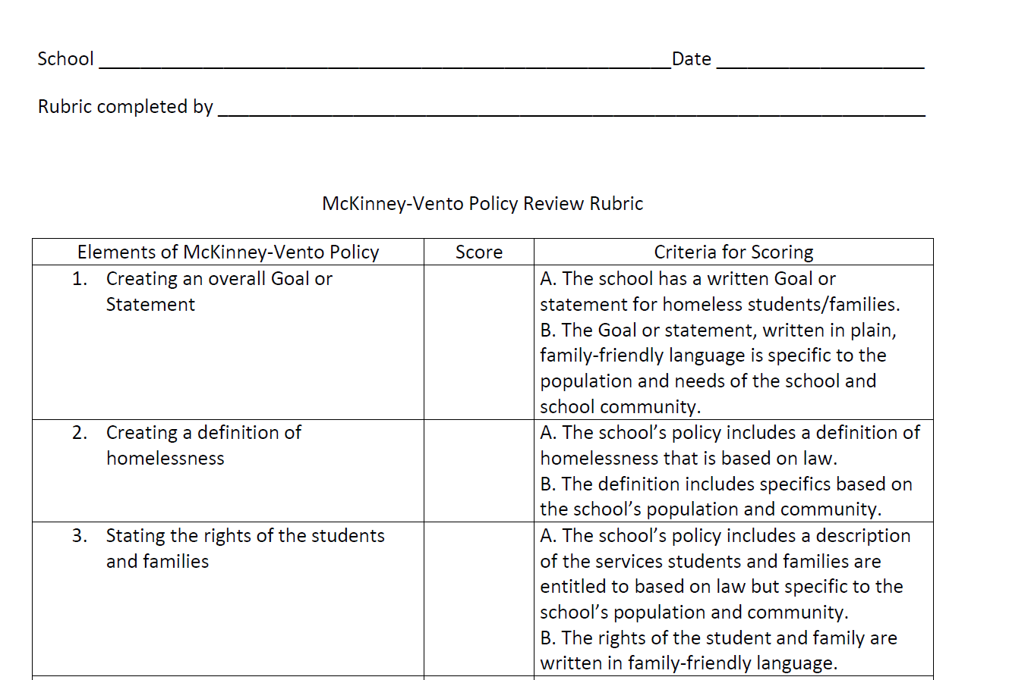
Homeless Policy Rubric: (PDF)
Uploaded to the BIE Website
Native Star “Docs & Links” tab

Slide 26
The School Team completes the School Community Survey
Step 4
Each member of the team completes the survey independently.
The team discusses each survey question and arrives at a consensus score for each question.
Discussing each question will take time, but it simplifies the development of your objectives step 5.

Slide 27
Sample Survey Page

Slide 28
The school team completes a needs assessment and develops objectives to include in their plan
Step 5
School Information Form
Policy Analysis
School Community Survey
About Your School
Needs Assessment

Slide 29
Needs Assessment Pages
WiseWays®

Slide 30
Planning Tool

Slide 31
Planning Tool
The planning tool is a planning and implementation tool that can be used to organize, record, and track your family engagement initiatives. This will help you begin your work in the “Next Steps” training where you will match your objectives to the Family Engagement indicators in Native Star.

Slide 32
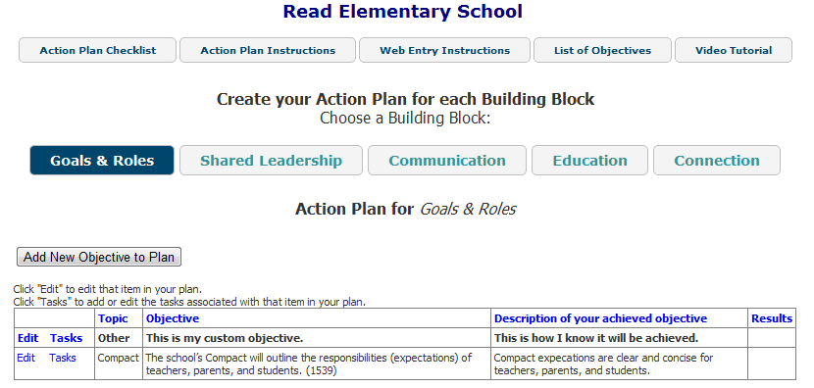
FET Planning Tool
Get started by reviewing the Action Plan Resources

Slide 33
Walk Through the Step 1

Slide 34
Tools for the Team
The principal/team lead prints out the needed
worksheets for Step 1
The principal/ team lead records the completed version in the online system

Slide 35
The team leader completes the Enter/Edit School Information with principal.
Step 1
School and District Contact Information
Demographics
School Personnel
School Grades Levels and Enrollment
State Standards Assessment Scores

Slide 36
STEP 1
Complete School Information Form
Review Information on School Information Form
District Title I Director enter ELO/Education Specialist
Emails must be entered correctly
When completed click “Done-Review Responses”

Slide 37
Step 1
“Click” here to return to the Main Menu

Slide 38
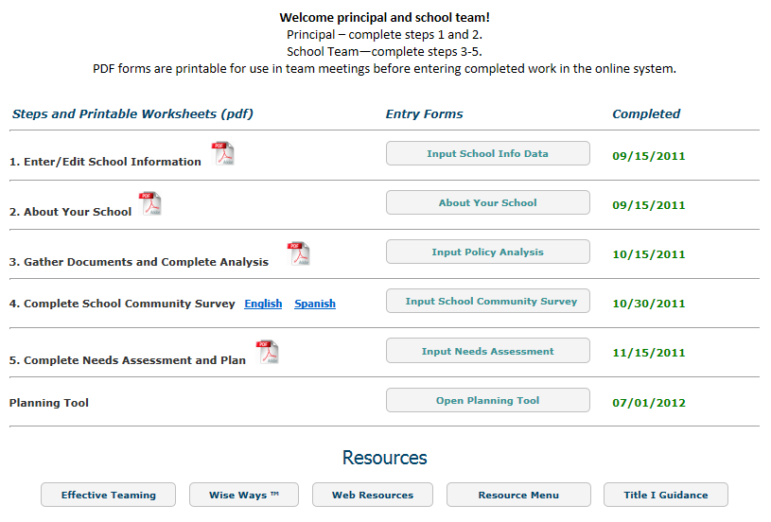
STEP 1
Indicate date completed

Slide 39
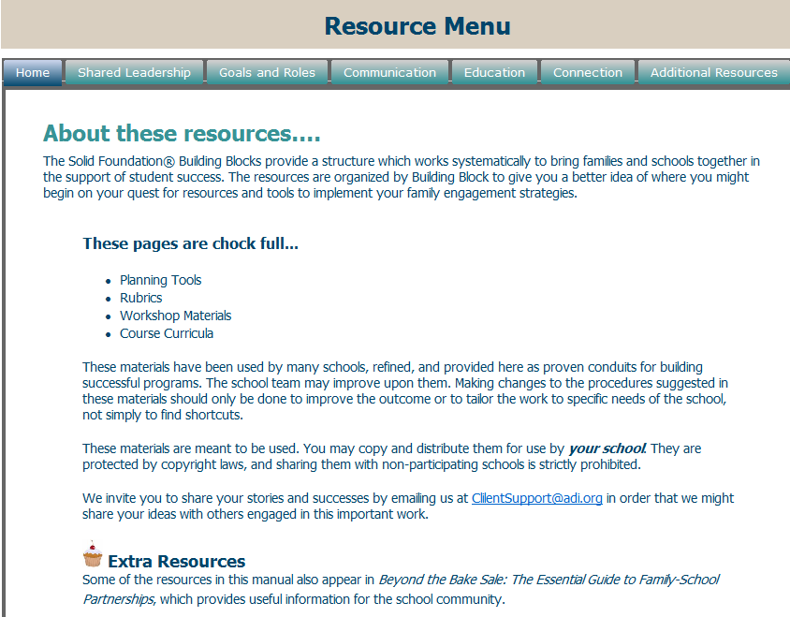
Resources provided
to help schools implement their plan.

Slide 40
Technical Support

Slide 41
Username & Passwords
Completion of <date> Training
Distributed to Principal
If you have problems accessing the tool, contact <Presenter’s Name, Email, and Phone Number>

Slide 42
Trainings for FET Steps 1-5
<Enter Date> Step 1
<Enter Date> Steps 2 & 3
<Enter Date> Step 4
<Enter Date> Step 5
<Enter Date> Planning Tool/Debriefing

Slide 43
Completion of FET Steps 1-5
<Enter Date>, Complete Step 1
<Enter Date>, Complete Steps 2 & 3
<Enter Date>, Complete Step 4
<Enter Date>, Complete Step 5

Slide 44
We can help you to build strong school communities
within the schools you serve.
Presenter’s Name
Title
Email
Phone Number

