Slide 1
Step 4
<Insert Date>
Presenter: <Insert Presenter’s Name>
<Insert Presentation Time>

Slide 2
Training Overview
Introduction
Walk Through Step 4
Scheduled FET Trainings & Completion Dates for FET Step(s)
Question(s) & Answer(s)

Slide 3
Orientation Objectives
Provide an overview of Step 4 of the Family Engagement Tool web based system for the School Improvement Team to utilize.
2. Demonstrate how the tool is used on the website.
3. Answer any questions at the end of the session.

Slide 4
Walk Through the Step 4

Slide 5
The School Team completes the School Community Survey
Step 4
Each member of the team completes the survey independently.
The team discusses each survey question and arrives at a consensus score for each question.
Discussing each question will take time, but it simplifies the development of your objectives step 5.

Slide 6
Tools for the Team
The principal/team leader prints out the needed worksheets for Step 4
The principal/team leader records the completed version in the online system

Slide 7
Schedule Meeting
Schedule 2 meetings for Step 4
First meeting to review Survey and provide instructions on completing Survey
Second meeting to complete Step 4 of tool with FET Team
All FET team members are required to attend

Slide 8
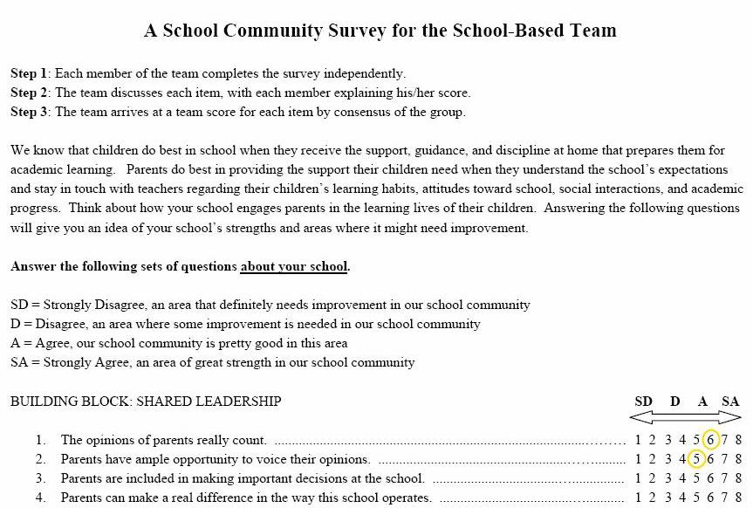
STEP 4

Slide 9
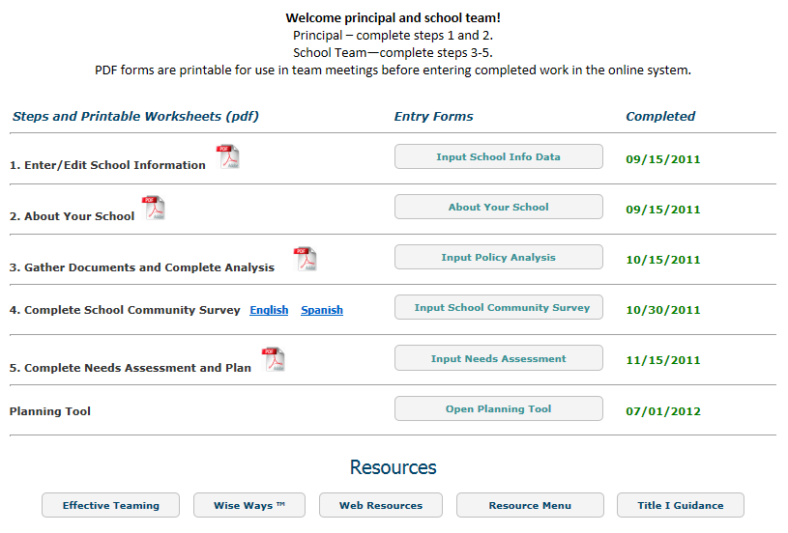
STEP 4
After the team meets and responds to survey as a group the responses are entered into FET.

Slide 10
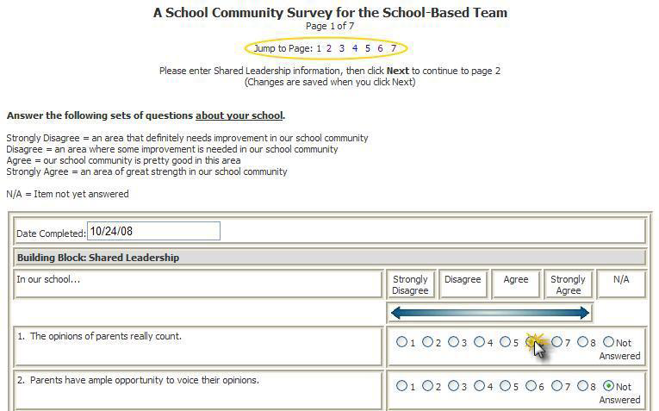
STEP 4
Enter Date
Enter
Response
Click Next to
Save & go to
Next page
Academic Development Institute, Family Engagement Tool Online User Manual, 2008

Slide 11
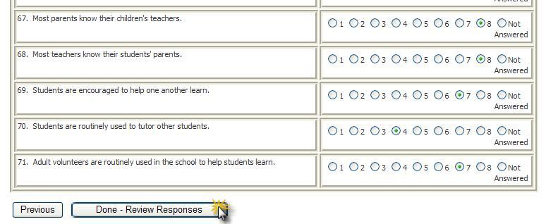
STEP 4
Once you entered the responses to the survey “click” Done-Review Responses
Academic Development Institute, Family Engagement Tool Online User Manual, 2008

Slide 12
STEP 4
Click here to submit your final survey

Slide 13
STEP 4
Once final survey is submitted you are not able to make edits to your survey.
Principal will receive update that the survey was submitted
Academic Development Institute, Family Engagement Tool Online User Manual, 2008

Slide 14
STEP 4
Indicate date completed

Slide 15
Trainings for FET Steps 1-5
<Enter Date> Step 1
<Enter Date> Steps 2 & 3
<Enter Date> Step 4
<Enter Date> Step 5
<Enter Date> Debriefing

Slide 16
Completion of FET Steps 1-5
<Enter Date>, Complete Step 1
<Enter Date>, Complete Steps 2 & 3
<Enter Date>, Complete Step 4
<Enter Date>, Complete Step 5

Slide 17
We can help you to build strong school communities
within the schools you serve.
Presenter’s Name
Title
Email
Phone Number

