Slide 1
Step 5
<Insert Date>
Presenter: <Insert Presenter’s Name>
<Insert Presentation Time>

Slide 2
Training Overview
Introduction
Walk Through Step 5
Scheduled FET Trainings & Completion Dates for FET Step(s)
Question(s) & Answer(s)

Slide 3
Orientation Objectives
Provide an overview of Step 5 of the Family Engagement Tool web based system for the School Improvement Team to utilize.
2. Demonstrate how the tool is used on the website.
3. Answer any questions at the end of the session.

Slide 4
Walk Through the Step 5

Slide 5
The school team completes a needs assessment and develops objectives to include in their plan
Step 5
School Information Form
Policy Analysis
School Community Survey
About Your School
Needs Assessment

Slide 6
Tools for the Team
The principal/team leader prints out the needed worksheets for Step 5
The principal/team leader records the completed version in the online system

Slide 7
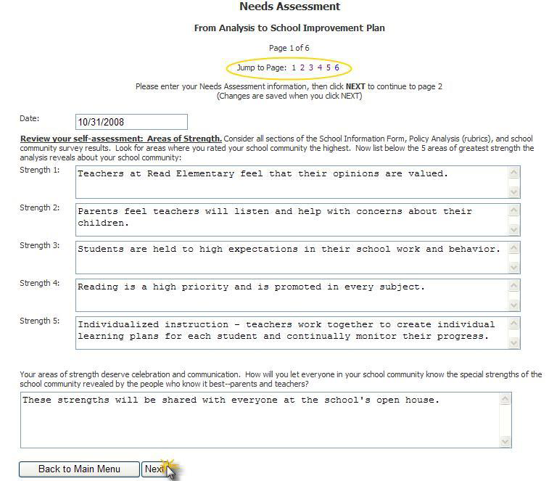
STEP 5
Academic Development Institute, Family Engagement Tool Online User Manual, 2008

Slide 8
STEP 5
Enter rating
for each
Building
Block
Enter notes
for each
Building
Block
Academic Development Institute, Family Engagement Tool Online User Manual, 2008

Slide 9
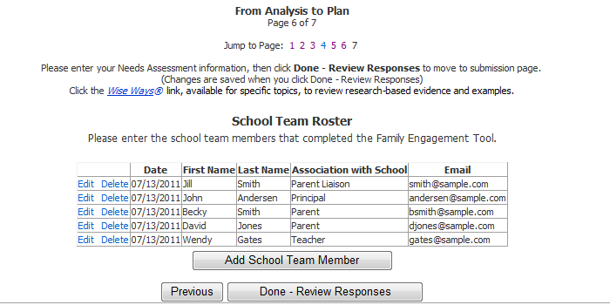
STEP 5
Enter the team members who completed the tool
Academic Development Institute, Family Engagement Tool Online User Manual, 2008

Slide 10
STEP 5
Click here to submit your final assessment
Click here to submit your final survey

Slide 11
STEP 5
Academic Development Institute, Family Engagement Tool Online User Manual, 2008

Slide 12
STEP 5
Date will appear in completed
Principal will receive email on completion
An email sent to Title I Director (ELO) & DPA will have access to final report.
Information cannot be edited

Slide 13
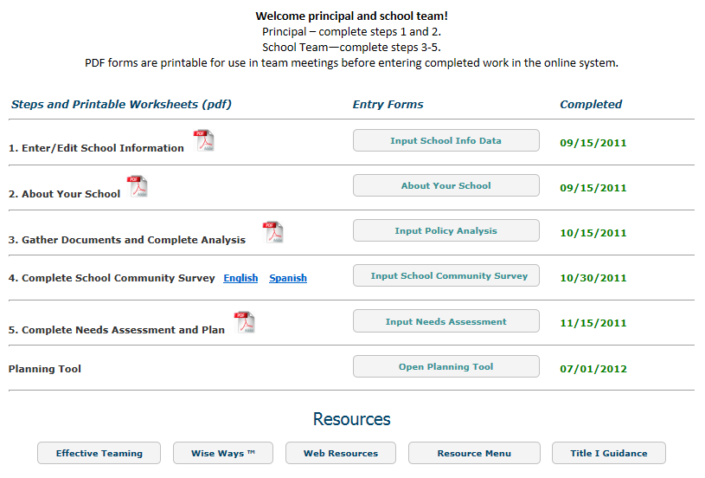
STEP 5
Indicate date completed

Slide 14
Trainings for FET Steps 1-5
<Enter Date> Step 1
<Enter Date> Steps 2 & 3
<Enter Date> Step 4
<Enter Date> Step 5
<Enter Date> Debriefing/Action Plan

Slide 15
Completion of FET Steps 1-5
<Enter Date>, Complete Step 1
<Enter Date>, Complete Steps 2 & 3
<Enter Date>, Complete Step 4
<Enter Date>, Complete Step 5

Slide 16
We can help you to build strong school communities
within the schools you serve.
Presenter’s Name
Title
Email
Phone Number

