Slide 1
Debriefing/Planning
<Insert Date>
Presenter: <Insert Presenter’s Name>
<Insert Presentation Time>

Slide 2
Orientation Objectives
Provide discussion on FET Experience and provide an overview of the Planning Tool in the Family Engagement Tool for the School Improvement Team to utilize.
2. Demonstrate how the tool is used on the website.
3. Answer any questions at the end of the session.

Slide 3
FET Overview
Describe your team’s involvement.
How did the tool assist with your Title I requirements?
Is your team motivated to move forward?

Slide 4
Walk Through the Planning Tool

Slide 5
FET Building Blocks
Shared Leadership
Policies & Practices
School Team, PTA/PTO, Parent Advisory Group
Guidelines that lead the way to engaging parents
Communication
Education
Connection
Ongoing two-way between school and families
Developing a partnership through quality learning opportunities
Face to face opportunities to connect with families on learning goals

Slide 6
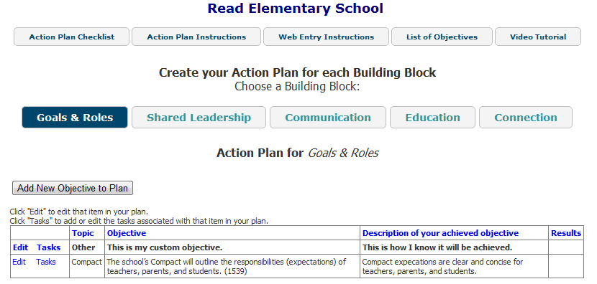
FET Planning Tool
Get started by reviewing the Action Plan Resources

Slide 7
“Next Steps” Overview
The Family Engagement Team will look at the School Community Indicators and other indicators found in Native Star involving Families/Parents and Assess and Plan for these indicators.
The goal of the “Next Steps” is familiarizing the Family Engagement Team of Native Star Indicators and involve this team in the School Improvement Process.
This will provide the team training to move into the Family Engagement Indicators.
This training will begin <DATE>

Slide 8
Trainings for FET Steps 1-5
<Enter Date> Step 1
<Enter Date> Steps 2 & 3
<Enter Date> Step 4
<Enter Date> Step 5
<Enter Date> Debriefing/Action Plan

Slide 9
Completion of FET Steps 1-5
<Enter Date>, Complete Step 1
<Enter Date>, Complete Steps 2 & 3
<Enter Date>, Complete Step 4
<Enter Date>, Complete Step 5

Slide 10
We can help you to build strong school communities
within the schools you serve.
Presenter’s Name
Title
Email
Phone Number

