Slide 1
“NEXT STEPS”
BIE FAMILY ENGAGEMENT
<ENTER DATE>
Facilitated by: <ENTER NAME>

Slide 2
Agenda
Welcome/Introductions
Housekeeping
“Warm Up” Activity
Expectations
Presentation
Resource(s)/Tool(s)
Evaluation

Slide 3
Housekeeping
Please MUTE your phones
Training attendance will be taken at the beginning and end of the session
Active Participation

Slide 4
“Warm Up” Activity
Talk about experience with FET.
Positive Experience
Challenging Experience
10 minutes

Slide 5
Expectations
What are your training Expectations?
Provide them in the “Chat”
Send to me via Email
5 minutes

Slide 6
FET Needs Assessment
Looking at areas of strength
Document Strengths; will provide the foundation on other initiatives.
How did you your school share strengths?
Chat
Email

Slide 7
Building Blocks
According to Redding, “school community is built and continuously strengthened with the six building blocks” (p. 16, 2011, Redding, Murphy, Sheley, Handbook on Family & Community Engagement)
Shared Leadership
Goals & Roles/Policies
Communication
Education
Connections
Continuous Improvement

Slide 8
FET Building Blocks
Shared Leadership
How are parents involved in the decision making of your school?
Goals & Roles/Policies
What are your school’s key documents that incorporates school community’s roles
Communication
Clear, concise, consistent communication between school and school community
Education
How does school provide learning opportunities between school staff and parents to maximize student learning.
Connections
How does school increase sense of community and connectedness between school and parents/community?

Slide 9
Assessing Building Blocks
FET asked that you assess each building block
Requested to create objectives for items you rated “1” or “2” which will be included in your Family Engagement Plan and will be incorporated in your school improvement plan.
Identify which of the building blocks you have assessed is priority for your school to address. *Focus on the immediate Title I requirements that your school must address
Use “Family Engagement/School Community Indicators” in addressing the priorities. These indicators are indicators of effective practice on family engagement. *Among the 99 indicators that your school is assessed and planned for in Native Star.

Slide 10
Indicators that Involve Parents/Families
Classroom Instruction - Expecting and monitoring sound homework practices and communication with parents
IIIB01 - All teachers maintain a file of communication with parents. (150)
IIIB02 - All teachers regularly assign homework (4 or more days a week). (151)
IIIB03 - All teachers check, mark, and return homework. (152)
IIIB06 - All teachers systematically report to parents the student’s mastery of specific standards-based objectives. (155)
School leadership and Decision Making – Helping parents to help their children meet the standards
IG02 - Parents receive regular communication (absent jargon) about learning standards, their children’s progress, and the parents’ role in their children’s school success. (76)
School Community: Policies and Practices-
IG10 - Parent involvement policy, classroom visit policy, and homework policy are clear, constructive, and include a plan for communicating the policies to parents and teachers. (84)
IVA09 - The school's Compact outlines the responsibilities/expectations of teachers, parents, and students. (202)
School Community: Communication
IVA11 - The school's Compact is annually distributed to teachers, school personnel, parents, and students. (204)
IVA06 - The school regularly and clearly communicates with parents about its expectations of them and the importance of the "curriculum of the home." (184)
IVB04 - The "ongoing conversation" between school personnel and parents is candid, supportive, and flows in both directions. (185)
School Community: Education
IVC02 Professional development programs for teachers include assistance in working effectively with parents. (192)

Slide 11
Resources/Tools
Action Plan Checklist
Action Plan Instructions/Web Entry Instructions
List of Objectives
Video Tutorial

Slide 12
FET Planning Tool
Return to FET and go to the Planning Tool
This helps you develop an action plan for the findings that you want to improve from your FET assessment.
Refer to your notes for each building block on planning to improve in areas within a particular building block. This is where you will derive your objectives.
The action plan allows you to organize your findings where you can identify a plan by developing objectives within each of the building block, describe how the objective is achieved and the expected results.

Slide 13
FET Planning Tool
Play the Video Tutorial for your participants

Slide 14
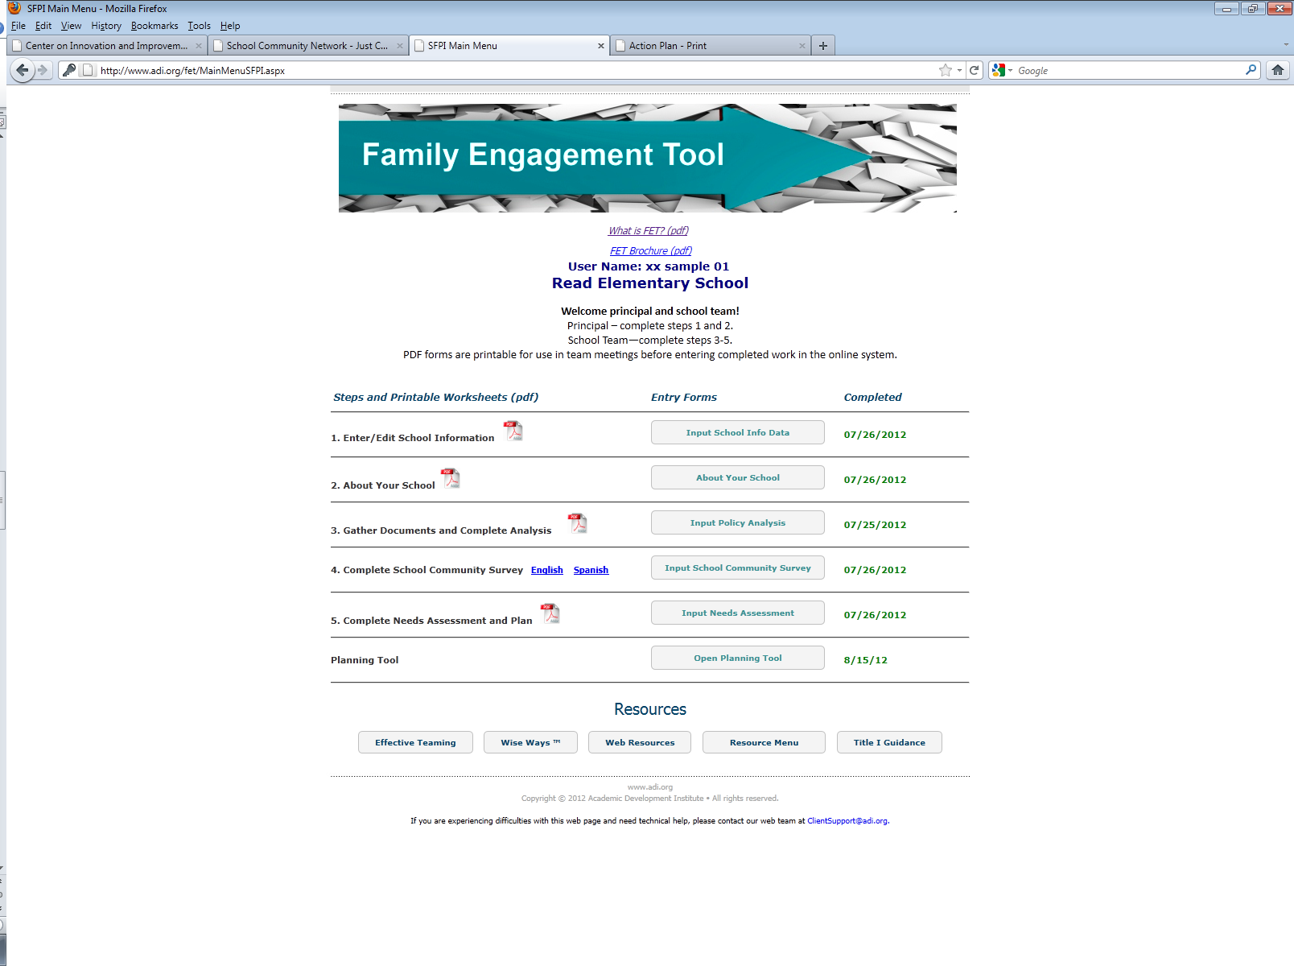
FET Planning Tool
Play the Video Tutorial for your participants
Date Completed in FET

Slide 15
Evaluation
Please submit feedback on today’s presentation using the following guiding questions:
Did today’s information meet your expectation?
What information did you want presented today but was not discussed?
What information provided today you felt was most helpful?
Other feedback or questions.

Slide 16
Contact Information
<ENTER NAME>
<ENTER TITLE>
<ENTER CONTACT INFORMATION>

