Slide 1

“NEXT STEPS”
BIE FAMILY ENGAGEMENT
<ENTER DATE>
Facilitated by: <ENTER NAME>

Slide 2
Agenda
Welcome/Introductions
Housekeeping
“Warm Up” Activity
Expectations
Presentation
Resource(s)/Tool(s)
Evaluation

Slide 3
Housekeeping
Please MUTE your phones
Training attendance will be taken at the beginning and end of the session
Active Participation

Slide 4
“Warm Up” Activity
Talk about experience with Action Plan and aligning them with the indicators
  Positive Experience
  Challenging Experience

Slide 5
Indicators that Involve Parents/Families
Classroom Instruction - Expecting and monitoring sound homework practices and communication with parents
IIIB01 - All teachers maintain a file of communication with parents. (150)
IIIB02 - All teachers regularly assign homework (4 or more days a week). (151)
IIIB03 - All teachers check, mark, and return homework. (152)
IIIB06 - All teachers systematically report to parents the student’s mastery of specific standards-based objectives. (155)
School leadership and Decision Making – Helping parents to help their children meet the standards
IG02 - Parents receive regular communication (absent jargon) about learning standards, their children’s progress, and the parents’ role in their children’s school success. (76)
School Community: Policies and Practices-
IG10 - Parent involvement policy, classroom visit policy, and homework policy are clear, constructive, and include a plan for communicating the policies to parents and teachers. (84)
IVA09 - The school's Compact outlines the responsibilities/expectations of teachers, parents, and students. (202)
School Community: Communication
IVA11 - The school's Compact is annually distributed to teachers, school personnel, parents, and students. (204)
IVA06 - The school regularly and clearly communicates with parents about its expectations of them and the importance of the "curriculum of the home." (184)
IVB04 - The "ongoing conversation" between school personnel and parents is candid, supportive, and flows in both directions. (185)
School Community: Education
IVC02 Professional development programs for teachers include assistance in working effectively with parents. (192)

Slide 6
Expectations
What are your training Expectations?
Provide them in the “Chat”
Send to me via Email
5 minutes

Slide 7
Resources/Tools
Handbook on Family and Community Engagement
Native Star Reporting Guide 2013-2014
SY 2013-14 Native Star Annual Reports and School Level Benchmarks
Wise Ways, Assess Worksheet for IVA09

Slide 8
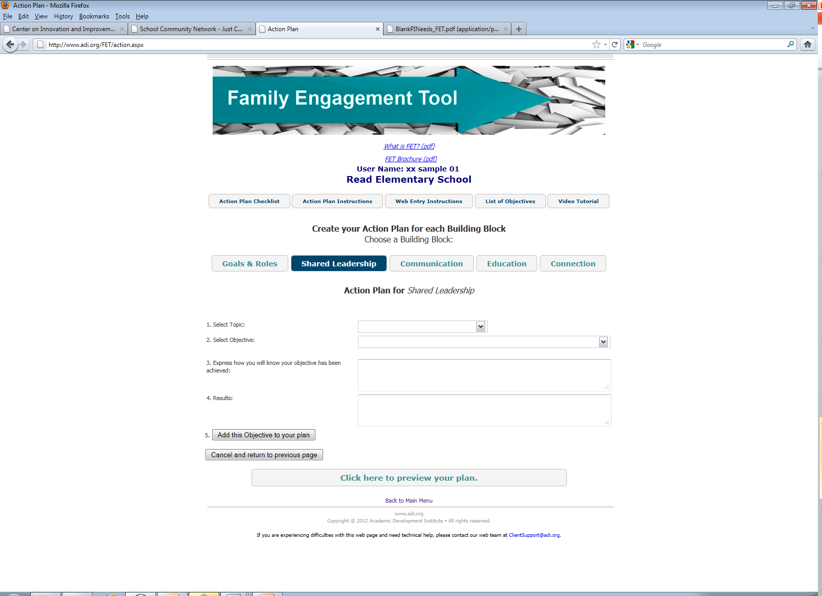
FET Planning Tool
Play the Video Tutorial for your participants

Slide 9
Family Engagement Indicators:
Sample Selection
School Community: Policies and Practices
IVA09 The school's Compact outlines the responsibilities/expectations of teachers, parents, and students. (202)

Slide 10
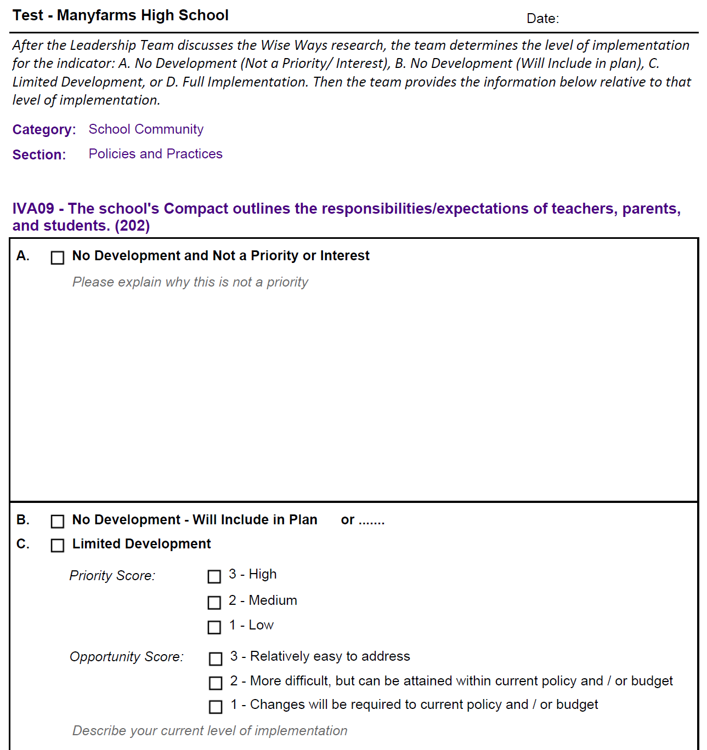
Family Engagement Assessing

Slide 11
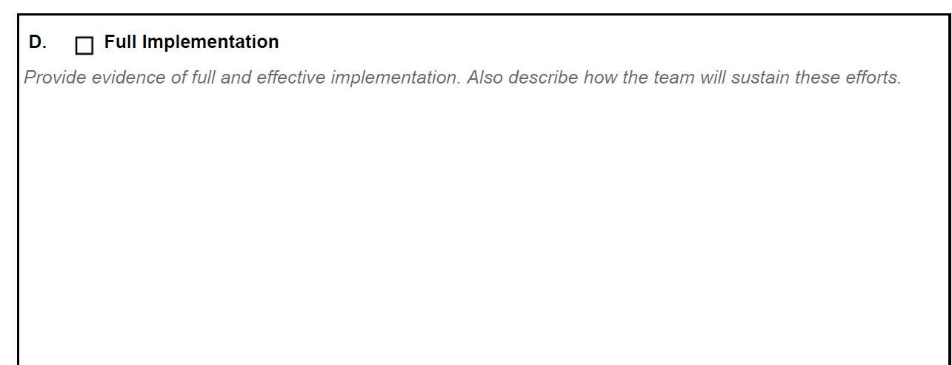
Family Engagement Assessing

Slide 12
Assignment
INSTRUCTIONS-
Look at the results of your assignment where you matched your objectives from the action plan to the 11 indicators.
Go to your Native Star worksheets for the indicators your team will be assessing. There should be eleven (11) different worksheets for the eleven (11) indicators and Wise Ways guidance sheets to assist in this process. Distribute these worksheets to your team members, select indicators your team will be working with.
Respond to A-D on the worksheets, and read each of the instructions carefully. You can use the WiseWays for guidance.
After your team has assessed the indicators they selected to work with on the worksheets, they can submit into Native Star by (ENTER DATE) and I will provide coaching comments on your submission(s).

Slide 13
Indicators that Involve Parents/Families
Classroom Instruction - Expecting and monitoring sound homework practices and communication with parents
IIIB01 - All teachers maintain a file of communication with parents. (150)
IIIB02 - All teachers regularly assign homework (4 or more days a week). (151)
IIIB03 - All teachers check, mark, and return homework. (152)
IIIB06 - All teachers systematically report to parents the student’s mastery of specific standards-based objectives. (155)
School leadership and Decision Making – Helping parents to help their children meet the standards
IG02 - Parents receive regular communication (absent jargon) about learning standards, their children’s progress, and the parents’ role in their children’s school success. (76)
School Community: Policies and Practices-
IG10 - Parent involvement policy, classroom visit policy, and homework policy are clear, constructive, and include a plan for communicating the policies to parents and teachers. (84)
IVA09 - The school's Compact outlines the responsibilities/expectations of teachers, parents, and students. (202)
School Community: Communication
IVA11 - The school's Compact is annually distributed to teachers, school personnel, parents, and students. (204)
IVA06 - The school regularly and clearly communicates with parents about its expectations of them and the importance of the "curriculum of the home." (184)
IVB04 - The "ongoing conversation" between school personnel and parents is candid, supportive, and flows in both directions. (185)
School Community: Education
IVC02 Professional development programs for teachers include assistance in working effectively with parents. (192)

Slide 14
Evaluation
Please submit feedback on today’s presentation using the following guiding questions:
  Did today’s information meet your expectation?
  What information did you want presented today but was not discussed?
  What information provided today you felt was most helpful?
  Other feedback or questions.

Slide 15
Contact Information
<ENTER NAME>
<ENTER TITLE>
<ENTER CONTACT INFORMATION>

