Slide 1

“NEXT STEPS”
BIE FAMILY ENGAGEMENT
<ENTER DATE>
Facilitated by: <ENTER NAME>

Slide 2
Agenda
Welcome/Introductions
Housekeeping
“Warm Up” Activity
Expectations
Presentation
Resource(s)/Tool(s)
Evaluation

Slide 3
Housekeeping
Please MUTE your phones
Training attendance will be taken at the beginning and end of the session
Active Participation

Slide 4
Expectations
What are your training Expectations?
Provide them in the “Chat”
Send to me via Email
5 minutes

Slide 5
Resources/Tools
Handbook on Family and Community Engagement
Native Star Reporting Guide 2013-2014
SY 2013-14 Native Star Annual Reports and School Level Benchmarks
Wise Ways, Planning Worksheets for IVA09

Slide 6
“Warm Up” Activity
Talk about experience with Assessing Indicators.
  Positive Experience
  Challenging Experience
10 minutes

Slide 7
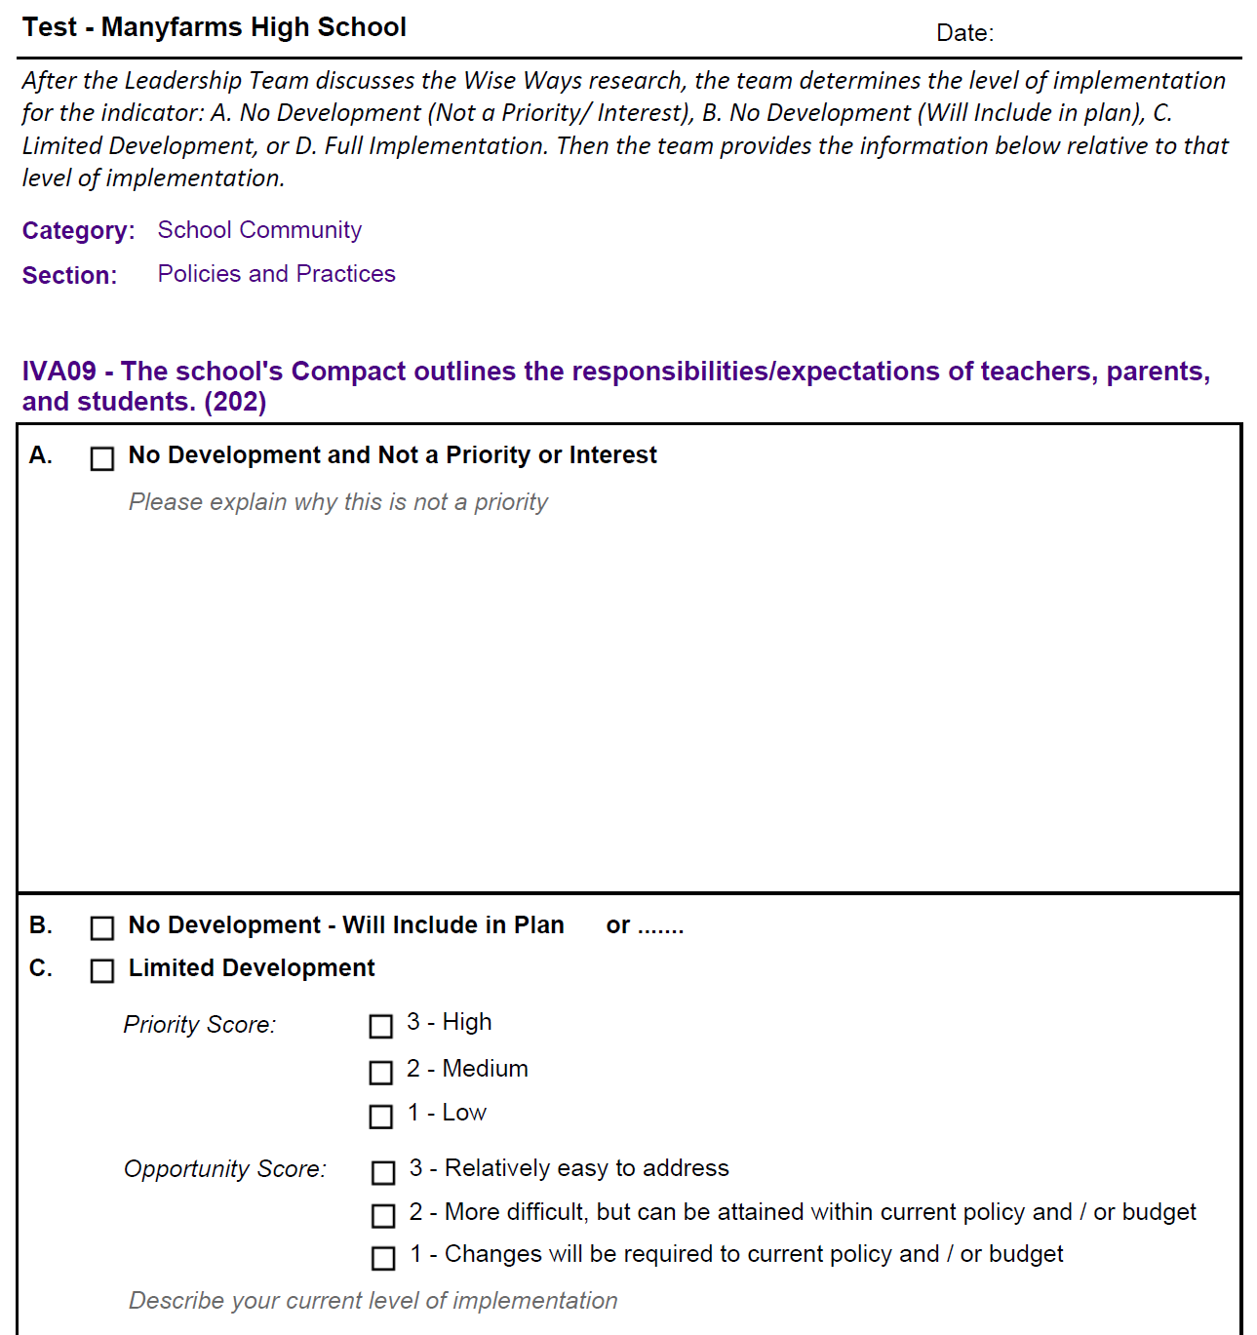
Family Engagement Assessing

Slide 8
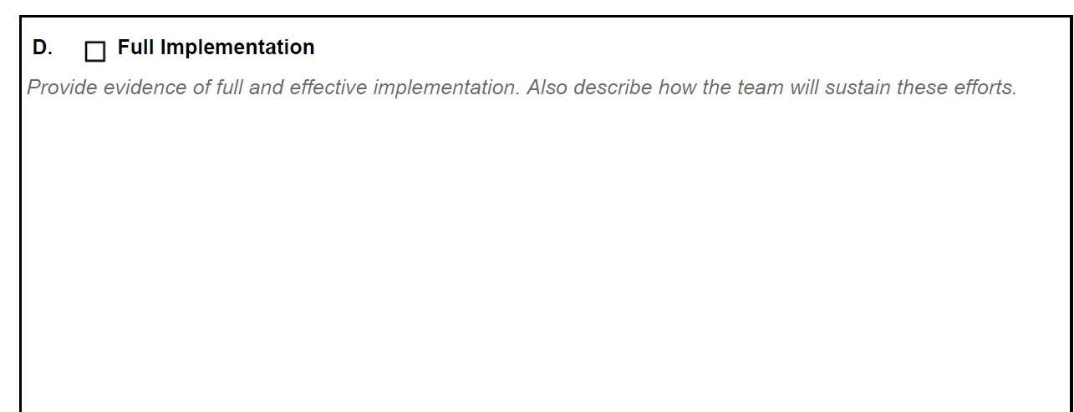
Family Engagement Assessing

Slide 9
Planning Indicator(s)

Slide 10
Family Engagement Indicators:
Sample Selection
School Community: Policies and Practices
IVA09 The school's Compact outlines the responsibilities/expectations of teachers, parents, and students. (202)

Slide 11
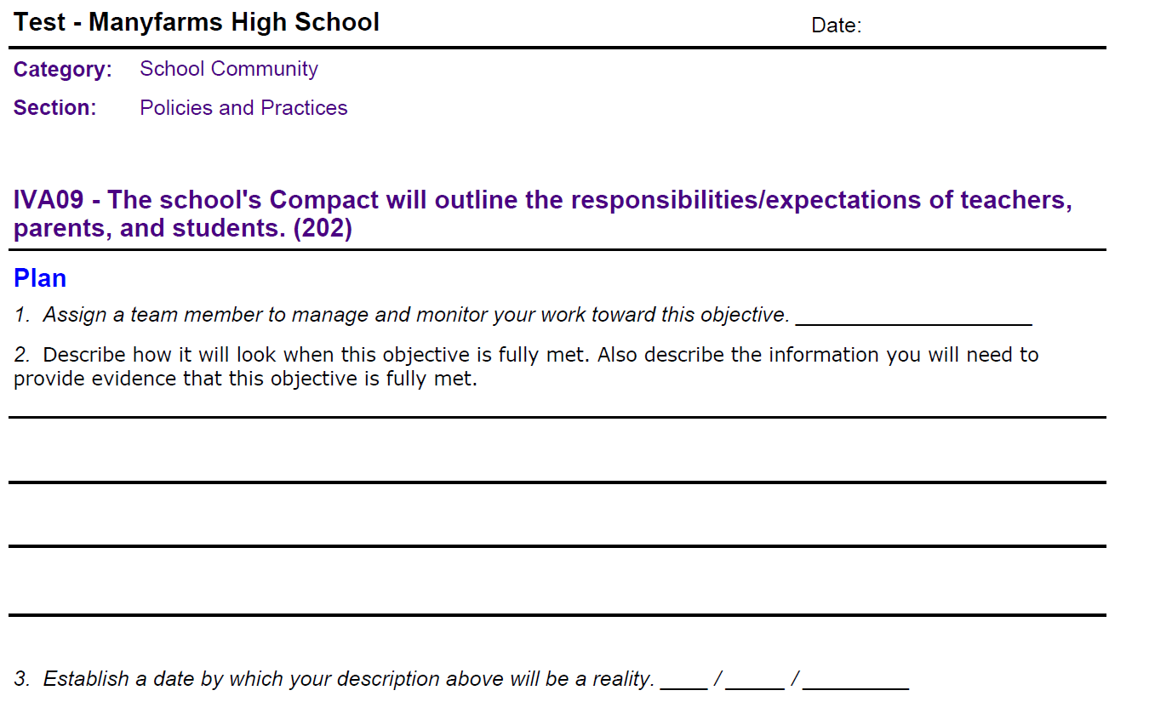
Family Engagement Planning

Slide 12
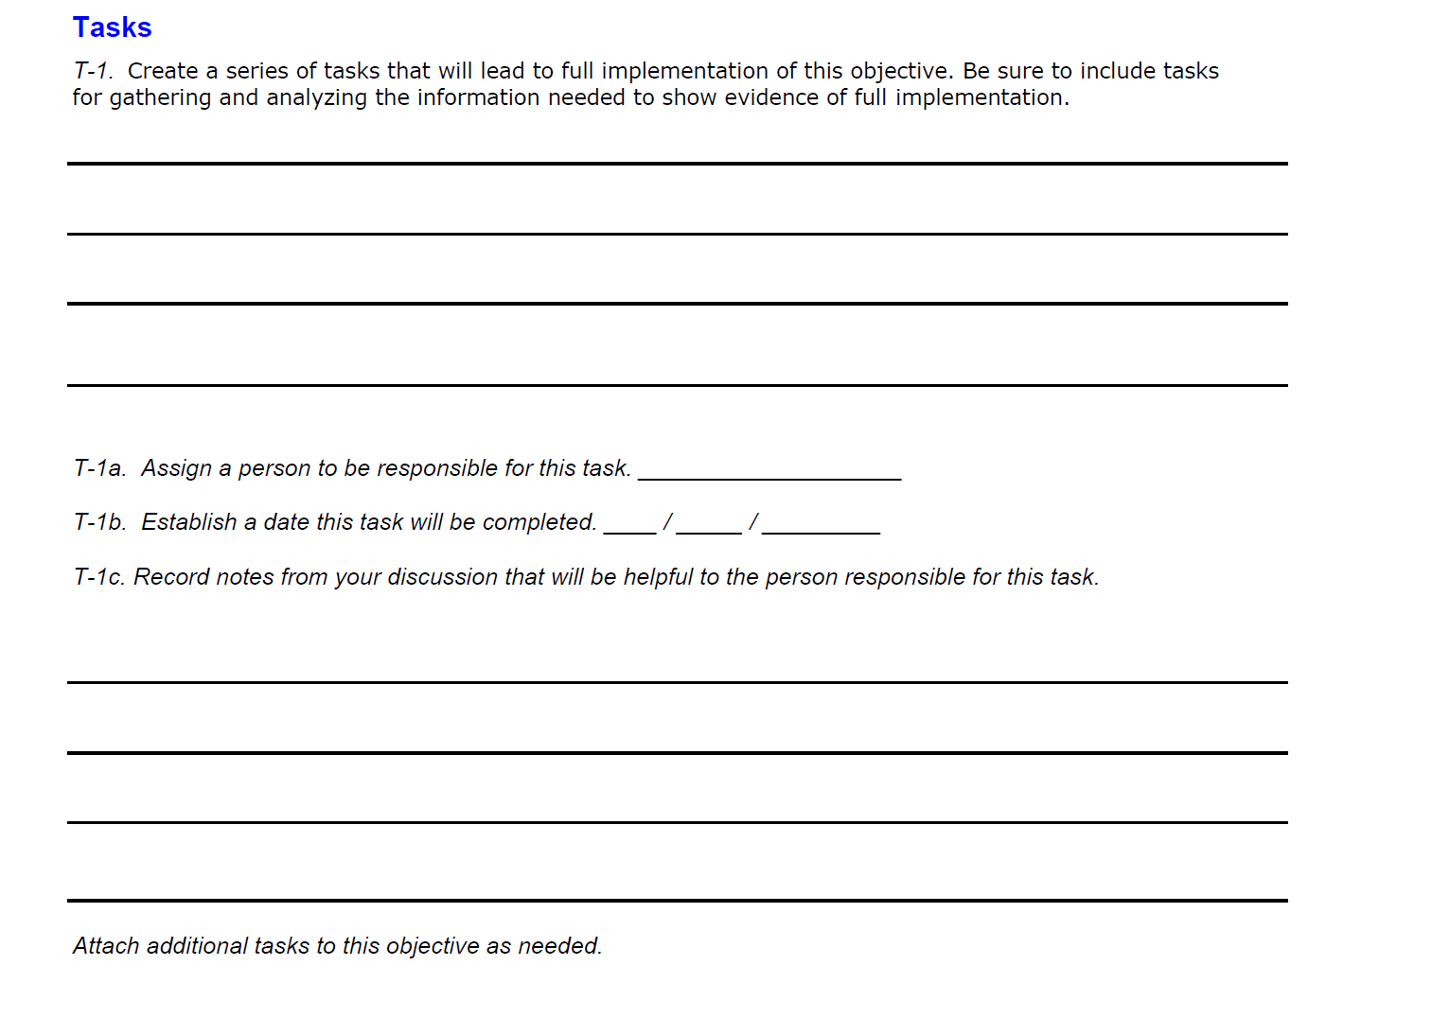
Family Engagement Planning

Slide 13
Assignment
INSTRUCTIONS-
Review your assessment and next you will be planning for the indicators.
Provide copies of the Indicator Planning Worksheets, for your team and use the Wise Ways for each indicator if you need assistance. There should be eleven (11) different worksheets for the eleven (11) indicators and Wise Ways guidance sheets.
On Indicator Planning Worksheets please respond to numbers 1 through 3 under Plan and Tasks on the worksheets, and read the instructions carefully.
After your team has assessed the four indicators on the worksheets, they can submit into Native Star by (ENTER DATE) and I will provide coaching comments on your submission(s).

Slide 14
Indicators that Involve Parents/Families
Classroom Instruction - Expecting and monitoring sound homework practices and communication with parents
IIIB01 - All teachers maintain a file of communication with parents. (150)
IIIB02 - All teachers regularly assign homework (4 or more days a week). (151)
IIIB03 - All teachers check, mark, and return homework. (152)
IIIB06 - All teachers systematically report to parents the student’s mastery of specific standards-based objectives. (155)
School leadership and Decision Making – Helping parents to help their children meet the standards
IG02 - Parents receive regular communication (absent jargon) about learning standards, their children’s progress, and the parents’ role in their children’s school success. (76)
School Community: Policies and Practices-
IG10 - Parent involvement policy, classroom visit policy, and homework policy are clear, constructive, and include a plan for communicating the policies to parents and teachers. (84)
IVA09 - The school's Compact outlines the responsibilities/expectations of teachers, parents, and students. (202)
School Community: Communication
IVA11 - The school's Compact is annually distributed to teachers, school personnel, parents, and students. (204)
IVA06 - The school regularly and clearly communicates with parents about its expectations of them and the importance of the "curriculum of the home." (184)
IVB04 - The "ongoing conversation" between school personnel and parents is candid, supportive, and flows in both directions. (185)
School Community: Education
IVC02 Professional development programs for teachers include assistance in working effectively with parents. (192)

Slide 15
Evaluation
Please submit feedback on today’s presentation using the following guiding questions:
  Did today’s information meet your expectation?
  What information did you want presented today but was not discussed?
  What information provided today you felt was most helpful?
  Other feedback or questions.

Slide 16
Contact Information
<ENTER NAME>
<ENTER TITLE>
<ENTER CONTACT INFORMATION>

