Slide 1
“NEXT STEPS”
BIE FAMILY ENGAGEMENT
<ENTER DATE>
Facilitated by: <ENTER NAME>

Slide 2
Agenda
Welcome/Introductions
Housekeeping
“Warm Up” Activity
Expectations
Presentation
Resource(s)/Tool(s)
Evaluation

Slide 3
Housekeeping
Please MUTE your phones
Training attendance will be taken at the beginning and end of the session
Active Participation

Slide 4
Expectations
What are your training Expectations?
Provide them in the “Chat”
Send to me via Email
5 minutes

Slide 5
Resources/Tools
Handbook on Family and Community Engagement
Native Star Reporting Guide 2013-2014
SY 2013-14 Native Star Annual Reports and School Level Benchmarks
Wise Ways, Implementation Worksheets

Slide 6
“Warm Up” Activity
Talk about experience with Planning.
Positive Experience
Challenging Experience
10 minutes

Slide 7
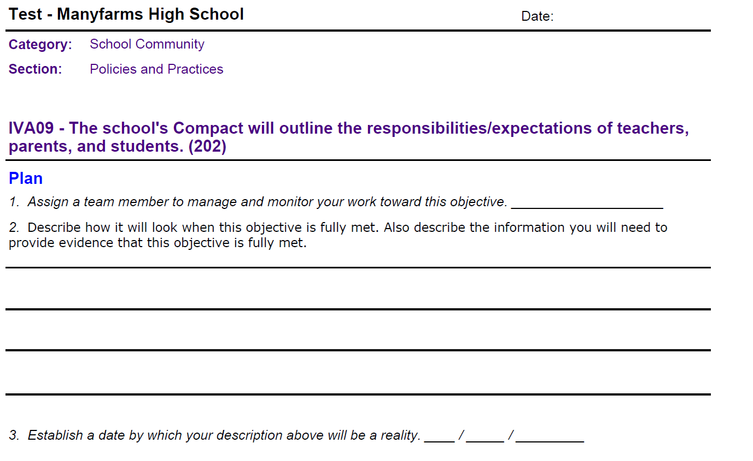
Family Engagement Planning

Slide 8
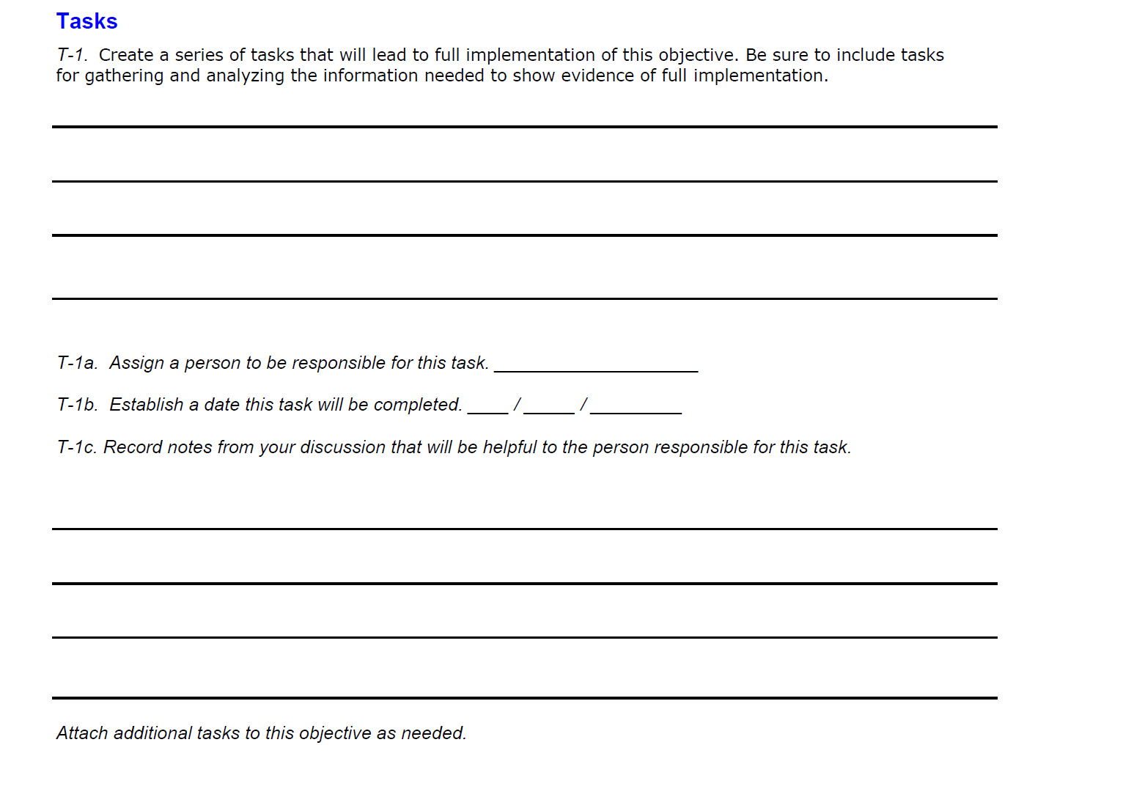
Family Engagement Planning

Slide 9
Monitoring/ Implementation Indicator(s)

Slide 10
Indicators that Involve Parents/Families
Classroom Instruction - Expecting and monitoring sound homework practices and communication with parents
IIIB01 - All teachers maintain a file of communication with parents. (150)
IIIB02 - All teachers regularly assign homework (4 or more days a week). (151)
IIIB03 - All teachers check, mark, and return homework. (152)
IIIB06 - All teachers systematically report to parents the student’s mastery of specific standards-based objectives. (155)
School leadership and Decision Making – Helping parents to help their children meet the standards
IG02 - Parents receive regular communication (absent jargon) about learning standards, their children’s progress, and the parents’ role in their children’s school success. (76)
School Community: Policies and Practices-
IG10 - Parent involvement policy, classroom visit policy, and homework policy are clear, constructive, and include a plan for communicating the policies to parents and teachers. (84)
IVA09 - The school's Compact outlines the responsibilities/expectations of teachers, parents, and students. (202)
School Community: Communication
IVA11 - The school's Compact is annually distributed to teachers, school personnel, parents, and students. (204)
IVA06 - The school regularly and clearly communicates with parents about its expectations of them and the importance of the "curriculum of the home." (184)
IVB04 - The "ongoing conversation" between school personnel and parents is candid, supportive, and flows in both directions. (185)
School Community: Education
IVC02 Professional development programs for teachers include assistance in working effectively with parents. (192)

Slide 11
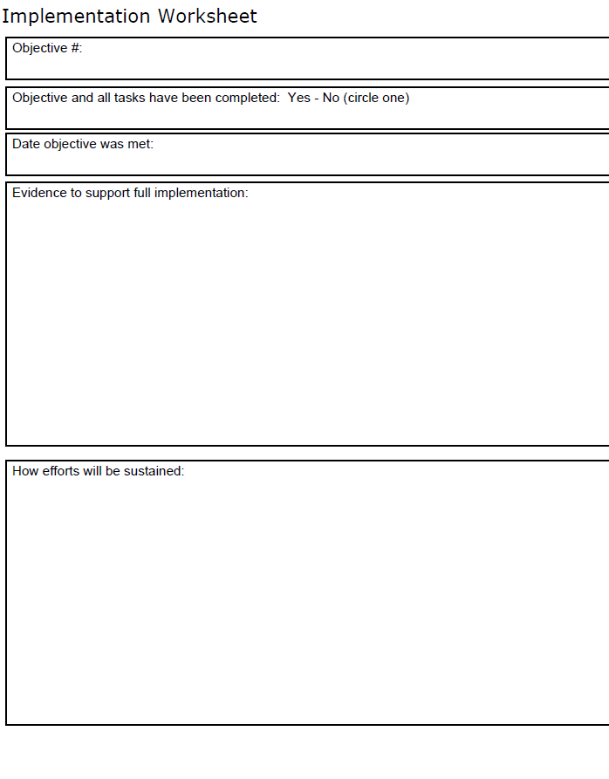
Family Engagement Monitoring

Slide 12
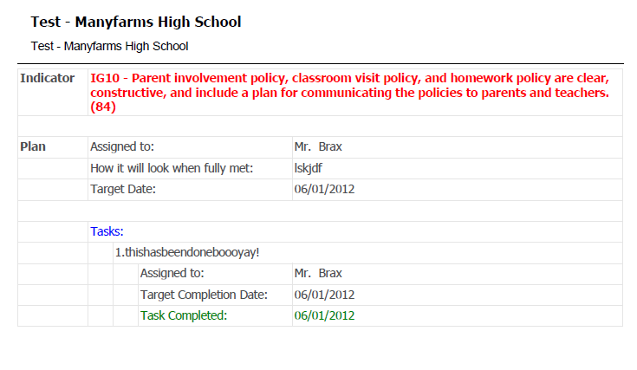
Family Engagement Monitoring

Slide 13
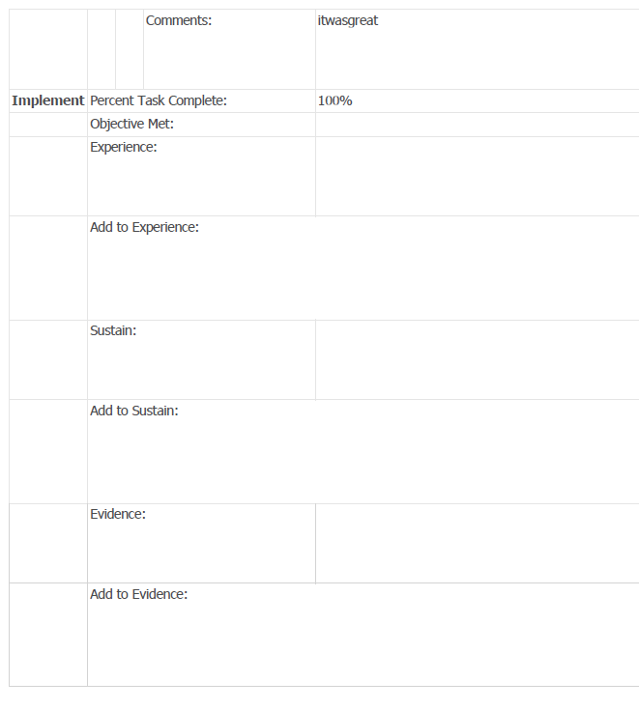
Family Engagement Monitoring

Slide 14
Family Engagement Planning
What you anticipate the results will be
FACTORS
What are things that will promote or hinder this from happening? (Resources and Barriers)
ACTIVITIES
What needs to be done to make this happen?
OUTPUTS
The results of activities
OUTCOMES
What kinds of things occur once program begins? (evidence)
IMPACT
Changes occur?
What you plan on doing
W.K. Kellogg Foundation (2004). Logic Model Development Guide. Retrieved from http://www.mscd.edu/~ssac/Kellogg_Logic_Model.pdf

Slide 15
Family Engagement Planning
FACTORS
ACTIVITIES
OUTPUTS
OUTCOMES
INDICATORS OF EFFECTIVE PRACTICE
IMPACT
What you plan on doing
What you anticipate the results will be
W.K. Kellogg Foundation (2004). Logic Model Development Guide. Retrieved from http://www.mscd.edu/~ssac/Kellogg_Logic_Model.pdf

Slide 16
Family Engagement Planning
FACTORS
ACTIVITIES
OUTPUTS
Budget
OUTCOMES
IMPACT
What you plan on doing
What you anticipate the results will be
W.K. Kellogg Foundation (2004). Logic Model Development Guide. Retrieved from http://www.mscd.edu/~ssac/Kellogg_Logic_Model.pdf

Slide 17
Family Engagement Planning
Identifying Resources (BUDGET)
Identify your school wide funding sources and its allocations
Identify what percentage of each resource will be allocated for Family Engagement
Identify your Family Engagement needs and identify what types of resources you will need to accomplish your strategies
Develop an overall Strategic Planning worksheet and identify your strategies
Identify what which funding you will used to help you accomplish your strategies.

Slide 18
Assignment
INSTRUCTIONS-
Have a monitoring plan.
Have discussions with School Improvement Team on your findings.
Provide calendar on meetings for continuous improvement, and begin planning to me into the Family Engagement Indicators.

Slide 19
Evaluation
Please submit feedback on today’s presentation using the following guiding questions:
Did today’s information meet your expectation?
What information did you want presented today but was not discussed?
What information provided today you felt was most helpful?
Other feedback or questions.

Slide 20
Contact Information
<ENTER NAME>
<ENTER TITLE>
<ENTER CONTACT INFORMATION>

