Slide 1

Family Engagement Indicators: Moving Towards Family Engagement
BIE FAMILY ENGAGEMENT
<ENTER DATE>
Facilitated by: <ENTER NAME>
Planning Indicators

Slide 2
AGENDA
Family Engagement Indicators
Dashboard Overview
Assessing Indicators
Questions

Slide 3
Family Engagement Building Blocks
Shared Leadership
  How are parents involved in the decision making of your school?
Goals & Roles/Policies
  What are your school’s key documents that incorporates the school community’s roles?
Communication
  Clear, concise, consistent communication between the school and school community
Education
  How does the school provide learning opportunities between the school staff and parents to maximize student learning?
Connections
  How does school increase sense of community and connectedness between school and parents/community?

Slide 4
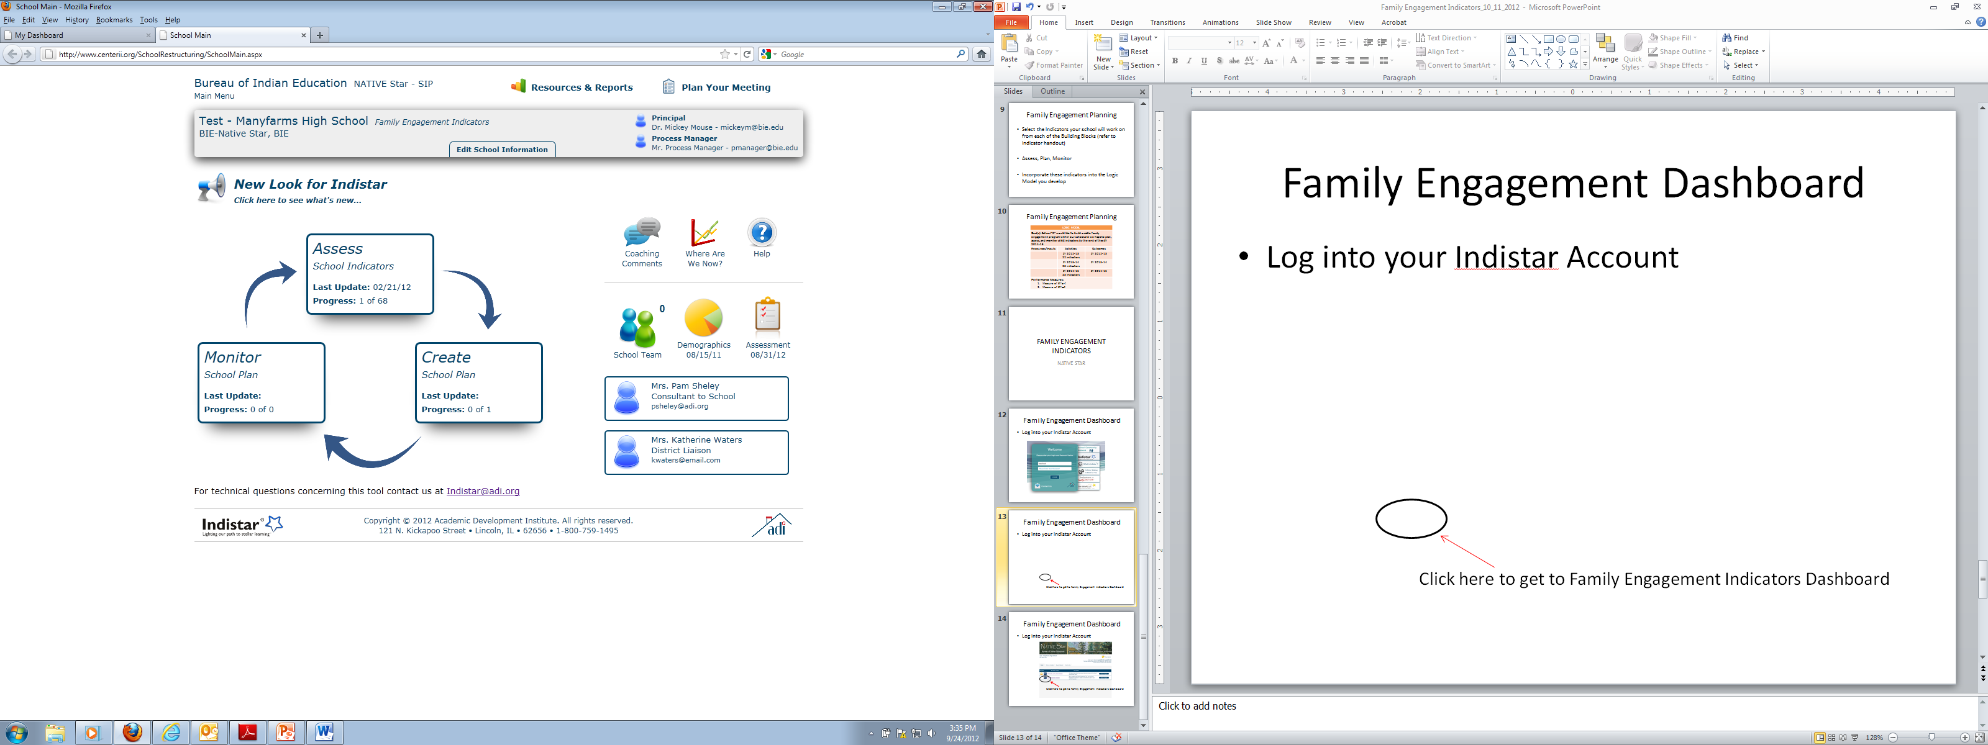
Assessing Indicators
A. Print Worksheets on the Indicator for the Team
Assess one Indicator from each of the five building blocks.
  Shared Leadership
  Goals & Roles
  Communication
  Education
  Connection
Refer to your Family Engagement Indicator Hand-out to select indicator
Your School Community Council or Family Engagement Team should work on these indicators with you
Once completed submitted to Process Manger to enter into Native Star

Slide 5
Family Engagement Indicator Assignment
Shared Leadership-
Goals & Roles/Policies-
Communication-
Education-
Connections-

Slide 6
Assessing Family Engagement Indicators
Take one Indicator that you assessed and share your experience on assessing indicator(s).
What was the first thing you did with your team?
Give an example on how your team determined the level of implementation for the indicator(s)?
Please submit the indicators you assessed today, I plan on providing feedback on your submission through the coaching comments.

Slide 7
PLANNING FAMILY ENGAGEMENT INDICATORS
NATIVE STAR

Slide 8
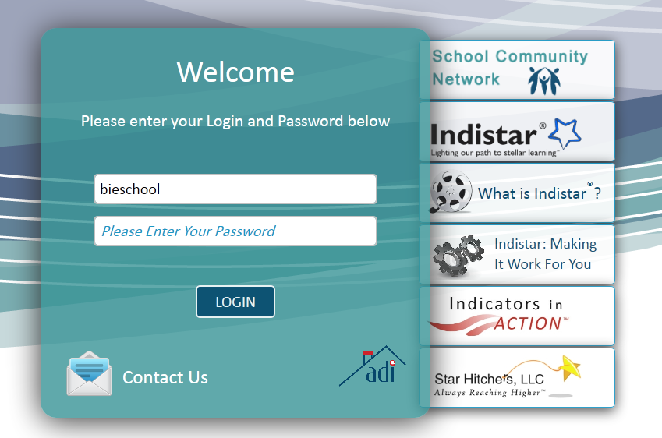
Family Engagement Dashboard
Log into your Indistar Account

Slide 9

Family Engagement Dashboard
Log into your Indistar Account
Click here to get to Family Engagement Indicators Dashboard

Slide 10
Family Engagement Dashboard
1
2
3
4
5
6

Slide 11
Planning Indicators
A. Print Worksheets on the Indicator for the Team
Plan for the Indicators you selected from each of the five building blocks.
  Shared Leadership
  Goals & Roles
  Communication
  Education
  Connection
Refer to Wise Ways if you have difficulty with the planning and tutorials on the webpage
Your School Community Council or Family Engagement Team should work on planning for these indicators with you
Once completed submit to the Process Manager to enter into Native Star

Slide 12
Family Engagement Dashboard
2
1
Retrieve Worksheets

Slide 13
Trainings for Family Engagement Indicators
  <ENTER DATE>, Assessing Indicators
  <ENTER DATE>, Planning Indicators
  <ENTER DATE>, Monitoring Indicators
  <ENTER DATE>, Debriefing on Training

Slide 14
Assignments
  <ENTER DATE>, Assessing Indicators
  <ENTER DATE>, Planning Indicators
  <ENTER DATE>, Monitoring Indicators

Slide 15
Questions?
<ENTER FACILITATOR NAME>
<ENTER FACILITATOR TITLE>
<ENTER EMAIL>
<ENTER PHONE NUMBER>

