Slide 1
Jump Start: Parental Involvement Family Engagement 2013-14 SY
September 9-13, 2013
Facilitated by: Valerie Todacheene

Slide 2
Agenda
BIE Monitoring Initiative on Parent Involvement/Engagement
Review Requirements
Evidence Parental Involvement Requirements
BIE Resources/Training
Native Star “Document Upload”
Questions

Slide 3
BIE Initiative
NCLB Requirements Monitoring 2011-12, 2012-13, 2013-14
Communicate with ADDs/ELOs
Provide support to schools through ADDs/ELOs on Family Engagement

Slide 4
NCLB Parental Involvement
Parents Right Know (NCLB 1111)
  Parents have the right to know the qualifications of their children’s teacher and have right to request this information. At the beginning of each school year, the school must notify parents of such information. Parent Notification Letter if their child is being taught by a teacher who is not highly qualified for 4 or more weeks.
Schoolwide Program Criteria (NCLB 1114)
  Parents must be involved in the planning, reviewing, and improving the schoolwide plan. This plan must include a parental involvement policy and a plan.
Academic Assessment & Local Educational Agency & School Improvement (NCLB 1116)
  Adequate Yearly Progress – A copy of the school’s annual yearly progress reports must be provided to parents along with an explanation of the report.

Slide 5
NCLB Parental Involvement
Parental Involvement (NCLB 1118)
  Parent Involvement Policies - Each school receiving Title IA funds or services must collaboratively develop, agree upon and distribute to parent(s) of participating children, parental involvement policies that contain information required by the law.
  Parent Involvement Compacts - Compacts must be developed yearly which includes all school community members, including parents, teachers, principals, students, and involved community members, who will agree to share responsibility for the learning among students at the school.
  Annual Parent Meetings - The school is required to host a meeting for parents to explain the Title I program at the school and its requirements and how parents can be involved in their child’s education.

Slide 6
NCLB Parental Involvement
Parental Involvement (NCLB 1118 continued)
  Assessing/Evaluating Your School’s Parent Involvement Program - The school must assess their parent involvement component. This can be achieved by requesting parents to participate in a formal meeting or complete a survey questionnaire.
  Parent Trainings - The school provides parents with opportunities to become partners with the school and enhance their child’s education at home and at school through parent trainings.
  Annual Review Meeting – Title I require a review to be conducted of the entire Title I program each year. Parents must be informed of the results of this meeting.
  1% Compliance - If a school’s Title I allocation is $500,000 or more, they are then required to set aside 1% of their Title I allocation for parental involvement. *Included in the Schoolwide Plan & the Consolidated Schoolwide budget. Also, are parents involved in how funds are spent.

Slide 7
NCLB Parental Involvement
Create a Timeline on how the requirements will be met and by what means and the evidence that supports the activities occurred or requirements were met.
Activities | Completion | Evidence
Insert Parent Involvement Requirement | When Expected to complete | What evidence can you provide on this requirement

Slide 8
NS Indicators Parents/Families (11)
Classroom Instruction - Expecting and monitoring sound homework practices and communication with parents
IIIB01 - All teachers maintain a file of communication with parents. (150)
IIIB02 - All teachers regularly assign homework (4 or more days a week). (151)
IIIB03 - All teachers check, mark, and return homework. (152)
IIIB06 - All teachers systematically report to parents the student’s mastery of specific standards-based objectives. (155)
School leadership and Decision Making – Helping parents to help their children meet the standards
IG02 - Parents receive regular communication (absent jargon) about learning standards, their children’s progress, and the parents’ role in their children’s school success. (76)
School Community: Policies and Practices-
IG10 - Parent involvement policy, classroom visit policy, and homework policy are clear, constructive, and include a plan for communicating the policies to parents and teachers. (84)
IVA09 - The school's Compact outlines the responsibilities/expectations of teachers, parents, and students. (202)
School Community: Communication
IVA11 - The school's Compact is annually distributed to teachers, school personnel, parents, and students. (204)
IVA06 - The school regularly and clearly communicates with parents about its expectations of them and the importance of the "curriculum of the home." (184)
IVB04 - The "ongoing conversation" between school personnel and parents is candid, supportive, and flows in both directions. (185)
School Community: Education
IVC02 Professional development programs for teachers include assistance in working effectively with parents. (192)

Slide 9
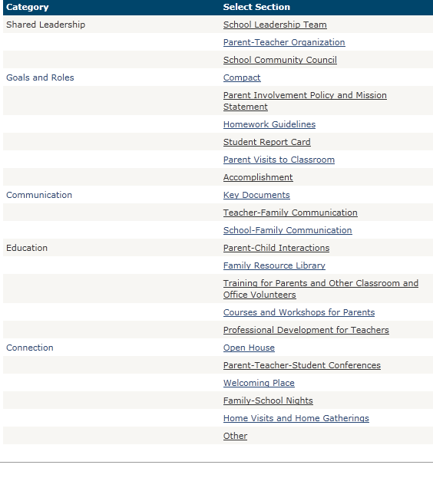
Family Engagement Indicators (68)

Slide 10
BIE Resources
Link: http://www.bie.edu/Programs/supprog/TitleI/index.htm
Parental Involvement Compliance Checklist
Family Engagement/Parental Involvement Planning Timeline
NCLB Parental Involvement/Engagement
State Resources for Parental Involvement (Notification Letters, Policies, Compacts, etc.)
Parent Compact Rubric & Template developed by ADI (Title I Requirement)
Parental Involvement Policy Template developed by ADI (Title I Requirement)
Parental Involvement Policy Rubric developed by ADI

Slide 11
BIE Training
Link: http://www.bie.edu/Programs/supprog/TitleI/index.htm
  Family Engagement Tool Training Materials
    ADD-West Cohort (Contact Loverty Erickson, loverty.erickson@bie.edu)
    ADD-East & ADD-Navajo (Beginning 9/24/2013 contact Valerie Todacheene)
  “Next Steps” Family Engagement Training Materials
  Family Engagement Indicators Training Materials

Slide 12
Training
Family Engagement Tool
(FET)
"Next Steps"
Introduction to Indicators
"Family Engagement Indicators"
Moving Towards Family Engagement

Slide 13

Native Star Document Upload
Parental Involvement/Engagement

Slide 14
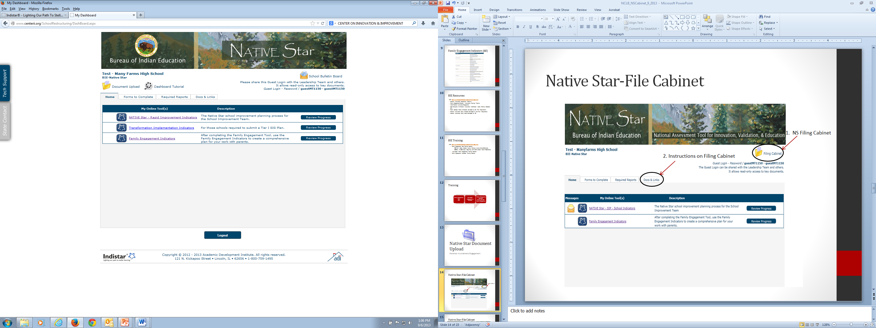
Native Star-Document Upload

Slide 15
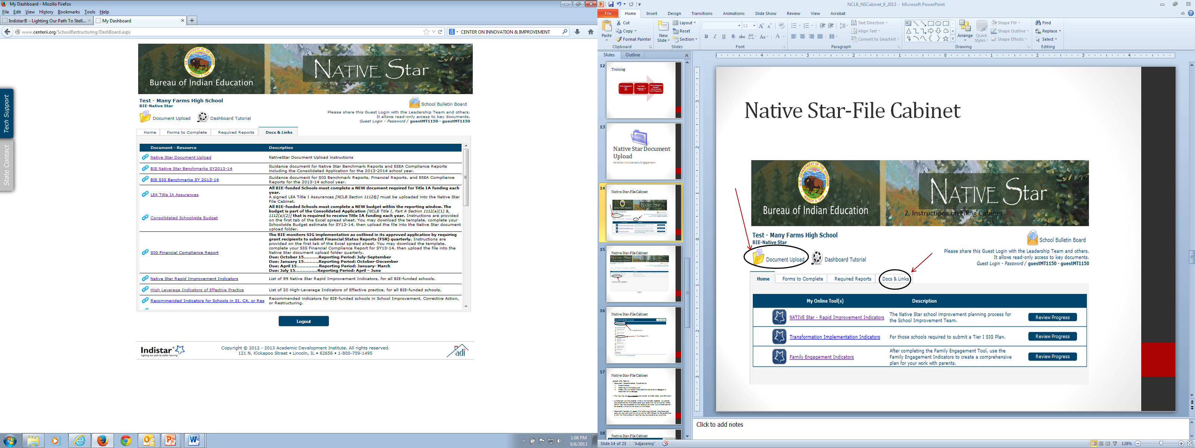
Native Star-File Cabinet

Slide 16
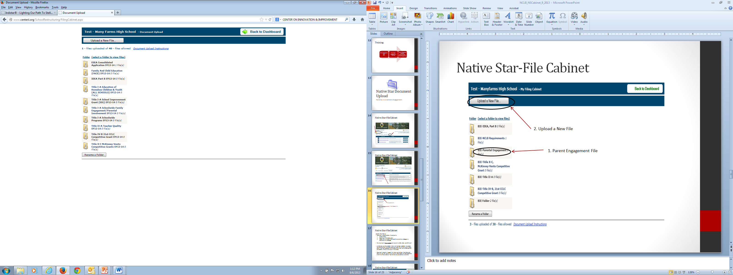
Native Star-Document Upload
2. Upload a New File
1. Parent Engagement File

Slide 17
Native Star-Document Upload
The Document Upload
The Native Star Document Upload feature was developed and instituted in SY 2012-13 to collect specific types of supporting documents that address those components of NCLB that are not explicitly addressed by indicators. For SY 2013-14, specific documents for IDEA Part B, 21st CCLC (Title V), and FACE have been identified to upload into the appropriate folders. The names of those documents are outlined in this Document Upload document along with a description of Acceptable Documentation, the Due Dates or Window to Upload, and a Recommended Name for the uploaded files. Schools should use the Document upload feature for documents that support the plans and not as a substitute for the succinct information entered into the indicator-based planning tool.
The Document Upload Feature
  Document Upload enables the school to:
  Place files in the designated folders created for the schools.
  Place a URL in a folder that directs the viewers to a webpage or a document on a webpage.
  Create a new folder if folders are inadvertently deleted or if an additional folder is necessary.
  The files may be viewed and downloaded viewed by ADD and DPA staff.
Folders have been created for BIE schools in the Native Star Document Upload. A folder can also be created in the Document Upload if necessary. Please be aware that a folder may only be created when a file has been selected to upload. The school enters the folder name and saves the file to the new folder. Other files may be added to the folder at any time, but a folder cannot be created without a file to put in the folder.
Document Upload will accept the following file types: doc, docx, ppt, pptx, xls, xlsx, pdf, and txt with a limit of 100 MB per file. BIE establishes a limit for the number of files that may be stored at any one time.

Slide 18
Native Star-Document Upload
Name of Folder: Title I-A Schoolwide Family Engagement/Parental Involvement
DOCUMENT | ACCEPTABLE DOCUMENTATION | WINDOW TO UPLOAD | RECOMMENDED FILE NAME
Title I Annual Parent Meeting Documentation | Varies, any format is acceptable (meeting agenda and sign-in sheets, announcement in newspaper or website URL, etc.) | August 1 - October 31, 2013 | SchoolName_TI Annual Meeting Agenda_SY13-14 SchoolName_TI Sign-In_XX-XX2013 SchoolName_TI Newspaper_SY13-14
Title I School-Parent Compact | Varies, any format is acceptable Sample can be found at Docs & Links | August 1 - October 31, 2013 | SchoolName_TI School-Parent Comp_SY13-14
Parental Involvement Policy | Varies, any format is acceptable. Sample under Docs & Links tab | August 1 - October 31, 2013 | SchoolName_TI Parental Involve Policy_SY13-14
Annual Parent Notification of AYP Status | Documentation varies-Letter, Newsletter, Meeting Agenda, copy of presentation, screenshot & URL, etc. | August 1 - October 31, 2013 | SchoolName_TI Parent Notification_SY13-14 SchoolName_TI Parent Agenda_SY13-14 SchoolName_TI Presentation_SY13-14
Parent’s Right to Know | Documentation varies-Student Handbook, Title I Annual Meeting Agenda, copy of presentation, Handouts, screenshot or URL., etc. | August 1 - October 31, 2013 | SchoolName_TI Parent Right to Know_SY13-14 SchoolName_TI Handbook_SY13-14 SchoolName_TI Meeting Agenda_SY13-14 SchoolName_TI Right-to-Know PPT_SY13-14
Family Engagement Needs Assessment | Family Engagement Tool or other format | August 1 - October 31, 2013 | SchoolName_FET_SY13-14
Family or Parent Liaison (Job Description) | Varies, any format is acceptable | August 1 - October 31, 2013 | SchoolName_Liaison_JD_SY13-14

Slide 19
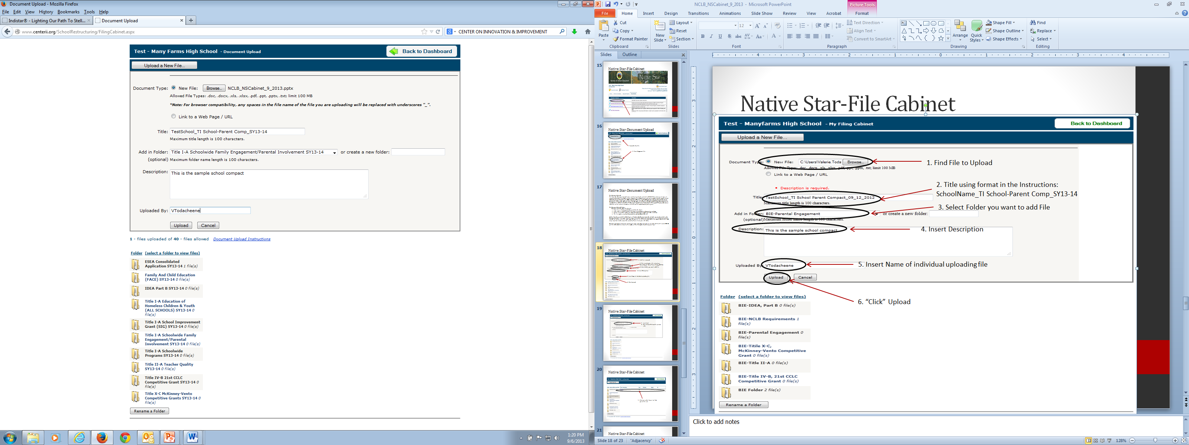
Native Star-Document Upload
1. Find File to Upload
2. Title using format in the Instructions:
SchoolName_TI School-Parent Comp_SY13-14
3. Select Folder you want to add File
4. Insert Description
5. Insert Name of individual uploading file
6. “Click” Upload

Slide 20
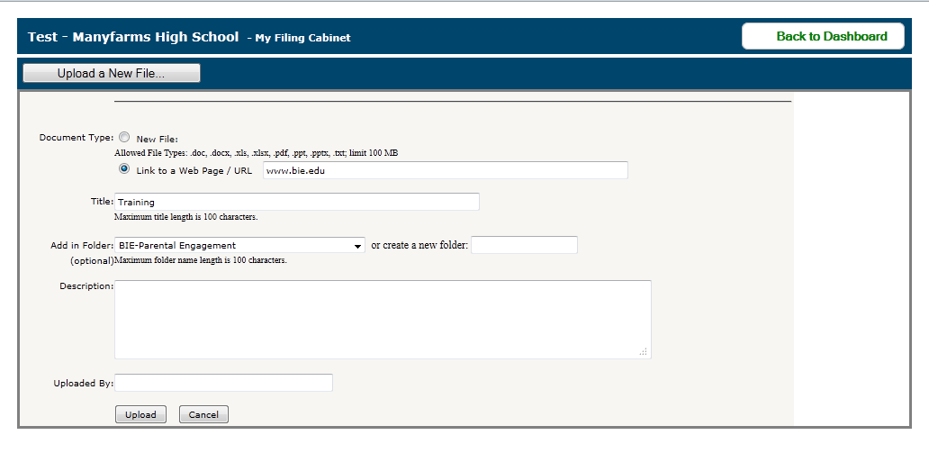
Native Star-Document Upload
Insert Link
Then follow 2-6 from the previous slide

Slide 21
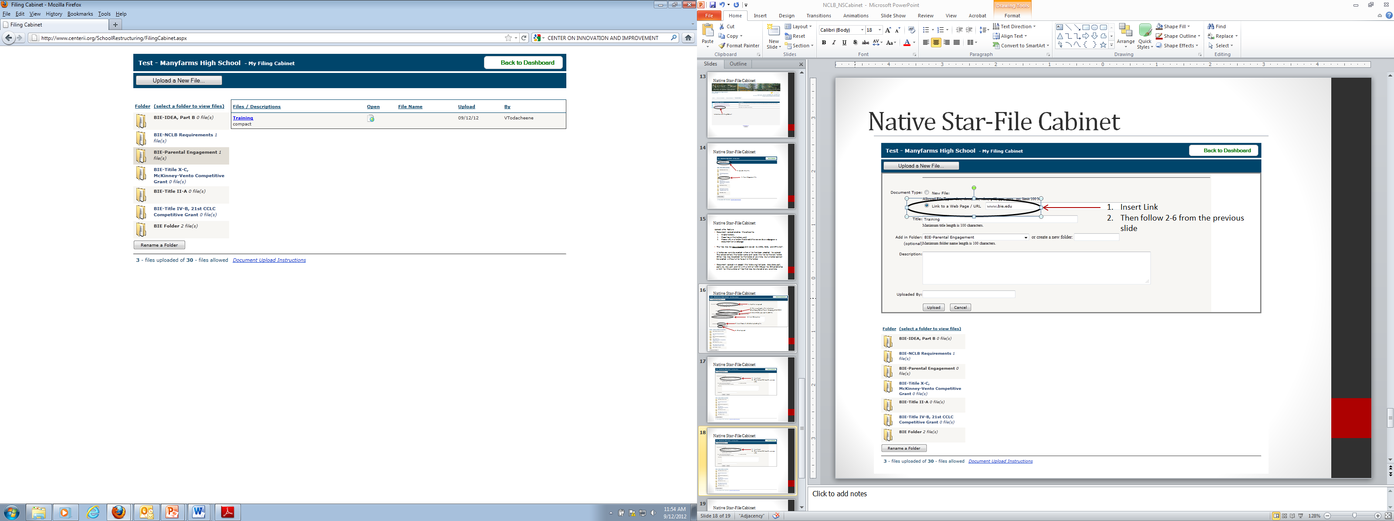
Native Star-Document Upload
Click icon under “open” will take you to the link

Slide 22
Parent Involvement Policies
Non-Compliant NCLB Cycle I&II
ADD-NAVAJO
  Chilchinbeto (Cycle II)
  Crystal Boarding School (Cycle I)
  Dennehotso Boarding School (Cycle I) Not Reported
  Borrego (Cycle I) Not Reported
  Dzlith-Na-O-Dith-Hle School (Cycle I) Not Reported
  Jeehdeez’a Academy (Low Mtn.)
  Lake Valley Navajo School (Cycle I)
  Little Singer Community School (Cycle I) Not Reported
  Mariano Lake Community School (Cycle I)
  Nazlini Boarding School Little Singer Community School (Cycle I) Not Reported
  Rocky Ridge Boarding School (Cycle II)
  Rough Rock Community School Little Singer Community School (Cycle I) Not Reported
ADD-EAST
  Ahfachkee Day School (Cycle II)
  American Horse School (Cycle I)
  Crow Creek Reservation HS (Cycle II)
  Crow Creek Tribal Elementary School (Cycle II)
  Sitting Bull (Cycle I)
  Standing Rock Community School (Cycle II)
  Takini School (Cycle II)
ADD WEST
  Cibecue (Cycle II)
  Havasupai Elem. School (Cycle I)
  Lummi Tribal School (Cycle I)
  Paschal Sherman Indian School (Cycle II)
  Shoshone Bannock School District No, 512 (Cycle II)
  Tsiya Day School (Cycle I)

Slide 23
Parent Involvement Compacts
Non-Compliant NCLB Cycle I&II
ADD-NAVAJO
  Cottonwood Day School (Cycle II)
  Crystal Boarding School (Cycle I)
  Dennehotso Boarding School (Cycle I) Not Reported
  Borrego (Cycle I) Not Reported
  Dzlith-Na-O-Dith-Hle School (Cycle I) Not Reported
  Jeehdeez’a Academy (Low Mtn.) (Cycle I) Not Reported
  Lake Valley Navajo School (Cycle I)
  Little Singer Community School (Cycle I) Not Reported
  Nazlini Boarding School Little Singer Community School (Cycle I)
  Rough Rock Community School Little Singer Community School (Cycle I) Not Reported
  Tohajillee Elementary School (Cycle I)
  Tonalea Day School (Cycle II)
  Wingate HS (Cycle II)
ADD-EAST
  Ahfachkee Day School (Cycle II)
  Pine Ridge School (Cycle I) HS
  Porcupine Day School (Cycle I)
  Sitting Bull (Cycle I)
  Standing Rock Community School (Cycle II)
  Takini School (Cycle II)
  Wounded Knee (Cycle II)

Slide 24
Parent Involvement & McKinney-Vento Training NCLB Cycle III Preparation
Fall 2013 Date TBD (Monitoring)
  DPA will be providing Webinar Training(s) for schools that will be monitored in the Fall 2013 for NCLB Cycle III. The training will involve review of Parental Involvement requirements which includes Parental Involvement Policies & Compacts along with McKinney Vento requirements and review of Homeless Policy. DPA has provided resources, templates, & rubrics on the BIE Website and the Native Star Dashboard for Parental Involvement Policies & Compacts, and Homeless Policies which will be reviewed during the webinars. The schools targeted for monitoring for NCLB Cycle III in the Fall 2013 should be encouraged to participate in the FET trainings which will begin also in the Fall 2013. NOTE: Schools that were in non-compliance for Parental Involvement requirements for Cycle I & II NCLB monitoring should be highly encouraged to participate in FET training for the Fall 2013. ADD-West has already started their cohort training list and DPA will also be providing FET training for ADD Navajo & East & SIG schools in the Fall 2013. Training dates will be provided at the next NSS meeting in August 2013.

Slide 25
FUTURE TRAININGS
FET/Next Steps/Family Engagement Indicator Trainings (Contact V. Todacheene for ADD-East & ADD-Navajo & Loverty Erickson for ADD-West)
November 12-15, 2013
February 10-14, 2013
April 28-May 02, 2013

Slide 26
Presentations
Copies of presentations will be on the BIE Website at:
http://www.bie.edu/Programs/supprog/TitleI/index.htm

Slide 27
Any Questions, Contact:
Valerie Todacheene, Ed.D.
Education Program Specialist, DPA
valerie.todacheene@bie.edu
505-563-5269

