Slide 1


BIE McKinney Vento Local Liaison Training: McKinney Vento
101
November 26, 2013, 11:00 am (MST)
Facilitator: Valerie Todacheene, Ed.D.

Slide 2
Agenda
History
Policies/Procedures
Identification
Enrollment
Educational Service Plan
Public Notice
Accountability
Funding

Slide 3
History McKinney-Vento Homeless Assistance Act
Subtitle B of title VII of the McKinney-Vento Homeless Assistance Act (42 U.S.C. 11431 et seq.)
Signed into Law 1987
Reauthorized in 2002

Slide 4
Policies & Procedures
SEAs and LEAs must develop, review and revise their policies to remove barriers to the enrollment and retention of children and youth in homeless situations. [722(g)(1)(I)]
Immediate enrollment of Homeless students, regardless of missing documentation.
Transportation is provided to & from the “school of origin.”
Homeless children and youths are not stigmatized or segregated on the basis of their status as Homeless.

Slide 5
Policies & Procedures
States are prohibited from segregating homeless students in separate schools, separate programs within schools, or separate settings within schools. [722(e)(3)(A)]
Local educational agencies will designate an appropriate staff person, who may also be a coordinator for other Federal programs, as a local educational agency liaison for homeless children and youths, to carry out the duties… [722(g)(1)(J)(ii)]

Slide 6
Identification
Local Education Agency Liaison must ensure that….
(i) homeless children and youths are identified by school personnel and through coordination activities with other entities and agencies… [722(g)(6)(A)(i)]

Slide 7
Identification
Local Education Agency Liaison must ensure that….
Housing is:
Temporary and as a result of hardship
or
Substandard or considered inadequate
or
Unaccompanied Youth

Slide 8
Identification
Local Education Agency Liaison must ensure that student meets the definition….
(i) The term ‘homeless children and youth’ (A)means individuals who lack a fixed, regular, and adequate nighttime residence. [725(2)(A)]
Fixed – one that is stationary, permanent, and not subject to change
Regular – one which is used on a regular (i.e. nightly) basis
Adequate – one that is sufficient for meeting both the physical and psychological needs typically met in home environments.

Slide 9
Identification
Definition con’t….
Sharing housing due to loss of housing or economic hardship.
Living in motels, hotels, trailer parks, or camping grounds due to lack of alternative adequate housing.
Living in emergency or transitional housing.
Abandoned in hospitals.
Awaiting foster care.
Living in cars, parks, public spaces, abandoned buildings, substandard housing, and bus or train stations.
Children and youth who have a primary nighttime residence that is a public or private place not designed for, or ordinarily used as, regular sleeping accommodations.

Slide 10
Identification
Local Education Agency Liaison must ensure that student meets the definition unaccompanied youth….
a youth not in the physical custody of a parent or guardian. [725(6)]

Slide 11
What are some identification Strategies?
List on Chat

Slide 12
What are some identification Strategies?
Review Responses

Slide 13
Enrollment
Local Education Agency Liaison must ensure that….
(ii) homeless children and youths enroll in, and have a full and equal opportunity to succeed in, schools of that local education agency. [722(g)(6)(A)(ii)]

Slide 14
Enrollment
Local Education Agency Liaison must ensure that….
Enrollment is immediate even without the following documents:
Birth Certificates
School records
Immunization
Tribal Enrollment
Children and youth have the right to enroll in school immediately, even if they do not have required documents, such as school records, medical records, proof of residency, or other documents. [722(g)(3)(C)(i)]

Slide 15
Enrollment
Local Education Agency Liaison must enroll immediately but must follow up on the required documents.
If a student does not have immunizations, or immunization or medical records, the liaison must immediately assist in obtaining them, and the student must be enrolled in school in the interim. [722(g)(3)(C)(iii)]
Enrolling schools must obtain school records from the previous school, and students must be enrolled in school while records are obtained. [722(g)(3)(C)(ii)]
Schools must maintain records for students who are homeless so they are available quickly. [722(g)(3)(D)]

Slide 16
Enrollment
School Selection (if applicable):
Local Educational Agencies (LEAs) must keep students in homeless situations in their school of origin, to the extent feasible, unless it is against the parent’s or guardian’s wishes. [722(g)(3)(B)(i)]
Students can stay in their school of origin the entire time they are homeless, and until the end of any academic year in which they move into permanent housing. [722(g)(3)(A)(i)] [722(g)(3)(A)(i)(II)]

Slide 17
Educational Service Plan
Local Education Agency Liaison must ensure that….
Homeless families, children, and youths receive educational services for which such families, children, and youths are eligible, including Head Start and Even Start programs and preschool programs administered by the local educational agency, and referrals to health care services, dental services, mental health services, and other appropriate services; [722(g)(6)(A)(iii)]

Slide 18
Educational Service Plan
Local Education Agency Liaison must ensure that….
Receives Title I services
The school has a Title I set-aside for Homeless students and youth at recommended .5%
English Acquisition Services/ELL
Gifted
Counseling
Head Start
Liaisons must ensure that families and children receive Head Start, Even Start programs and preschool programs. [722(g)(6)(A)(iii)]
Preschool
Special Education (if eligible)

Slide 19
Public Notice
Local Education Agency Liaison must ensure that….
The parents or guardians of homeless children and youths are informed of the educational and related opportunities available to their children and are provided with meaningful opportunities to participate in the education of their children; [722(g)(6)(A)(iv)]
Public notice of the educational rights of homeless children and youths is disseminated where such children and youths receive services under this Act such as schools, family shelters, and soup kitchens; [722(g)(6)(A)(v)]

Slide 20
Public Notice
Local Education Agency Liaison must ensure that….
There is information distributed to all parents about the school’s services provided to homeless youth & children during beginning and end of year.
Samples include: poster, newsletters, brochures, Handbook, Website
Provided in school and community

Slide 21
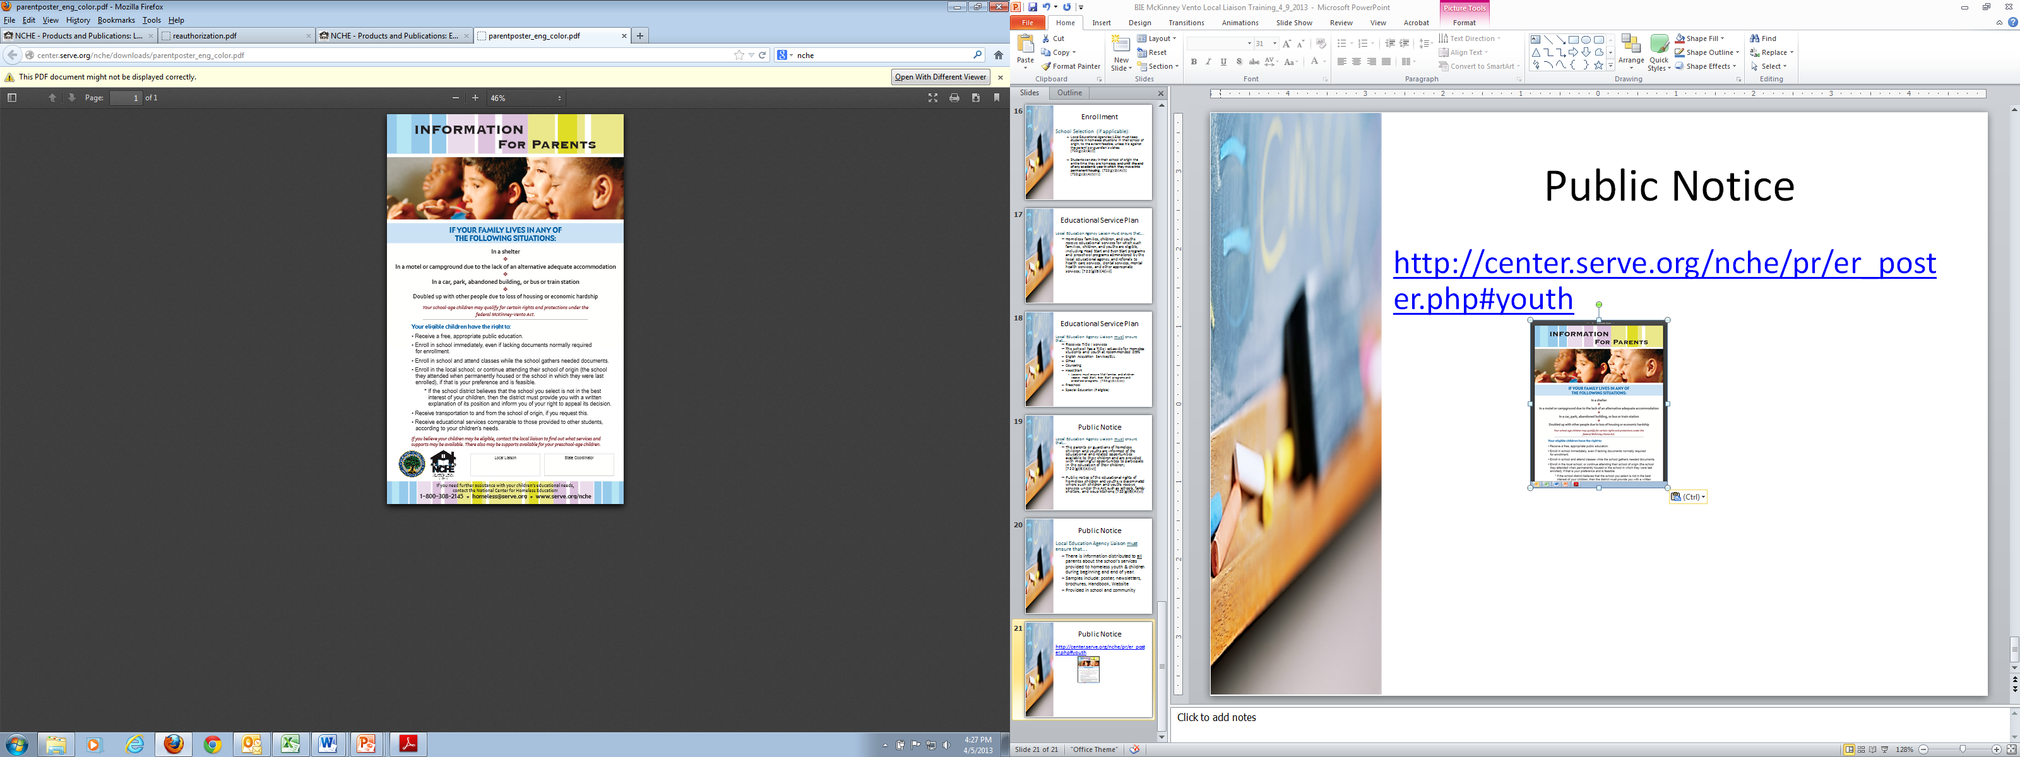
Public Notice
http://center.serve.org/nche/pr/er_poster.php#youth

Slide 22
Accountability
Data Collection
All LEAs Identify Homeless Children & Youth in NASIS
LEAs with Sub-Grants
Annual Evaluation Template
Number of homeless children & youth served by sub-grant funding
Number of children receiving educational and school support services
Barriers to the education of homeless children & youth.

Slide 23
Accountability
BIE Monitoring
Describe local partnerships and collaborations in which the project is engaged.
The school has a procedure in place to identify school-age homeless children and youth and determine whether or not they are attending and succeeding in school.
Public notice of educational rights of homeless children and youth is disseminated by LEA in places where families and youth are likely to be present (e.g., schools, shelters, soup kitchens), and in comprehensible formats (e.g., in Native Language, geared for low literacy, or other community need).

Slide 24
Accountability
BIE Monitoring
The school has designated a staff person as the liaison for homeless children and youths, to carry out the duties described in paragraph (6)(A) of Title X, Part C, Sec. 1032, Subtitle B Sec. 722(g)(1)(j)(ii) and all schools, local service providers, and advocates are informed of the liaison’s duties, the definition of homeless and Title X requirements.
The school has a homeless education policy for the purpose of removing enrollment and retention barriers of homeless children and youth; the policy includes assurance that homeless children and youth are not stigmatized or segregated.

Slide 25
Accountability
Additional Items for BIE Monitoring
Homeless youth & children goals are integrated in Schoolwide Plan and Consolidated Schoolwide Budget
Parental Involvement

Slide 26
Funding
Title I Set-Asides (.5%)
McKinney-Vento Sub Grant (Competitive)
General Funds
Illustrated in Consolidated Schoolwide Budget(s)

Slide 27
Resources
PowerPoint
NCHE Title I (Law into Practice Brief Series)
BIE Homeless Education/McKinney-Vento Local Liaison Listing
Local Liaison Toolkit (NCHE) post on BIE website
http://center.serve.org/nche/pr/liaison_toolkit.php

Slide 28
Additional Resources
The National Center for Homeless Education (NCHE) www.serve.org/nche
U.S. Department of Education, Education for Homeless Children Youth Program www.ed.gov/programs/homeless/index.html
The National Association for the Education of Homeless Children and Youth (NAEHCY) www.naehcy.org
The National Law Center on Homelessness and Poverty (NLCHP) www.nlchp.org

Slide 29
McKinney Vento Local Liaison Trainings (WebEx)
January 9, 2014, 11:00am (MST)
Topic: TBA
March 11, 2014, 11:00am (MST)
Topic: TBA
May 13, 11:00am (MDT)
Topic: TBA

Slide 30
QUESTIONS

Slide 31
BIE State Coordinator
Valerie Todacheene, Ed.D.
BIE-McKinney Vento State Coordinator
505-563-5269
Valerie.todacheene@bie.edu

