Slide 1

MCkINNEY-vento homeless education
2012-2015 grant awardee training
      Division of Performance and Accountability
      September 26, 2013
      2:00 PM(MDT)

Slide 2
Agenda
Carryover Requests
Modifications
Document Submissions/Requirements SY13-14
Homeless Policy/Procedures
SY 13-14 Funding Status

Slide 3
Carryover
Subgrantees must submit Carryover Requests for 2012-13 funds by October 1, 2013 if you have a balance of your 12-13 funds by September 30, 2013.
See attached document
Must have signature/date of requestor/ELO
Provide Justification
DPA will review/approve and provide a date in which carryover must be expended.
Carryover is discouraged, and any carryovers may potentially impact subsequent funding.

Slide 4
Modifications to Approved Application
If there are changes that you are making to your application in: activities, budget description, budget you must submit a modification request.
Modifications must still fall within the goal & intent of the McKinney Vento grant.
Three (3) parts to the modification: 1) Modification Template, 2) Budget Description, and 3) Budget
Requestor must sign & the ELO must sign

Slide 5
Document Submissions in NS Document Upload
Submit an Evaluation Template which provides a status report of their project to the McKinney-Vento State Coordinator at the beginning, middle and end of the school year. (Sept. 1st , Dec. 30th, July 1st)
End of the Year Report (July 1-31, 2014)
Homeless Education Modification Request (As necessary)
Submission can be made into the Native Star Document Upload
Homeless Policy/Procedures (August 1-October 31, 2013)

Slide 6

Native Star Document Upload
McKinney-Vento

Slide 7
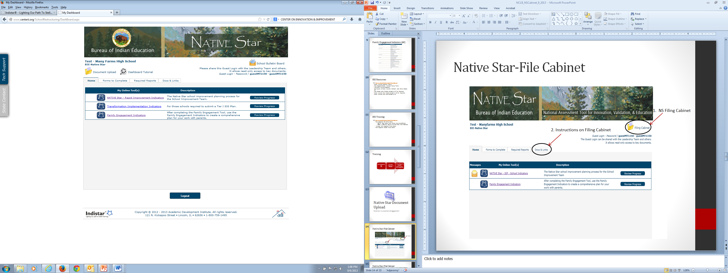
Native Star-Document Upload

Slide 8
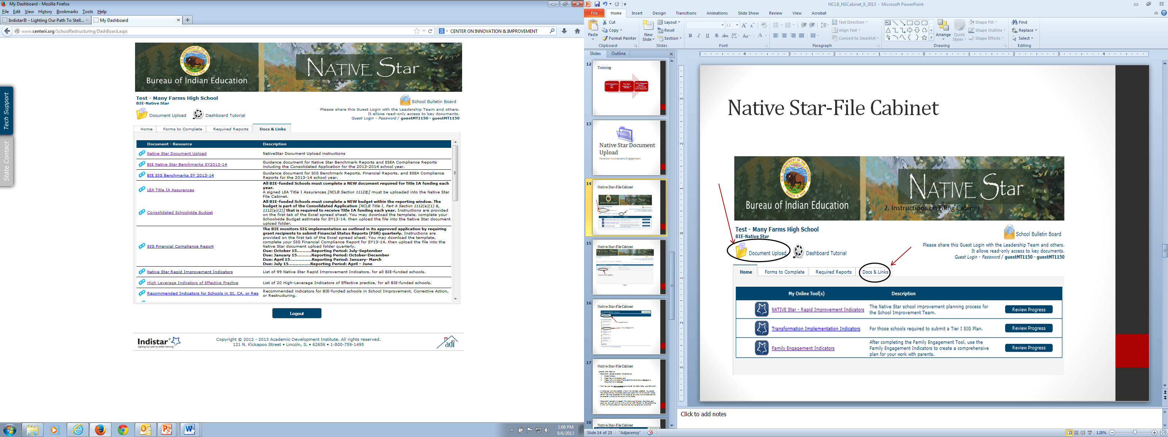
Native Star-File Cabinet

Slide 9
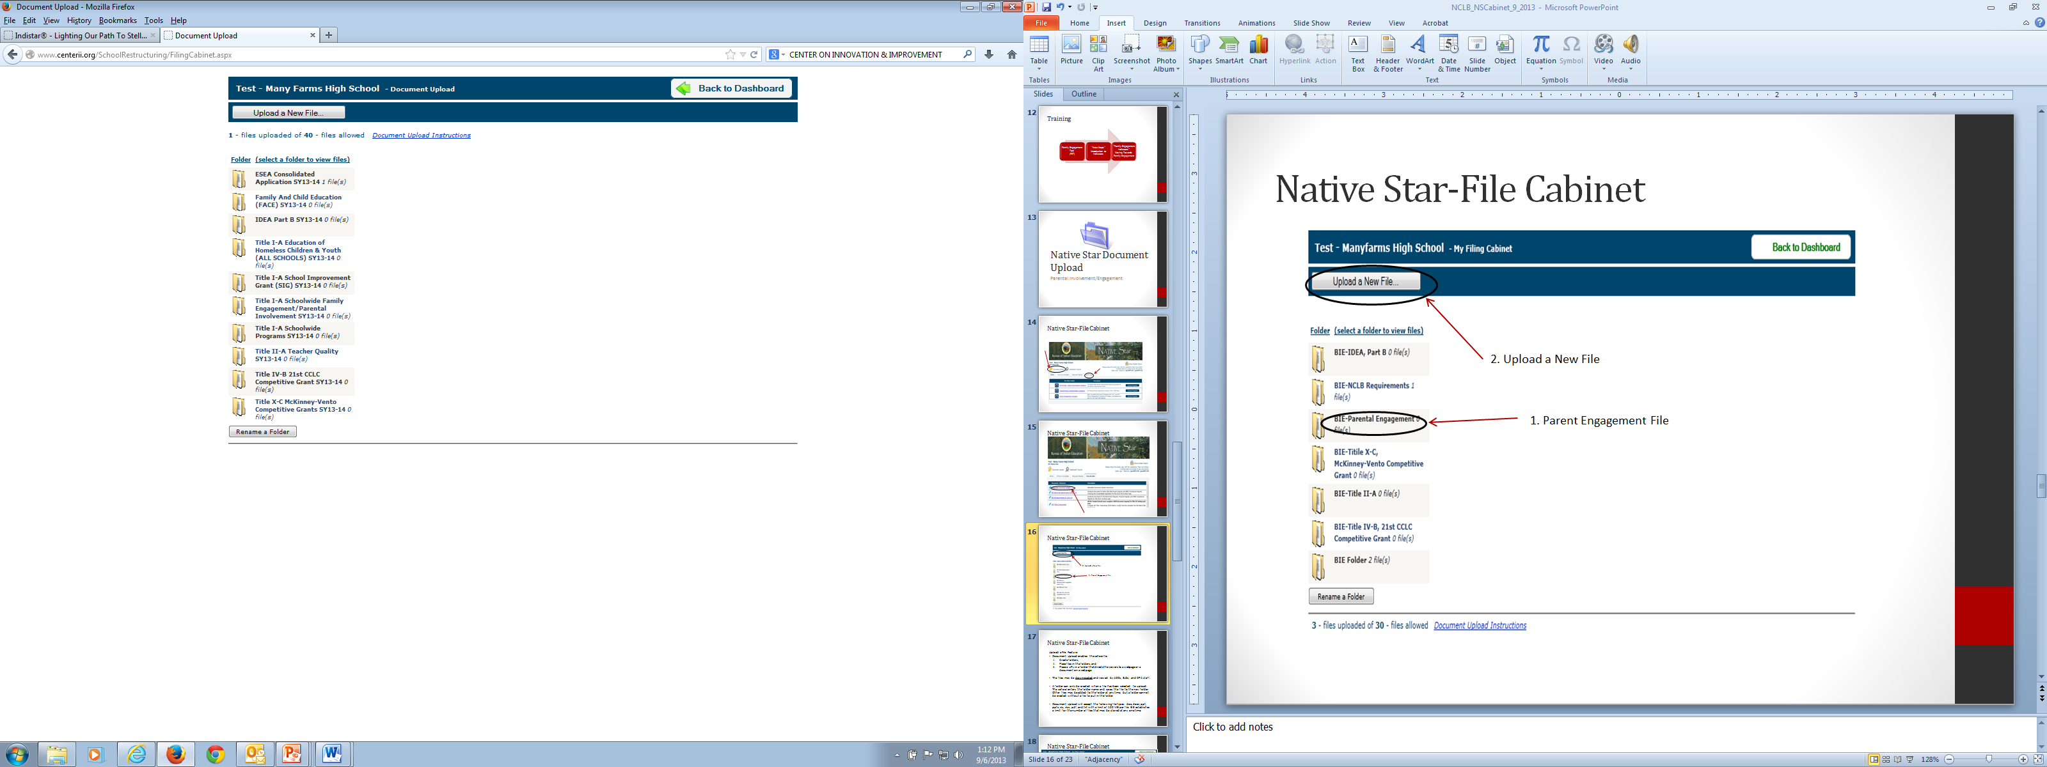
Native Star-Document Upload
2. Upload a New File
1. McKinney Vento File

Slide 10
Native Star-Document Upload
The Document Upload
The Native Star Document Upload feature was developed and instituted in SY 2012-13 to collect specific types of supporting documents that address those components of NCLB that are not explicitly addressed by indicators. For SY 2013-14, specific documents for IDEA Part B, 21st CCLC (Title V), and FACE have been identified to upload into the appropriate folders. The names of those documents are outlined in this Document Upload document along with a description of Acceptable Documentation, the Due Dates or Window to Upload, and a Recommended Name for the uploaded files. Schools should use the Document upload feature for documents that support the plans and not as a substitute for the succinct information entered into the indicator-based planning tool.
The Document Upload Feature
  Document Upload enables the school to:
  Place files in the designated folders created for the schools.
  Place a URL in a folder that directs the viewers to a webpage or a document on a webpage.
  Create a new folder if folders are inadvertently deleted or if an additional folder is necessary.
  The files may be viewed and downloaded viewed by ADD and DPA staff.
Folders have been created for BIE schools in the Native Star Document Upload. A folder can also be created in the Document Upload if necessary. Please be aware that a folder may only be created when a file has been selected to upload. The school enters the folder name and saves the file to the new folder. Other files may be added to the folder at any time, but a folder cannot be created without a file to put in the folder.
Document Upload will accept the following file types: doc, docx, ppt, pptx, xls, xlsx, pdf, and txt with a limit of 100 MB per file. BIE establishes a limit for the number of files that may be stored at any one time.

Slide 11
Native Star Document Upload
Name of Folder: TITLE X-C McKinney-Vento Competitive Grant SY13-14
DOCUMENT | Acceptable Documentation | WINDOW or DUE DATES | RECOMMENDED FILE NAME
Homeless Education Policy | Varies, any format is acceptable | August 1 - October 31, 2013 | SchoolName_TX Policy_SY13-14
Student Verification Document (Blank Document) | Example at www.bie.edu | August 1 - October 31, 2013 | SchoolName_TX Enrollment Form_SY13-14
Homeless Education Liaison (Job Description) | Varies, any format is acceptable | August 1 - October 31, 2013 | SchoolName_TX Liaison_SY13-14
Evaluation Template | Template at www.bie.edu | September 1, 2013, December 30, 2013, and July 1, 2014 | SchoolName_TX Evaluation_SY13-14
End of the Year Report Template | Template at www.bie.edu | July 1 - 31, 2013 | SchoolName_TX EOY Report_SY13-14
Homeless Education Approved Plan with Budget | Varies, any format is acceptable | August 1 - October 31, 2013 | SchoolName_TX Plan&Budget_SY13-14
Homeless Education Modification Request | Template at www.bie.edu | As necessary | SchoolName_TX Modification_SY13-14

Slide 12
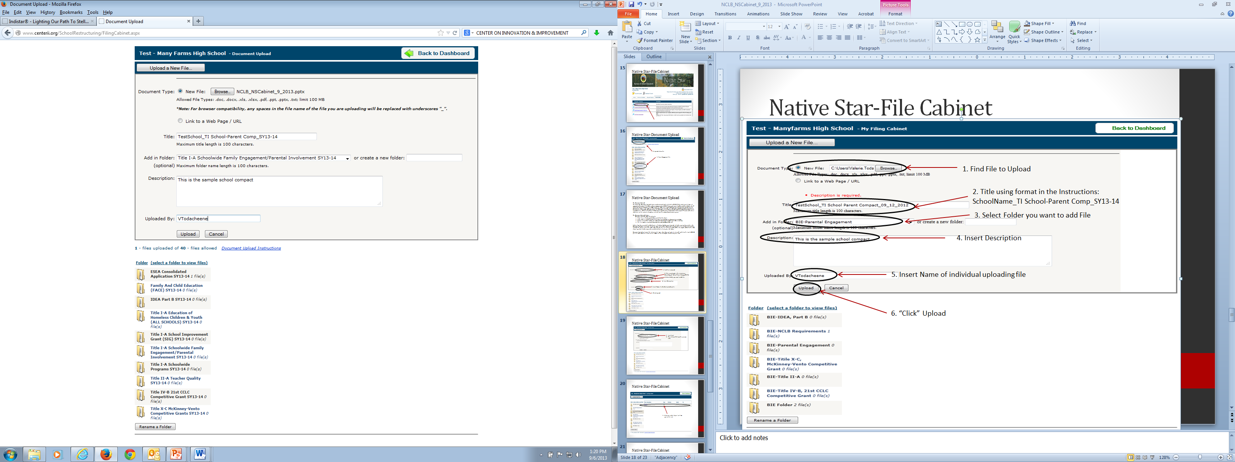
Native Star-Document Upload
1. Find File to Upload
2. Title using format in the Instructions:
SchoolName_TI School-Parent Comp_SY13-14
3. Select Folder you want to add File
4. Insert Description
5. Insert Name of individual uploading file
6. “Click” Upload

Slide 13
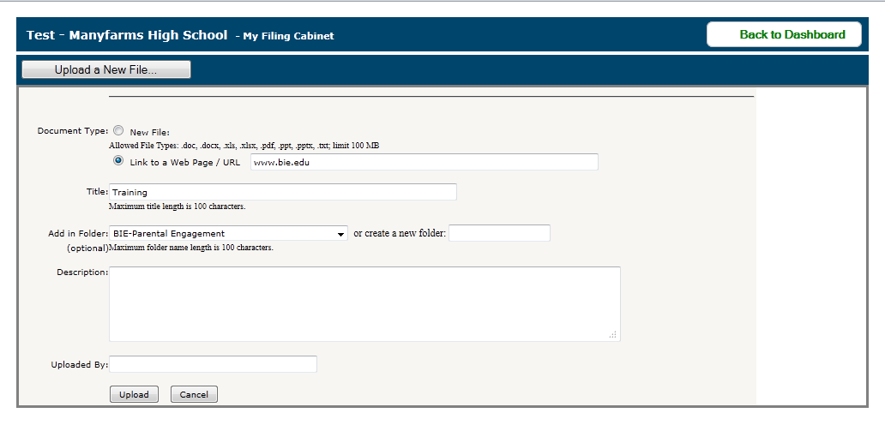
Native Star-Document Upload
Insert Link
Then follow 2-6 from the previous slide

Slide 14
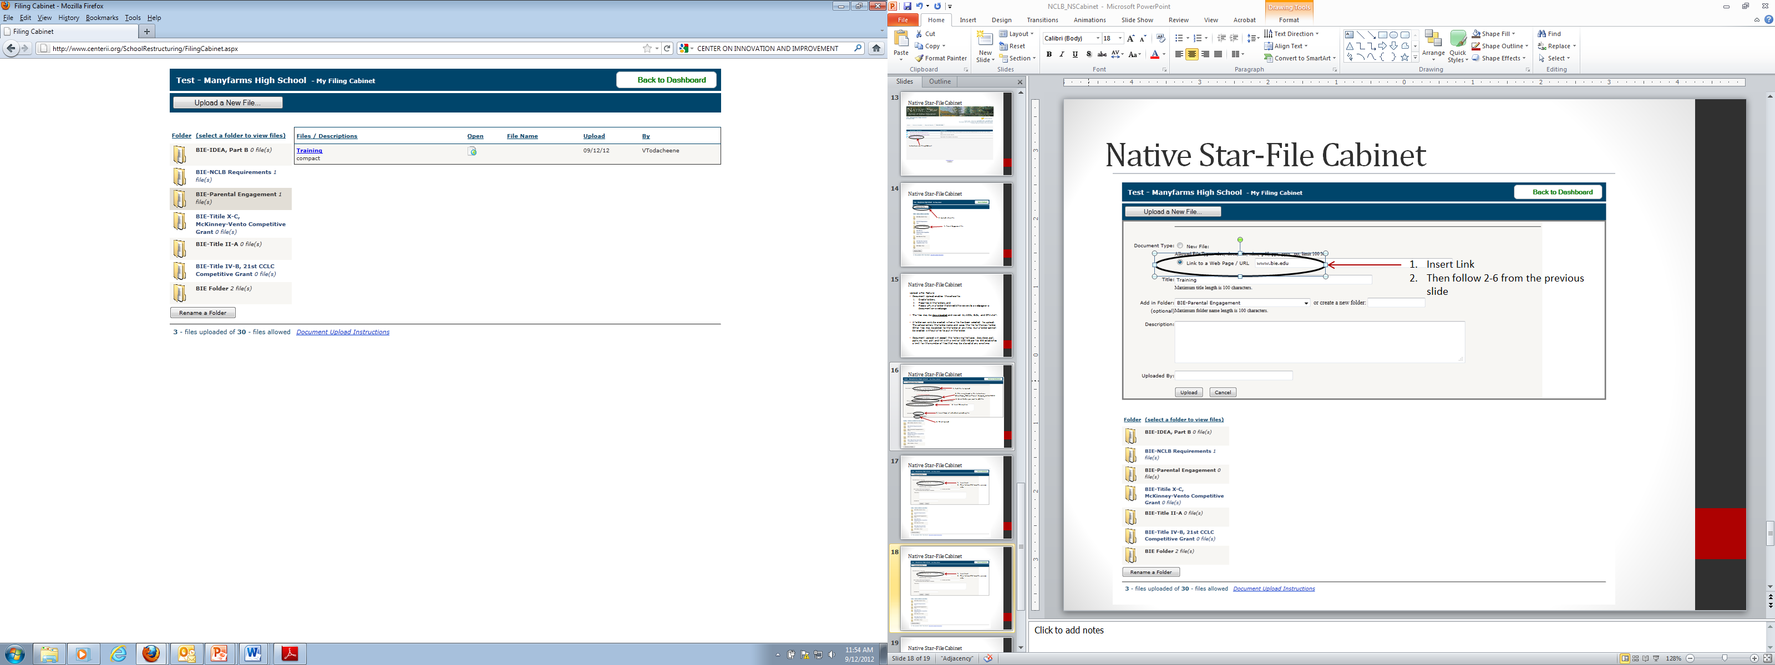
Native Star-Document Upload
Click icon under “open” will take you to the link

Slide 15
NS Report Submissions
Subgrantees should be working on the High Leverage Indicators (Sept. 15th, Dec. 15th, May 15th)
Consolidated Schoolwide Budgets (July 1st -Sept. 30th)
AYP Smart Goals & Title I Supplemental Report (July 1st-Sept. 30th)
LEA Title I Assurances (July 1st-Sept. 30th)
School Improvement, Corrective Action, Restructuring (July 1st-Sept. 30th)
SIG Compliance Reports if applicable

Slide 16
Other Required Activities
Attend subgrantees’ webinars & trainings scheduled
Attend McKinney Vento Local Liaison trainings (four scheduled for the SY 13-14)
Submit Homeless information into NASIS
Participation in Family Engagement Tool

Slide 17
Suggested Activities
NAEHCY Conference
Atlanta, GA
November 2-5, 2013
Pre-Conference – November 2, 2013

Slide 18
Policy & Procedure Development
Policies and procedures that are or will be in place to promote accessibility and academic success of homeless students.
Reviewing and establishing policies and procedures for the purposes of promoting the education of McKinney-Vento eligible children and youth and addressing the following: determining eligibility, enrollment, transportation, attendance, guardianship assistance, credit accrual, comparable services, and any other policy or procedure-related.
Policies & Procedures should be in written form and can be included in Parent Policy, Handbook, or “stand alone” policy
Schools receive subgrants will participate in FET to assist with the development of policies to address the needs McKinney-Vento students. Training for this will begin April 2013 to assist with this process.
Policies must be uploaded into Native Star (August 1-October 31, 2013)

Slide 19
2013-14 SY Funding
  Demonstrate success yearly in order to be funded for a subsequent second and third year.
  Evidence of success includes meeting the grant requirements which were outlined in the application.
  In addition, this award is contingent upon funding and availability of funds.
  The distribution of this award is for the implementation of the goals of the subgrant which are carried out by the activities identified in the school’s approved application and signed assurances.

Slide 20
EOY Report Status
  Complete-
  St. Stephens, Wingate HS, Fond Du Lac, Rock
  Creek, Riverside, Circle of Nations, Little Wound
  Corrections-Rocky Ridge, Crow Creek, Tohaali, Hotevilla Bacavi, Lower Brule, Pueblo Pintado, Kayenta,Cheyenne Eagle Butte, Pine Ridge
  Not submitted- Standing Rock

Slide 21
FDD Status
  FDD Submitted- 50% or 100% SY 12-13 funds
  Wingate HS, Fond Du Lac, Rock
  Creek, Riverside, Circle of Nations
  FBMS “Black out”
  Complete Corrections/Submit reports
  October FDD submission, processed by November 2013.

Slide 22
Contact Information
Valerie Todacheene, Ed.D, BIE McKinney-Vento State Coordinator
  E-mail: Valerie.Todacheene@bie.edu
  Ph: 505.563.5269

Slide 23

Questions

