Slide 1


BIE McKinney Vento Local Liaison Training: McKinney Vento
Review:
Homeless Liaison Toolkit
May 13, 2014, 11:00 am (MDT)
Facilitator: Valerie Todacheene, Ed.D.

Slide 2
Introduction
-Overview Liaison Responsibilities
-Review Critical Chapters
-Planning for SY14-15

Slide 3
Legislative Requirement-LEA
LEA Responsibilities §722(g)(3)(A-D)
(3) LOCAL EDUCATIONAL AGENCY REQUIREMENTS-
(A) IN GENERAL- The local educational agency serving each child or youth to be assisted under this subtitle shall, according to the child's or youth's best interest 
(i) continue the child's or youth's education in the school of origin for the duration of homelessness 
(I) in any case in which a family becomes homeless between academic years or during an academic year; or
(II) for the remainder of the academic year, if the child or youth becomes permanently housed during an academic year; or
(ii) enroll the child or youth in any public school that nonhomeless students who live in the attendance area in which the child or youth is actually living are eligible to attend.
(B) BEST INTEREST- In determining the best interest of the child or youth under subparagraph (A), the local educational agency shall 
(i) to the extent feasible, keep a homeless child or youth in the school of origin, except when doing so is contrary to the wishes of the child's or youth's parent or guardian;
(ii) provide a written explanation, including a statement regarding the right to appeal under subparagraph (E), to the homeless child's or youth's parent or guardian, if the local educational agency sends such child or youth to a school other than the school of origin or a school requested by the parent or guardian; and
(iii) in the case of an unaccompanied youth, ensure that the homeless liaison designated under paragraph (1)(J)(ii) assists in placement or enrollment decisions under this subparagraph, considers the views of such unaccompanied youth, and provides notice to such youth of the right to appeal under subparagraph (E).
(C) ENROLLMENT- (i) The school selected in accordance with this paragraph shall immediately enroll the homeless child or youth, even if the child or youth is unable to produce records normally required for enrollment, such as previous academic records, medical records, proof of residency, or other documentation.
(ii) The enrolling school shall immediately contact the school last attended by the child or youth to obtain relevant academic and other records.
(iii) If the child or youth needs to obtain immunizations, or immunization or medical records, the enrolling school shall immediately refer the parent or guardian of the child or youth to the local educational agency liaison designated under paragraph (1)(J)(ii), who shall assist in obtaining necessary immunizations, or immunization or medical records, in accordance with subparagraph (D).
(D) RECORDS- Any record ordinarily kept by the school, including immunization or medical records, academic records, birth certificates, guardianship records, and evaluations for special services or programs, regarding each homeless child or youth shall be maintained 
(i) so that the records are available, in a timely fashion, when a child or youth enters a new school or school district; and
(ii) in a manner consistent with section 444 of the General Education Provisions Act (20 U.S.C. 1232g).
~NCHE, http://center.serve.org/nche/downloads/sc_mon_hb.pdf

Slide 4
LEA LIAISON
Local Education Agency Liaison must ensure that….
(ii) homeless children and youths enroll in, and have a full and equal opportunity to succeed in, schools of that local education agency. [722(g)(6)(A)(ii)]
Enrollment is immediate even without the following documents:
Birth Certificates
School records
Immunization
Tribal Enrollment
Children and youth have the right to enroll in school immediately, even if they do not have required documents, such as school records, medical records, proof of residency, or other documents. [722(g)(3)(C)(i)]
Local Education Agency Liaison must enroll immediately but must follow up on the required documents.
If a student does not have immunizations, or immunization or medical records, the liaison must immediately assist in obtaining them, and the student must be enrolled in school in the interim. [722(g)(3)(C)(iii)]
Enrolling schools must obtain school records from the previous school, and students must be enrolled in school while records are obtained. [722(g)(3)(C)(ii)]
Schools must maintain records for students who are homeless so they are available quickly. [722(g)(3)(D)]

Slide 5
LEA LIAISON
Local Education Agency Liaison must ensure that….
Homeless families, children, and youths receive educational services for which such families, children, and youths are eligible, including Head Start and Even Start programs and preschool programs administered by the local educational agency, and referrals to health care services, dental services, mental health services, and other appropriate services; [722(g)(6)(A)(iii)]
Receives Title I services
The school has a Title I set-aside for Homeless students and youth at recommended .5%
English Acquisition Services/ELL
Gifted
Counseling
Head Start
Liaisons must ensure that families and children receive Head Start, Even Start programs and preschool programs. [722(g)(6)(A)(iii)]
Preschool
Special Education (if eligible)

Slide 6
LEA LIAISON
Local Education Agency Liaison must ensure that….
The parents or guardians of homeless children and youths are informed of the educational and related opportunities available to their children and are provided with meaningful opportunities to participate in the education of their children; [722(g)(6)(A)(iv)]
Public notice of the educational rights of homeless children and youths is disseminated where such children and youths receive services under this Act such as schools, family shelters, and soup kitchens; [722(g)(6)(A)(v)]
There is information distributed to all parents about the school’s services provided to homeless youth & children during beginning and end of year.
Samples include: poster, newsletters, brochures, Handbook, Website
Provided in school and community

Slide 7
Toolkit Chapters
Chapter 1 Overview and History
Chapter 2 Local Educational Agency and Homeless Liaison Responsibilities
Chapter 3 Identification of Students Experiencing Homelessness
Chapter 4 Determining Eligibility
Chapter 5 Enrolling Homeless Students.
Chapter 6 School Selection
Chapter 7 Transportation
Chapter 8 Dispute Resolution
Chapter 9 Unaccompanied Homeless Youth
Chapter 10 Working with Parents
Chapter 11 Collaboration
Chapter 12 Training and Awareness
Chapter 13 Data Collection and Requirements
Chapter 14 Subgrants
Chapter 15 Managing the Work
Chapter 16 Related Legislation
Chapter 17 Additional Resources

Slide 8
Toolkit Chapters
Chapter 1 Overview and History
Chapter 2 Local Educational Agency and Homeless Liaison Responsibilities
Chapter 3 Identification of Students Experiencing Homelessness
Chapter 4 Determining Eligibility
Chapter 5 Enrolling Homeless Students.
Chapter 6 School Selection
Chapter 7 Transportation
Chapter 8 Dispute Resolution
Chapter 9 Unaccompanied Homeless Youth
Chapter 10 Working with Parents
Chapter 11 Collaboration
Chapter 12 Training and Awareness
Chapter 13 Data Collection and Requirements
Chapter 14 Subgrants
Chapter 15 Managing the Work
Chapter 16 Related Legislation
Chapter 17 Additional Resources

Slide 9
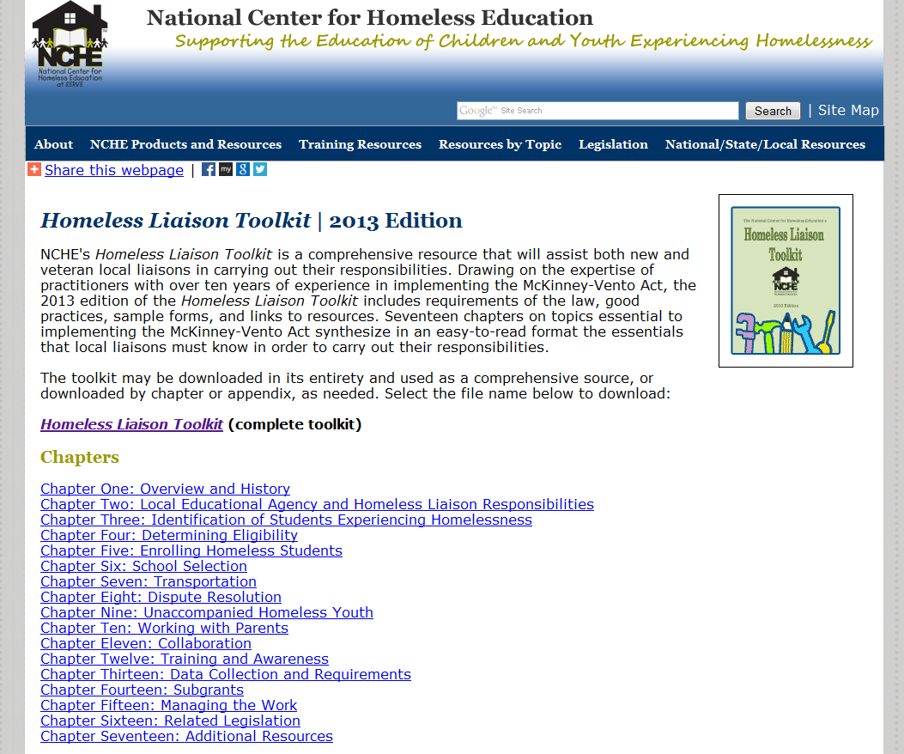
Accessing Toolkit
http://center.serve.org/nche/pr/liaison_toolkit.php

Slide 10
SY14-15 PLANNING
Verification Documents
Homeless Policy
.05 % set-aside
NAEHCY 2014 Annual Conference---Kansas City, MO, October 25-28, 2014
Submit Annual Evaluation Template in Native Star for SY 13-14 & Plan to Submit for SY 14-15
Posters/Publications/Brochures of Services
Collaboration & Outreach to community organizations

Slide 11
BIE State Coordinator
Valerie Todacheene, Ed.D.
BIE-McKinney Vento State Coordinator
505-563-5269
Valerie.todacheene@bie.edu

