Slide 1
Family Engagement 2014-15 SY
October 9, 2014
Facilitated by: Valerie Todacheene

Slide 2
Agenda
BIE Monitoring Initiative on Parent Involvement/Engagement
Review Requirements
Evidence Parental Involvement Requirements
BIE Resources/Training
Native Star “Document Upload”
Questions

Slide 3
BIE Monitoring
IA&S Monitoring 2011-12, 2012-13, 2013-14
Communicate with ADDs/ELOs on non-compliance
Provide support to schools through ADDs/ELOs on Family Engagement

Slide 4
IA&S Monitoring SY 2014-15
ON-SITE VISIT(S)
Ojibwa Indian School
Dunseith Day School
Turtle Mountain Community Middle School
Pine Springs Day School
Shonto Preparatory School
T'iisnazbas Community School
Tate Topa Tribal School
Theodore Jamerson Elementary School
Beclabito Day School
Kin Dah Lichi Olta
Casa Blanca Community School
Salt River Community School
Rock Creek Grant School (SIG)
Wounded Knee District School (SIG)
Beatrice Rafferty School
Cherokee Central Elementary School
Jemez Day School
Meskwaki Settlement School
Taos Day School
Isleta Elementary School
First Mesa Elementary School
Hopi Junior/Senior High School
Cheyenne-Eagle Butte School
Circle of Nations
Second Mesa Day School
DESK REVIEW
Choctaw Central High School
Choctaw Cental Middle School
Circle of Life School
Lac Courte Oreilles Ojibwa School
Aneth Community School
Sanostee Day School
Seba Dalkai Boarding School
Tuba City Boarding School
Santa Clara Day School

Slide 5
IA&S Monitoring SY 2014-15
FISCAL ON-SITE VISIT(S)
Tohajiilee Community School
Hopi Day School
Hotevilla-Bacavi Community School
Moencopi Day School
Ch'ooshgai Community School
Cove Day School
Yakama Nation Tribal School

Slide 6
IA&S Monitoring Indicators
Area 3: Family and Community Engagement
7. For Schools in School Improvement: The LEA/School described how it publicizes and disseminates the annual progress of the school in making adequate yearly progress (AYP) to staff, parents, and the community. [Section 1116(a)(1)(C)]
8. For Schools in School Improvement: The school outlines and implements strategies to promote effective parental involvement. [Section 1116(c)(7)(A)(viii)]
9. For All Schools: The LEA/School described how its Parental Involvement Policy was jointly developed with and distributed to parents. The Parental Involvement Policy establishes the LEA/School’s expectations for parent involvement. [Section 1118(a)(2)]
10. For All Schools: The LEA/School described how it will annually review and evaluate – with parent input – the effectiveness of LEA/School’s parental involvement policy in improving the academic achievement of students, and revise the plan as necessary. [Section 1118 (a)(2)(E)]
11. For All Schools: The LEA/School described how it informs parents, through an annual meeting, about the school’s participation in Title I, Part A, as well as parents’ rights to be involved in school activities. [Section 1118(c)(1)]

Slide 7
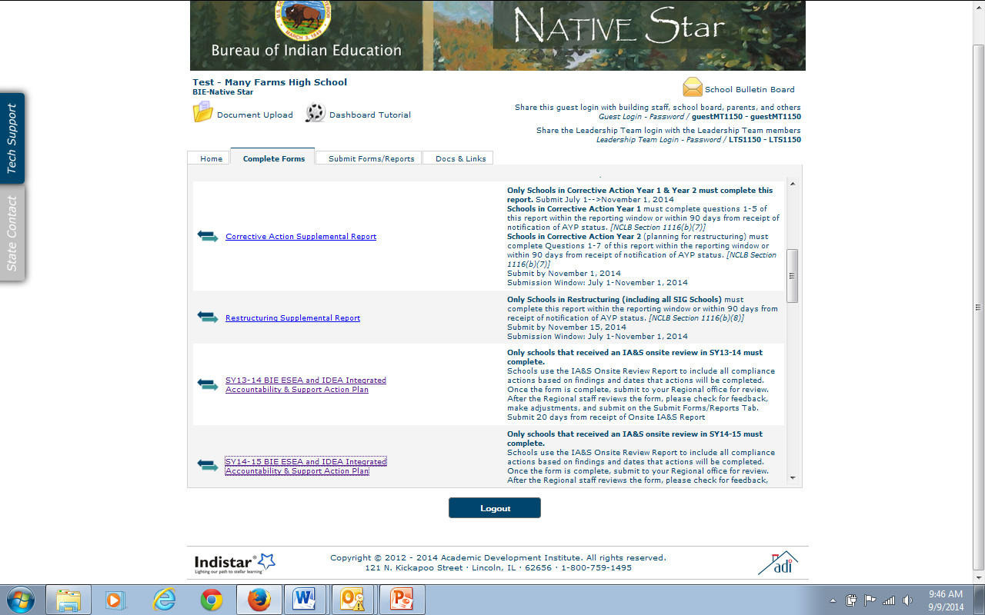
Corrective Action Plan
CLICK HERE

Slide 8
ESEA Family Engagement
Parents Right Know (ESEA 1111)
Parents have the right to know the qualifications of their children’s teacher and have right to request this information. At the beginning of each school year, the school must notify parents of such information. Parent Notification Letter if their child is being taught by a teacher who is not highly qualified for 4 or more weeks.
Schoolwide Program Criteria (ESEA 1114)
Parents must be involved in the planning, reviewing, and improving the schoolwide plan. This plan must include a parental involvement policy and a plan.
Academic Assessment & Local Educational Agency & School Improvement (ESEA 1116)
Adequate Yearly Progress – A copy of the school’s annual yearly progress reports must be provided to parents along with an explanation of the report.

Slide 9
ESEA Family Engagement
Parental Involvement (ESEA 1118)
Parent Involvement Policies - Each school receiving Title IA funds or services must collaboratively develop, agree upon and distribute to parent(s) of participating children, parental involvement policies that contain information required by the law.
Parent Involvement Compacts - Compacts must be developed yearly which includes all school community members, including parents, teachers, principals, students, and involved community members, who will agree to share responsibility for the learning among students at the school.
Annual Parent Meetings - The school is required to host a meeting for parents to explain the Title I program at the school and its requirements and how parents can be involved in their child’s education.

Slide 10
ESEA Family Engagement
Parental Involvement (ESEA 1118 continued)
Assessing/Evaluating Your School’s Parent Involvement Program - The school must assess their parent involvement component. This can be achieved by requesting parents to participate in a formal meeting or complete a survey questionnaire.
Parent Trainings - The school provides parents with opportunities to become partners with the school and enhance their child’s education at home and at school through parent trainings.
Annual Review Meeting – Title I require a review to be conducted of the entire Title I program each year. Parents must be informed of the results of this meeting.
1% Compliance - If a school’s Title I allocation is $500,000 or more, they are then required to set aside 1% of their Title I allocation for parental involvement. *Included in the Schoolwide Plan & the Consolidated Schoolwide budget. Also, are parents involved in how funds are spent.

Slide 11
BIE Training
Link: http://www.bie.edu/Programs/supprog/TitleI/index.htm
Family Engagement Tool Training Materials
“Next Steps” Family Engagement Training Materials
Family Engagement Indicators Training Materials
Contacts:
ADD-West Cohort (Contact Loverty Erickson, loverty.erickson@bie.edu)
ADD-East & ADD-Navajo (TBD)

Slide 12
Training
Family Engagement Tool
(FET)
"Next Steps"
Introduction to Indicators
"Family Engagement Indicators"
Moving Towards Family Engagement

Slide 13
FUTURE TRAININGS
McKinney-Vento Homeless Liaison Webinar, October 23, 2014, 1pm-2pm
Family Engagement Webinar, November 21, 2014, Recorded Webinar
McKinney-Vento Homeless Liaison Webinar, November 21, 2014, Recorded Webinar

Slide 14
Presentations
Copies of presentations will be on the BIE Website at:
http://www.bie.edu/Programs/supprog/TitleI/index.htm

Slide 15
Any Questions, Contact:
Valerie Todacheene, Ed.D.
Education Program Specialist, DPA
valerie.todacheene@bie.edu
505-563-5269

