Slide 1
Accessing LEA/School IDEA 2004 Part B application & CSW-Special Education Spending Plan
To join the training session
1. 1. Go to https://dcma100.webex.com/dcma100/k2/j.php?MTID=tbe47f467a0cb4df3b49793b2dddc1d53
2. Enter your name and email address (or registration ID).
3. Enter the session password: Sped1234
4. Click "Join Now".
5. Follow the instructions that appear on your screen.
Teleconference No: (888)417-0376, Participant Passcode: 1509140

Slide 2
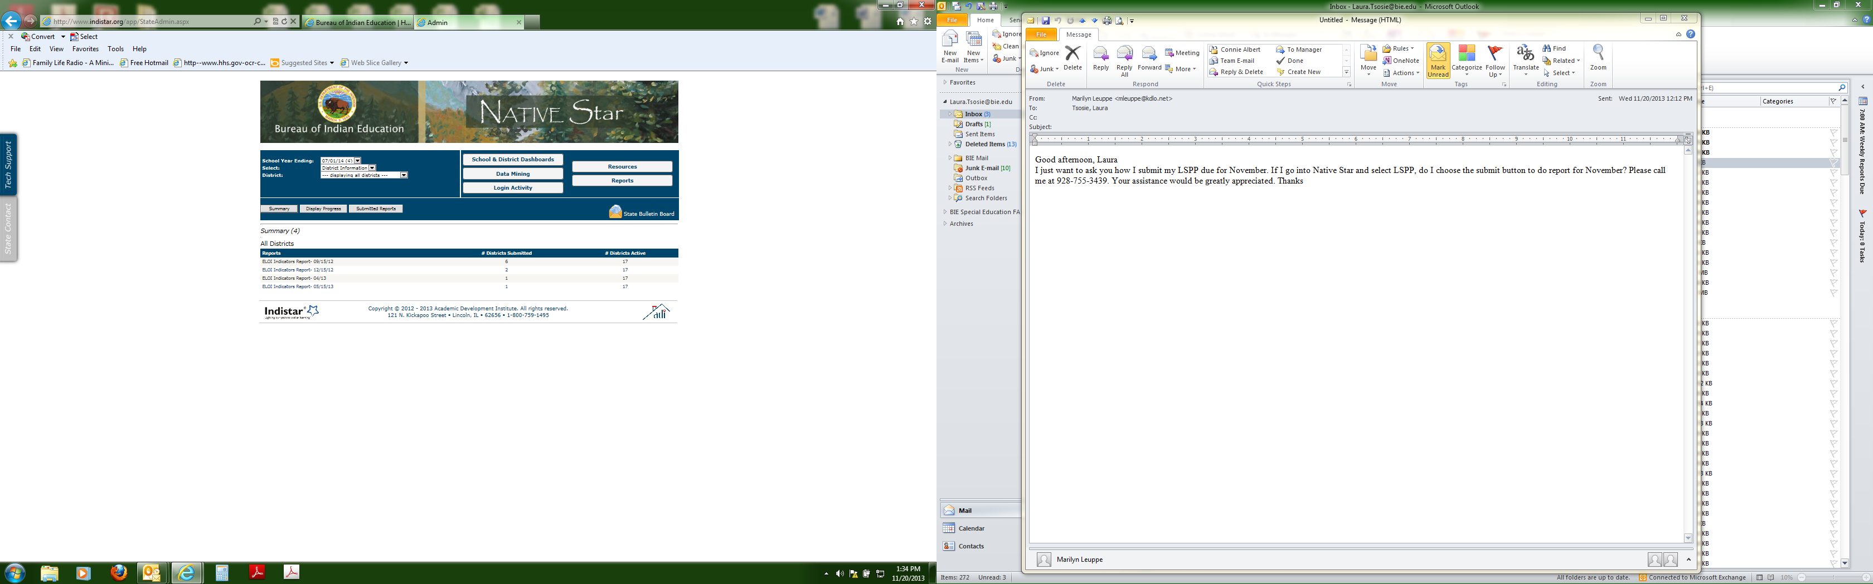
Accessing LEA/School IDEA 2004 Part B application & CSW-Special Education Spending Plan
Laura N. Tsosie & Connie Albert
Education Program Specialists
Special Education Programs - DPA
Albuquerque, NM
March 5, 2015

Slide 3
WELCOME
Protocol for the Session:
As a courtesy to other participants mute your phone during the training session.
The PowerPoint Presentation will be available on the BIE Website at www.bie.edu, at the following tabs, Programs, Special Education, and Fiscal Management below the title Webinar: SY 2015-2016 Part B Application, Consolidated Schoolwide Budget, CEIS and Coordinated Agreement Unit (CAU)
3. The recorded session will be available on the WebEx link: https://dcma100.webex.com and click on recorded session.

Slide 4
AGENDA
Introduction
Background Information – 25 CFR
Local Education Agency (LEA)/School Part B Application SY2015-16 on Native Star
Consolidated Schoolwide Budget (CSW) –Special Education (SPED)Spending Plan

Slide 5
25 CFR §39.104- How must a school’s base funding provide for student with disabilities.
Each school must provide student with disabilities by:
  Reserving 15% of academics base funding to support Special Education programs.
  b) A school may spend all or part of the 15 percent academic base funding reserved under paragraph (a)(1) of this section on school-wide programs to benefit all students (including those without disabilities) only if the school can document that it has met all needs of students with disabilities with such funds, and after having done so, there are unspent funds remaining from such funds.

Slide 6
25 CFR §39.105 – Are Additional funds available for Special Education.
(a) Schools may supplement the 15 percent base academic funding reserved under Sec. 39.104 for special education with funds available under part B of the Individuals with Disabilities Education Act (IDEA).
To obtain part B funds, the school must submit an application to BIE-DPA. IDEA funds are available only if the school demonstrates that funds reserved under Sec. 39.104(a) are inadequate to pay for services needed by all eligible ISEP students with disabilities.

Slide 7
If a school determines they have excess Special Education funds (15% ISEP and Part B funds) to support student’s with disabilities, and will not apply for Part B funds, the school shall still complete and submit the Part B application with school board approval.

Slide 8
Who is responsible in completing the documents?
School Administrator in cooperation with the Special Education Coordinator and/or Lead Special Education teacher, and the Business manger/Business technician.
The School Administrator has the responsibility to provide access and completion of the documents.

Slide 9
Accessing LEA/School IDEA 2004 Part B Application for SY2015-16

Slide 10
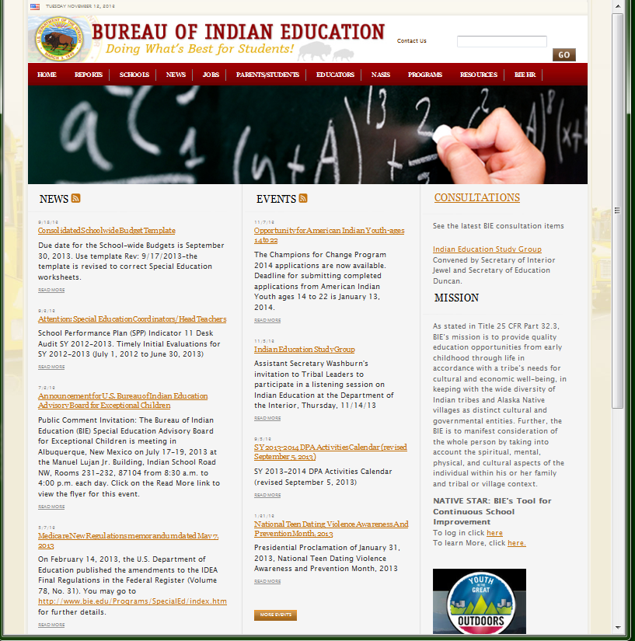
How to Login?
Step 1:
On the Internet type in www.bie.edu to open the BIE website. Once you open you will see the BIE homepage (see right clip). On the BIE homepage, look to the far right hand side, and use the scroll bar to move the page down until you see NATIVE STAR: BIE’s tool for Continuous School Improvement and click on the first highlighted word here (see RED Arrow)
Notes:
The Native Star link is found on BIE website- that is www.bie.edu

Slide 11
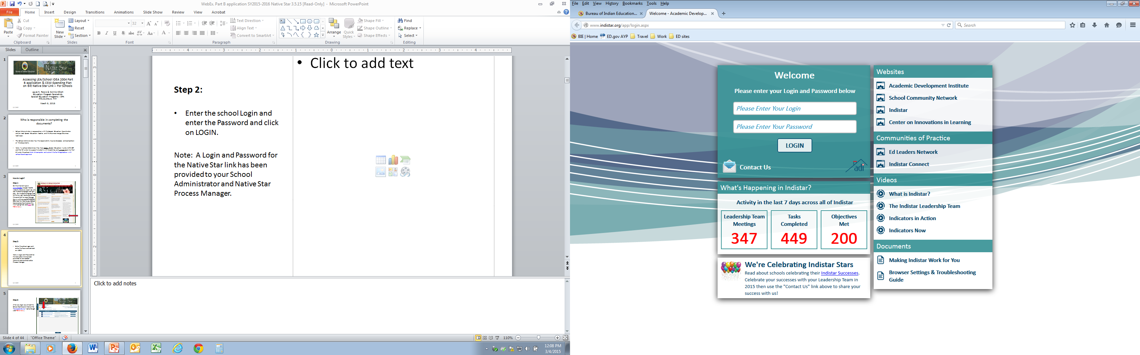
Step 2:
Enter the school Login and enter the Password and click on LOGIN.
Note: A Login and Password for the Native Star link has been provided to your School Administrator and Native Star Process Manager.

Slide 12
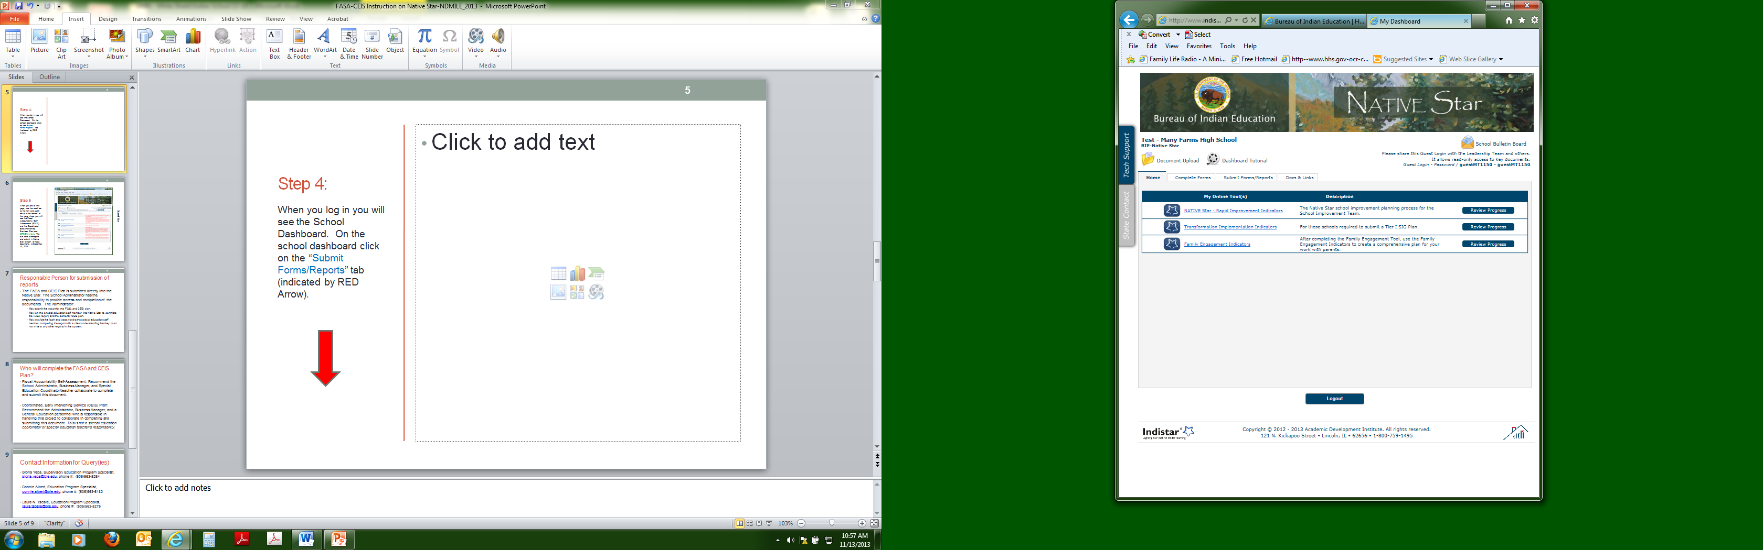
Step 3:
After you login you will see the School Dashboard. Click on the “Complete Forms” tab (see RED Arrow).
The Local Education Agency (LEA)/School Part 2004 Part B Application has 2 components
The LEA Part B Application
The Consolidated Schoolwide Budget (CSW)– Special Education Spending Plan (located on the BIE website/programs/special education/fiscal accountability )
The submission of both documents is considered a Complete application request.

Slide 13
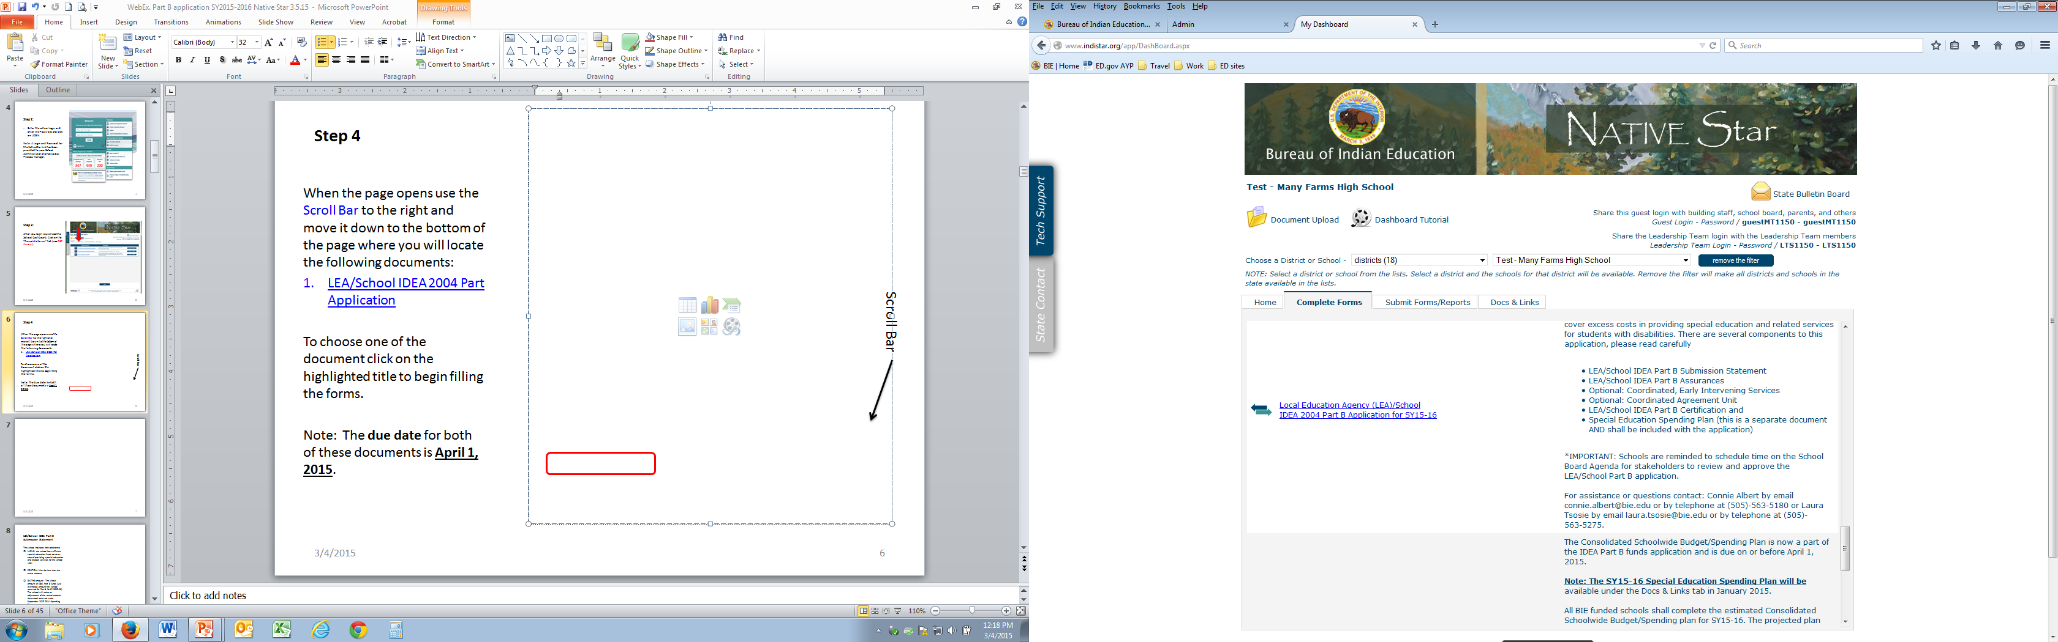
Step 4
When the page opens use the Scroll Bar to the right and move it down to the bottom of the page where you will locate the following document:
LEA/School IDEA 2004 Part Application
Click on the highlighted title to begin filling the form.
Note: The due date is April 1, 2015.
Scroll Bar

Slide 14
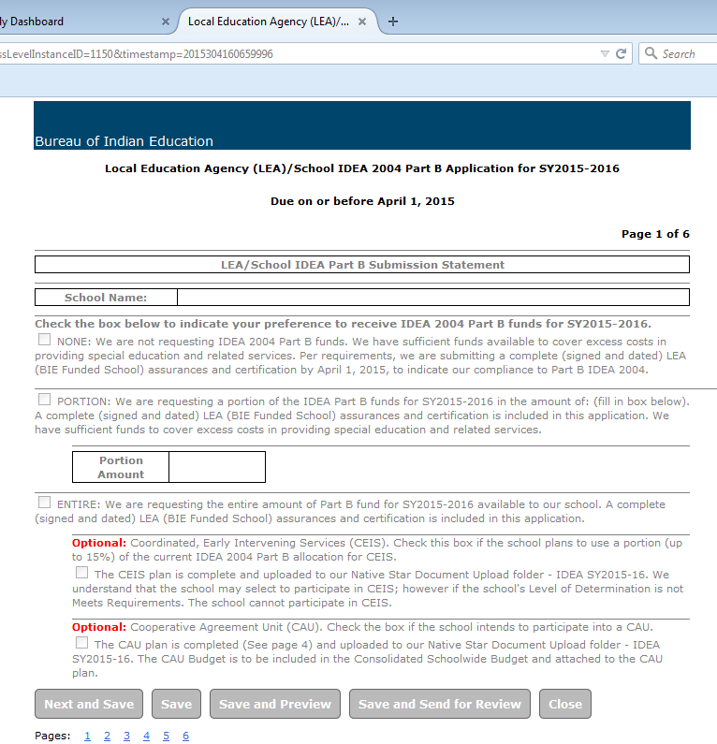
LEA/School IDEA Part B Submission Statement
The school indicates their preference
NONE: the school has sufficient special education funds to cover cost of providing special education and related services for the school year.
PORTION: Must be less than the entire amount. Indicate in the Portion Amount how much the school is requesting.
ENTIRE amount: The whole amount of IDEA Part B funds

Slide 15
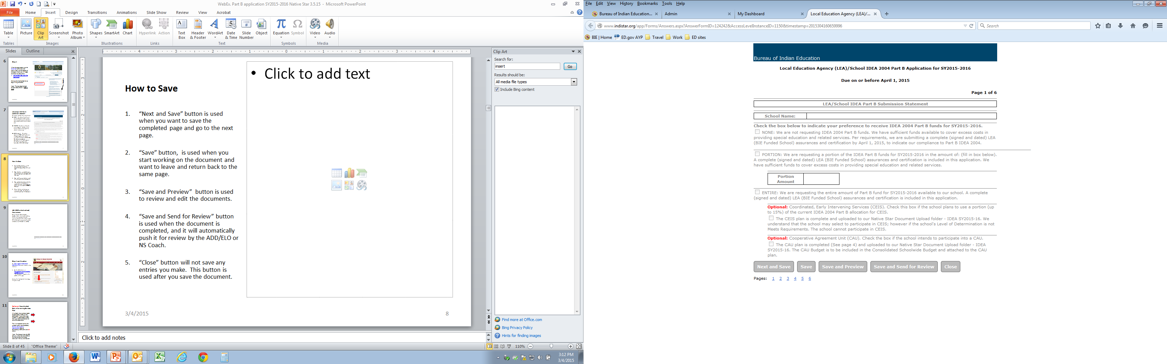
How to Save
“Next and Save” button is used when you want to save the completed page and go to the next page.
“Save” button, is used when you start working on the document and want to leave and return back to the same page.
“Save and Preview” button is used to review and edit the documents.
“Save and Send for Review” button is used when the document is completed, and it will automatically push it for review by the ADD/ELO or Native Star Coach.
“Close” button will not save any entries you make. This button is used after you save the document.

Slide 16
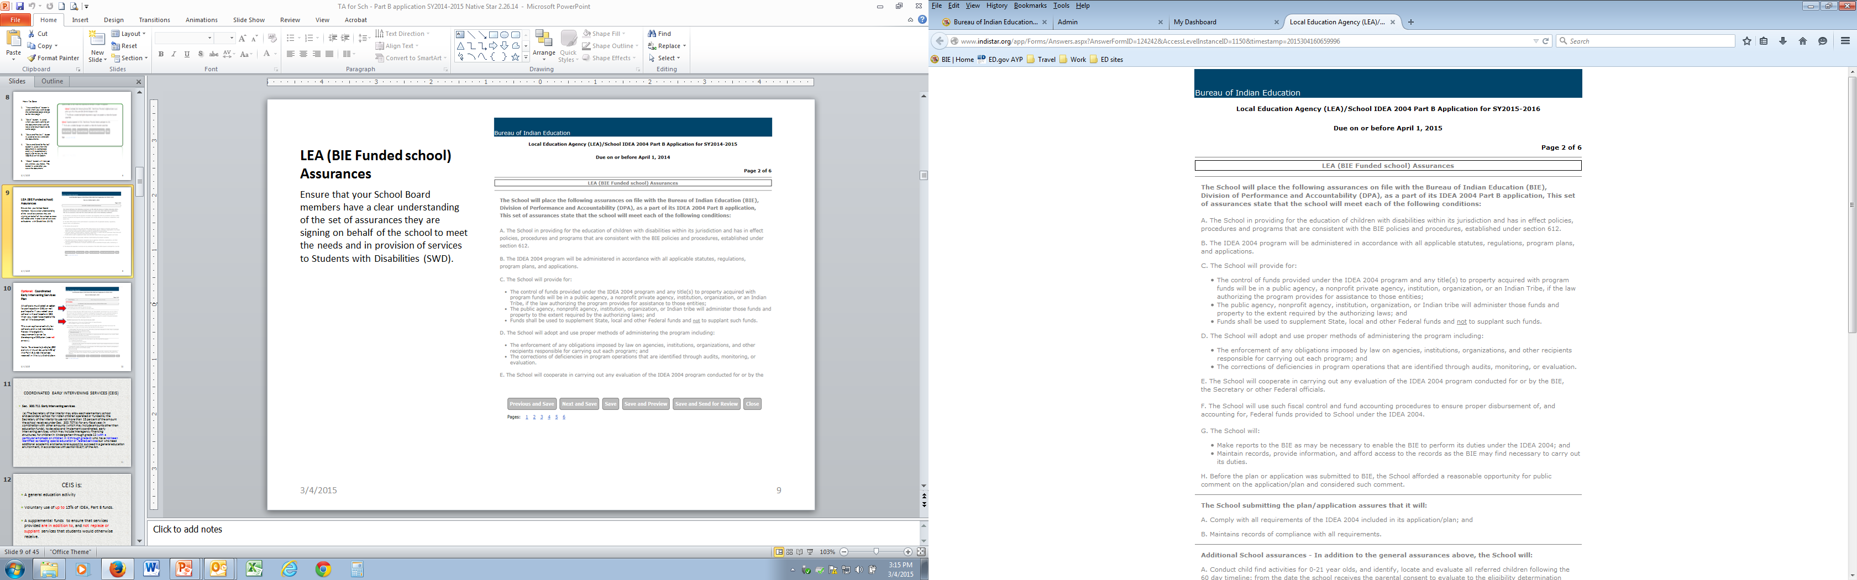
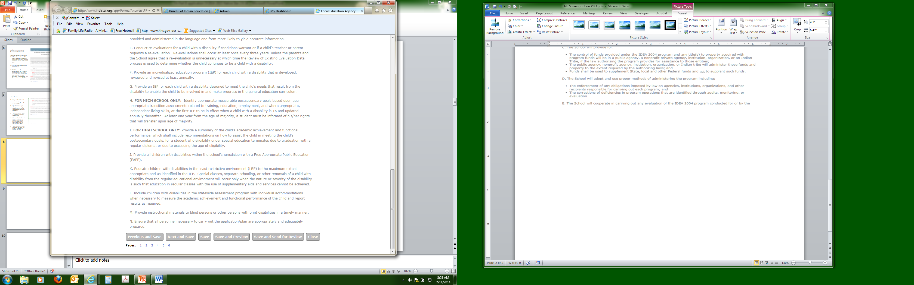
LEA (BIE Funded school) Assurances
Ensure that your School Board members have a clear understanding of the set of assurances they are signing on behalf of the school to meet the needs and in provision of services to Students with Disabilities (SWD).

Slide 17
Coordinated Early Intervening Services (CEIS)

Slide 18
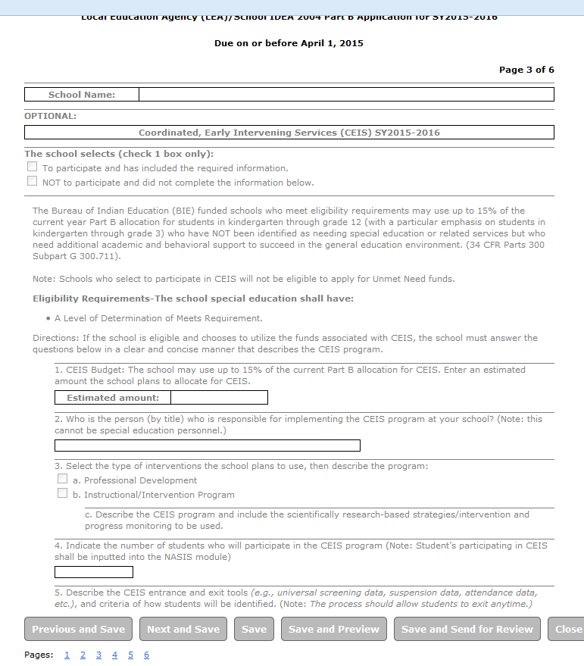
Optional: Coordinated Early Intervening Services Plan
All schools must select an option to participate in CEIS, or not participate. If you select your school will participate in CEIS then you need to complete the rest of the document.
This is an optional activity for schools and is not mandatory. Review the eligibility requirements prior to developing a CEIS plan (see red arrow).
Note: To allocate funds for CEIS activity it must be up to 15% of the Total Part B allocation the school receives for the year.

Slide 19

Eligibility Requirements for CEIS
The school special education shall have:
  A Level of Determination of Meets Requirements
  Note: School who select to participate in CEIS, will not be eligible to apply for Unmet Needs funds

Slide 20
COORDINATED EARLY INTERVENING SERVICES (CEIS)
Sec. 300.711 Early intervening services.
(a) The Secretary of the Interior may allow each elementary school
and secondary school for Indian children operated or funded by the
Secretary of the Interior to use not more than 15 percent of the amount
the school receives under Sec. 300.707(b) for any fiscal year, in
combination with other amounts (which may include amounts other than
education funds), to develop and implement coordinated, early
intervening services, which may include interagency financing
structures, for children in kindergarten through grade 12 (with a
particular emphasis on children in K through grade 3) who have not been identified as needing special education or related services but who need additional academic and behavioral support to succeed in a general education environment, in accordance with section 613(f) of the Act.

Slide 21
CEIS is:
A general education activity
Voluntarily choose to use up to 15% of IDEA, Part B funds.
A supplemental funds to ensure that services provided are in addition to, and not replace or supplant services that students would otherwise receive.
Specific to Kindergarten through grade 12.

Slide 22
CEIS is not:
A special education activity or program.
Mandatory for Bureau of Indian Education (BIE) funded schools
Used to provide intervention to students who are currently identified as needing special education and related services.

Slide 23
Allowed activities for implementation of CEIS
Employment of general education teachers and paraprofessional to deliver coordinated early intervening services (CEIS).
Professional Development for CEIS teachers and other school staff.
Providing educational and behavioral evaluations, services, and supports, including scientifically based literacy instruction.

Slide 24
CEIS Plan Submission
If the school indicates it will use of up to 15% of IDEA Part B funds for SY 2015-16. All of the following components must be thoroughly completed:
  Identify CEIS Budget – account for this in the CSW-SPED Spending Plan and in the Fiscal Accountability Self-Assessment (FASA)
  Identify personnel responsible in implementing the program.
  Identify the type of intervention and describe the scientifically research-based activity program and progress monitoring process to be used.
  Estimate anticipated number of students to be served.
  Describe the entrance and exit tools used to identify students who will participate in the CEIS program.

Slide 25
Monitoring to ensure appropriate use of CEIS funds for allowable purpose (CFR 34 Sect 300.226)
Schools will submit on April 1, 2015 an estimated amount of the CEIS on the CSW- Special Education Spending Plan for SY 2015-16, indicating how they will use Part B CEIS funds, if applicable.
Updated budget using the CSW Budget on January 15, 2016.

Slide 26
NASIS Special Education Process Guide
BIE Website – www.bie.edu/
Links:
  NASIS
    NASIS Training
      NASIS Special Education Process Guide, Procedure for CEIS
      pages 7-10

Slide 27
Where will DPA – Special Education get the information?
From NASIS. We will go back the years needed and look at each year.
  We will ask schools to verify numbers as well as numbers of students who were subsequently identified for special education services.
From information submitted by the school.
  If for example: the school indicates they spent $$ on CEIS yet we find no students identified as receiving CEIS in NASIS. We will ask school to clarify.
From fiscal reports by school that identify the dollar amount used for CEIS (SY 2014-15) or projected (SY 2015-16).

Slide 28
State Education Agency
Reporting
Sec. 300.711 Early intervening services.
(b) Each elementary school and secondary school for Indian children operated or funded by the Secretary of the Interior that develops and maintains coordinated early intervening services in accordance with section 613(f) of the Act and Sec. 300.226 must annually report to the Secretary of the Interior in accordance with section 613(f) of the Act.

Slide 29
What do we do if we change our mind about CEIS?
If the school initially selected to participate in CEIS.
Then school determined not to use the funds for CEIS.
  Step 1 : Write a memo/letter on a school letterhead describing the reason the school will not participate in CEIS.
  Step 2 : Present the memo/letter to the school board for review and approval. Provide appropriate signatures from the school board and school administration.
  Step 3: Submit memo to DPA Special Education unit.
Notes:
Why? It is a part of our fiscal management accountability. We are accountable

Slide 30
Referral?
If the intervention strategies are not successful, the team may determine that a referral to special education should be initiated. BIE-funded schools report this information in the Enrollments-BIE Reporting tab for a child and document as 02: Being Evaluated, in the Reporting section (shown below). Schools are able to develop an Ad Hoc report indicating notice that the 60 day timeline is near.
Upon referral, schools will now indicate the student is in the evaluation process, placing the student in Special Ed Status 02, and removing the student from receiving CEIS as indicated above.

Slide 31
Cooperative Agreement Unit (CAU)

Slide 32
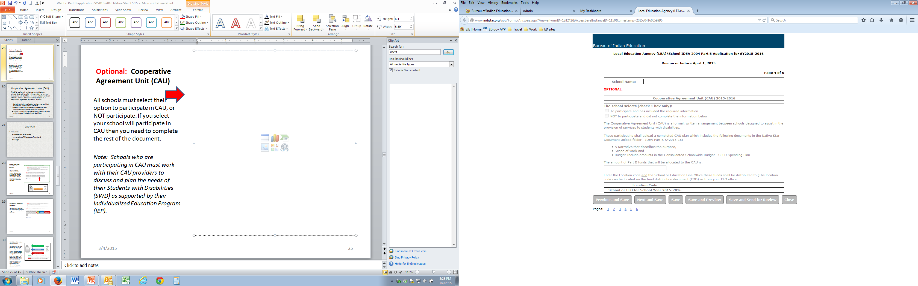
Optional: Cooperative Agreement Unit (CAU)
All schools must select their option to participate in CAU, or NOT participate. If your school selects to participate in CAU then you need to complete the rest of the document.
Note: Schools who are participating in CAU must work with their CAU providers to discuss and plan the needs of their Students with Disabilities (SWD) as supported by their Individualized Education Program (IEP).

Slide 33
Cooperative Agreement Units (CAU)
The CAU is a formal, written agreement between schools designed to assist in the provision of services to students with disabilities in a more efficient and cost effective manner. The school can participate in a cooperative agreement for various reasons:
  Schools located in rural isolated locations may pool their funds to hire related service providers
  Schools want to ensure consistency and quality in the provisions of services to students with disabilities
  Schools can identify the parameters of the services based on the needs of the students with disabilities.

Slide 34
CAU Plan
Includes:
  Description of purpose,
  A narrative of the scope of work and
  Budget – which is to be included in the CSW- Special Education Spending Plan.

Slide 35
Submission of LEA School IDEA Part B Application SY2015-16

Slide 36
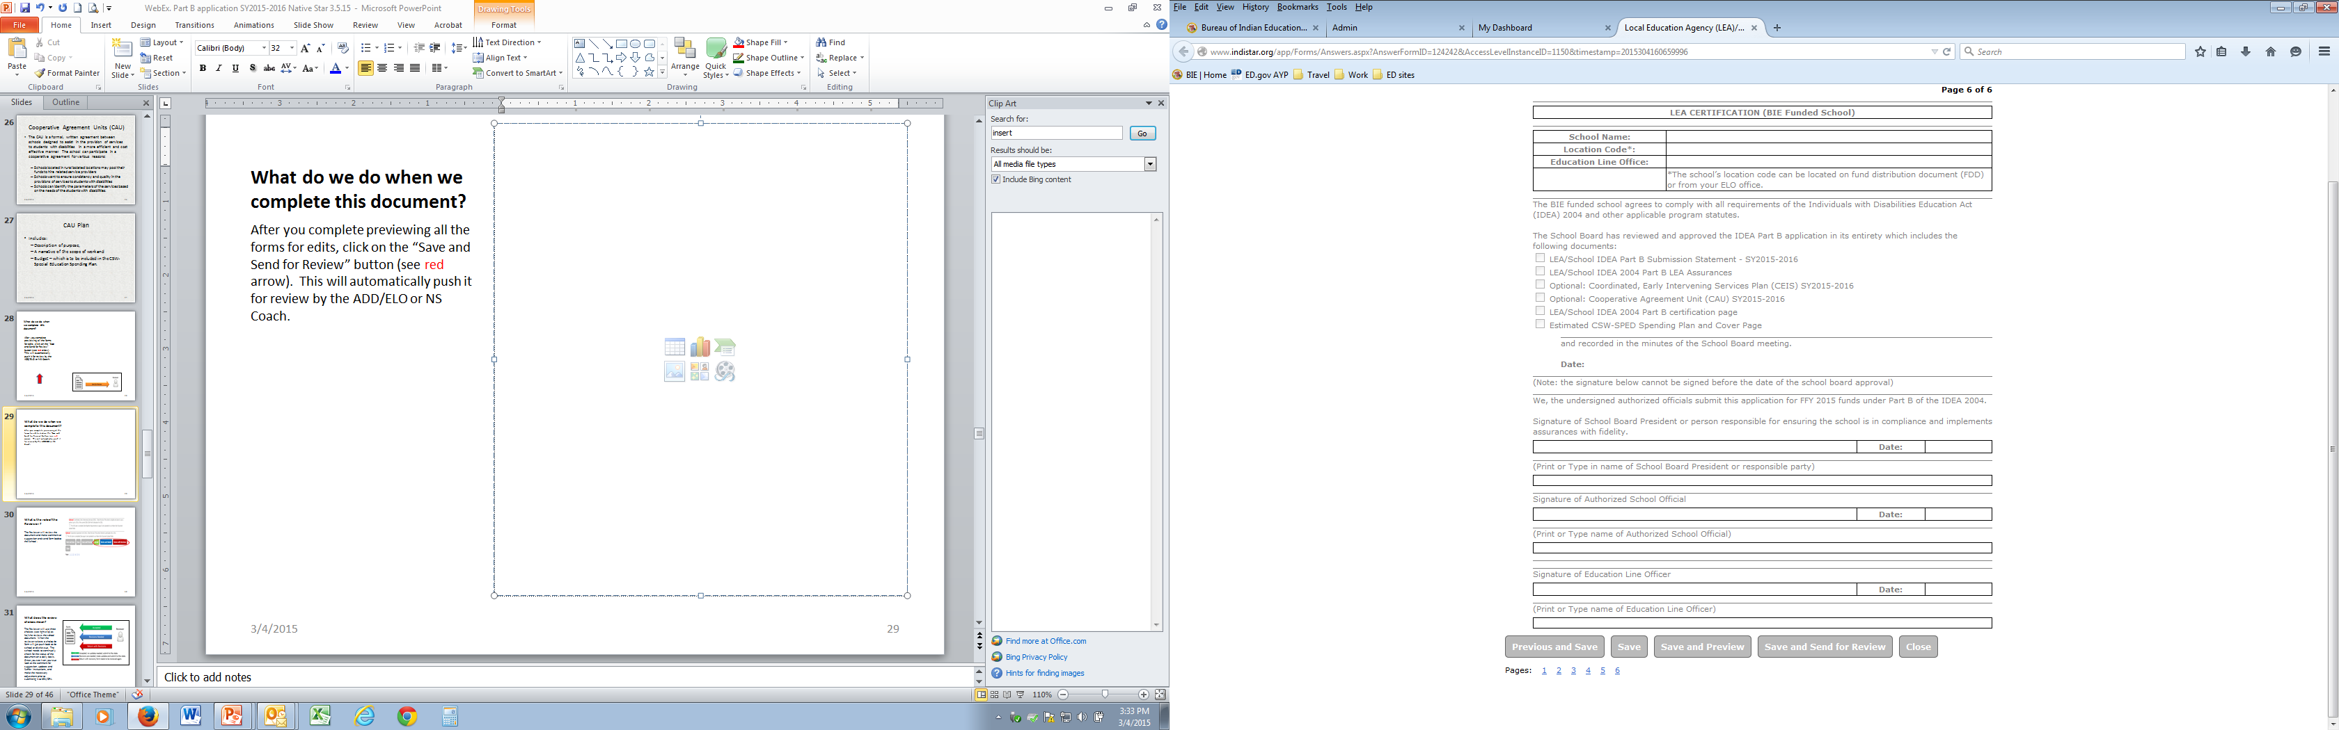


What do we do when we complete this document?
After you complete previewing all the forms for edits and are ready to submit to the ADD/ELO or NS Coach.
Click on the “Save and Send for Review” button (see red arrow). This will automatically push it for review by the ADD/ELO or NS Coach.

Slide 37
Role of the Native Star Reviewer

Slide 38
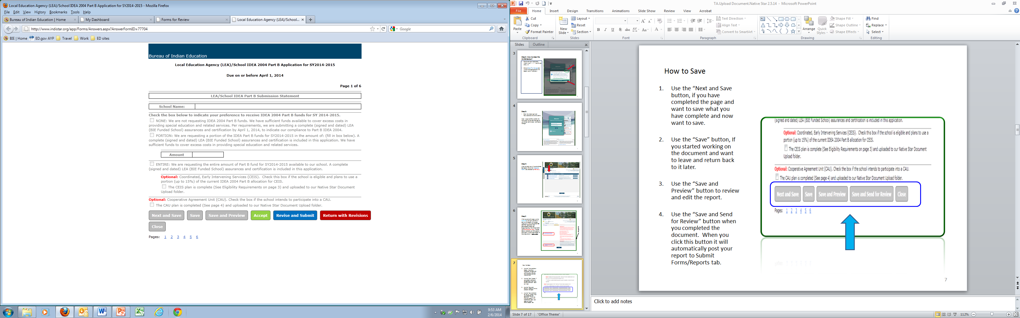

What is the role of the NS Coach/ELO or ADD Reviewer ?
Review the LEA School IDEA Part B Application and the uploaded CSW- Special Education Spending Plan prior to:
Accepting
Revise & submit or
Return with revisions

Slide 39
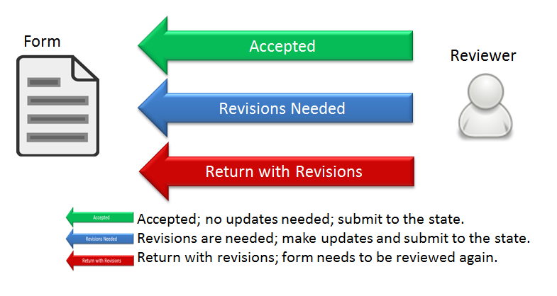
What does the review choices mean?
The Reviewer will use three choices as he/she reviews the school document.
When the reviewer selects a choice, the form will be returned back to the school or district cue.
The school needs to continually check for the status of the document on a daily basis. Once you see it on your cue look at the comment for suggestion, updates and further instructions, and make the necessary adjustment prior to submitting it to SEA/DPA.

Slide 40
Consolidated Schoolwide Budget (CSW)– Special Education (SPED) Spending Plan http://www.bie.edu/Programs/SpecialEd/SEF/index.htm or www.bie.edu/programs/specialeducation/fiscalmanagment

Slide 41
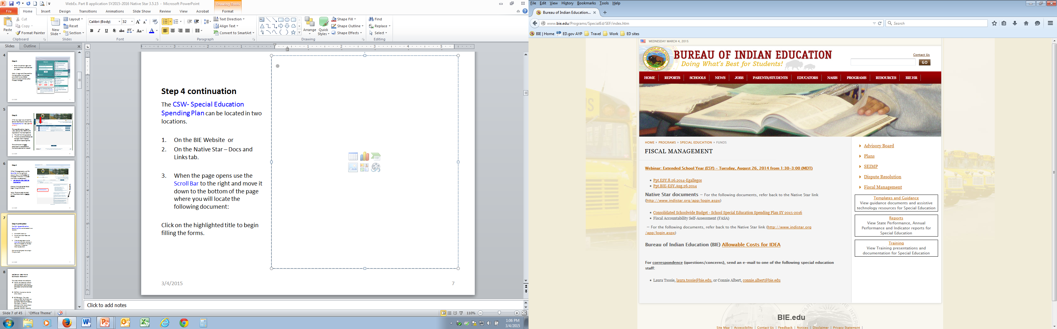
The CSW- SPED Spending Plan can be located on the:
Step 1
Click on the highlighted title located in the middle of the page to begin filling the form.

Slide 42
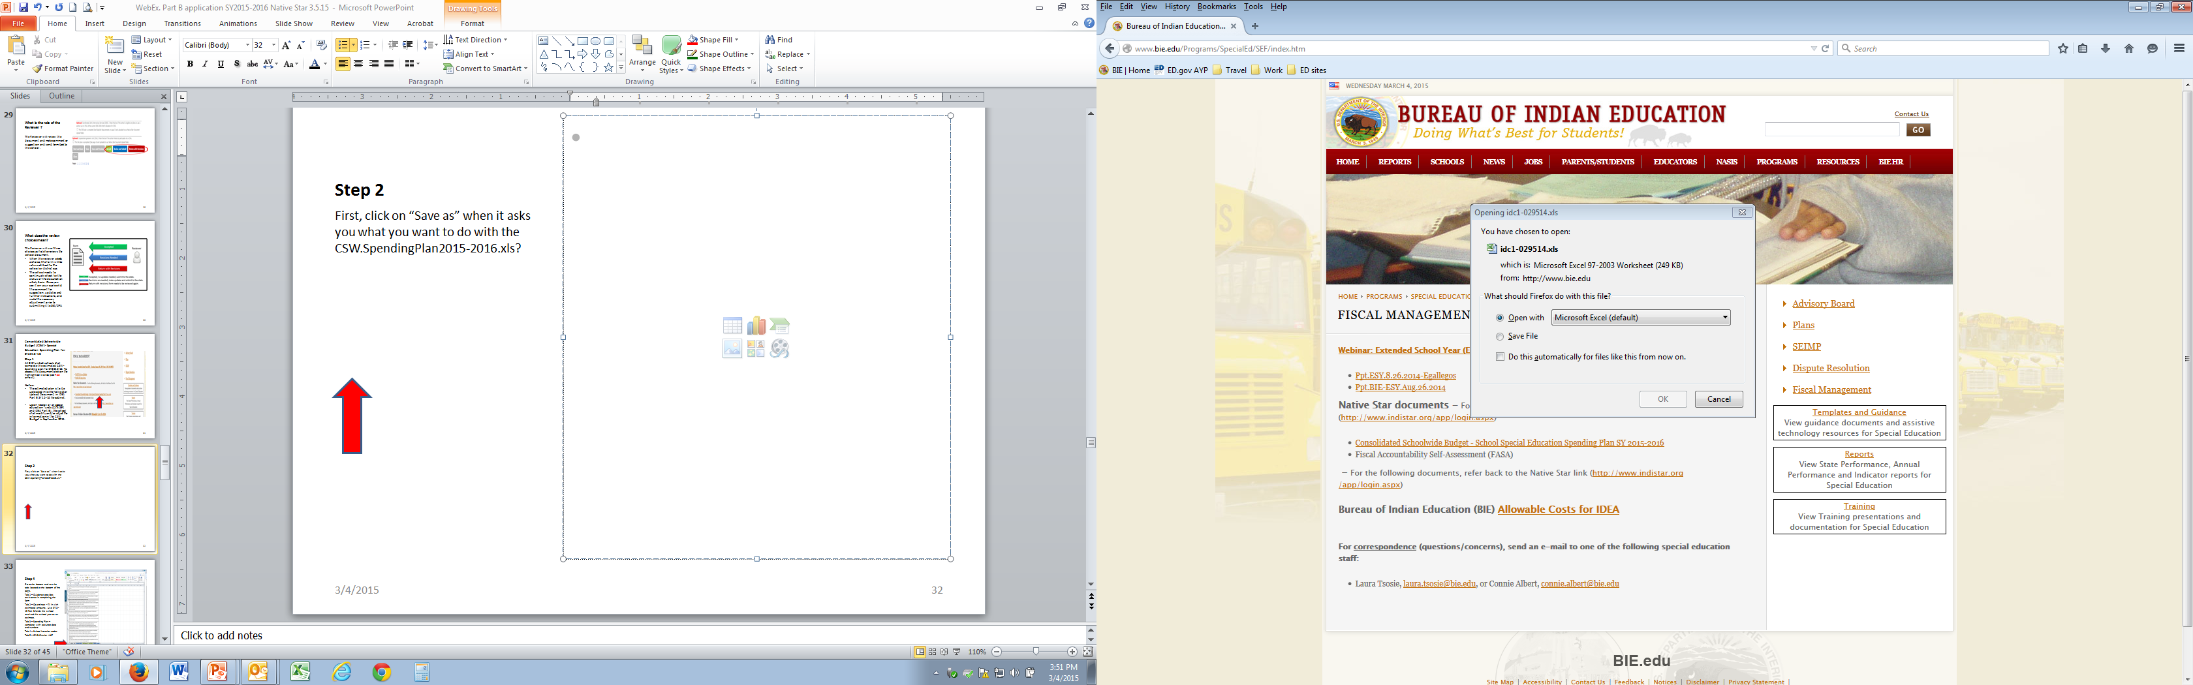
Step 2
Click “Open with” and push the “Ok” button below
Next, Click on the File and use the “Save As” and give it a file name to a location where you will be able to locate the document.
Then, review the Guidance document as it provides instructions on how to complete the CSW-SPED Spending plan. Begin completing the Cover Page and Spending Plan
Upon completion, “Save” the final document and upload it to Native Star in the IDEA SY2015-16 folder.

Slide 43
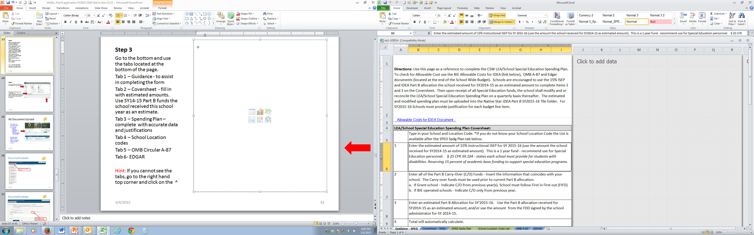
Step 3
Use the tabs located at the bottom of the page.
Tab 1 – Guidance - to assist in completing the form
Tab 2 – Coversheet - fill in with estimated amounts. Use SY14-15 Part B funds the school received this school year as an estimate.
Tab 3 – Spending Plan – complete with accurate data and justifications
Tab 4 – School Location codes
Tab 5 – OMB Circular A-87
Tab 6- EDGAR
Hint: If you cannot see the tabs, go to the right hand top corner and click on the ^

Slide 44
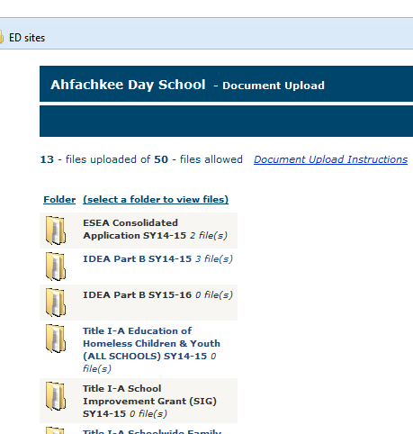
Consolidated Schoolwide Budget (CSW)- Special Education Spending Plan for SY2015-16
The estimated plan is to be uploaded into the Native Star Upload Document, in IDEA Part B SY15-16 file cabinet.
Upon receipt of all special education funds (15% ISEP, and IDEA Part B), the school shall modify and/or adjust the information in the CSW Budget in January 15, 2016.

Slide 45
Uploading Document in Native Star

Slide 46
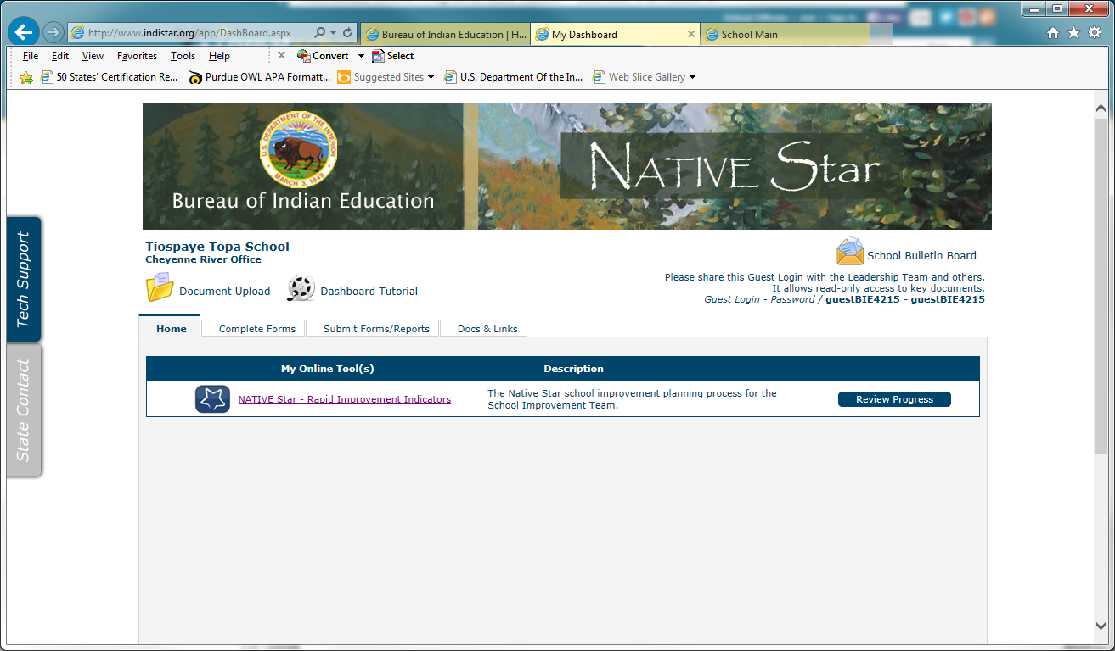
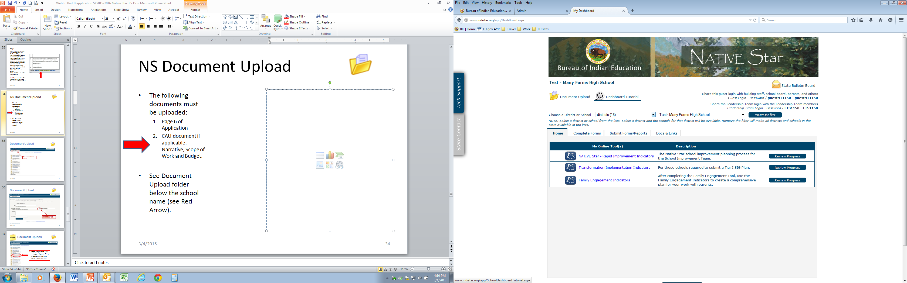

NS Document Upload
The Document Upload folder is below the school name (see Red Arrow).
The following documents must be uploaded:
  Page 6 of Signed Application by School Board and ADD/ELO representative
  CAU document if applicable: Narrative, Scope of Work and Budget.
  CSW-SPED Spending Plan Sy2015-16

Slide 47
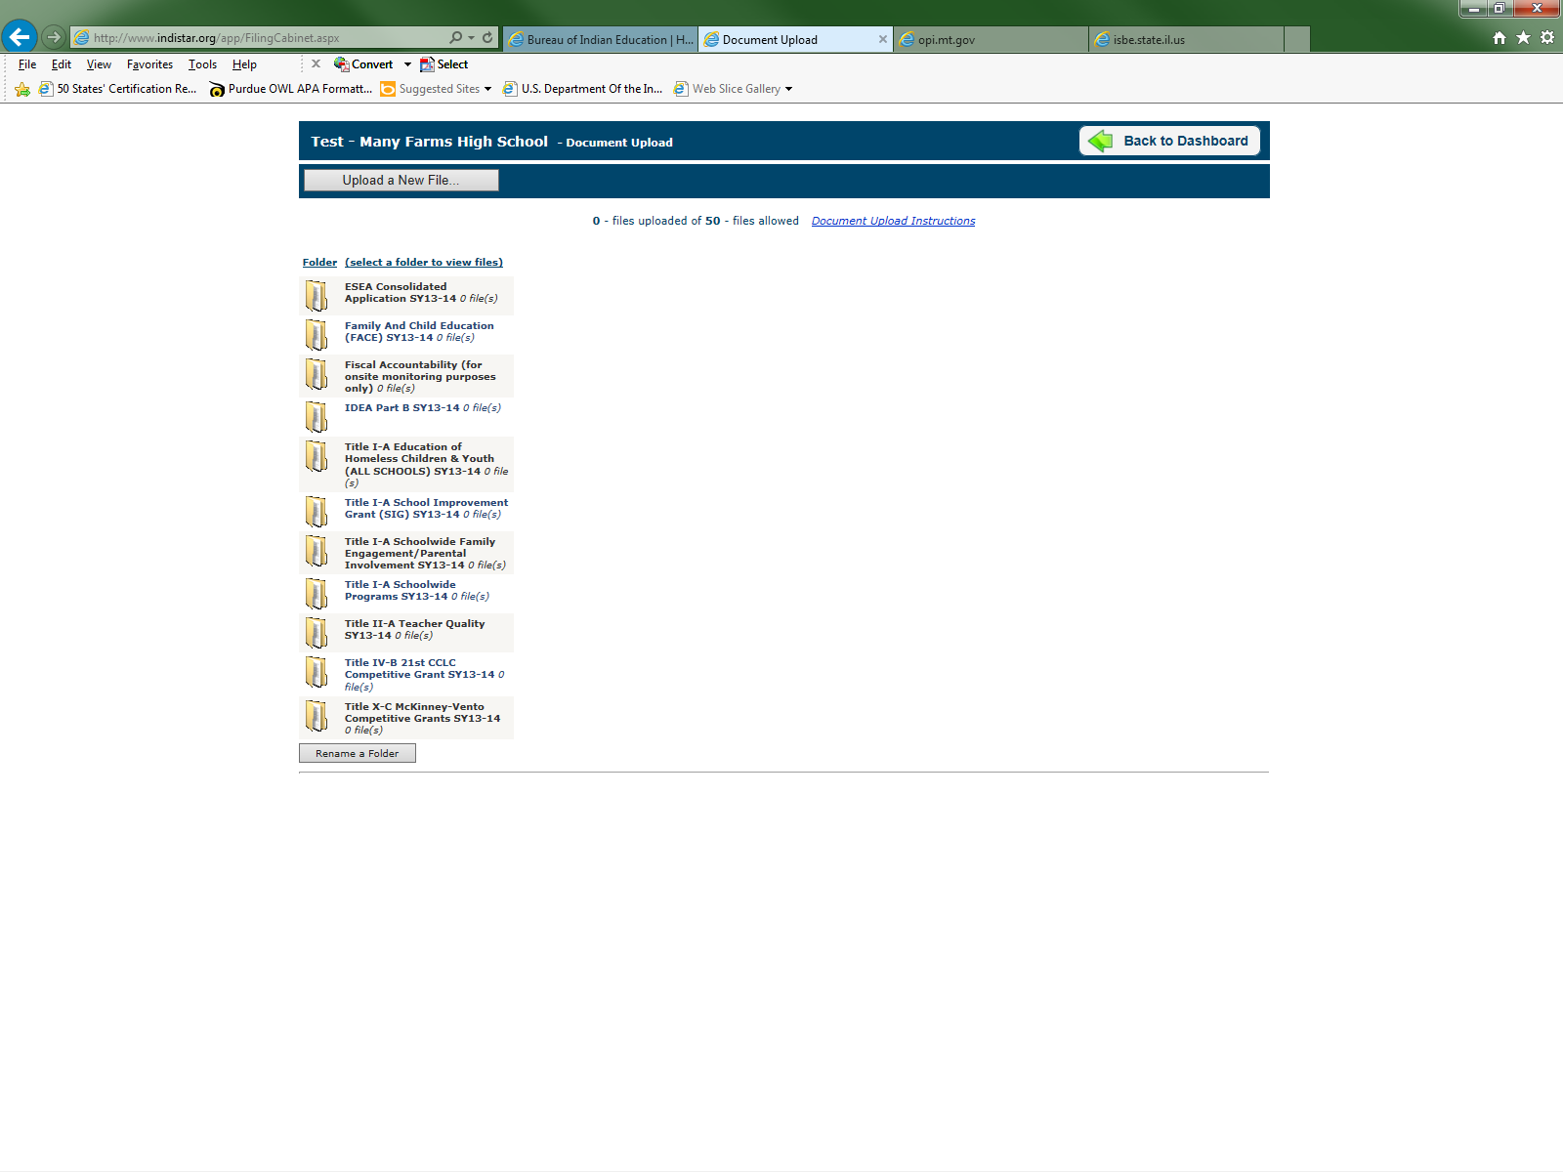
Document Upload
Press button to Upload a new file

Slide 48
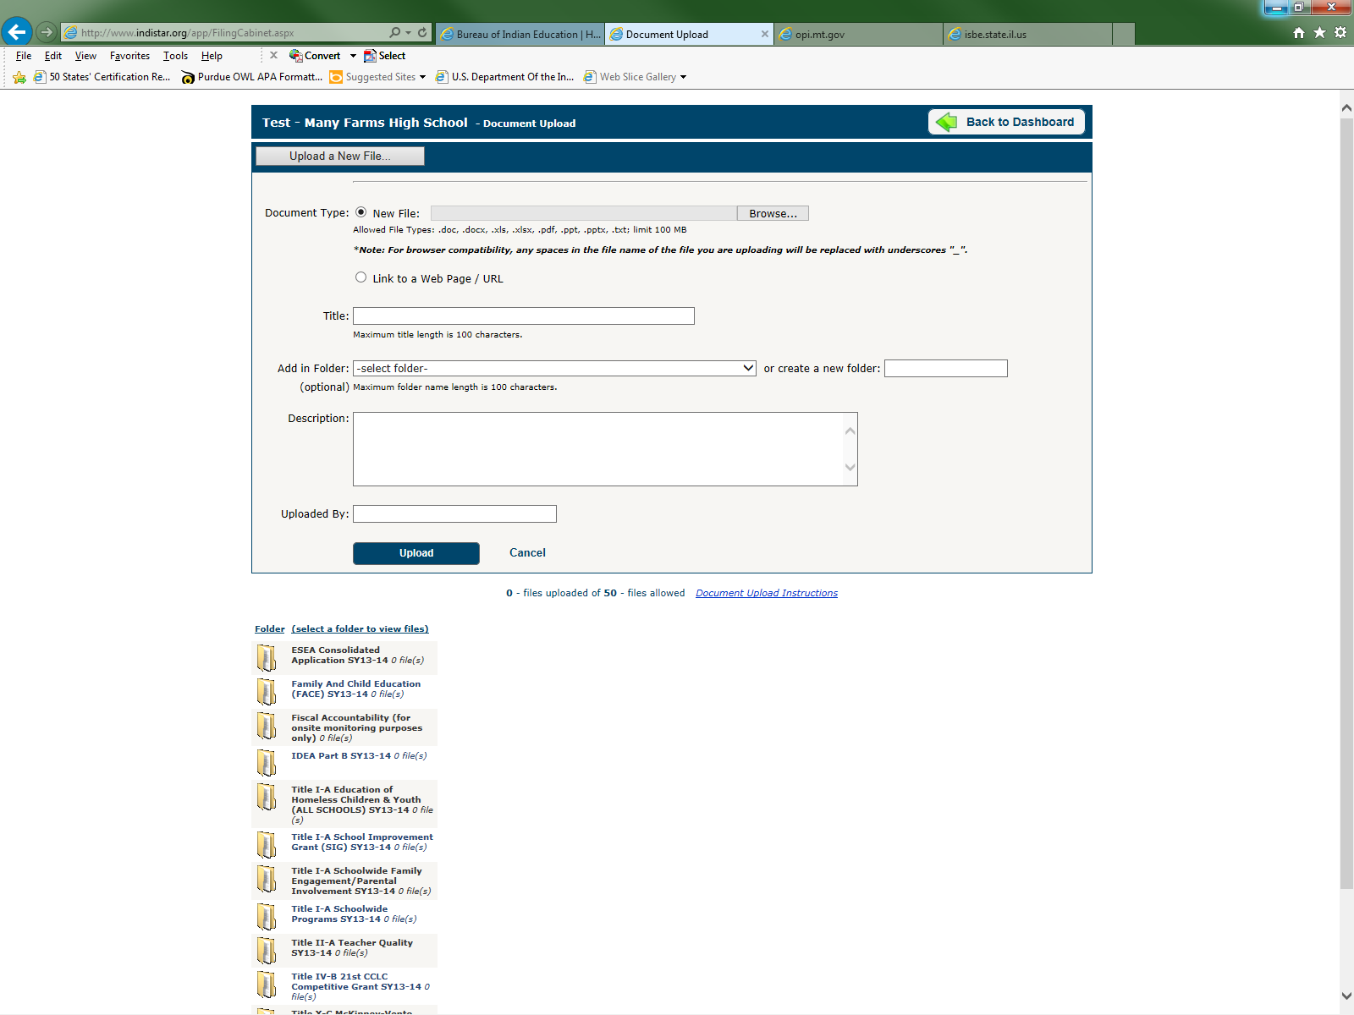
Document Upload
Press drop down list to select appropriate folder

Slide 49



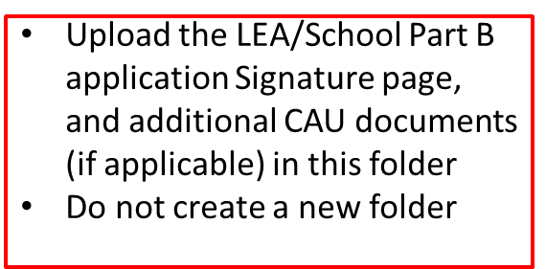
Document Upload

Slide 50
Final submission
Present the LEA/School IDEA Part B SY 2015-16 Application and the CSW-SPED Spending Plan to the School Board for public comment, review and approval.
Obtain signatures from the required individuals. Note: Signature should be obtained on the date of approval or after.
Upload only the signature page of the LEA/School IDEA Part B application in the IDEA Part B SY2015-2016 folder and/or revised CSW- SPED Spending Plan

Slide 51
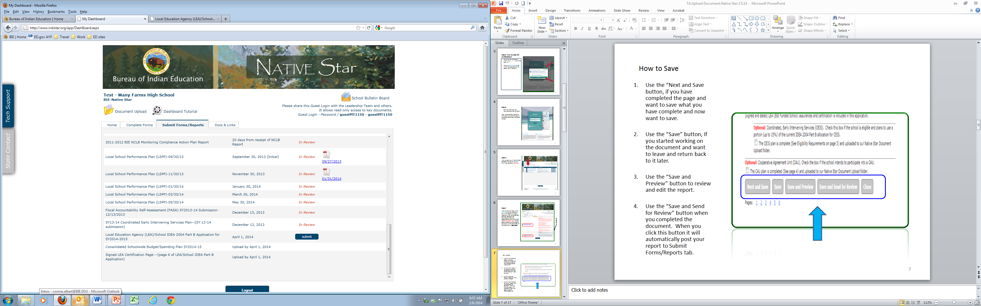
FINAL SUBMISSION OF DOCUMENTS to SEA/DPA
To submit the document , go back to the “Submit Forms/Report “ tab
Then scroll down to the report name, and click the “submit” button to send a final version to the State/DPA.

Slide 52
Responsible Person for submission of reports
The LEA/School IDEA Part B application and Consolidated Schoolwide Budget/Spending plan is submitted directly into the Native Star. Signatory page, additional CAU documents (if applicable)must be uploaded to “Document Upload” folder, and IDEA Part B SY15-16 file cabinet.
The Administrator:
    May submit the application and budget
    May log the special education staff member into Native Star to complete the documents.
    May provide the login and password to the special education staff member completing the report with a clear understanding that they must not write to any other reports in the system.

Slide 53
Frequently Asked Questions
Q1. How do I print the documents?
Select the page you want printed. Ctrl + P on the keyboard.
Q2. How do I upload the documents into Native Star?
See directions in this PowerPoint.

Slide 54
Continue – Frequently Asked Questions
Q3. Can a school relinquish their decision from doing CEIS activity during the School Year?
Yes. Then do Q4 below
Q4. What documentation do I need to provide?
  Tribally Controlled School: Write a letter explaining the reason for opting out of CEIS activity on a school letter head with the following signatures:
    School administrator
    School Board President or Representative
  BIE Operated schools: Write a Memorandum explaining the reason for opting out of CEIS activity on a school letter head with the following signatures:
    School Administrator
    School Board President or Representative

Slide 55
Continue – Frequently Asked Questions
Q5. Which documents do I need to upload
The documents the school need to upload:
  All schools: Page 6 – LEA CERTIFICATION
  All schools: The CSW budget – Special EducationSpending plan
  Optional: schools with CAU agreement must upload the following:
    A Narrative
    Scope of work
    CAU Budget

Slide 56
Contact Information
Gloria Yepa, Supervisory Education Program Specialist, gloria.yepa@bie.edu, phone #: (505)563-5264
Connie Albert, Education Program Specialist, connie.albert@bie.edu, phone #: (505)563-5180
Laura N. Tsosie, Education Program Specialist, laura.tsosie@bie.edu, phone #: (505)563-5275

