Slide 1
Family Engagement/Homeless Liaison Training 2015-16 SY
October 15, 2015
Facilitated by: Valerie Todacheene

Slide 2
BIE Monitoring
IA&S Monitoring 2011-12, 2012-13, 2013-14, 2014-15
Communicate with ADDs/ELOs on non-compliance
Provide support on Family Engagement/Homeless

Slide 3
IA&S Monitoring SY 2015-16
ON-SITE VISIT(S)
Chitimacha Tribal School
Fond du Lac Ojibwe School
Hannahville Indian School
Jones Academy
Lower Brule Day School
Menominee Tribal School
Meskwaki Settlement School
Oneida Nation School System
Porcupine Day School
Sequoyah High School
St. Francis Indian School
Black Mesa Community School
Greyhills Academy High School
Jeehdeez’a Elementary School
Kaibeto Boarding School
Tseii’ahi Community School
Wingate High School
Blackwater Community School
Coeur d’Alene Tribal School
Gila Crossing Community School
Noli Indian School
Northern Cheyenne Tribal School
Pine Hill Schools
Sherman Indian High School
Te Tsu Geh Oweenge Day School

Slide 4
IA&S Monitoring Indicators
Title I Schoolwide Plan-Stakeholders Involvement
The Local Education Agency (LEA) plans, designs, reviews, and revises the Title I Schoolwide Plan in consultation with appropriate stakeholders, including: teachers, principals, parents, and school administrators. [ESEA Section 1112(d)(1-3) and ESEA Section 1114(b)(2)(B)(ii)]
Curriculum, Assessment, and Instructional Planning
The LEA/School described how it uses assessments to track student progress; inform parents of student progress; assist in diagnosis, teaching and learning in the classroom; determine what changes are needed to the Title I Schoolwide Plan to help students meet the standards; and to identify at-risk students. [ESEA Section 1112(b)(1)(A)(i-iv)]
Family and Community Engagement
For Schools in School Improvement: The LEA/School described how it publicizes and disseminates the annual progress of the school in making adequate yearly progress (AYP) to staff, parents, and the community. [Section 1116(a)(1)(C)]
The school outlines and implements strategies to promote effective parental involvement. [Section 1116(c)(7)(A)(viii)]
The Parental Involvement Policy establishes the LEA/School’s expectations for parent involvement. The LEA/School described how its Parental Involvement Policy was jointly developed with and distributed to parents. The LEA/School has described how parents are involved in an annual evaluation of the content and effectiveness of the Policy in improving the academic quality of schools. [ESEA Title I, Part A, Section 1118(a)(2)]
The LEA/School described how it informs parents, through an annual meeting, about the school’s participation in Title I, Part A, as well as parents’ rights to be involved in school activities. [ESEA Title I, Part A, Section 1118(c)(1)]
A copy of the procedural safeguards available to the parents of a child with a disability shall be given to the parents once a year. [IDEA Section 615 (d)(1)(A)(i-iii)]

Slide 5
IA&S Monitoring Indicators
Highly Effective School Staff
In schools where not all staff is highly qualified, the LEA/School has described how it will provide, to each individual parent, timely notice that their child has been taught for four or more weeks by a non-highly qualified teacher. Parents have been notified that they may request information on professional qualifications of student’s classroom teachers. [ESEA Title I, Part A, Section 1111(h)(6)(A) and ESEA, Title I, Part A, Section 1111(h)(6)(B)(ii)]
Coordination and Integration of Educational Resources
The LEA/School described how it will coordinate and integrate its Title I program with other educational services at the LEA/School level, such as: (1) transitional services for students in preschool programs to local elementary schools programs and/or (2) services for English Language Learner and Limited English Proficient (ELL/LEP) students, children with disabilities, migratory students, neglected or delinquent youth, and homeless children in order to increase program effectiveness, eliminate duplication, and reduce fragmentation of the instructional program. [ESEA Title I, Part A, Section 1112(b)(1)(E)(i-ii) and Section 1112(b)(1)(O)]
The LEA/School has provided budget detail to verify appropriate use of recommended set-asides for professional development (10.0%), parental involvement (1.0%), and homeless students (0.5%). Schools have specified how funds will be used to remove the school from school improvement status, if applicable. [ESEA Title I, Part A, Section 1113(c)(3)(A), Section 1118(a)(3)(A) and Section 1116(3)(A)(iii-iv)]

Slide 6
ESEA Family Engagement
Parents Right Know (ESEA 1111)
Parents have the right to know the qualifications of their children’s teacher and have right to request this information. At the beginning of each school year, the school must notify parents of such information. Parent Notification Letter if their child is being taught by a teacher who is not highly qualified for 4 or more weeks.
Schoolwide Program Criteria (ESEA 1114)
Parents must be involved in the planning, reviewing, and improving the schoolwide plan. This plan must include a parental involvement policy and a plan.
Academic Assessment & Local Educational Agency & School Improvement (ESEA 1116)
Adequate Yearly Progress – A copy of the school’s annual yearly progress reports must be provided to parents along with an explanation of the report.

Slide 7
ESEA Family Engagement
Parental Involvement (ESEA 1118)
Parent Involvement Policies - Each school receiving Title IA funds or services must collaboratively develop, agree upon and distribute to parent(s) of participating children, parental involvement policies that contain information required by the law.
Parent Involvement Compacts - Compacts must be developed yearly which includes all school community members, including parents, teachers, principals, students, and involved community members, who will agree to share responsibility for the learning among students at the school.
Annual Parent Meetings - The school is required to host a meeting for parents to explain the Title I program at the school and its requirements and how parents can be involved in their child’s education.

Slide 8
ESEA Family Engagement
Parental Involvement (ESEA 1118 continued)
Assessing/Evaluating Your School’s Parent Involvement Program - The school must assess their parent involvement component. This can be achieved by requesting parents to participate in a formal meeting or complete a survey questionnaire.
Parent Trainings - The school provides parents with opportunities to become partners with the school and enhance their child’s education at home and at school through parent trainings.
Annual Review Meeting – Title I require a review to be conducted of the entire Title I program each year. Parents must be informed of the results of this meeting.
1% Compliance - If a school’s Title I allocation is $500,000 or more, they are then required to set aside 1% of their Title I allocation for parental involvement. *Included in the Schoolwide Plan & the Consolidated Schoolwide budget. Also, are parents involved in how funds are spent.

Slide 9
McKinney-Vento Act
Definition of Homeless-The term ‘homeless children and youth’ (A)means individuals who lack a fixed, regular, and adequate nighttime residence. [725(2)(A)]
  Fixed – one that is stationary, permanent, and not subject to change
  Regular – one which is used on a regular (i.e. nightly) basis
  Adequate – one that is sufficient for meeting both the physical and psychological needs typically met in home environments.

Slide 10
McKinney-Vento Act
States are prohibited from segregating homeless students in separate schools, separate programs within schools, or separate settings within schools. [722(e)(3)(A)]
Local educational agencies will designate an appropriate staff person, who may also be a coordinator for other Federal programs, as a local educational agency liaison for homeless children and youths, to carry out the duties… [722(g)(1)(J)(ii)]
SEAs and LEAs must develop, review and revise their policies to remove barriers to the enrollment and retention of children and youth in homeless situations. [722(g)(1)(I)]

Slide 11
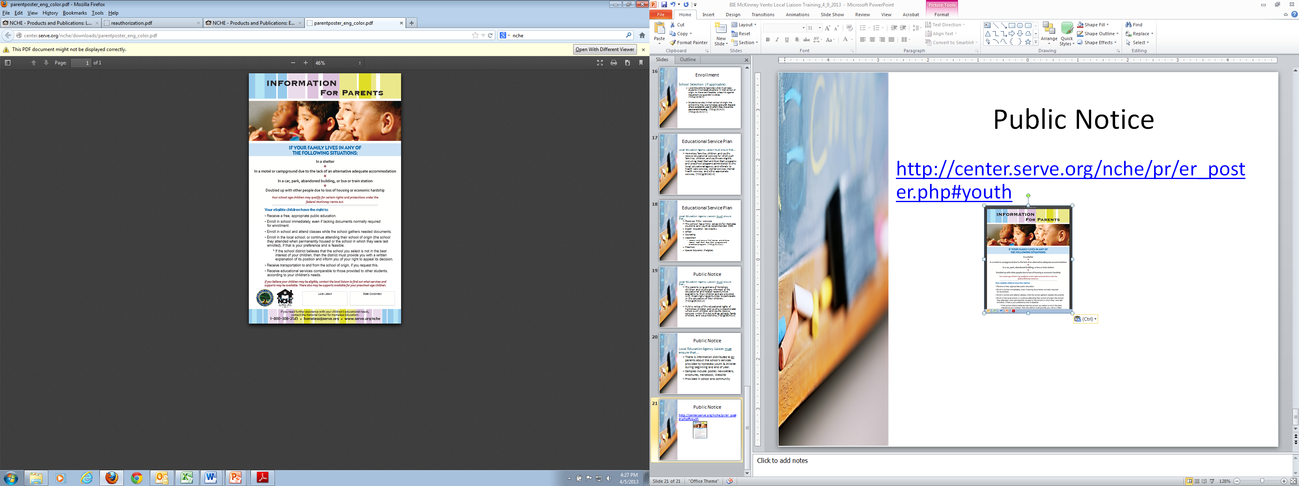
Public Notice
http://center.serve.org/nche/pr/er_poster.php#youth

Slide 12
Accountability
Data Collection
  All LEAs Identify Homeless Children & Youth in NASIS
  LEAs with Sub-Grants

Slide 13
Presentations
Copies of presentations will be on the BIE Website at:
http://www.bie.edu/Programs/supprog/TitleI/index.htm

Slide 14
Any Questions, Contact:
Valerie Todacheene, Ed.D.
Education Program Specialist, DPA
valerie.todacheene@bie.edu
505-563-5269

