Slide 1

Welcome to today’s Webinar:
Accessing and Completing Fiscal Accountability Self-Assessment (FASA) on BIE Native Star Link
Tips
-Please place your phone on Mute
-Do not put your phone on hold
-Please keep all cellular devices away from the computer or speaker

Slide 2
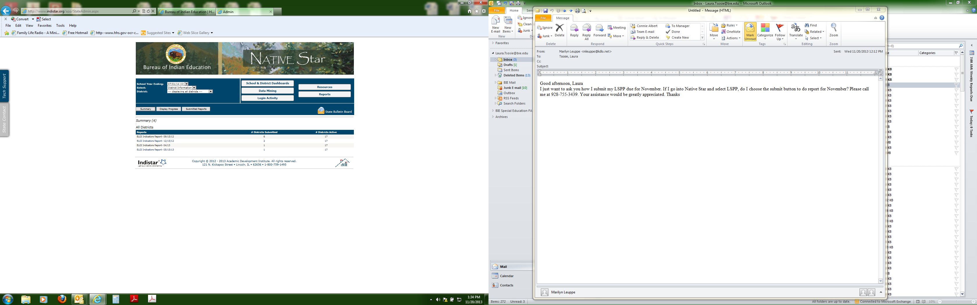
Accessing and Completing Fiscal Accountability Self-Assessment (FASA) on BIE Native Star Link
Connie Albert, Education Program Specialists
Special Education Programs – DPA
November 12, 2015

Slide 3
Purpose
To provide information on BIE Fiscal Management and importance of the fiscal documents.
To provide a step by step process to locate and upload documents into Native Star
To provide guidance and technical assistance on completing the SY2015-16 FASA
To provide a time for schools to request clarification and ask questions

Slide 4
Fiscal Management
Why is submission required?
  The BIE shall ensure that all BIE funded school’s are in compliance to certain fiscal and administrative requirements for all supplemental funding (e.g., Indian School Equalization Program (ISEP) 15% Academics base funds, Individuals with Disabilities Education Act (IDEA) of 2004; Part B supplemental funding and Elementary and Secondary Education Act (ESEA)
  The schools submits an application that provides assurances that the school meets the requirements under Public Law 108-, 20 U.S.C 1413, (a)(1),(2)(A)(i), (7), (8) and (9) along with 20 U.S.C 6301 et seq. (ESEA of 1965), P.L.89-10, P.L. 103-382; 20 U.S.C 7401 et seq (The No Child Left Behind Act of 2001), P.L. 107-110

Slide 5
Local Education Agency/Schools Assurances
§300.708 (c) references LEAs to elementary schools and secondary schools for Indian children operated or funded by the Secretary of the Interior
Part B funds flow through the State Education Agency (SEA) – DPA then provides funds directly to the schools.

Slide 6
Local Education Agency/Schools Assurances
The schools will meet each of the following conditions:
A. The School in providing for the education of children with disabilities within its jurisdiction and has in effect policies, procedures and programs that are consistent with the BIE policies and procedures, established under section 612.
B. The IDEA 2004 program will be administered in accordance with all applicable statutes, regulations, program plans, and applications.
C. The School will provide for:
  The control of funds provided under the IDEA 2004 program and any title(s) to property acquired with program funds will be in a public agency, a nonprofit private agency, institution, organization, or an Indian Tribe, if the law authorizing the program provides for assistance to those entities;
  The public agency, nonprofit agency, institution, organization, or Indian tribe will administer those funds and property to the extent required by the authorizing laws; and
  Funds shall be used to supplement State, local and other Federal funds and not to supplant such funds.

Slide 7
Local Education Agency/Schools Assurances
D. The School will adopt and use proper methods of administering the program including:
    The enforcement of any obligations imposed by law on agencies, institutions, organizations, and other recipients responsible for carrying out each program; and
    The corrections of deficiencies in program operations that are identified through audits, monitoring, or evaluation.
E. The School will cooperate in carrying out any evaluation of the IDEA 2004 program conducted for or by the BIE, the Secretary or other Federal officials.
F. The School will use such fiscal control and fund accounting procedures to ensure proper disbursement of, and accounting for, Federal funds provided to School under the IDEA 2004

Slide 8
Common concerns
Questions were not answered – left blank or partially answered.
Uploading of documents into Native Star
Staff new to Native Star and issues with the submit button
Travel and training to achieve the goals & objectives were not reasonable and necessary.
Use of indirect cost
Separation of duties
Special education coordinator/lead teacher not involved in the verification of purchase of supplies, and contracts.
Justification of unusual items

Slide 9
SY2015-16 FASA in Native Star
FASA is prefilled with information from SY2014-15
    Review and modify those questions that require updates
    Upload any new procedures the school has updates
Integrated document for ESEA and Special Education
    ESEA is Title 1 programs – schools will be evaluated on their responses
Note those questions that begin with SY2014-15
    Travel
    Carryover

Slide 10
SY2015-16 FASA

Slide 11
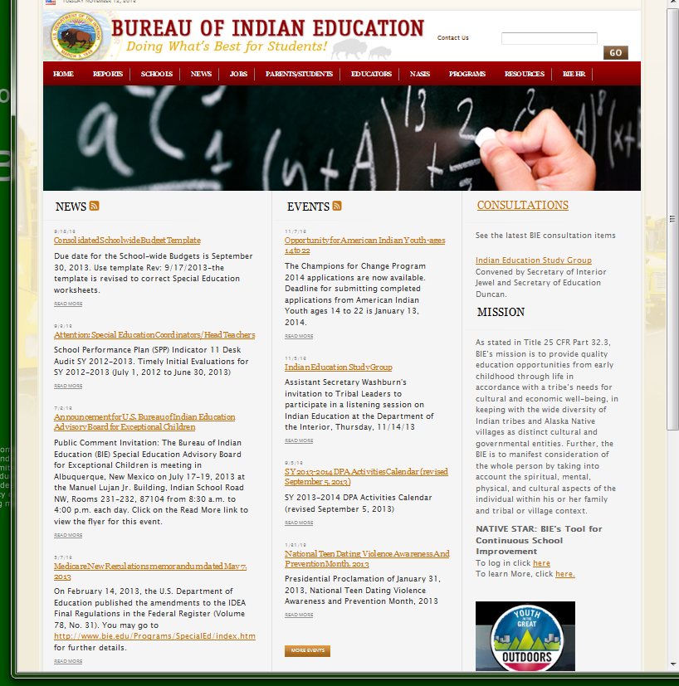
Where do I log in?
Step 1:
Login to www.bie.edu. Once you login you will see the BIE homepage (see right clip). On the BIE homepage, look to the far right hand side, and use the scroll bar to move the page down until you see NATIVE STAR: BIE’s tool for Continuous School Improvement and click on the highlighted word here (see RED Arrow)
Notes:
The Native Star link is found on BIE website- that is www.bie.edu

Slide 12
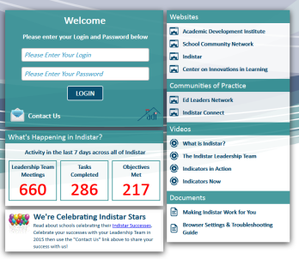
Step 2:
Enter the school Login and Password and click on the LOGIN.
Note: A Login and Password for the Native Star link has been provided to your School Administrator and Process Manager.

Slide 13
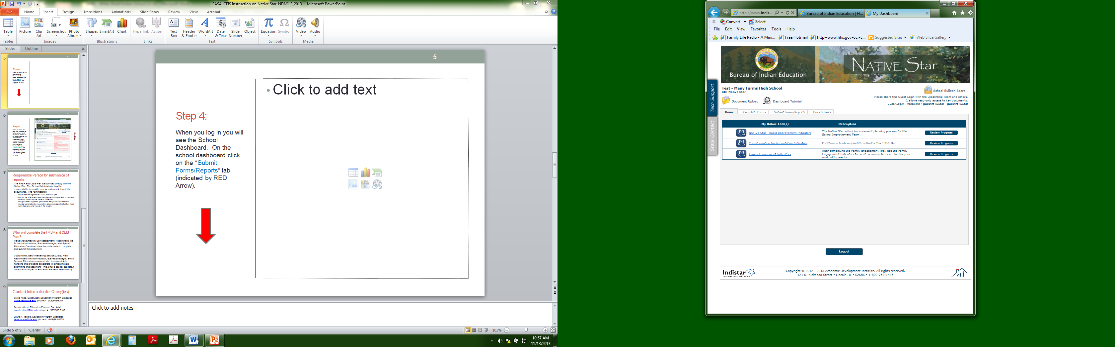
Step 3:
When you login you will see the School Dashboard. On the school dashboard click on the “Complete Forms” tab (indicated by RED Arrow).

Slide 14
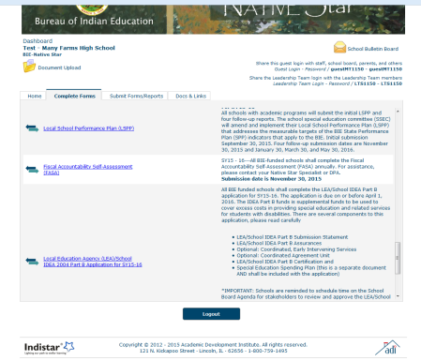
Step 4:
When you are at this page, use the Scroll Bar to the right and move it down to the bottom of the page where you will locate the Fiscal Accountability Self-Assessment (FASA), and the Coordinated Early Intervening Services Plan (see GREEN Arrow). The due date to complete and submit in Native Star link is November 30, 2015.
Scroll Bar

Slide 15
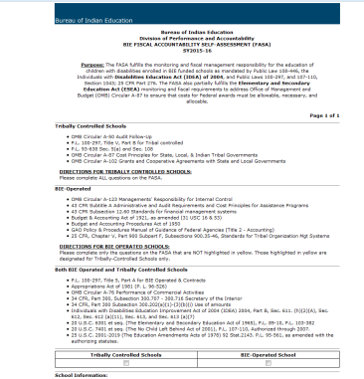
FASA
When you click on the Fiscal Accountability Self-Assessment (FASA) SY2015-16 you will see the document to the right.

Slide 16
How to upload a document in Native Star
1. Scan document using your copier or scanner.
2. Remember where you scanned the document to your computer.
3. Click on Document upload under the school name
4. Click on document type and locate scanned document (slide #17)
5. Title the document
6. Go to Add in Folder, click drop down box and select Fiscal Accountability Self-Assessment
7. Click upload button.

Slide 17
Document Upload
Locate Document upload (red arrow) on the top right corner underneath school name

Slide 18
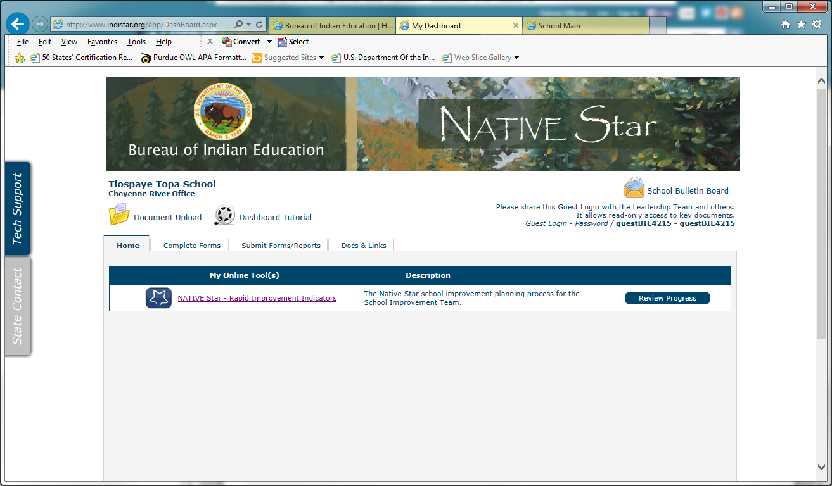
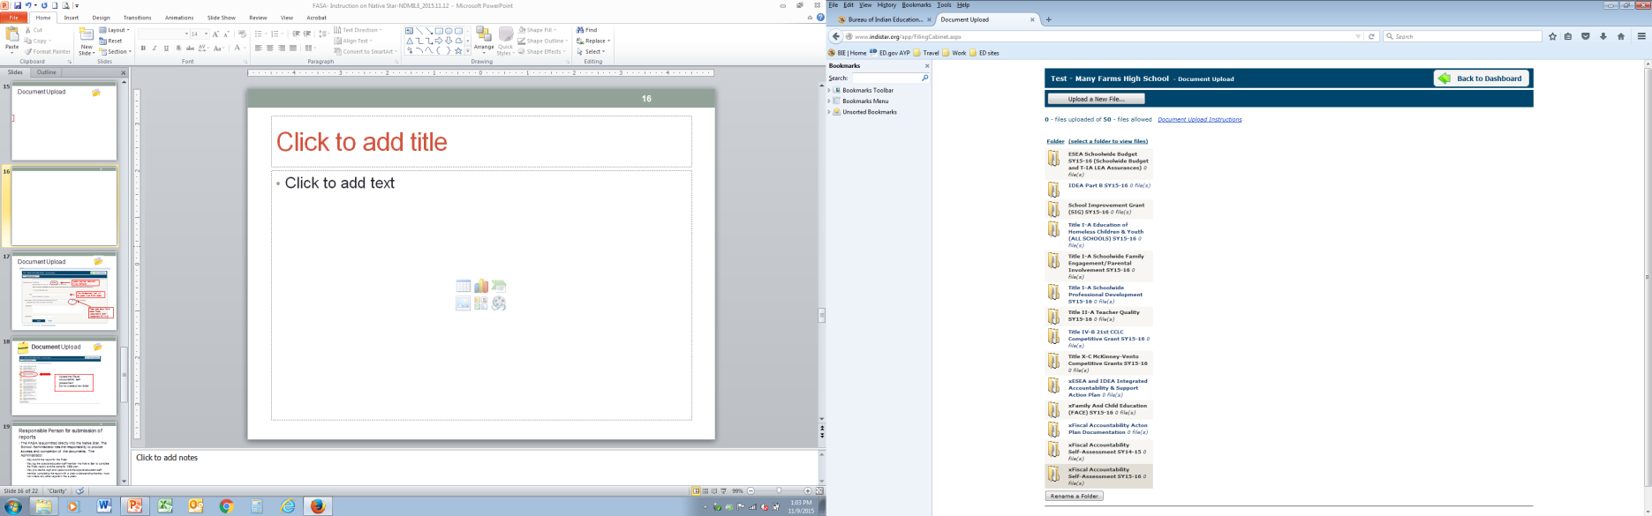
Document Upload
Press button to Upload a new file

Slide 19
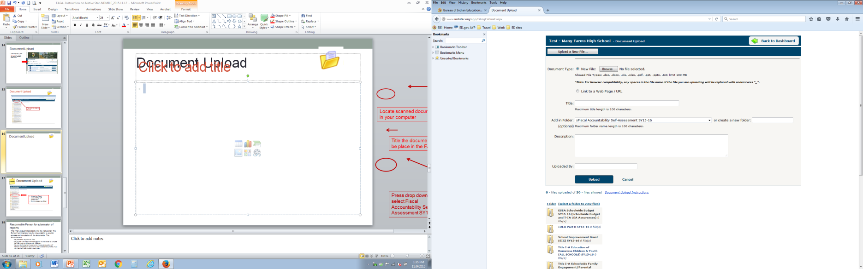

Document Upload
Locate scanned document in your computer
Title the document that will be place in the FASA folder
Press drop down list to select Fiscal Accountability Self-Assessment SY15-16

Slide 20

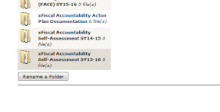
Document Upload
Upload into Fiscal Accountability Self-Assessment SY15-16
Do not create a new folder

Slide 21
Responsible Person for submission of reports
The FASA is submitted directly into the Native Star. The School Administrator has the responsibility to provide access and completion of the documents. The Administrator:
    May submit the report for the FASA
    May log the special education staff member into Native Star to complete the FASA report
    May provide the login and password to the special education staff member completing the report with a clear understanding that they must not write to any other reports in the system.

Slide 22
Who will complete the FASA?
It’s a Collaborative Team Effort:
  School Administrator,
  Business Manager, and
  Special Education Coordinator/teacher

Slide 23

Questions

Slide 24
Contact
Connie Albert, Education Program Specialist, connie.albert@bie.edu, phone #: (505)563-5180
Laura N. Tsosie, Education Program Specialist, laura.tsosie@bie.edu, phone #: (505)563-5275
Gloria Yepa, Supervisory Education Program Specialist
gloria.yepa@bie.edu, phone #: (505)563-5264

