Slide 1

School Improvement Grant 1003 Part A &
Student Support & Academic Enrichment IV PART A
SY 2018-19
      Division of Performance and Accountability
      Technical Assistance Webinar

Slide 2
School Improvement Grant (SIG)
1003 Part A Funds
Distributed May 2018 Amount $30,560.00
Purpose: Support schools in developing a comprehensive needs assessment which will assist with the development of a School Improvement Grant Application.
Allowable costs: . Funds may be used for salaries for short term contracts for planning time, consultants, travel to training activities, training materials focused on school improvement.
Funds should be expended by December 30, 2018

Slide 3
Student Support & Academic Enrichment (SSAE)
Title IV-Part A
Distributed May 2018 Amounts Varied
Purpose: Title IV, Part A, Student Support and Academic Enrichment (SSAE) grants are intended to improve students’ academic achievement by increasing the capacity of States, LEAs, schools, and local communities to:
  provide all students with access to a well-rounded education,
  improve school conditions for student learning, and
  improve the use of technology in order to improve the academic achievement and digital literacy of all students. (ESEA section 41​01).
Allowable costs: Funds should be used to assist in the development of a comprehensive needs assessment to support the three (3) areas above.
Funds should be expended by May 31, 2019

Slide 4
Requirements
Schools must submit a 1003a & Title IVA spending plan. This will be included in the Native Star Docs & Links. Also, a copy will be provided on the BIE website with recorded webinar.
Spending plan should be uploaded in the Native Star document Upload in Folder #1 and titled “SchoolName_1003a_TitleIVA_SpendingPLan_date”
Spending Plan submission deadline is July 9, 2018
School Administrator & School Board Signatures are required

Slide 5
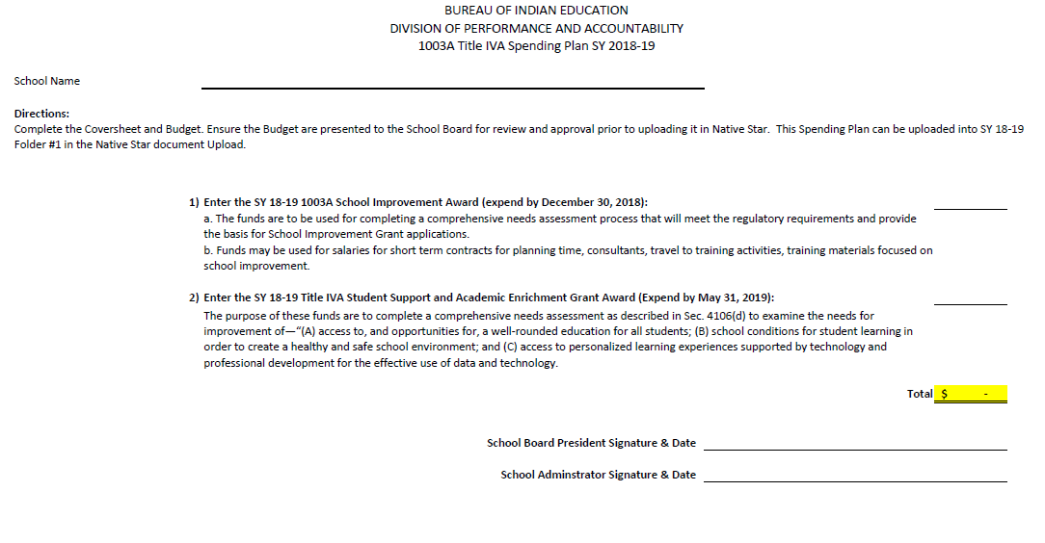
Spending Plan Page 1

Slide 6
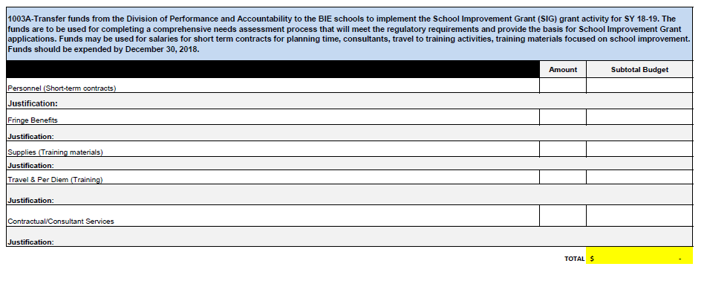
Spending Plan Page 2
1003 A Budget
Enter amounts for each line item
Provide a descriptive justification for each line item
Total should equal the amount you received for 1003A

Slide 7
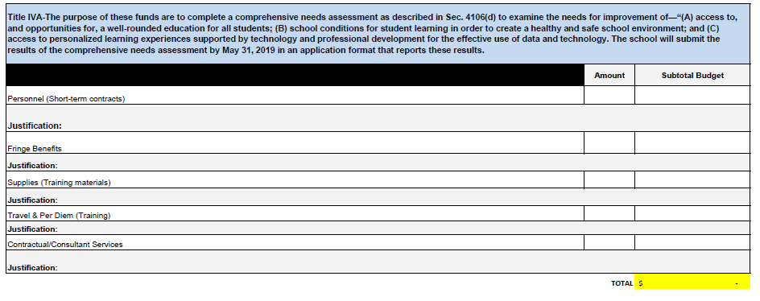
Spending Plan Page 3
Title IVA Budget
Enter amounts for each line item
Provide a descriptive justification for each line item
Total should equal the amount you received for Title IVA

Slide 8
Education Program Specialists
Division of Performance and Accountability (ESSA Programs)
Albuquerque and Nashville ERCs (Tribally Controlled)
VACANT POSITION
Albuquerque ERC (Bureau Operated)
North Dakota (Tribally Controlled)
Valerie Todacheene
505-563-5269
valerie.todacheene@bie.edu
Seattle and Minneapolis ERCs
(Tribally Controlled)
Margo Delaune
206-220-7978
margo.delaune@bie.edu
Phoenix ERC (Bureau Operated)
South Dakota (Tribally Controlled)
Jacqueline Wade
602-265-1592
jacqueline.wade@bie.edu
GayeLeia King, Supervisory Education Specialist
202-208-2535
gayeleia.king@bie.edu

Slide 9
Education Program Specialists
Division of Performance and Accountability (ESSA Programs)
Crownpoint and Window Rock ERCs
Cheryl Quimayousie
505-786-6144
cheryl.quimayouise@bie.edu
Chinle and Window Rock ERCs
Marie Silverhatband
938-674-5137
marie.silverhatband@bie.edu
Shiprock ERC
Eleanor Jones
505-368-3403/3400
eleanor.jones@bie.edu
Tuba City ERC
Andrea Bia
928-283-2308
andrea.bia@bie.edu
GayeLeia King, Supervisory Education Specialist
202-208-2535
gayeleia.king@bie.edu

Slide 10

Questions

