Slide 1

MCkINNEY-vento homeless education 2018-2021 grant awardee training
Division of Performance and Accountability
August 30, 2018, 10:00AM (MDT)

Slide 2
Overview
The McKinney-Vento Act guarantees a free, appropriate public education for all homeless children and youth by removing barriers to their enrollment and attendance in school and supporting their educational success. The purpose of McKinney-Vento subgrant is to facilitate the enrollment, attendance, and success in school of homeless children and youth.

Slide 3
Grant Requirements
Submission of Schoolwide Reports into Native Star. Grant initiative must be reflected in the school’s Schoolwide Plan and is included in the school’s Schoolwide Budget. Also, the SW Plan and Budget must demonstrate how grant is coordinated with TIA Homeless set-asides.
Track the academic progress for students in a homeless situation and grade levels. The school agrees to share their data with the Bureau of Indian Education as a means of documenting progress of the students served in the McKinney-Vento Homeless Education program.
School must enter homeless students identified into NASIS, these should align to the numbers identified in the Evaluation templates.

Slide 4
Grant Requirements
Each grant recipient is required to submit an end of the year report to the McKinney-Vento State Coordinator during the project period in order to be considered for the following year’s funding.
Must maintain fiscal and program records
Funds must be spent according to the approved project proposal in order to be considered for the following year’s funding.

Slide 5
Grant Requirements
The project will be awarded for 3 school years with funds being renewed at the beginning of the school year. Renewal of funds for the following each consecutive year will be based on availability of funds and satisfactory progress. It is expected that grant recipients will respond to all grant requirements in a timely manner.
Submit an Evaluation Template which provides a status report of their project to the McKinney-Vento State Coordinator at the beginning, middle and end of the school year.
Students receiving services from the subgrant must have a file which contains student information and a service plan.

Slide 6
Award Timeline
 | Start Date | End Date
Initial Award (Year 1) | August 1, 2018 | June 30, 2019
Year 2 | July 1, 2019 | June 30, 2020
Year 3 | July 1, 2020 | June 30, 2021

Slide 7
Data Collection
The school agrees to share their academic progress monitoring data (ie. NWEA) , Native Star and NASIS data or any other data stated in the application with the Bureau of Indian Education as a means of documenting progress of the students served in the McKinney-Vento Homeless Education program and evaluating the program. This information will be collected in the end of the year report.

Slide 8
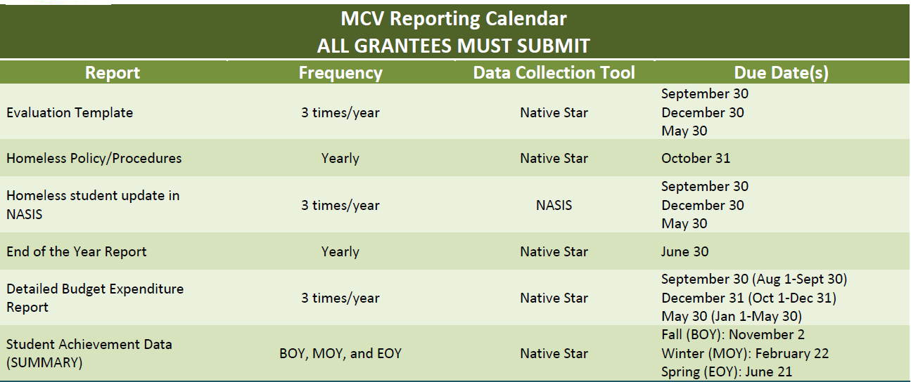
Important MCV Reporting Dates

Slide 9
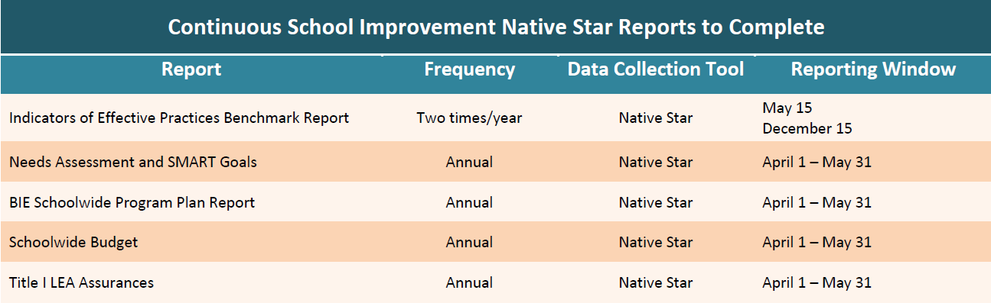
NS Report Submissions

Slide 10
Monitoring
Program Fiscal onsite visits
Native Star reports---Title I Supplemental report, CSWB
End of the Year Reports
Review School-wide Budget
Any changes to the budget or activities in your school’s approved application must be brought to the attention of the MCV State Coordinator. School may be requested to submit a modification template.
Carryover is discouraged, and any carryovers may potentially impact subsequent funding. If you do have carryover, you must bring that to the attention of the MCV State Coordinator and submit a carryover request document.

Slide 11
Probation
Subgrantees will be placed on probationary status for:
Non-submission of reports outlined in the grant requirements and assurances
Not following approved program plan and budget
Not meeting the requirement of providing services to a minimum number of 25 students.

Slide 12
Policy & Procedure Development
Policies and procedures that are or will be in place to promote accessibility and academic success of homeless students.
Reviewing and establishing policies and procedures for the purposes of promoting the education of McKinney-Vento eligible children and youth and addressing the following: determining eligibility, enrollment, transportation, attendance, guardianship assistance, credit accrual, comparable services, and any other policy or procedure-related.
Policies & Procedures should be in written form and can be included in Parent Policy, Handbook, or “stand alone” policy

Slide 13
2018-19 SY Funding
Demonstrate success yearly in order to be funded for a subsequent second and third year.
Evidence of success includes meeting the grant requirements which were outlined in the application.
In addition, this award is contingent upon funding and availability of funds.
The distribution of this award is for the implementation of the goals of the subgrant which are carried out by the activities identified in the school’s approved application and signed assurances.
All reporting documents for SY 18-19 must be submitted

Slide 14
Program Updates
Awards have been released with the exception of 3 schools.
Additional Homeless/Parent Liaison Training will be scheduled dates TBD.
Provide updated MCV contact information.
Please review the alignment of the budget with your needs assessment/program activities.
Gift cards & vouchers are unallowable costs
Tracking expenses to avoid large carryover and unallowable costs.

Slide 15
Missing Reports SY 17-18
School Name | Fund Balance Document | EOY Report 6/30/18
Loneman School | Not submitted | Not submitted
Chilchinbeto | Submitted | Not Submitted

Slide 16
SY 2018-19 Webinars
Webinar(s) | Date(s)
Introduction to MCV Grant | 8/30/2018
Alignment of Activities/Expenditures | 9/27/2018
CSPR Data Overview | 11/29/2018
Revisiting Program Activities | 2/28/2019
End of the Year Preparation | 4/25/2019

Slide 17
Contact Information
Eleanor Jones, BIE McKinney-Vento Co-State Coordinator
E-mail: eleanor.jones@bie.edu
Ph: 505.368.3403
Valerie Todacheene, BIE McKinney-Vento Co-State Coordinator
E-mail: Valerie.Todacheene@bie.edu
Ph: 505.563.5269

Slide 18

Questions

